Slide 1

"Flappy Quiz"
✓
✗

Slide 2
Table of contents
1. Our Team
2. About the project​
3. Used Technologies​

Slide 3
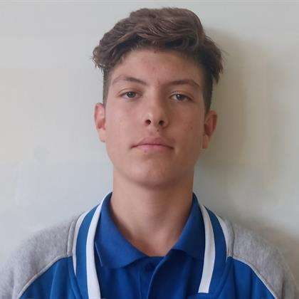

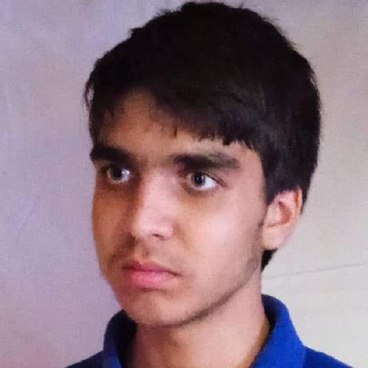
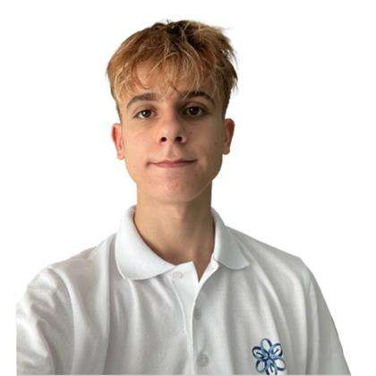
Our Team
Yavor Penkov, 10G
Scrum Trainer
Bozhidar Dimov,
10V
Back-End Developer
Gospodin Radev,
10A
Back-End Developer
Kristian Gaydov,
10B
Front-End Developer

Slide 4


About the project
✓
✗
Welcome to 'Flappy Quiz'! Guide a bird through the sky while avoiding acid rain caused by human-induced air pollution. If hit, answer an ecology, biology, or chemistry question. A correct answer keeps your bird flying, but an incorrect one ends the journey. Survive to learn and have fun! Enjoy learning and playing!

Slide 5








Used Technologies

Slide 6
Now let's jump to the project!
✓
✗

