Slide 1


Horizon
Where innovation meets limitless possibilities!

Slide 2
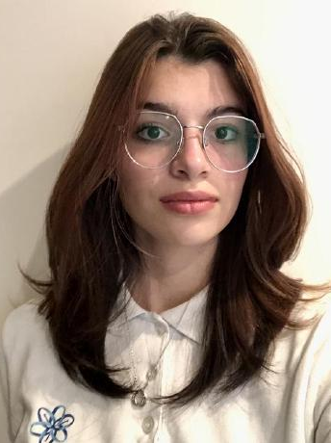
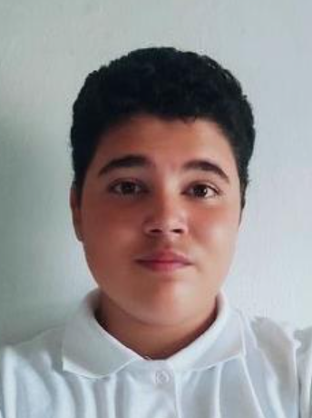
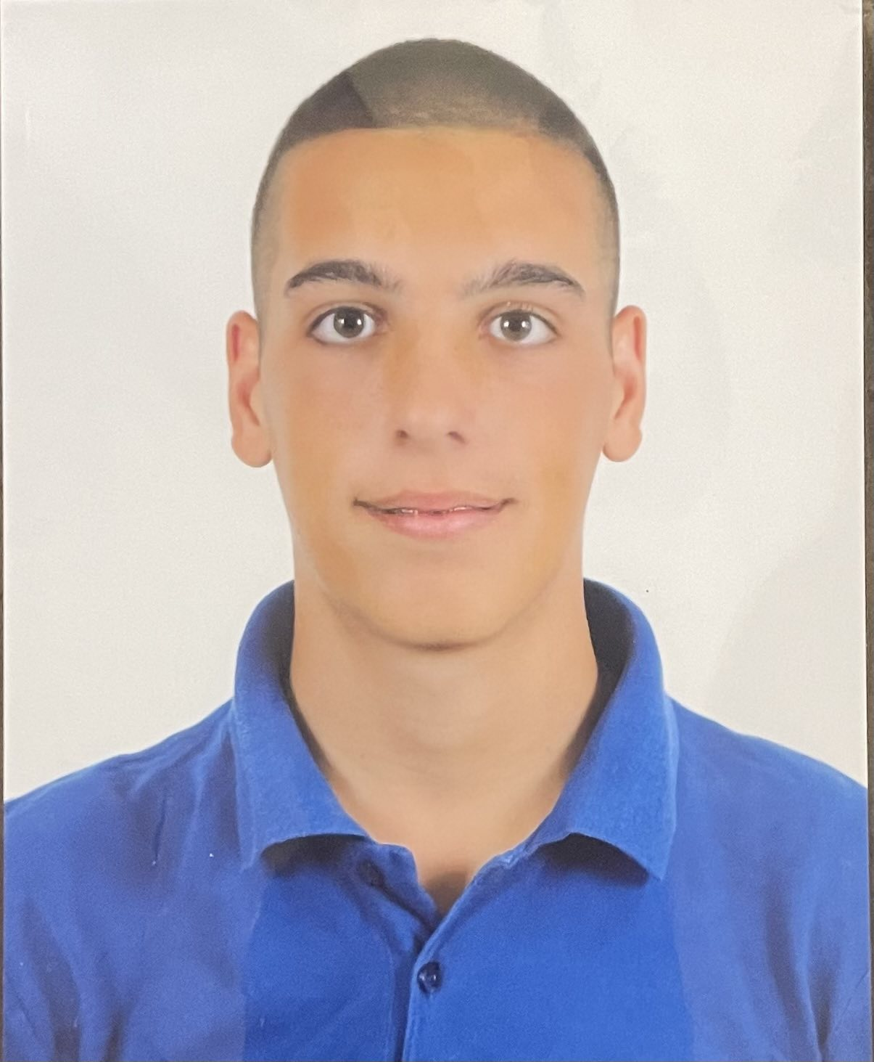
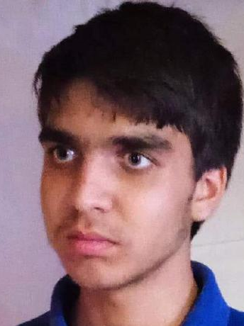
OUR TEAM
Filipa H. Popova
Bozhidar A. Dimov
Teodor T. Tanev
Gospodin S. Radev
Scrum Trainer
Front-End Developer
Back-End Developer
Back-End Developer

Slide 3
Stages
Stage 1
Stage 2
Stage 3
Stage 4
1st week
2nd week
3rd week
4th week
We started implementing our app idea through code.
The last week we have been focusing on finishing the app and the documentation.
We created our logo and discussed ideas about the app.
We made the basic design of the app and created our login/register form.

Slide 4











Used Technologies

Slide 5
Let’s get to the app!

