Slide 1
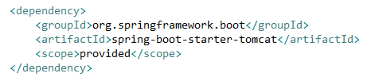
Spring Boot Configure DataSource Using JNDI with Example

Slide 2
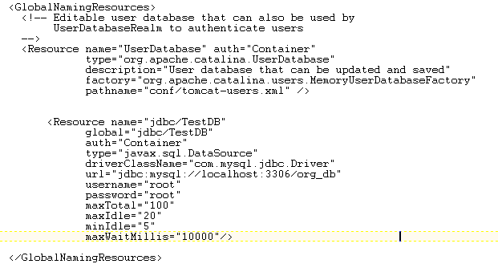

Spring Boot Configure DataSource Using JNDI with Example
Open server.xml file under /conf folder and add the below configuration under the <GlobalNamingResources> tag.
Resource tag allows you to give all configuration details about your database.
Here the name attribute represents the JNDI name
Configuring JNDI on Tomcat Server:
Configuring JNDI resource name (defined in server.xml file) in application.properties file.

Slide 3
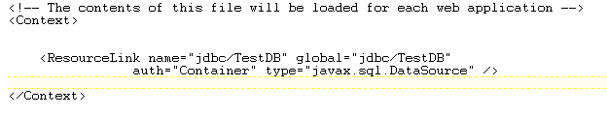
Spring Boot Configure DataSource Using JNDI with Example
Open context.xml file under the same /conf folder and add like below
The global attribute value should be equal to the name of the JNDI defined in the server.xml file.
Configuring JNDI on Tomcat Server:

Slide 4
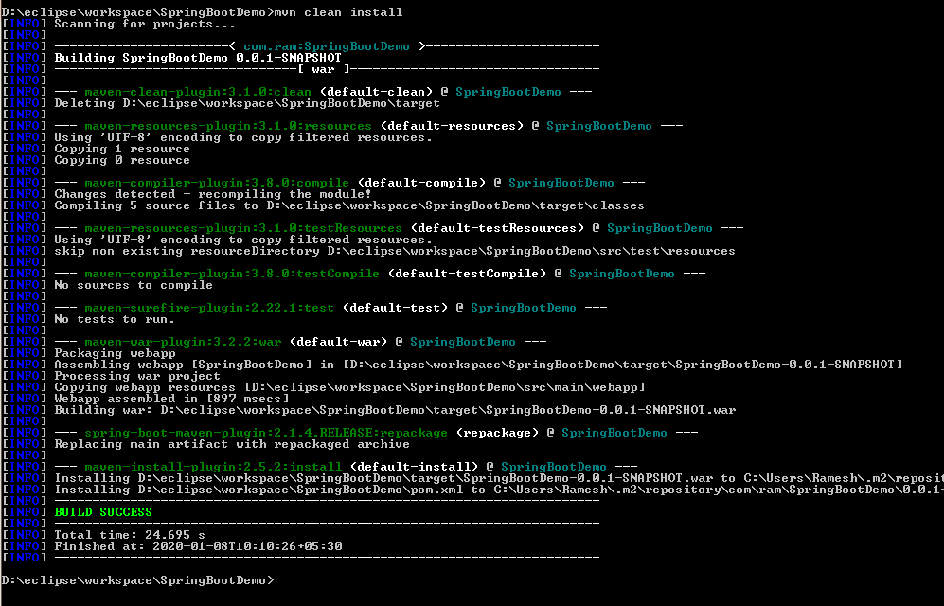
Spring Boot Configure DataSource Using JNDI with Example
mvn clean install

Slide 5
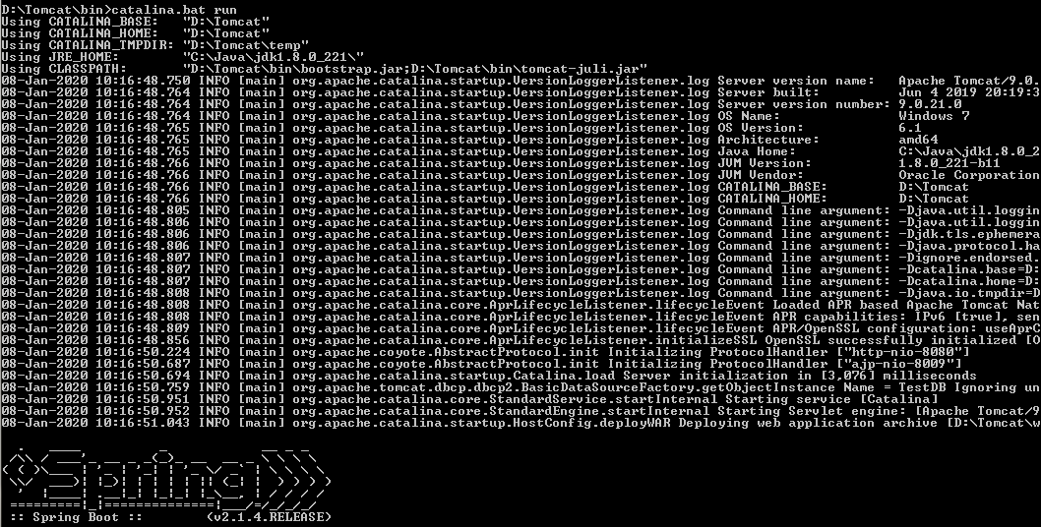
Spring Boot Configure DataSource Using JNDI with Example
catalina.bat run
Apache Tomcat Version 9.0.21

Slide 6
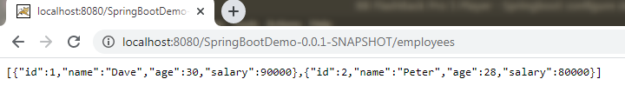
Spring Boot Configure DataSource Using JNDI with Example
http://localhost:8080/SpringBootDemo-0.0.1-SNAPSHOT/employees

Slide 7
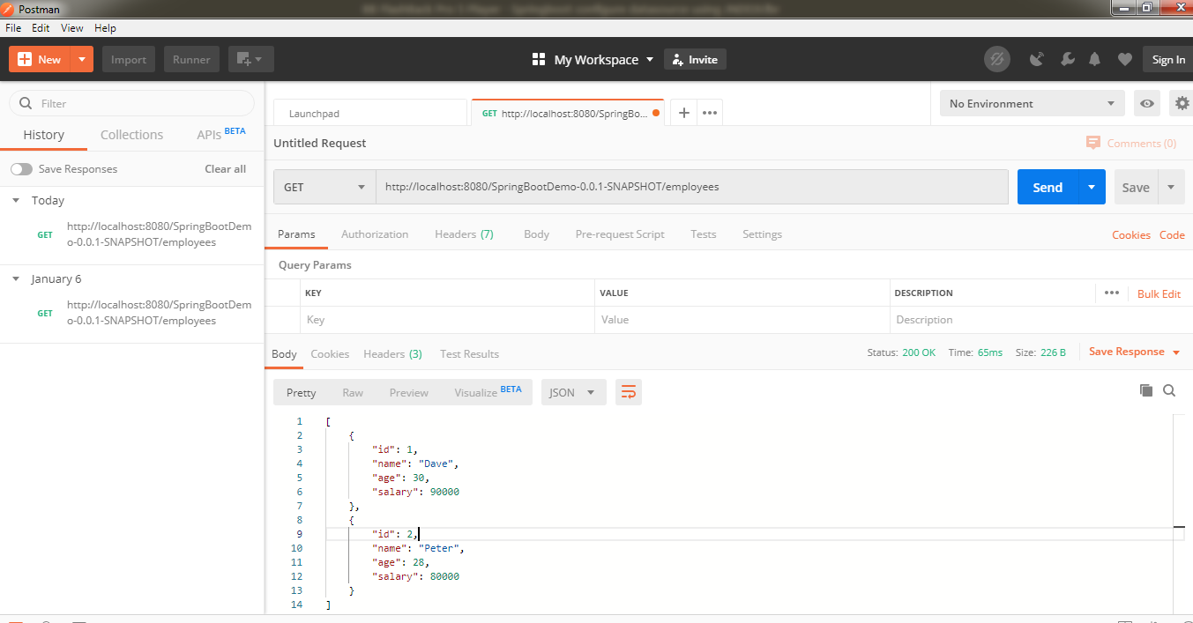
Spring Boot Configure DataSource Using JNDI with Example
http://localhost:8080/SpringBootDemo-0.0.1-SNAPSHOT/employees

