Slide 1
Open VSwitch
High Performance Network Lab

Slide 2

Meter
A switch element that can measure and control the rate of packets.
The meter trigger a meter band if the packet rate or byte rate passing through the meter exceed a predefined threshold.
If the meter band drops the packet, it is called a Rate Limiter.

Slide 3
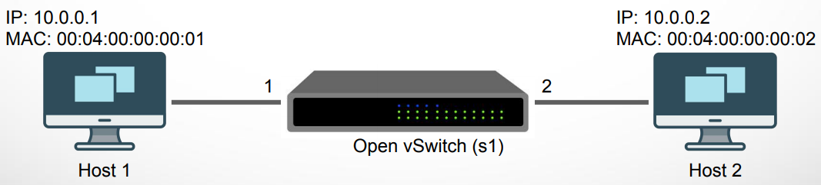
Meter
Add meter entry (set maximum rate with 30 kbps) sudo ovs-ofctl add-meter -O OpenFlow13 s1 meter=1,kbps,band=type=drop,rate=30000
Add a flow entries with binding meter sudo ovs-ofctl add-flow -O OpenFlow13 s1 in_port=1,actions=meter:1,output:2 sudo ovs-ofctl add-flow -O OpenFlow13 s1 in_port=2,actions=meter:1,output:1

Slide 4
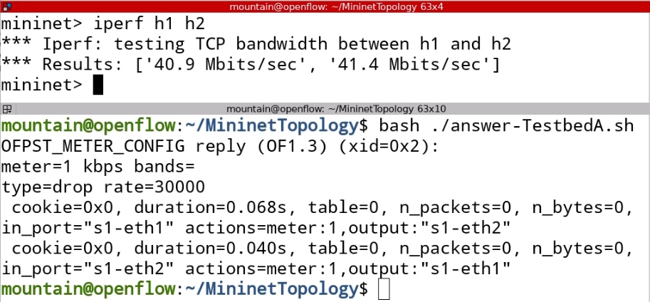
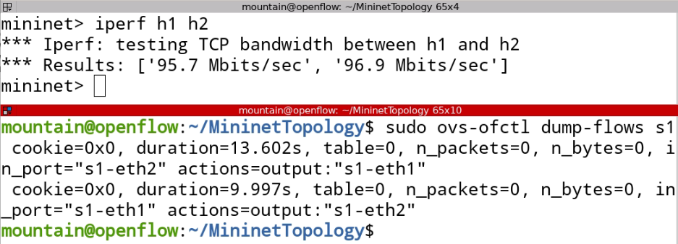
Meter

Slide 5


Groups
Groups represent sets of actions for flooding, as well as more complex forwarding semantics (e.g. multipath, fast reroute, and link aggregation).
As a general layer of indirection, groups also enable multiple flow entries to forward to a single identifier (e.g. IP forwarding to a common next hop).
This abstraction allows common output actions across flow entries to be changed efficiently.
OVS

Slide 6
Groups
Add group entry: sudo ovs-ofctl add-group s1 group_id=1,type=all,bucket=mod_dl_src=00:00:00:11:11:11,mod_dl_dst=00:00:00:22:22:22,output:2,bucket=mod_dl_src=00:00:00:11:11:11,mod_dl_dst=00:00:00:22:22:22,output:3,bucket=mod_dl_src=00:00:00:11:11:11,mod_dl_dst=00:00:00:22:22:22,output:4
Add flow entry with using group action: sudo ovs-ofctl add-flow s1 in_port=1,actions=group:1
OVS

Slide 7
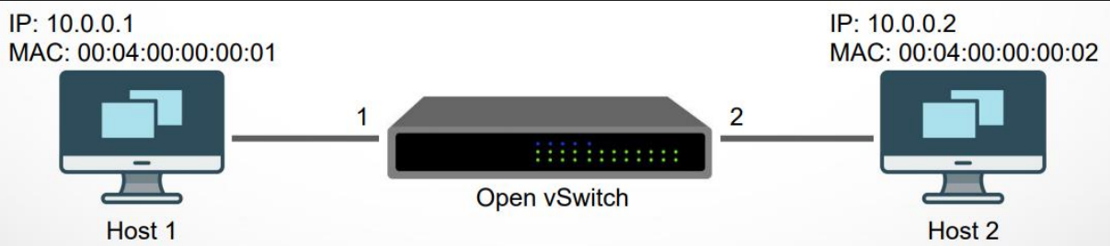
Experiment: Meter demo
Goal:
編寫交換機路由規則，讓封包傳輸速率受限10Mbps。
測試
使用指令sudo python3 ./Lab2.py啟動Mininet測試環境
編寫交換機路由規則
使用xterm H1 H2打開H1, H2之終端機
執行iperf測試，紀錄未受限速之結果
加入Meter規則，並再次執行iperf測試
把記錄內容擷圖表示即可。
10.0.0.10
10.0.0.11

Slide 8
Experiment: Learn MAC Address
Goal:
編寫controller程式碼，controller可以學到h1 h2的mac address。
測試
安裝ryu 用指令sudo apt install python3-ryu
編寫simple_switch_demo.py learn mac addres部分
先執行 sudo python3 ./Lab2.py啟動Mininet測試環境
再執行 ryu-manager simple_switch_demo.py
Ping 通 h1及h2
把記錄內容擷圖表示即可。
10.0.0.10
10.0.0.11

Slide 9
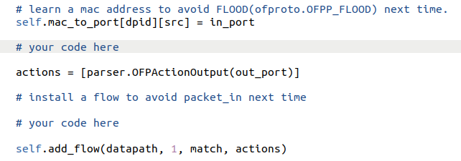
Controller

Slide 10
Homework - IPv4 Routing with Meter Rate limiter
S2
1
2
10.0.0.1
2
2
10.0.0.2
S1
S3
S5
1
3
1
2
3
1
4
4
4
H1
1
H2
1
S4
2
使用OpenVSwitch 指令對以下三條連線加入路由規則，並使用Meter 限定流量。
使用sudo ovs-ofctl dump-flows <bridge_id>把每一台交換機上的的規則印出並擷圖。
要求： 使用IPv4 位址及UDP Port ID進行路由
路線及使用的UDP Port
紅色： UDP Port ID 50001，meter id = 1, drop, max bandwidth: 50Mbps
藍色： UDP Port ID 50002，meter id = 2, drop, max bandwidth: 20Mbps
綠色： UDP Port ID 50003，meter id = 3, drop, max bandwidth: 30Mbps

Slide 11
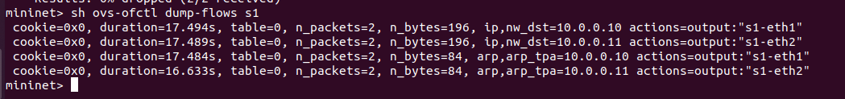
Homework - IPv4 Routing
啟用環境: sudo python3 ./Homework.py
編寫路由規則 （Flow entries)
於Mininet 使用xterm h1 打開Host 之終端機
在h1的終端機上執行iperf 進行測試（UDP發送速率需設定為60Mbps)
測試後iperf 畫面與交換機flow 畫面擷圖
Hints:
編寫規則時要比對封包上ip_protocol 後才能比對UDP封包內容

