Slide 1
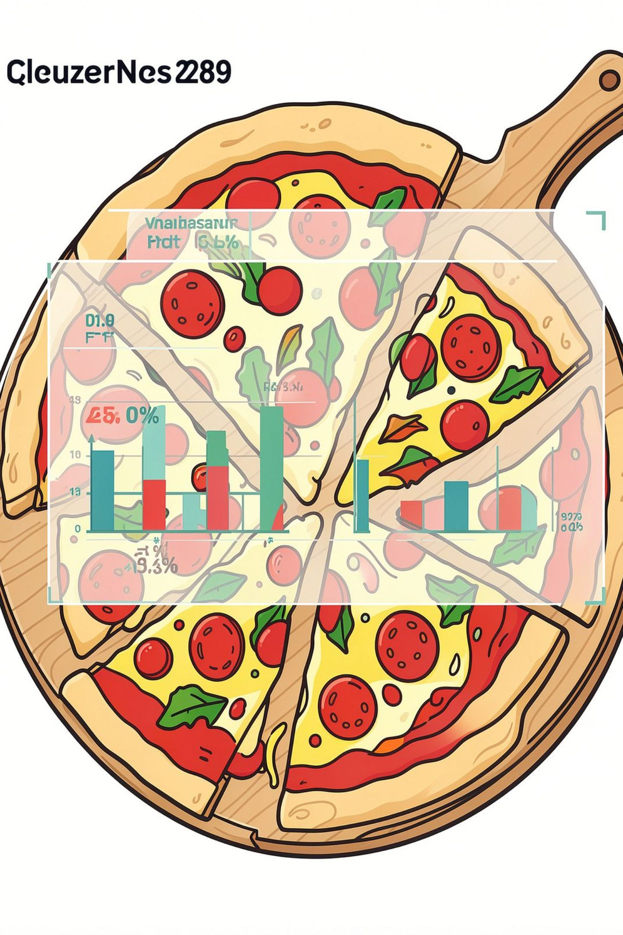
PIZZA SALES ANALYSIS USING SQL
A complete SQL project covering basic, intermediate, and advanced business questions — turning transactional pizza data into actionable insights.
PRESENTER: BAJRANG MAHLI
SQL
JOINS
AGGREGATION
WINDOW FUNCTIONS
BUSINESS ANALYSIS

Slide 2
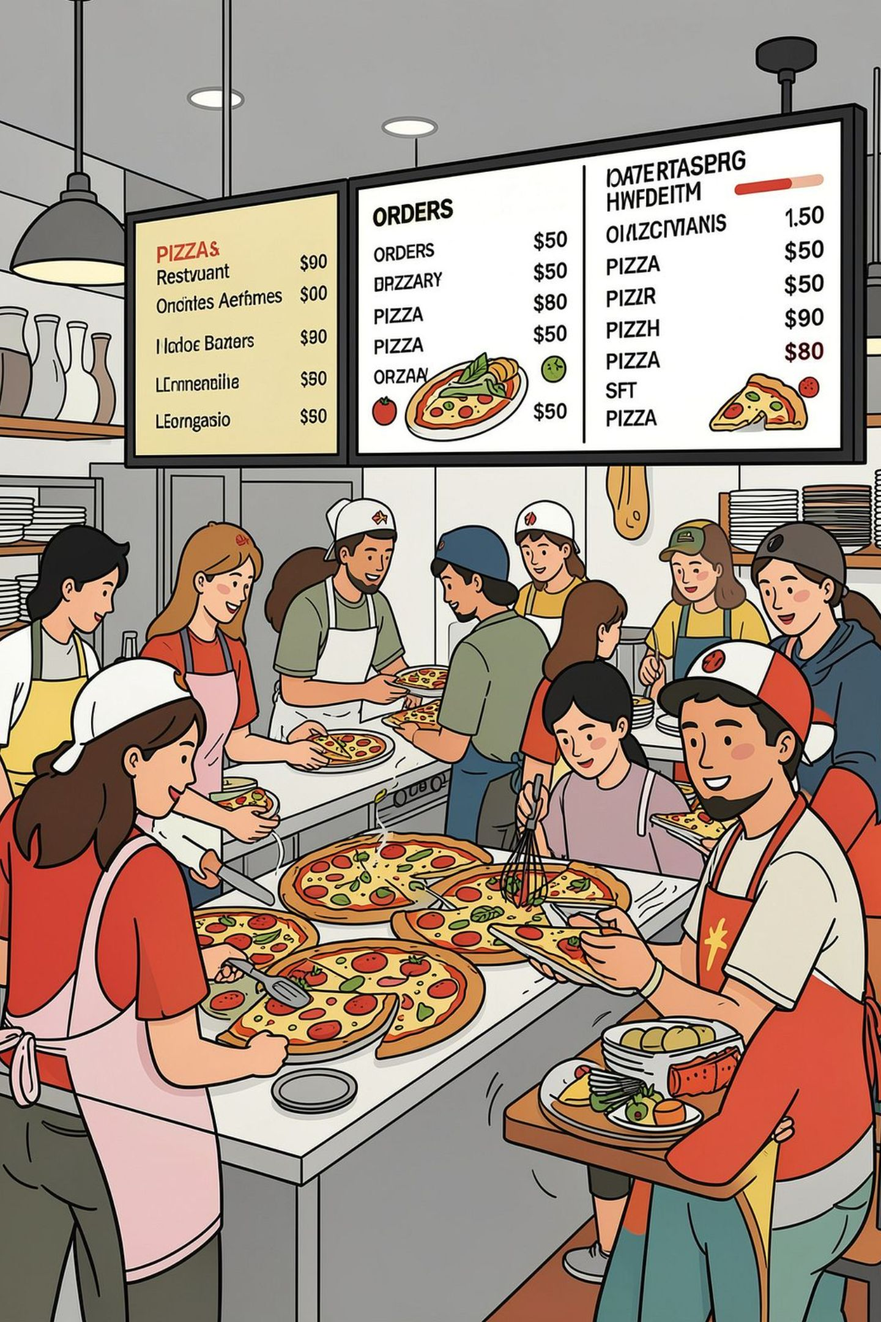
THE BUSINESS PROBLEM
A pizza business generates a large volume of transactional data every day. Management needs to move beyond raw order records and understand what the data reveals about customer behavior, product performance, and operational efficiency. This project uses SQL to answer critical business questions across three analytical levels.
SALES PERFORMANCE
How many orders were placed? How much revenue was generated? Which pizzas drive the most sales?
PRODUCT INSIGHTS
Which sizes and categories are most popular? Which pizza types should receive more attention?
OPERATIONAL PEAKS
During which hours are orders highest? How can staffing and inventory be optimized?
STRATEGIC OBJECTIVE
Convert raw order-level data into meaningful insights for sales planning, menu optimization, and decision-making.

Slide 3
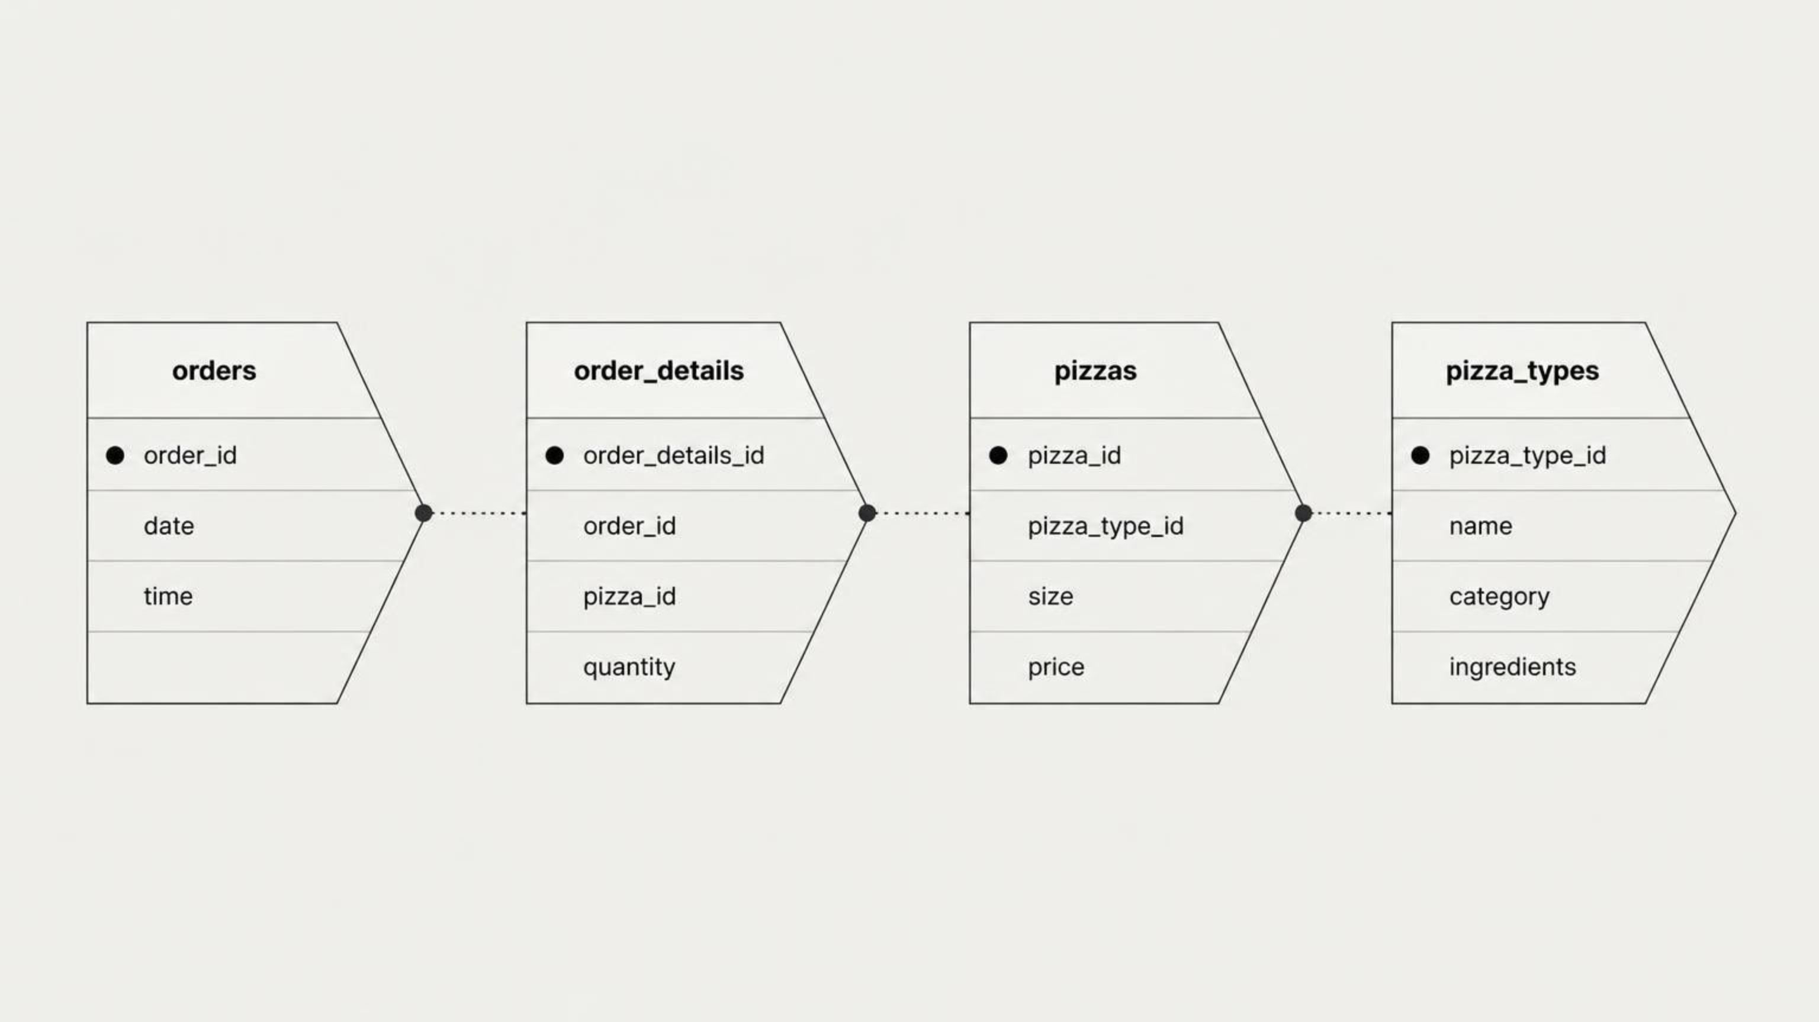
DATASET & DATABASE SCHEMA
The analysis is built on four relational tables. Combining transaction, price, product, and category information requires multi-table JOINs — a core SQL skill for any data analyst.
TABLE ROLES
WHY JOINS ARE REQUIRED
orders — Stores order date and time
order_details — Stores ordered quantities per pizza
pizzas — Stores size and price information
pizza_types — Stores pizza names and categories
No single table contains all the information needed to answer business questions. JOINs combine transaction records with pricing, product names, and category data to produce complete analytical results.

Slide 4

ANALYTICAL QUESTIONS — THREE LEVELS
The project is structured across three difficulty levels, progressively demonstrating more advanced SQL techniques and deeper business insight generation.
1
2
3
BASIC ANALYSIS
INTERMEDIATE ANALYSIS
ADVANCED ANALYSIS
Total number of orders
Total revenue generated
Highest-priced pizza
Most common pizza size
Top 5 pizza types by quantity
Quantity ordered by category
Orders by hour of day
Category-wise pizza distribution
Average pizzas ordered per day
Top 3 pizza types by revenue
Percentage contribution to total revenue
Cumulative revenue over time
Top 3 revenue-generating pizzas within every category

Slide 5
BASIC KPI RESULTS
These key performance indicators provide an immediate snapshot of overall business performance. Revenue was calculated by multiplying quantity by pizza price across all orders.
$81,760
$35.95
138
TOTAL REVENUE
HIGHEST PRICE
AVG. PIZZAS/DAY
Calculated as SUM(quantity × price) across all orders
The Greek Pizza — most expensive item on the menu
138.47 pizzas sold per day on average
MOST COMMON PIZZA SIZE
TOTAL ORDERS QUERY
Large (L) is the most frequently ordered size — a key signal for inventory and promotional focus.
SELECT COUNT(DISTINCT order_id)
AS total_orders
FROM orders;
Total orders: To be calculated from the database.

Slide 6

SQL SOLUTIONS — BASIC ANALYSIS
These three queries demonstrate foundational SQL concepts: aggregation, JOINs, sorting, and limiting results. Each query builds on the previous to show how SQL answers progressively complex business questions.
QUERY 1 — TOTAL ORDERS
SQL CONCEPTS DEMONSTRATED
SELECT COUNT(DISTINCT order_id)
AS total_orders
FROM orders;
COUNT(DISTINCT)
Counts unique order IDs without duplication
SUM() & ROUND()
QUERY 2 — TOTAL REVENUE
Aggregates revenue and formats to 2 decimals
SELECT ROUND(
SUM(od.quantity * p.price), 2
) AS total_revenue
FROM order_details od
JOIN pizzas p
ON p.pizza_id = od.pizza_id;
INNER JOIN
Combines tables on matching foreign keys
ORDER BY DESC & LIMIT
Sorts descending and returns top result
QUERY 3 — HIGHEST-PRICED PIZZA
SELECT pt.name, p.price
FROM pizza_types pt
JOIN pizzas p
ON p.pizza_type_id = pt.pizza_type_id
ORDER BY p.price DESC
LIMIT 1;

Slide 7
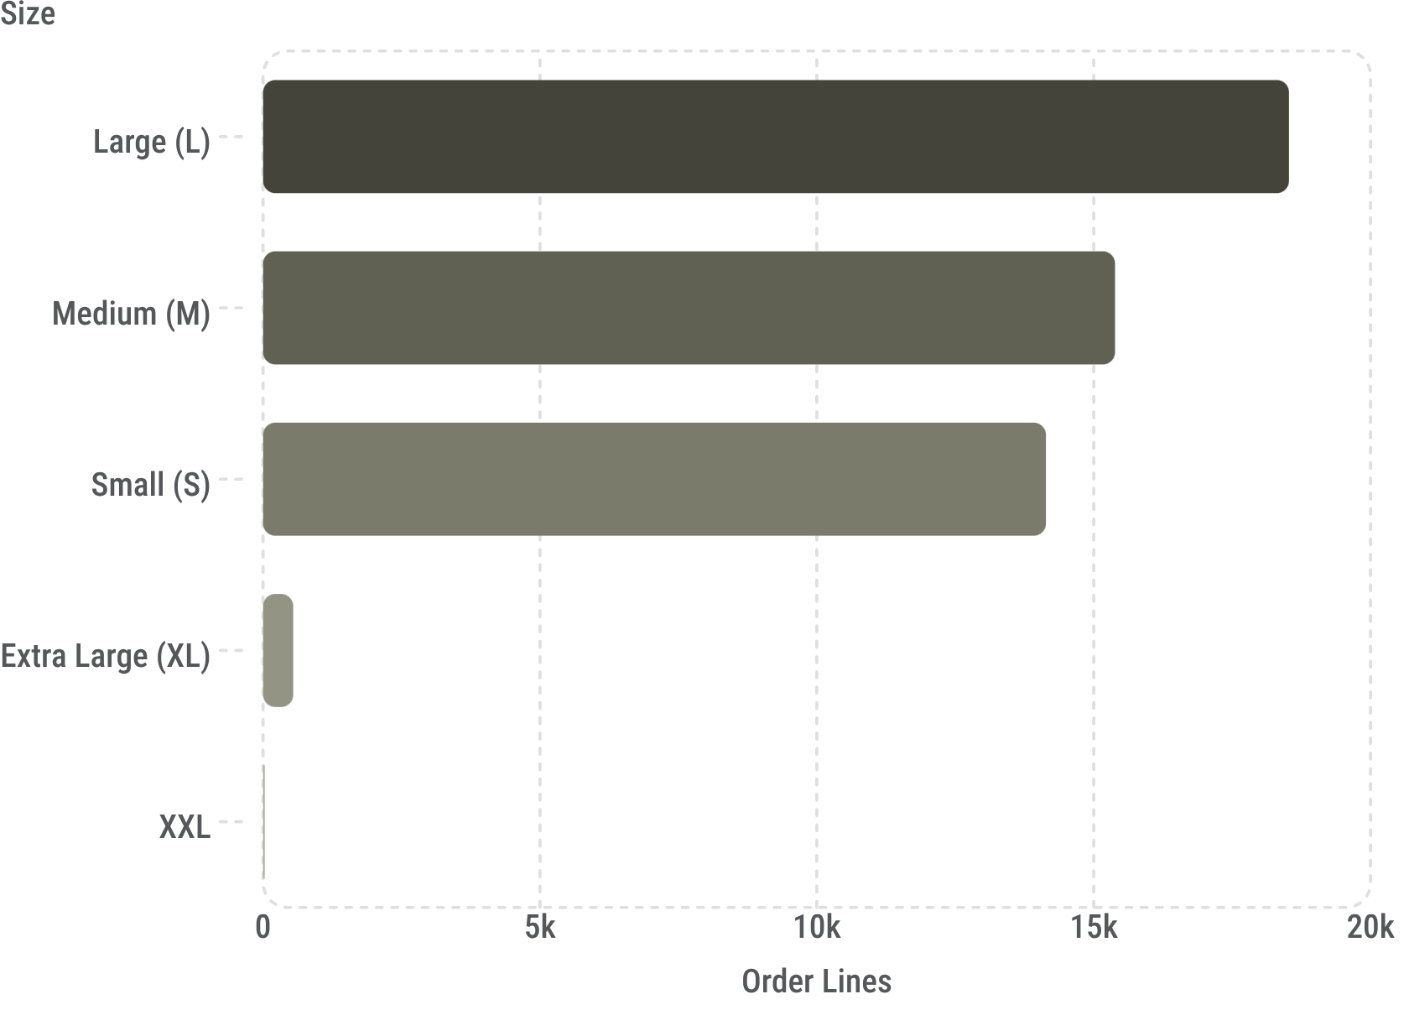
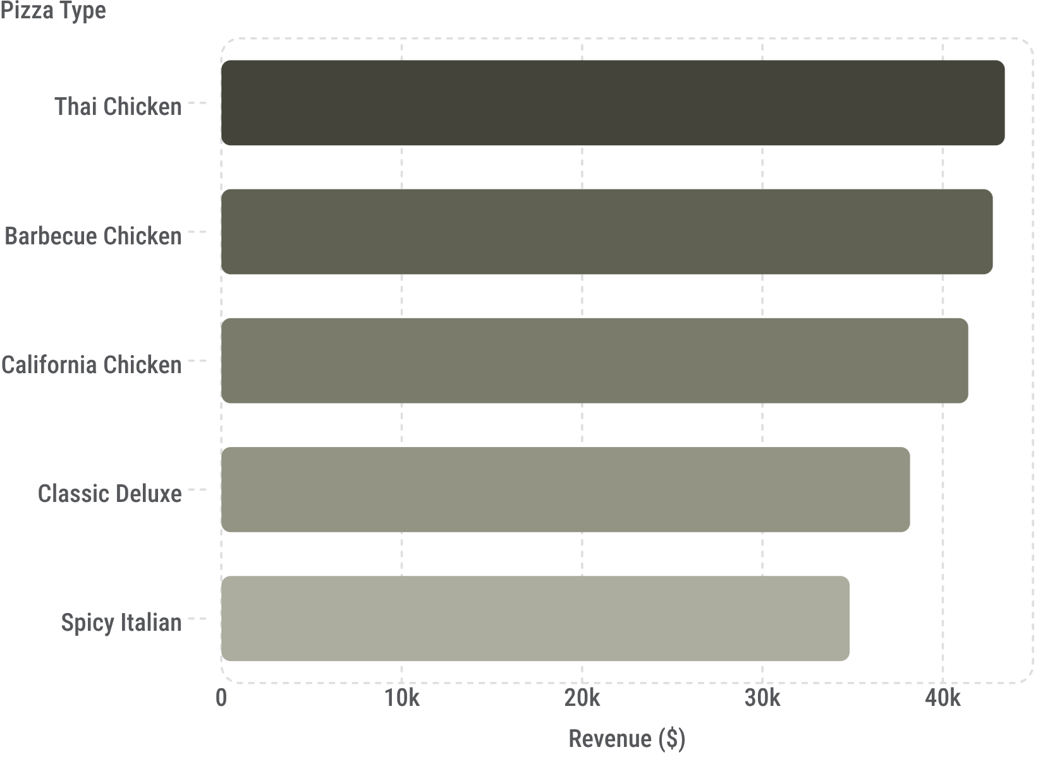
PIZZA SIZE DEMAND & TOP REVENUE-GENERATING PIZZAS
PIZZA SIZE DEMAND (ORDER-LINE FREQUENCY)
TOP 5 PIZZA TYPES BY REVENUE
Business Insight: Large pizzas have the highest order-line frequency and should receive strong inventory and promotional focus.
Note: The query ranks by revenue. To rank by quantity, use SUM(quantity) instead of COUNT(pizza_id).
SELECT pt.name, SUM(od.quantity) AS total_quantity
FROM pizza_types pt
JOIN pizzas p ON pt.pizza_type_id = p.pizza_type_id
JOIN order_details od ON od.pizza_id = p.pizza_id
GROUP BY pt.name
ORDER BY total_quantity DESC
LIMIT 5;

Slide 8
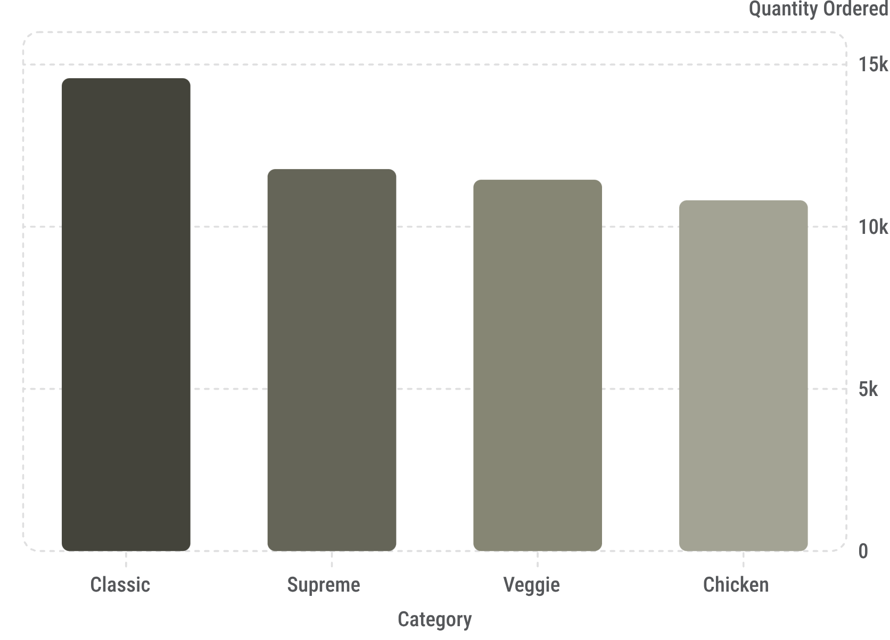
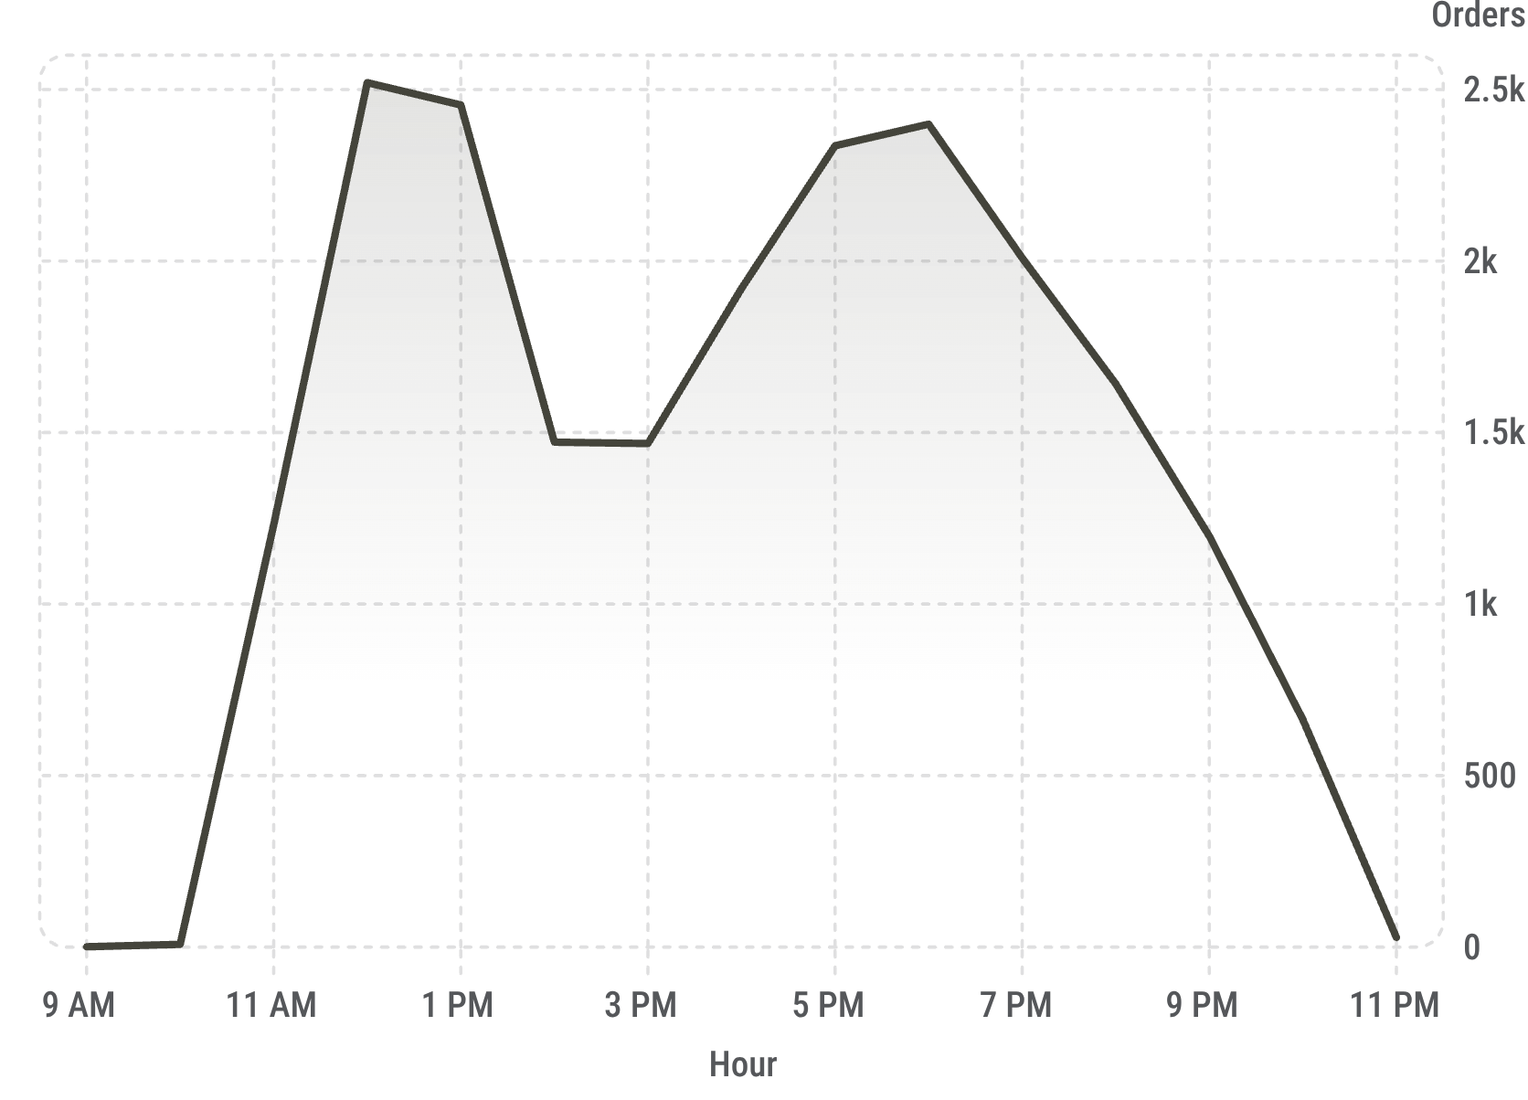
INTERMEDIATE ANALYSIS — CATEGORIES, HOURS & DAILY VOLUME
QUANTITY ORDERED BY CATEGORY
ORDERS BY HOUR OF DAY
Classic pizzas lead in quantity demand. Chicken has the lowest volume — a potential growth opportunity through targeted campaigns.
Peaks occur at lunch (12–1 PM) and dinner (5–8 PM). Staff scheduling and ingredient prep should align to these windows.
SELECT HOUR(o.time) AS order_hour, COUNT(o.order_id) AS total_orders
FROM orders o
GROUP BY HOUR(o.time)
ORDER BY total_orders DESC;

Slide 9
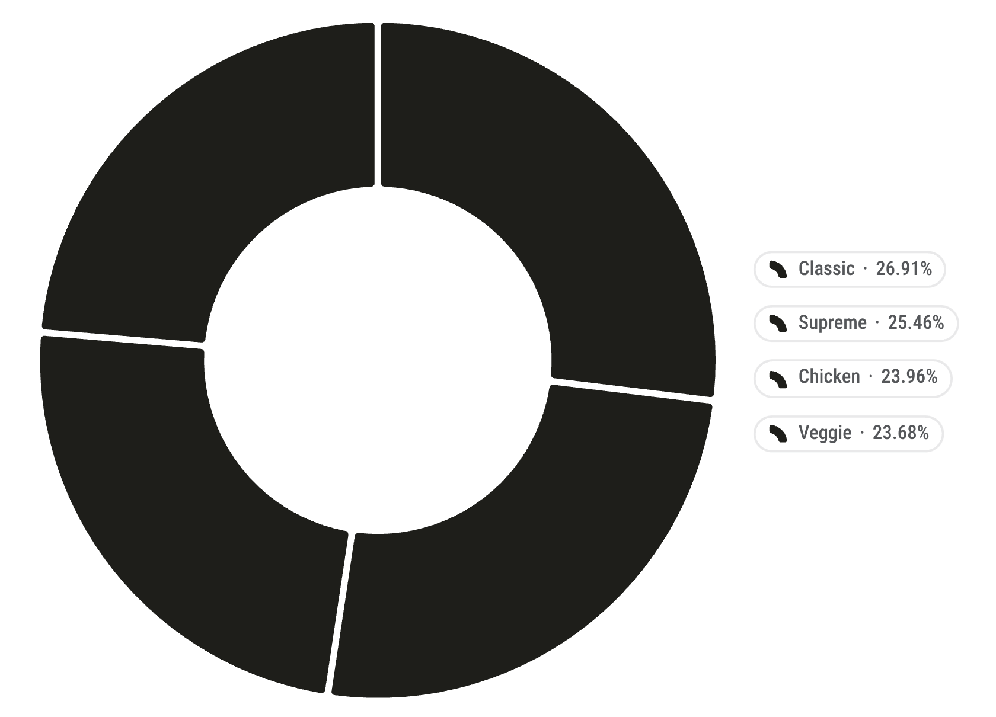
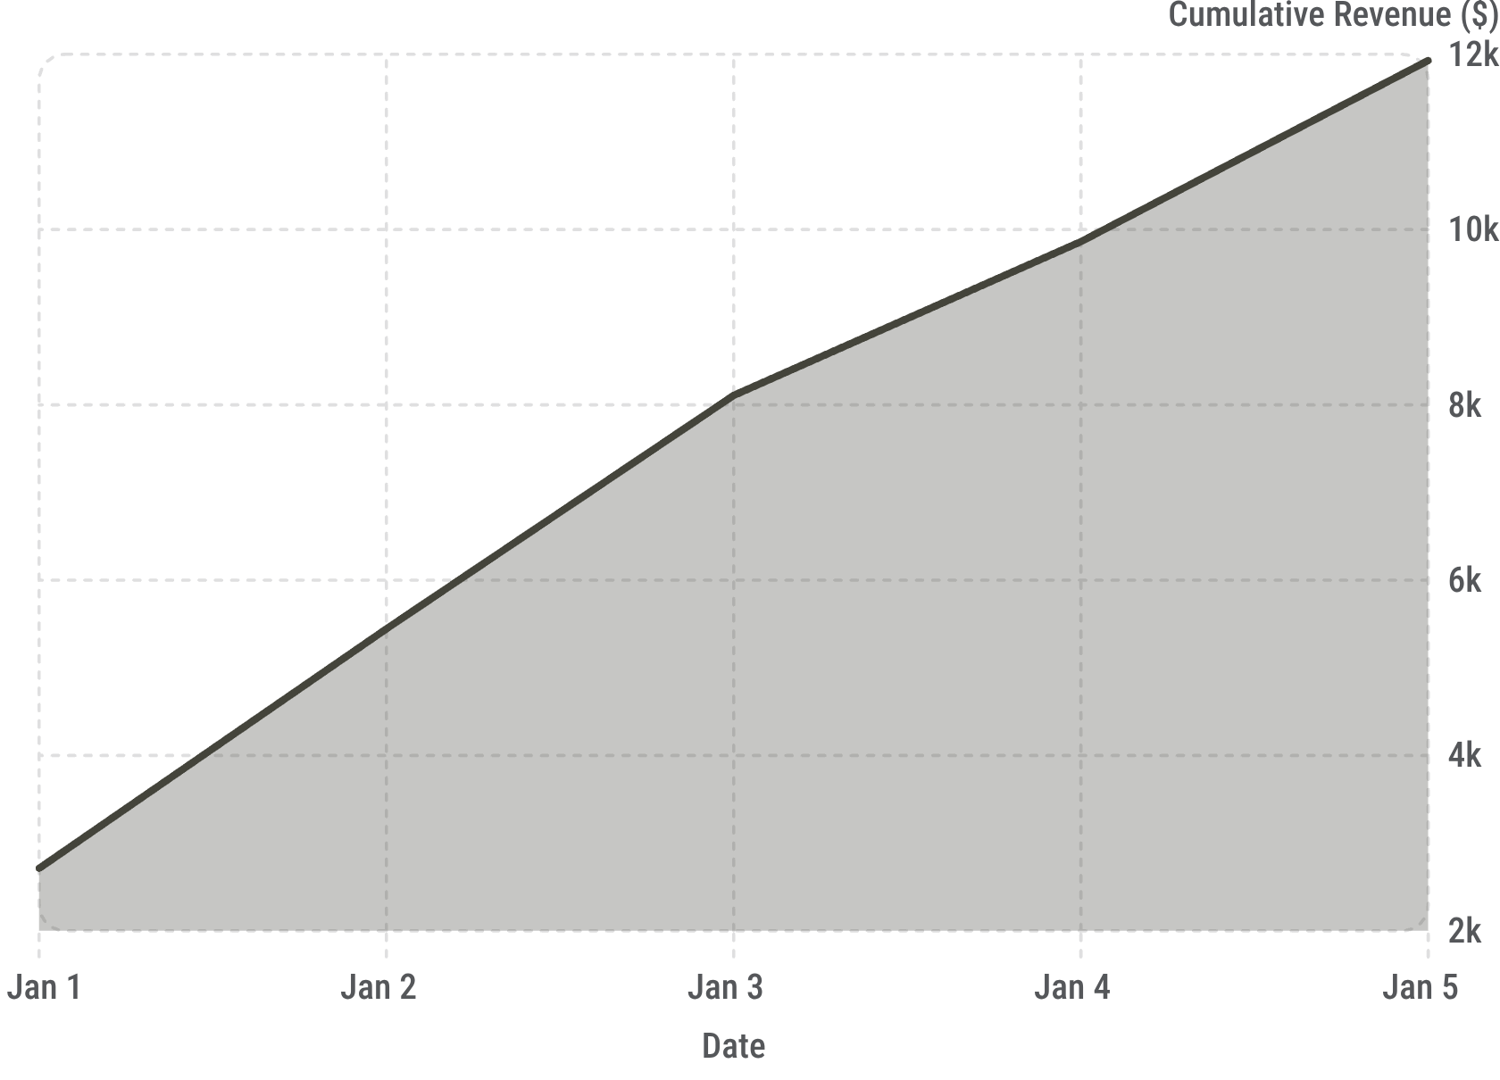
ADVANCED ANALYSIS — REVENUE CONTRIBUTION, CUMULATIVE GROWTH & CATEGORY RANKINGS
CATEGORY REVENUE CONTRIBUTION (%)
CUMULATIVE REVENUE GROWTH (FIRST 5 DAYS)
Classic leads at 26.91%. All four categories are relatively balanced — each contributes roughly a quarter of total revenue.
A running total built with SUM() OVER() helps management track performance against monthly targets and spot growth trends.
TOP 3 PIZZAS BY CATEGORY — RANK() OVER(PARTITION BY)
Category | Pizza Type | Revenue | Rank
Chicken | Thai Chicken Pizza | $43,434.25 | 1
Chicken | Barbecue Chicken Pizza | $42,768.00 | 2
Chicken | California Chicken Pizza | $41,409.50 | 3
Classic | Classic Deluxe Pizza | $38,180.50 | 1
Classic | Hawaiian Pizza | $32,273.25 | 2
Classic | Pepperoni Pizza | $30,161.75 | 3
Supreme | Spicy Italian Pizza | $34,831.25 | 1
Supreme | Italian Supreme Pizza | $33,476.75 | 2
Business Insight: Category-level ranking reveals the best performers within each segment — more actionable than overall rankings alone.

Slide 10







KEY INSIGHTS, RECOMMENDATIONS & NEXT STEPS
KEY BUSINESS INSIGHTS
STRATEGIC RECOMMENDATIONS
Large is the most popular pizza size
Classic category leads in quantity and revenue share (26.91%)
Chicken pizzas dominate the top 3 revenue positions
Orders peak at lunch (12–1 PM) and dinner (5–8 PM)
Average daily demand: 138 pizzas
Supreme and Veggie offer the broadest menu variety
Menu: Promote Thai Chicken, Barbecue Chicken, and California Chicken in bundles
Inventory: Stock up on Large and Classic pizza ingredients before peak hours
Marketing: Offer lunch bundles (12–1 PM) and off-peak discounts (9–11 AM, after 10 PM)
Analytics: Build a Power BI dashboard tracking revenue, quantity, and repeat customers
SQL TECHNIQUES DEMONSTRATED
SELECT & FILTERING
AGGREGATIONS
COUNT, SUM, AVG, ROUND
JOINS
CTES & SUBQUERIES
INNER JOIN across 4 tables
WINDOW FUNCTIONS
DATE FUNCTIONS
RANK, PARTITION BY, running totals
HOUR() for time extraction
From SQL Queries to Business Decisions — This project demonstrates how raw pizza sales data can be transformed into useful business insights. A strong data analyst connects technical SQL skills with actionable business recommendations.
Next Step: Build an interactive Power BI dashboard from these SQL results.
BAJRANG MAHLI| Data Analytics | SQL | Power BI | Excel

