Slide 1
EMPLOYEE DATA ANALYSIS USING EXCEL
STUDENT NAME : BAKIYA LAKSHMI B
REGISTER NO : 2213371036106
DEPARTMENT : B.COM (GENERAL) COMMERCE
COLLEGE : QUAID-E-MILLATH GOVERNMENT GOVT COLLEGE

Slide 2
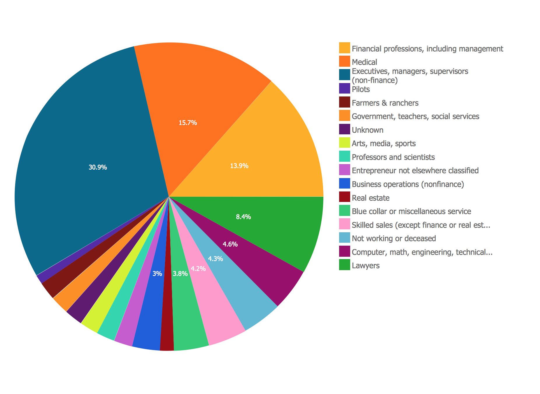
PROJECT TITLE
Employee Performance Analysis using Excel

Slide 3

AGENDA
Problem statement
Project overview
End user
Modelling approach
Dataset description
Results and discussion
Conclusion

Slide 4
PROBLEM STATEMENT
This analysis evaluates the performance of employees over the past [time period, e.g., quarter, year] to identify strengths, areas for improvement, and development needs
It include productivity, quality of work, attendance, teamwork, and adherence to company values.
Highlighted the top-performing employees and teams, showcasing exceptional contributions and achievements.
Identified common challenges faced by employees, such as skill gaps, time management, and communication issues.
It also analyse the time management of the employees to level up

Slide 5
PROJECT OVERVIEW
Slide explaining the methods used for performance analysis (e.g., data collection, rating scales, performance metrics)
Where excel data set includes the data of the employee for the analysis
Visual representation (e.g., bar chart, pie chart) to show the distribution of ratings across the organization
Visual representation (e.g., heatmap or grouped bar chart) to show which teams or departments have the highest and lowest performance ratings

Slide 6

END USERS
Senior Management/Executives
Human Resources (HR) Team
Department Heads/Team Leaders
Board of Directors
Finance Department
Consultants/External

Slide 7
MODELLING APPROACH
DATA INTERGRATION: COMBINE DATA FROM VARIOUS SOURCES INTO A SINGLE UNIFIED
DATASETDATA CLEANING PLAN: IDENTIFY MISSING VALUES IN PERFORMANCE METRICS., RATINGS AND EMPLOYEE DATA
REMOVE DUPLICATES: IDENTIFY DUPLICATE EMPLOYEE RECORDS OR PERFORMANCE DATA ENTRIES REMOVE DUPLICATES TO ENSURE UNIQUE DATA POINTS
DATA CLEANING TOOLS: EXCEL FORMULAS AND FUNCTIONS (ES. IFERROR, VLOOKUP)
PERFORMANCE LEVEL FRAMEWORK: EXCEPTIONAL STRONG MEETS EXPECTATIONS PIE CHART
VISUALIZATION: GRAPH

Slide 8
Dataset Description
Employee master data
Employer ID
Name
Gender
Department
Salary
Start Date FTE
Employee type
Work location
current employee rating
performance level

Slide 9
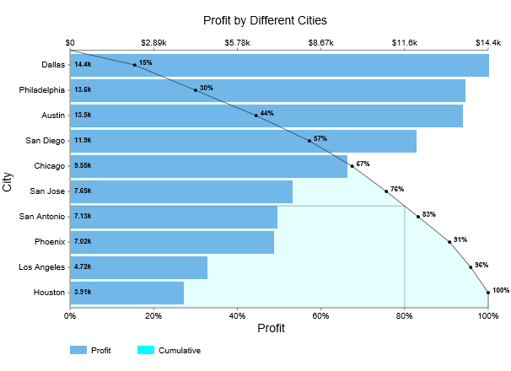
RESULTS

Slide 10
conclusion
The graph illustrates the distribution of employees across various departments by employment type (Fixed Term, Permanent, Temporary). The data highlights that:
Permanent employees dominate most departments, indicating a stable workforce with a focus on longterm employment.
Fixed Term and Temporary roles are significantly fewer across all departments, suggesting limited reliance on short-term or temporary staffing.

