Slide 1
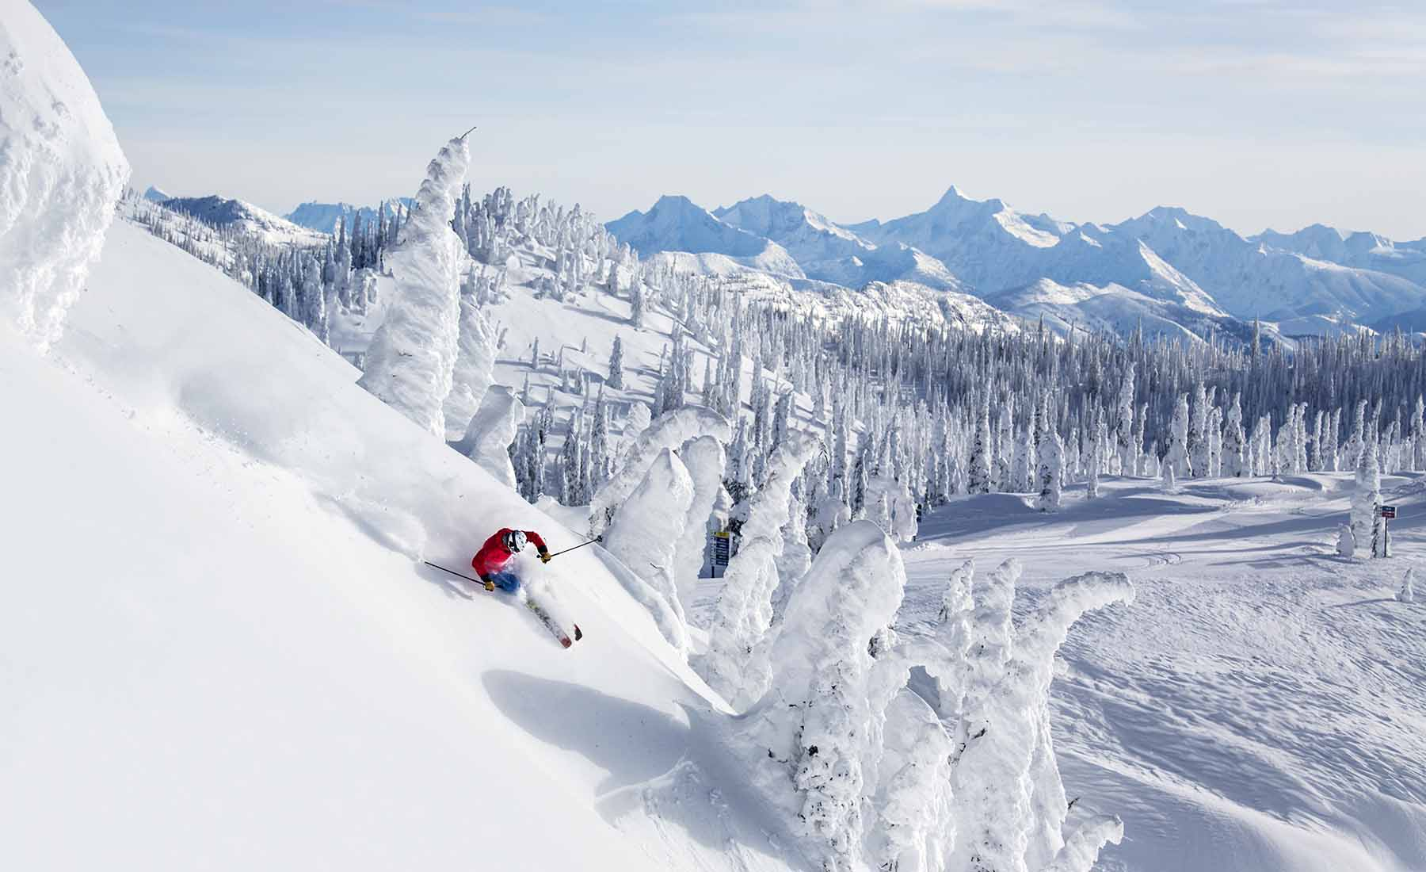
BIG MOUNTAIN RESORT
Whitefish, Montana

Slide 2
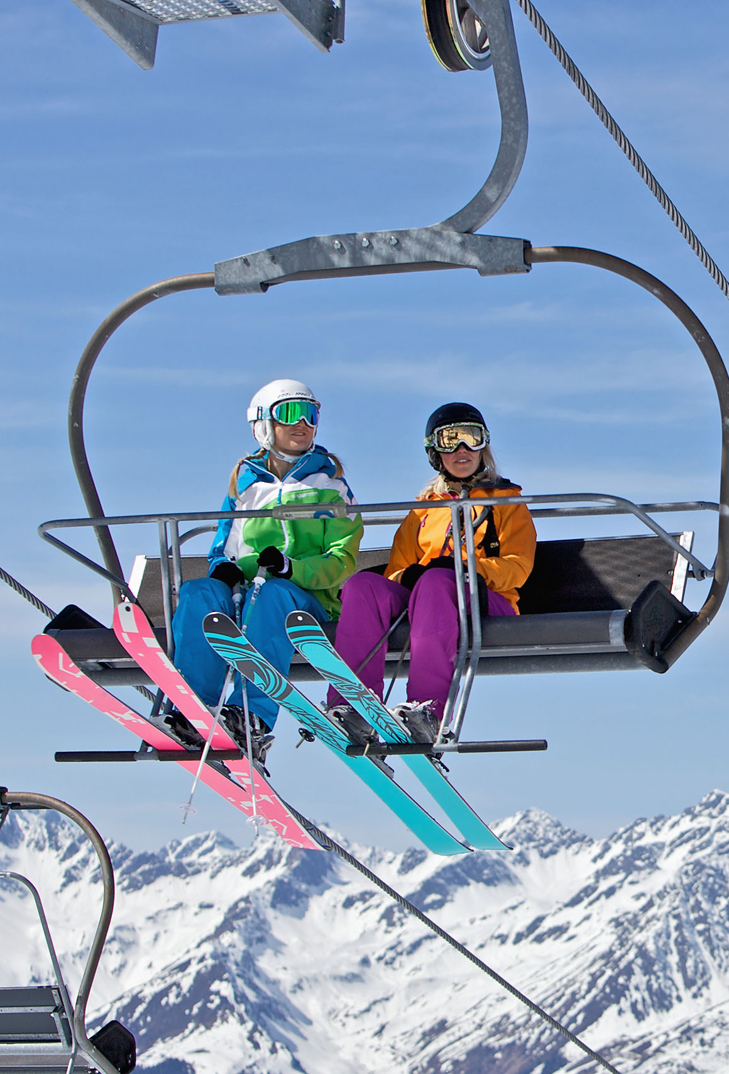
Problem identification
Big Mountain Resort, a ski resort located in Montana, offers spectacular views of Glacier National Park and Flathead National Forest, with access to 105 trails. Every year about 350,000 people ski or snowboard at Big Mountain. This mountain can accommodate skiers and riders of all levels and abilities. Big Mountain Resort has recently installed an additional chair lift to help increase the distribution of visitors across the mountain. This additional chair increases their operating costs by $1,540,000 this season. The resort needs guidance on pricing strategy in order to offset their operating costs by $1,540,000 this season.

Slide 3
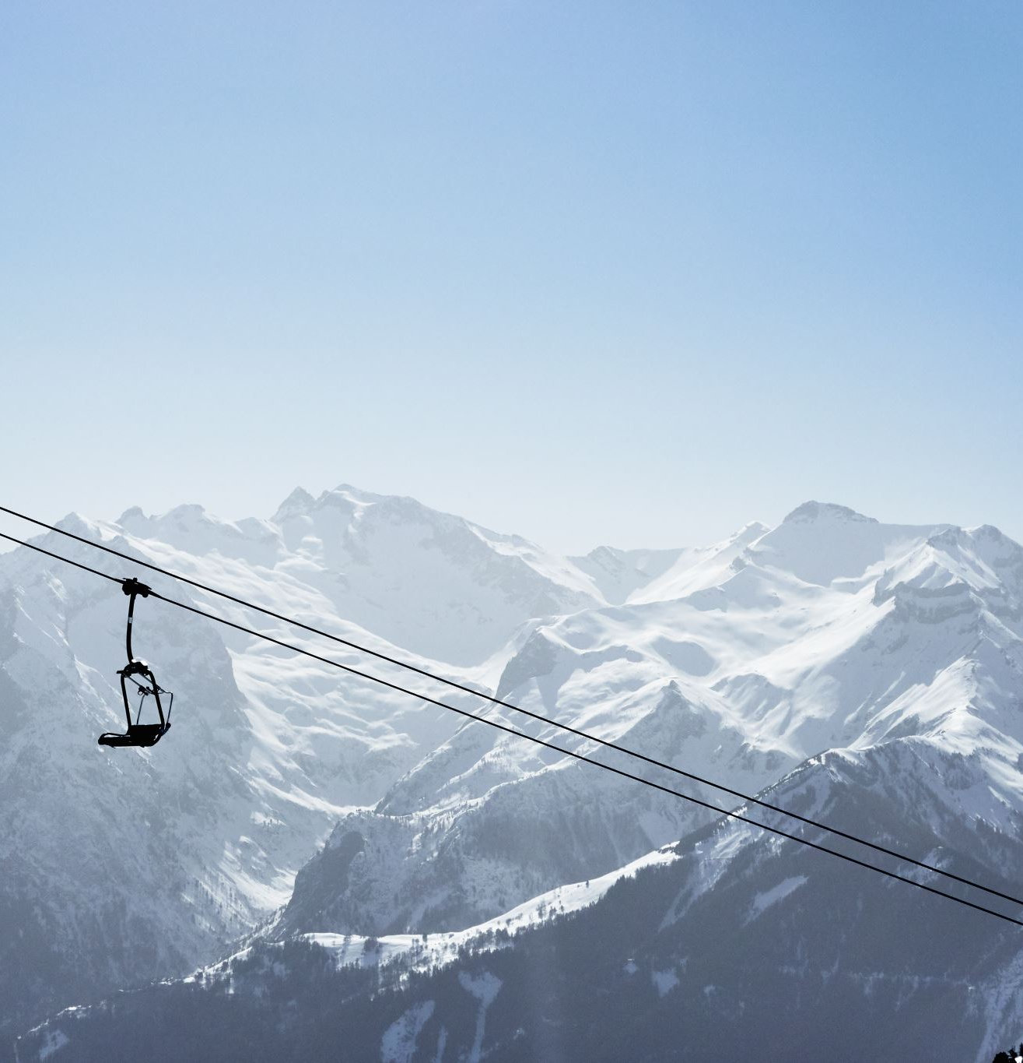
Recommendation and key findings
Our modeling suggests that Big Mountain Resort could charge a price of $95.87 for its tickets instead of the current price of $81.00.
In order to achieve an offset of their recent additional operating cost of $1,540,000 (due to the new chair lift) without reducing ticket prices or by increasing them, we recommend reducing operating costs by closing some of the runs at Big Mountain Resort. Our modeling suggests that closing one run would have no impact on ticket prices or revenue, and therefore, could be a good option. However, we do not have visibility into the operating cost per run. Based on our model, closing two runs would reduce support for ticket prices and revenue, but would still allow for a reduction in operating costs. Closing three runs may result in no further loss in ticket prices, which could translate into a reduction in operating costs. I would recommend a gradual reduction in the number of runs to minimize any potential negative impact on ticket prices and revenue.

Slide 4
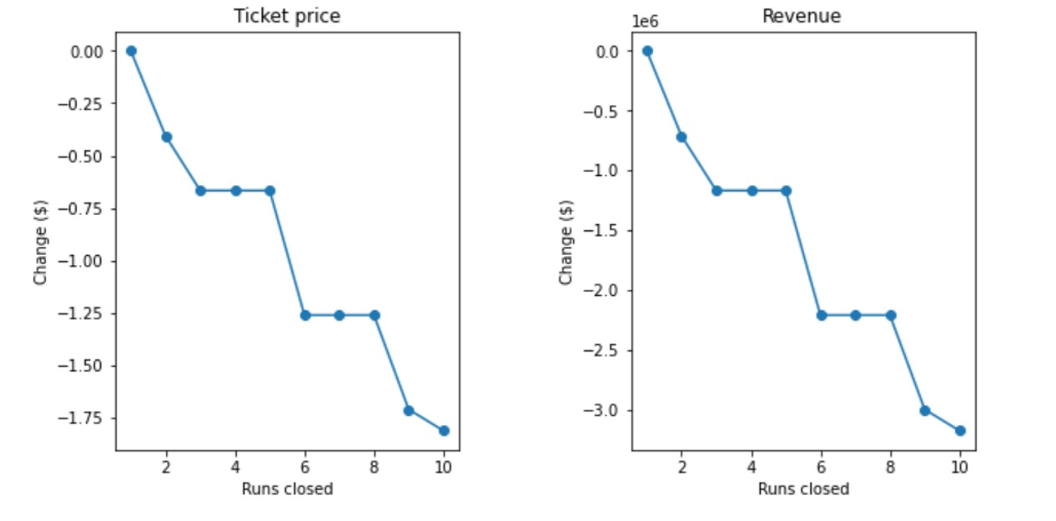
Other options that can also be considered are: Increase the vertical drop by adding a run to a point 150 feet lower down but requiring the installation of an additional chair lift to bring skiers back up, without additional snow making coverage. Same as number 1, but adding 2 acres of snow making cover. Increase the longest run by 0.2 mile to boast 3.5 miles length, requiring an additional snow making coverage of 4 acres.

Slide 5
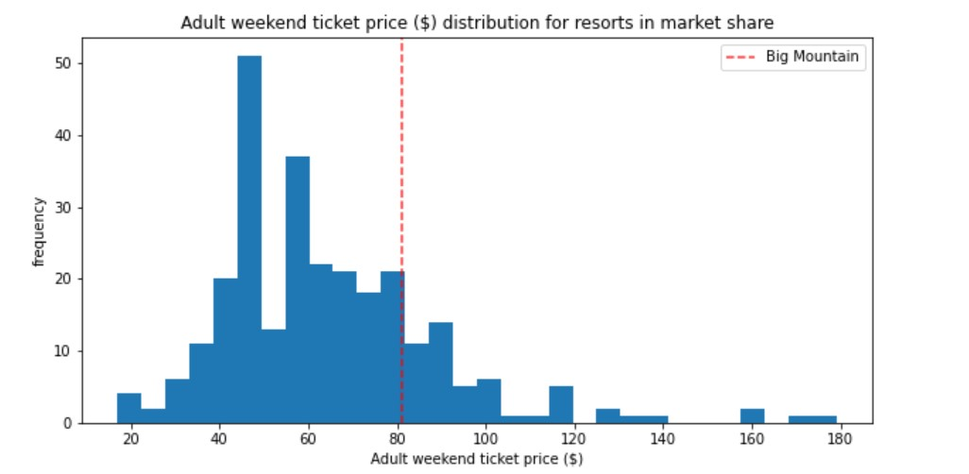
Modeling results and analysis
This chart shows where Big Mountain sits overall amongst all resorts for price and for just other resorts in Montana.

Slide 6
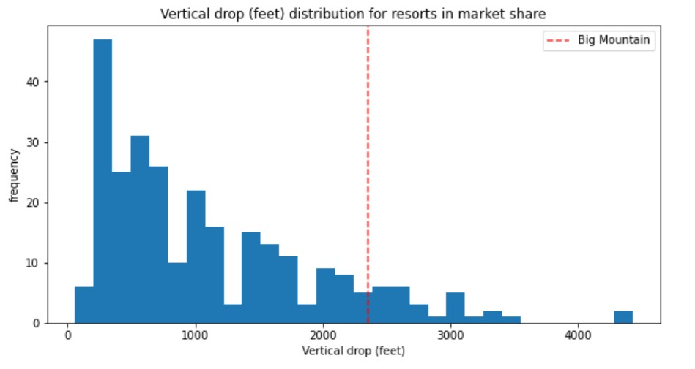
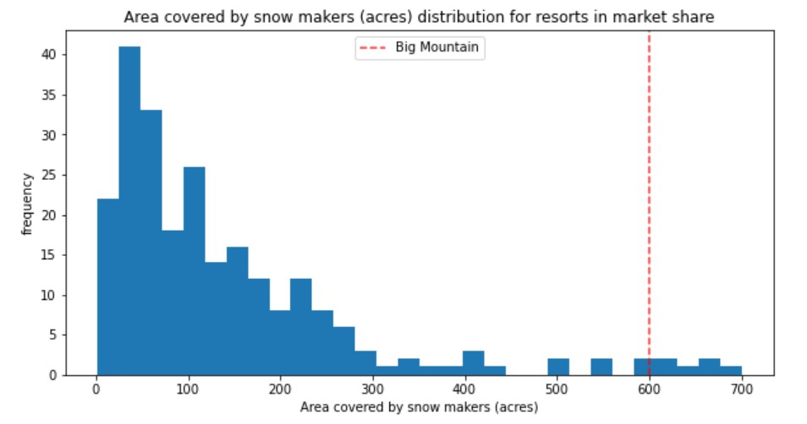
Big Mountain is doing well for vertical drop, but there are still quite a few resorts with a greater drop.
Big Mountain is very high up the league table of snow making area.

Slide 7
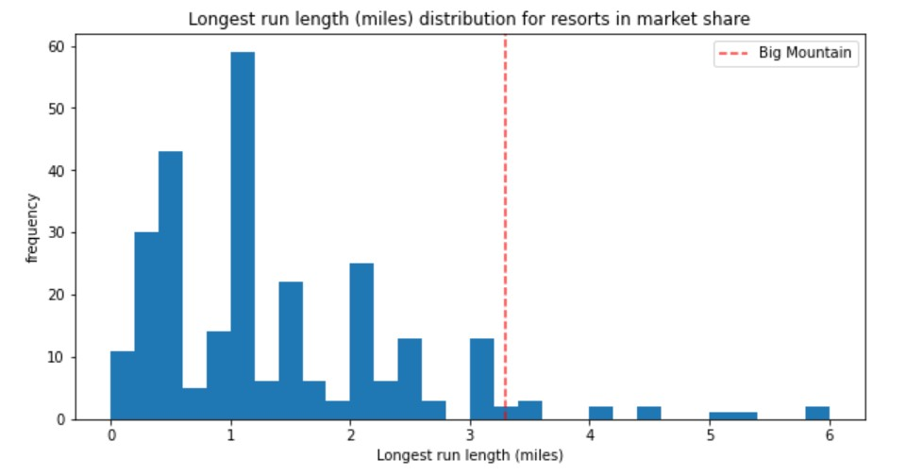
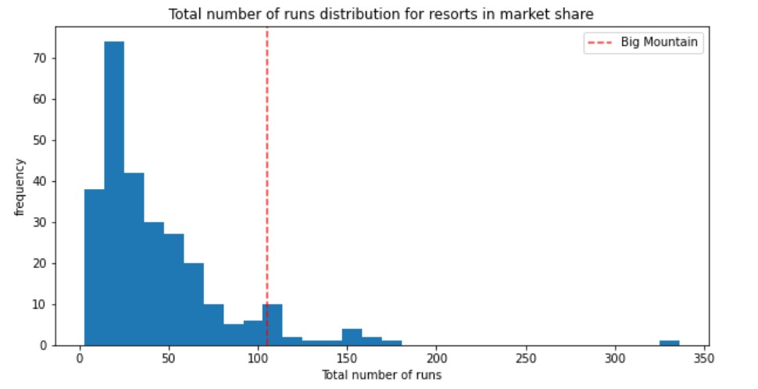
Big Mountain has one of the longest runs. Although it is just over half the length of the longest, the longer ones are rare.
Big Mountain compares well for the number of runs. There are some resorts with more, but not many.

Slide 8
We explored three different models.
We built our first model by using the mean value as a predictor, which allowed us to establish a baseline performance model with estimated value of $19 per ticket using the average price.
Next, we developed a linear model where we used the median and mean to fill in missing values and then trained the regression model. Using this approach, we can estimate a ticket price within $9 which is significant improvement from just guessing using the average.
Finally, we explored the random forest model. Instead of repeatedly checking performance on the test split, we defined the pipeline upfront and assessed performance using cross-validation. This model helped us identify four positive features (fastQuads, Runs, Snow Making_ac, vertical_drop) that are also present in the linear model.
After comparing the performance of the linear model and the random forest model, we decided to proceed with the random forest model as it shows a lower cross-validation mean absolute error by almost $1 and exhibits less variability.

Slide 9
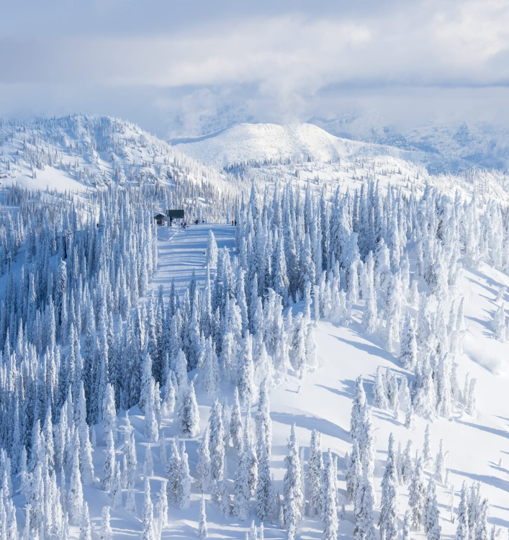
Summary and conclusion
We have reviewed potential scenarios for Big Mountain Resort for either cutting costs or increasing revenue (from ticket prices). Ticket price is not determined by any set of parameters; the resort is free to set whatever price it likes. However, the resort operates within a market where people pay more for certain facilities, and less for others. Being able to sense how facilities support a given ticket price is valuable business intelligence. This is where the utility of our model comes in. We have determined that closing some of the used runs can help with reducing operating costs. Other options that can also be considered are:
Increase the vertical drop by adding a run to a point 150 feet lower down but requiring the installation of an additional chair lift to bring skiers back up, without additional snow making coverage.
Same as number 1, but adding 2 acres of snow making cover.
Increase the longest run by 0.2 mile to boast 3.5 miles length, requiring an additional snow making coverage of 4 acres.

