Slide 1


Loan Default Prediction Using Machine Learning
by
Irina Nobaeva

Slide 2

The Problem:
Our main problem is the risk associated with lending loans, as loan defaults are common and can lead to financial losses and legal actions for banks and lenders.
.
The goal is to predict loan default among new consumers by using historical client behavior data and machine learning techniques. Specifically, the aim is to develop a classification model that can predict whether a new borrower is likely to default on their loan.
What factors affect loan default?
Can we predict the likelihood of a loan getting nonpaid?

Slide 3





Who might care?
Banks and Lenders
Regulatory Authorities
Investors
Consumers
Credit Rating Agencies
Economists and Analysts

Slide 4
Data information
Original dataset comprised of 148,670 Rows and 34 Columns
Loan data for the period of 2019
Exclude insignificant columns
Drop duplicates
Fill in missing values
Convert all values into numerical

Slide 5
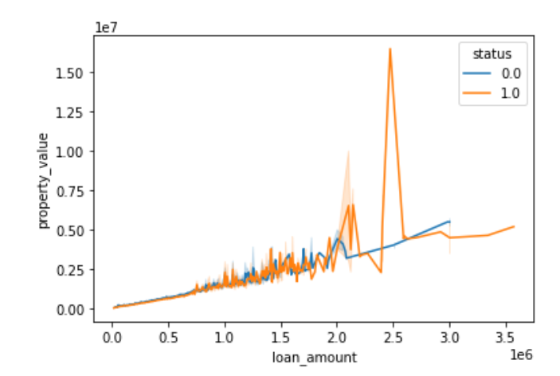
Visualization We can observe a correlation between the loan amount and the property value. Typically, borrowers tend to secure higher loan amounts when the property's value is higher, which is a logical outcome.

Slide 6
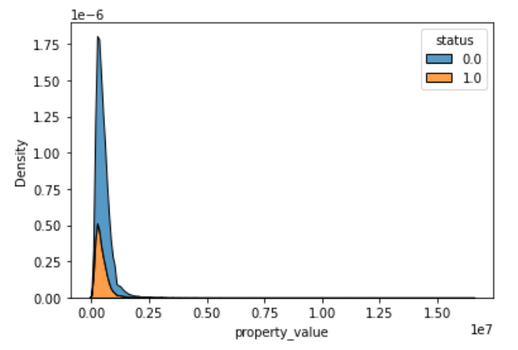
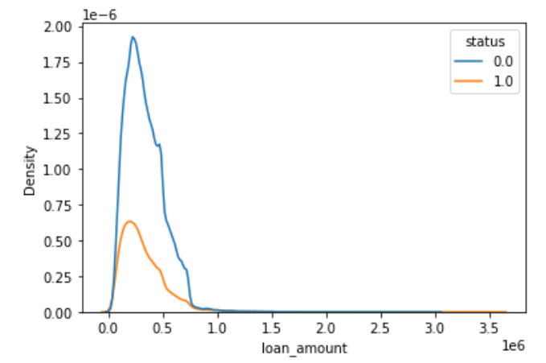
In the two plots below, we can observe the distribution of property values and loan amounts. The density of non-defaulted loans is notably higher than that of defaulted loans.

Slide 7

Machine learning modeling

Slide 8

Modeling steps
Pre-processing:
Label encoding
Data splitting into training and test sets (70%-30%)
Cross-validation (CV) for hyperparameter tuning:
3 fold cv
Using scikit-learn’s grid search method
Evacuation metric: Area under precision recall curve
Classifier training using optimal parameters

Slide 9
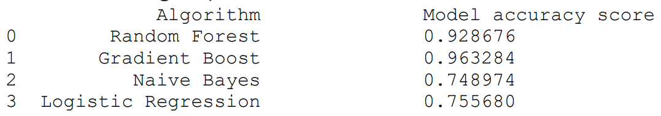
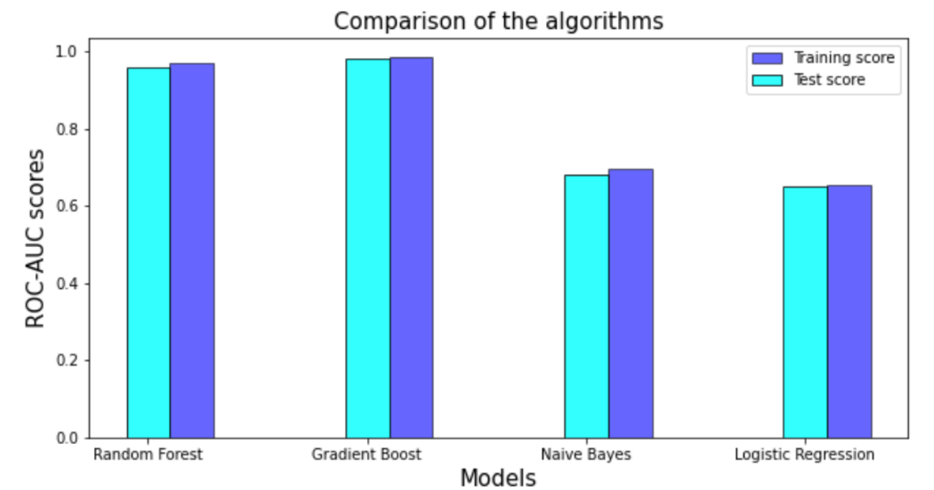
Classification Models

Slide 10
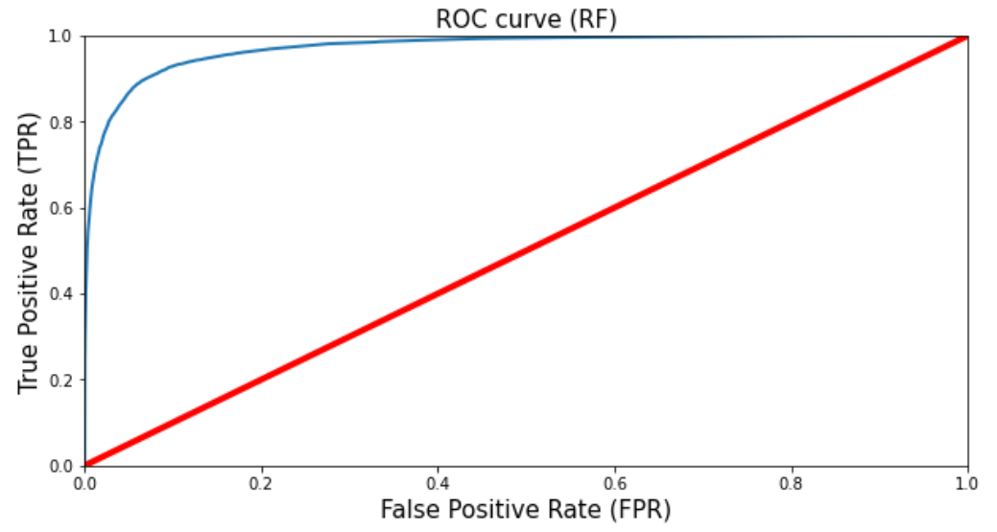
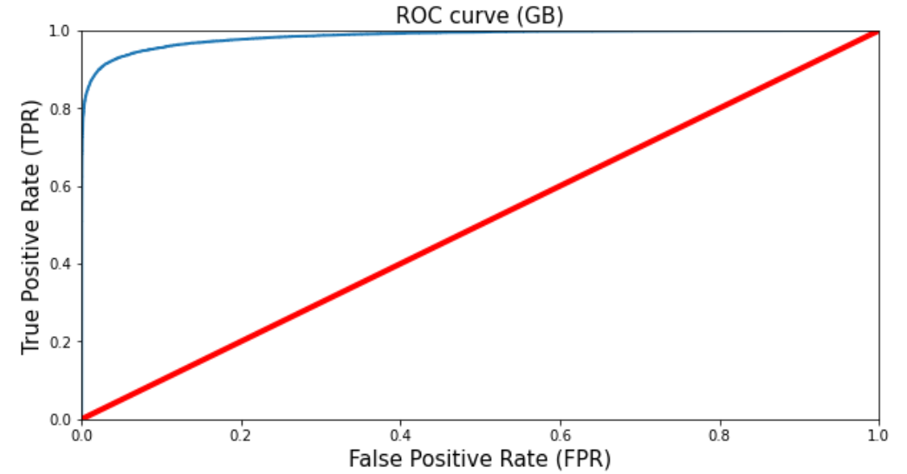
Models Overview Applying Grid search CV for hyperparameter T
Random Forest (test set)
ROC – AUC Score: 0.9724
Gradient Boost (test set)
ROC – AUC Score: 0.9848

Slide 11

Future research
Explore more areas like Feature Engineering to investigate new and informative features
Apply Advanced Machine Learning Techniques, such as deep learning models or ensemble methods
Investigate techniques like transfer learning or semi-supervised learning
Online learning and real-time monitoring that can help to adapt and update models in real-time as new data becomes available

Slide 12

Where it can be useful
The Loan Default Prediction models can be used in various ways to make informed decisions and manage risk effectively:
Loan Approval Process
Interest Rate Determination
Portfolio Management
Fraud Detection
Risk Assessment and Risk Mitigation

Slide 13
takeaways
All sources of datasets contributed to the predictive power of the model.
Out of 4 supervised classification models, the Gradient Boost provided the best results.
Out of 34 features, we used only 12 features With 70%-30% splitting, the test data set gave ROC AUC = 0.98.
With more ideas, the model can be improved with accuracy in the future.

