Slide 1
EARTHQUAKE PREDICTION MODEL USING AI

Slide 2
ABSTARCT
Reinforcement and evolutionary algorithms have been applied with a variety of features and parameters to predict the earthquake in the past.
Normal artificial intelligence practices have contributed a significantly in determining the possibility of potential natural disasters.
Many approaches have yielded comparatively better results when applied to a certain geographical area. This work covers the study and scientific analysis of the recent intelligence techniques that have been applied to the earthquake data sets.
The survey indicates that the dynamics and the nature of potential seismic disasters cannot be predicted completely by applying the results of a single approach.

Slide 3
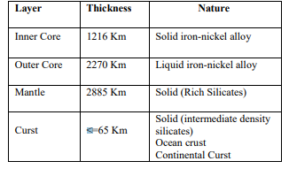
EARTH LAYERS AND DEPTH

Slide 4
Components Required
Arduino
Accelerometer
Power supply
Buzzer
LED Indiction
Proccesing plot Earthquake over computer

Slide 5
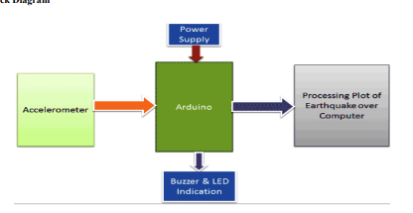
BLOCK DIAGRAM

Slide 6
Block Diagram Description
Working of this earthquake detector is simple. As we mentioned earlier that we have used Accelerometer for detecting earthquake vibrations along any of the three axes so that whenever vibrations occur accelerometer senses the vibrations and convert them into equivalent ADC value.
Then these ADC values are read by Arduino and shown over the 16x2 LCD. First we need to calibrate the Accelerometer by taking the samples of surrounding vibrations whenever Arduinopowers up. Then we need to subtract those sample values from the actual readings to get the real readings.
This calibration is needed so that it will not show alerts with respect to its normal surrounding vibrations. After finding real readings, Arduino compares these values with predefined max and min values.
If Arduino finds any changes values are more then or less then the predefined values of any axis in both direction (negative and positive) then Arduino trigger the buzzer and shows the status of alert over the 16x2 LCD and a LED also turned on as well.
We can adjust the sensitivity of earthquake detector by changing the predefined values in Arduino code.

Slide 7
Conclusion
This work entitled “Arduino based earthquake detection using accelerometer”, is successfully developed and working satisfactory.
Thus to sum up we have introduced this product with a view to reduce the destruction caused by earthquakeby alerting the people. It is economical and its price is quoted in such a way that it is affordable by every individual.
We have presented a novel technique to solve the automatic detection and classification problem of earth tremor in single step by using Arduino based earthquake detecting device.
In our system the majority of cases offer real practical benefits in the event of an earthquake to safeguard lives and resources

