Slide 1
Employee Data Analysis using Excel
STUDENT NAME : BALAJI. R
REGISTER NO :422200819
DEPARTMENT :B.Com (ISM)
COLLEGE :J.H.A. Agarsen College

Slide 2
PROJECT TITLE
EMPLOYEE PERFORMANCE ANALYSIS USING EXCEL

Slide 3
AGENDA
Problem Statement
Project Overview
End Users
Our Solution and Proposition
Dataset Description
Modelling Approach
Results and Discussion
Conclusion

Slide 4

PROBLEM STATEMENT
Employee performance is defined as how well a person executes their job duties and responsibilities. The companies assess their employees performance on an annual or quarterly basis to define certain areas.
The Dataset overview of an employee, contains the information about employees in a company.

Slide 5

PROJECT OVERVIEW
The project involves analyzing employee data using Excel which helps in gaining the knowledge regarding organizational data, performance statistical analysis by creating visualizations to understand the employee performances.

Slide 6

WHO ARE THE END USERS?
The end users in employee performance analysis include:
1. Human Resource management professionals.
2. Data Analysts.
3. Team Leaders.

Slide 7

OUR SOLUTION AND ITS VALUE PROPOSITION
*Filtering- purpose to fill the missing values.
*Conditional formatting- blank values.
*Using- Pivot table and chart.

Slide 8
Dataset Description
Employee data set- Kaggle
There are 26 features
The important ten features are,
  Employment ID
  First name
  Last name
  Gender
  Employee status
  Employee type
  Employee classification
  Performance score
  Current employee ratings
  Business units

Slide 9

THE "WOW" IN OUR SOLUTION
Performance Level– These include the categories such as Levels in very high, high, medium, low, etc...
3/21/2024 Annual Review

Slide 10
MODELLING
The modelling in this employee performance analysis project includes the following:
  *Data collection
  *Data cleaning
  *Results
  *Pivot table
  *Chart

Slide 11
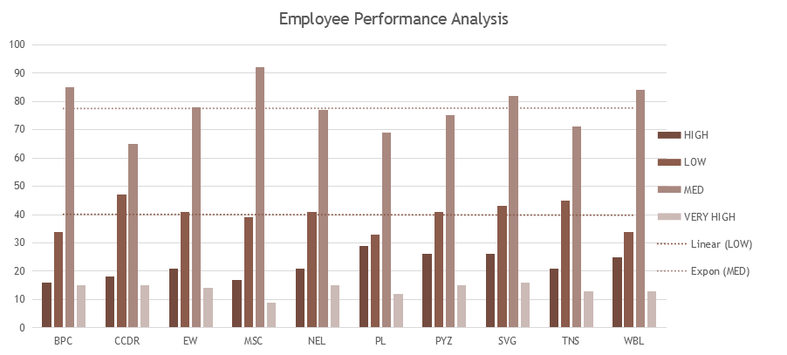
RESULTS

Slide 12
CONCLUSION
The conclusion is the employee data analysis reveals the key insights in workforce performance and areas needed for improvement. The effective data analysis provides a foundation for the improvised planning and operational developments, which leads to a motivated and productive workforce environment.

