Slide 1
DIRECTORY APP USING ANDROID NATIVE (Android Native )
Project Work
Guided by,
Dr. MR.ILANGO , M.C.A., M.Phil., Ph.D.,
DIRECTOR OF MCA,
MCA Department,
K.L.N College of Engineering, Pottapalayam.
Submitted by,
S.AFRIN,
910618621001,
Department of MCA,
K.L.N. College of Engineering,

Slide 2
ABSTRACT
The project is to be implemented on Madurai city in which it helps the user to find location based on various category. The goal of the project is to explore how to realize a mobile city guide using the Android platform. The project uses the research method Design Science. The project is evaluated in four aspects including platform evaluation, general functional evaluation, scenario evaluation, and non-functional evaluation. The prototype implemented includes basic functionalities of city guide such as showing a map, locating points of interest (POIs) on a map, locating location of a user, retrieving information of POIs, add reviews about POIs, plan a tour, support communication (e.g. phone, short message), show route direction to POIs, add reminder, and choose different kinds of POIs to show on map. Moreover, the project has explored how to integrate current technologies like Google Calendar, Google Map, Browser, Contact application and Phone application into the prototype.

Slide 3

Company Profile
Company Name | TECHELF
Contact Person Name | MR.A.SRIDHAR(CEO)
Sector | Information Technology Services
Address | 152, 3RD STREET BAMANAGAR,P&T NAGAR MADURAI.
Location | Madurai - 625001, Tamil Nadu
For More Details visit Website | https://TECHELF.in

Slide 4
Project Description
This project acts as an important role in helping people to locate to their places inside a city and promote their business. The project directory app using android native is developed so that users can view the detailed information about the particular city. The users are register by providing details such as Name, MailId. The project also has a login page where the registered user can login, then the user can explore popular places, tourist places, restaurant & residency, jewellery, banking and finance, automobile, shops and they can also promote their shops using ads. Thus this application helps to select the location they need to explore in a efficient manner .The main aim of developing this application is to reduce the time and to give a accurate location in a city. Thus this application provides the required information for quicker decision making.

Slide 5
Existing System
In the Existing system the directory app shows the route with a voice recongisation but it is hard to explore places based on the catagories such as tourist places, restaurant & residency, jewellery, banking and finance, automobile, shops ,hospital public utility .
DISADVANTAGES
There is a Less catagoriesed list.
Hard for the user to provide the appropriate keywords.
Sometimes the route is unapproximate.

Slide 6
Proposed System
The motive of the proposed system is to provide the most accurate route and reliable path to the user and to overcome the drawbacks of the existing system. A suggestion-based system determines the similarity to users or items and produces a prediction for the user by taking the weighted average of all the ratings.
Therefore, we use some indexes which are appropriate to evaluate our approaches, such direction, Contact information ,reviews, updates,promotions. Then, we design several evaluation methods to analyze performance.
To predict a rating for an place,we calculate the overall review such as like comments. This enables users to find not only content items they are currently interested in, but also those in which they might become interested.

Slide 7
Advantages of Proposed System
The Advantages of Proposed System:
The current data can be added easily and incrementally with an updated set of information.
It’s used for collecting and analyzing a large amount of information on a user's behaviour, preference and predicting what users will like based on similarity to other users.

Slide 8
Hardware and Software Specification
Hardware Specification:
Front-end : Android UI Native, Java
Back End : JAVA
Database : Firebase, MySQL (maria db)
Hardware Specification:
CPU : Inter Core i3 10th Gen(Minimum)
RAM : 8GB Ram or more
OS : Windows 10

Slide 9
MODULES
The Modules in this application are:
REGISTER / LOGIN ACCOUNT
PROFILE SETTING
INTERST
UPLOADED ITEMS
USER MANAGEMENT

Slide 10
MODULE DESCRIPTION
REGISTER / LOGIN ACCOUNT
Register/ login account is about verification of user detail such as Username and password to verify your personality. Usually, authentication is done with a username and password, although there are various ways to be authenticated. However, the authorization process of this is to give access in the form of approval to the user. So that after the approval the one can able to access by verifying your rights.
UPLOADED ITEMS
Uploaded item is the process that will upload the new places to this application. The agent uploads the places. The uploaded articles can view all users. User can search based on the catagories , then it will show all the uploaded places to user

Slide 11
MODULE DESCRIPTION
USER MANAGEMENT
The user management is the process of approval. user uploads places are approved by the admin . The user request to admin, through mail to the admin. Once it is verified , then the places is getting approved to be uploaded. If the places is not matched then it will be rejected.
INTEREST
Interest is the process of filtering based on searching for content by users. In this filtering consists of trending based on catagories will display while searching. The model used to predict items that the user may have an interest in. Content- based filtering approaches appropriate a series of distinct, identification characteristics of an place in order to justify increased review with similar properties.

Slide 12
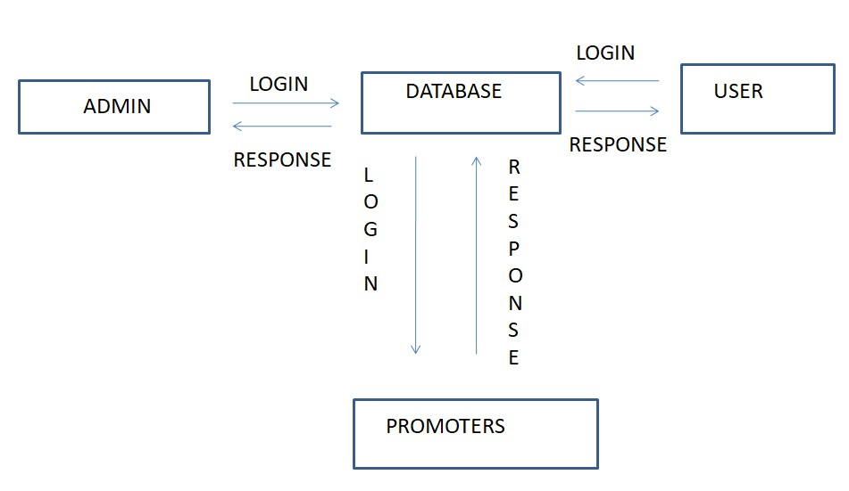
Dataflow Diagram

Slide 13
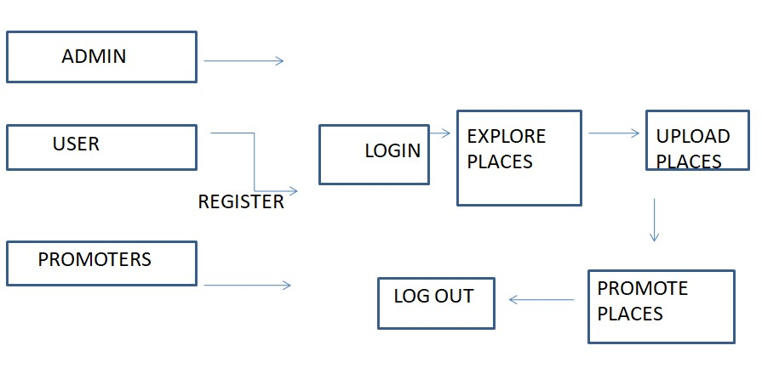
LEVEL 2 DFD

Slide 14
Table Design
USER REGISTER TABLE
S.No. | Logical Name | Data Type | Is Null | Comments
1 | Name | VARCHAR(20) | N | Describes the name of the user
2 | Email | VARCHAR(25) | N | Used to confirm the identity of a user
3 | Password | VARCHAR(20) | N | Used to confirm the identity of a user
4 | Profile-Pic | IMAGE | N | To get the user profile

Slide 15
ADMIN TABLE
S.No. | Logical Name | Data Type | Is Null | Comments
1 | NAME | VARCHAR(25) | N | Name of the admin
2 | Email | VARCHAR(25) | N | Used to confirm the identity of admin
3 | Password | VARCHAR(20) | N | Used to confirm the identity of a admin
4 | Phone-number | VARCHAR(MAX) | N | To get identity of the admin
6 | Logo | IMAGE | N | To get the identity
7 | Status | VARCHAR(25) | N | To get the status of approve or decline

Slide 16
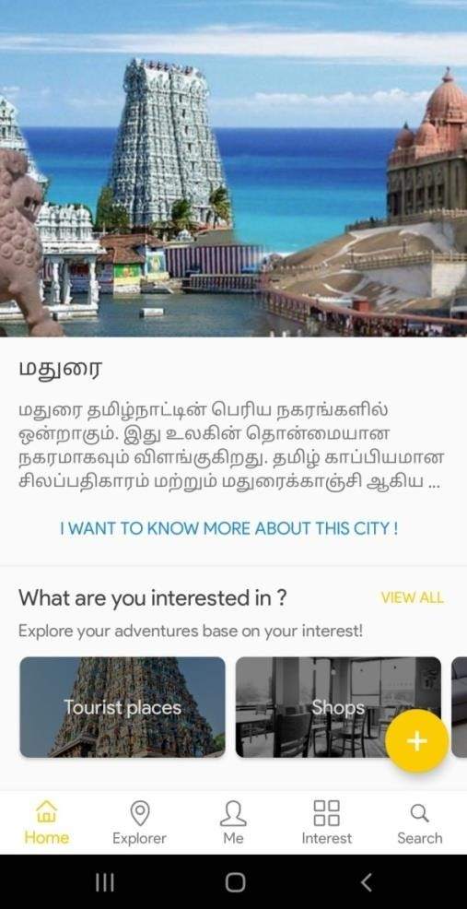
Screenshots
HOME PAGE

Slide 17
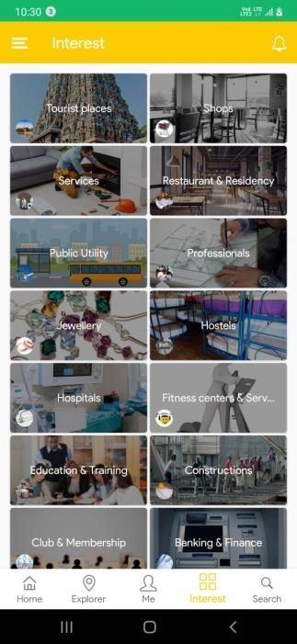
INTEREST

Slide 18
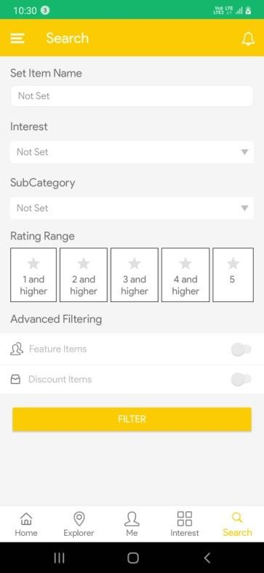
SEARCH

Slide 19
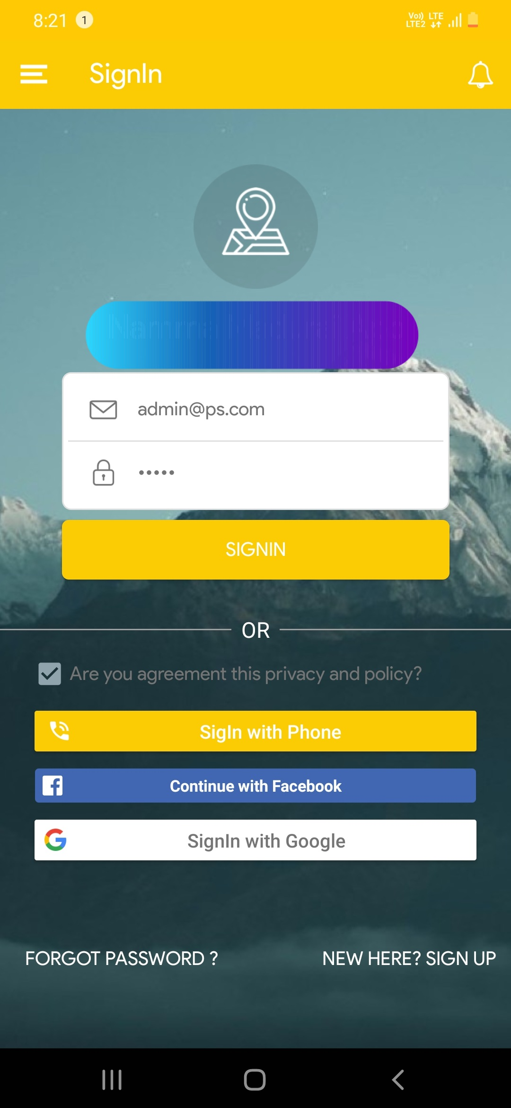
Screenshots
REGISTER

Slide 20
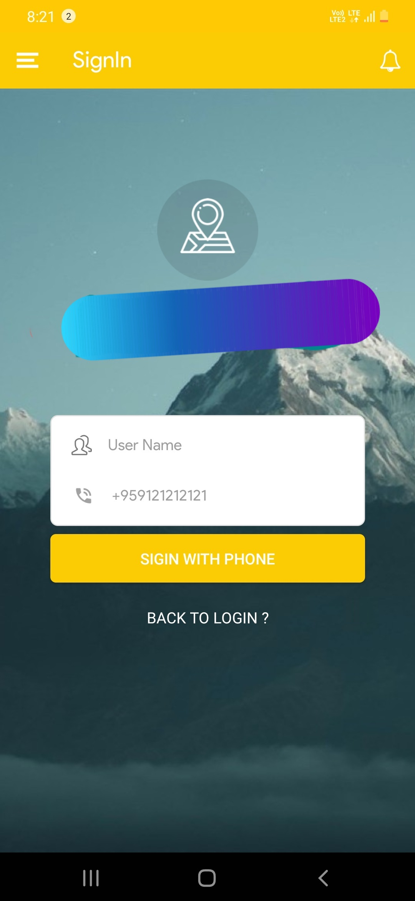
SIGN UP USING MOBILE NO

Slide 21
FUTURE ENHANCEMENT
Our future work is based on making more convenient to the public who can access this process more easily and also get their details. In this study, a filtering strategy is proposed to achieve personalized route recommendations.The next level of the project to make a app more userfriendly by devolping news and mazagines into the app, which help the user read the dialy new inside a city.

Slide 22
THANK YOU

