Slide 1


K.RAMAKRISHNAN COLLEGE OF ENGINEERING
(AUTONOMOUS)
ANALYZING SOCIAL MEDIA TRENDS FOR PRODUCT LAUNCH SUCCESS
Presented by,
Name : BALAMURUGAN N
Register No. : 8115U23IT021
Roll. No. : ITA2321
Year & Section : III & A
Course Code : ITB1303
Course Name : Data Mining Techniques (TCPR)
Date of Review :9.12.2025

Slide 2
AGENDA
Abstract
Introduction
Literature Survey
Existing System
Proposed System
System specification
Architecture Diagram
Methodology
Experimental results
Conclusion
References

Slide 3
ABSTRACT
To analyze social media posts to understand public opinion about upcoming products.
To identify trending keywords, hashtags, and engagement patterns related to a product launch.
To perform sentiment analysis and classify user emotions as positive, negative, or neutral.
To apply machine learning models to predict the success of a product before its launch.
To help businesses make better decisions by using real-time consumer insights.

Slide 4
INTRODUCTION
Social media platforms like Twitter, Instagram, YouTube, and Reddit have become major sources of public opinion.
People share reactions, expectations, and reviews that strongly influence how successful a new product will be.
Analyzing these large volumes of social media data helps understand customer interest and market trends.
This project predicts product launch success by studying sentiment, trends, and engagement from online conversations.

Slide 5
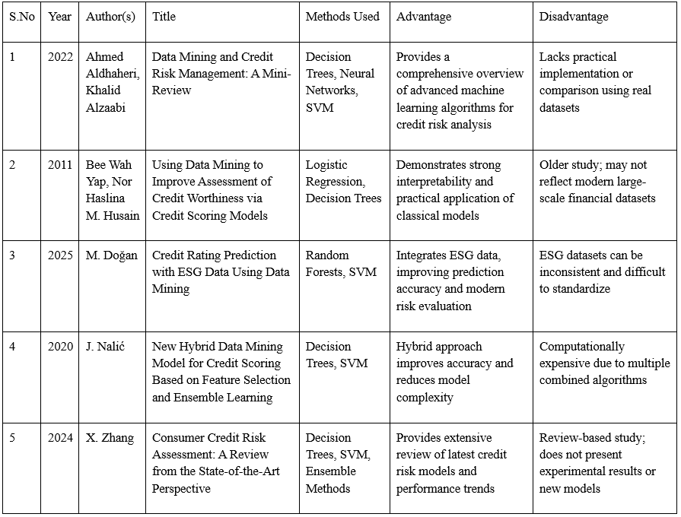
LITERATURE SURVEY

Slide 6
EXISTING SYSTEM
Companies rely on surveys, interviews, and manual feedback to understand customer interest.
These methods are slow and cannot capture real-time public opinion.
Existing systems cannot process large social media data or trending hashtags.
No sentiment analysis is used to understand customer emotions accurately.
Decisions are often less reliable because they depend on limited and outdated information.

Slide 7
PROPOSED SYSTEM
The proposed system analyzes social media data to understand public interest in real time.
It uses NLP techniques to extract sentiment, trending keywords, and engagement levels.
Machine learning models are applied to predict the success of a product before launch.
The system provides visual charts and insights to help businesses make better decisions.
It offers faster, more accurate, and data-driven predictions compared to traditional methods.

Slide 8
SYSTEM SPECIFICATION
Software Specification
Operating System: Windows 11 Programming Language: Python 3.10+
Data Analysis Libraries: Pandas, NumPy
Visualization Tools: Plotly, Matplotlib
Database / Storage: CSV files (local storage)
IDE / Editor: Visual Studio Code
Browser: Google Chrome / Edge
Hardware Specification
Processor: Intel Core i5
RAM: Minimum 8 GB
Storage: 512 GB SSD or higher
Monitor: 15.6″ or above, Full HD resolution
Input Devices: Keyboard and Mouse

Slide 9
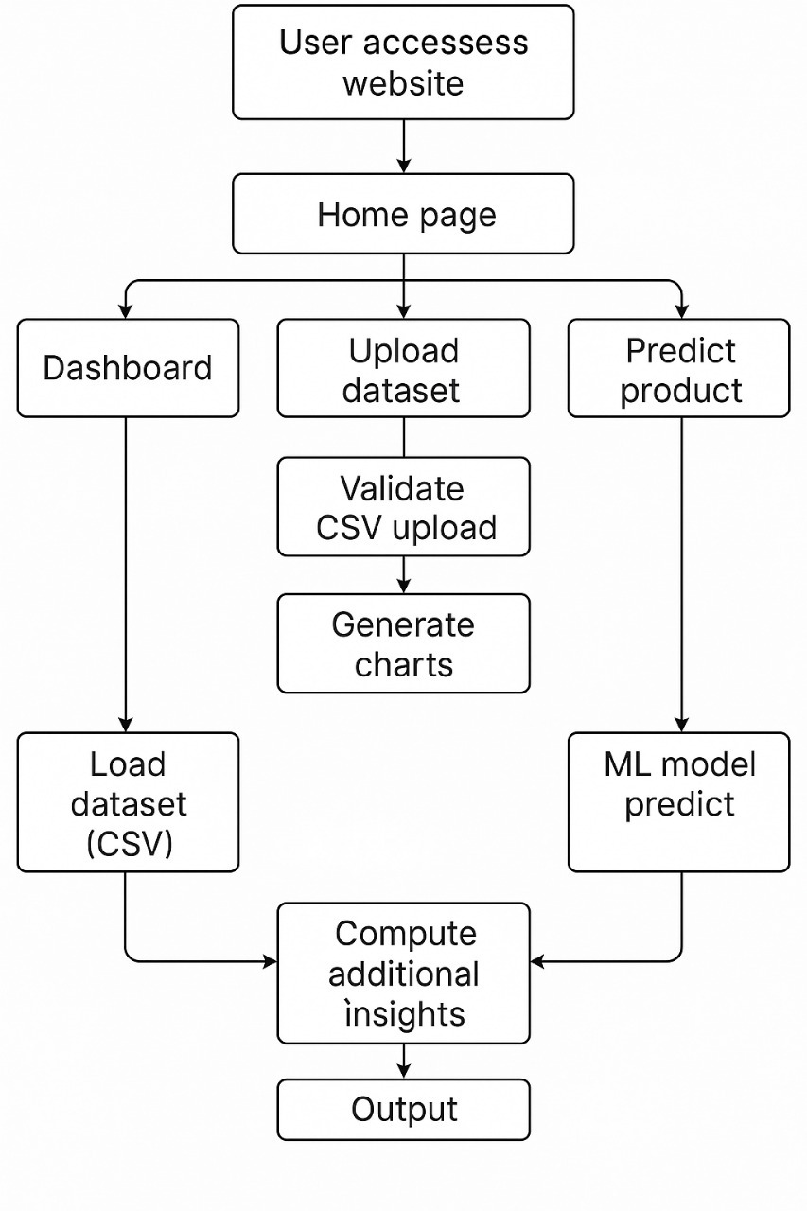
PROPOSED ARCHITECTURE

Slide 10
METHODOLOGY
1. Sentiment Analysis:Analyzes social media posts to identify whether public opinion about a product is positive, negative, or neutral before launch.
2. Trend & Keyword Mining:Tracks frequently used keywords and hashtags to understand what features or topics people are most interested in.
3. Engagement Analysis:Measures likes, comments, shares, and views to evaluate how actively users interact with product-related content.

Slide 11
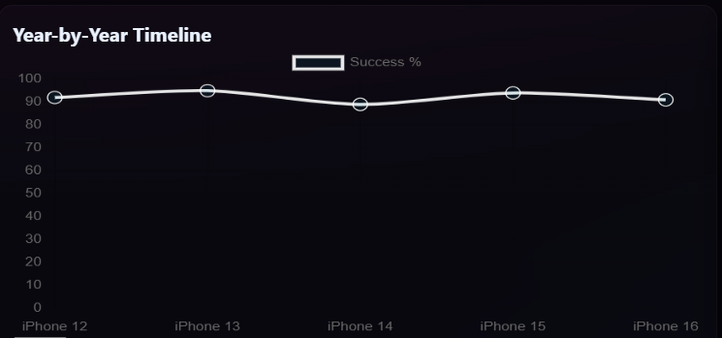
EXPERIMENTAL RESULTS

Slide 12
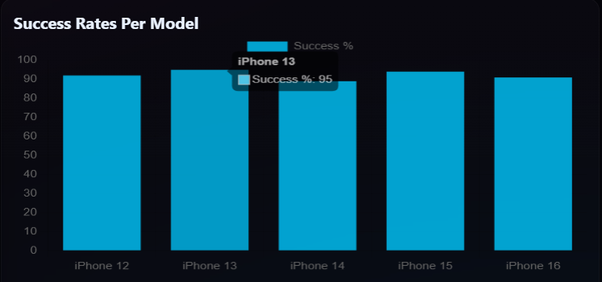
EXPERIMENTAL RESULTS

Slide 13
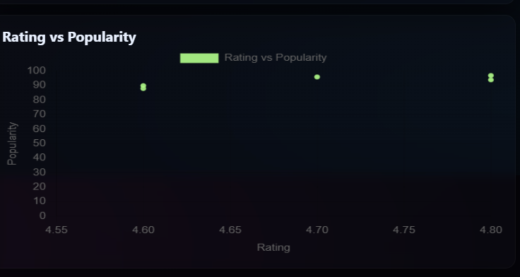
EXPERIMENTAL RESULTS

Slide 14
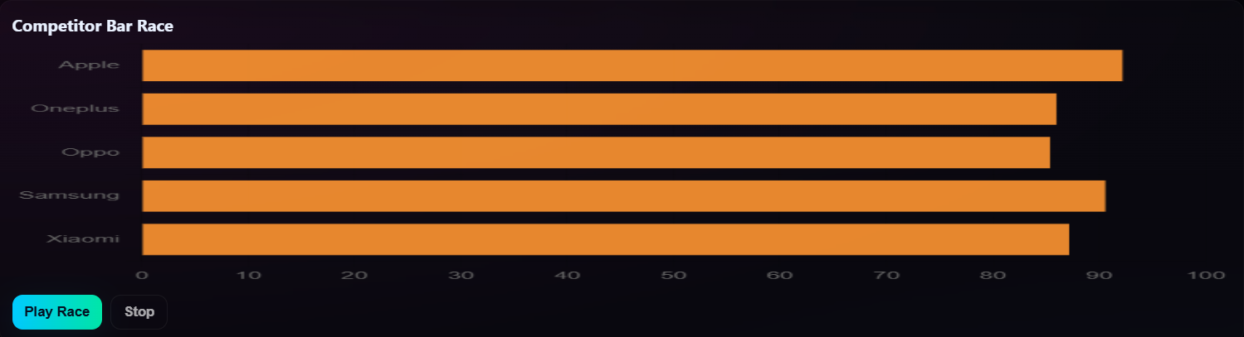
EXPERIMENTAL RESULTS

Slide 15
CONCLUSION
Social media data provides valuable early insights into public opinion about new products.
Sentiment, trends, and engagement strongly influence product launch success.
Machine learning improves the accuracy of predicting market response before launch.
The system helps businesses make better, data-driven launch and marketing decisions.

Slide 16
REFERENCE
Sharma, A., Deshmukh, K., & Rao, L. (2020). Sentiment-Driven Product Launch Forecasting Using Social Media Data. IEEE Journal of Intelligent Market Analytics.
Gupta, S., & Sharma, R. (2021). Trend Mining Techniques in Twitter for Product Market Intelligence. Springer Journal of Social Computing Systems.
Wang, L., Xiang, H., & Zhao, M. (2019). Predicting Product Demand Using User-Generated Social Media Content. International Journal of Predictive Analytics.
Kumar, P., & Mukherjee, A. (2022). LSTM-Based Sentiment Analysis for Consumer Behavior Prediction. IEEE Transactions on Computational Social Systems.
Martin, J., & Lee, R. (2018). Consumer Influence Modeling in Social Media Communities. ACM Transactions on Web Intelligence.

