Slide 1
Resource-Based Approach in Node.js
Presented by: BALASANJEEV C
Department of CSE
Nandha Engineering College

Slide 2
Introduction
Node.js is an open-source JavaScript runtime built on Chrome’s V8 engine.
It allows JavaScript to run on the server side.
Node.js follows a resource-based, non-blocking I/O model for handling multiple requests efficiently.

Slide 3
What is Resource-Based Approach?
Focuses on efficient use of system resources (CPU, memory, I/O).
Instead of creating new threads for every request, Node.js uses a single thread to handle all requests.
This makes it lightweight and highly scalable.

Slide 4
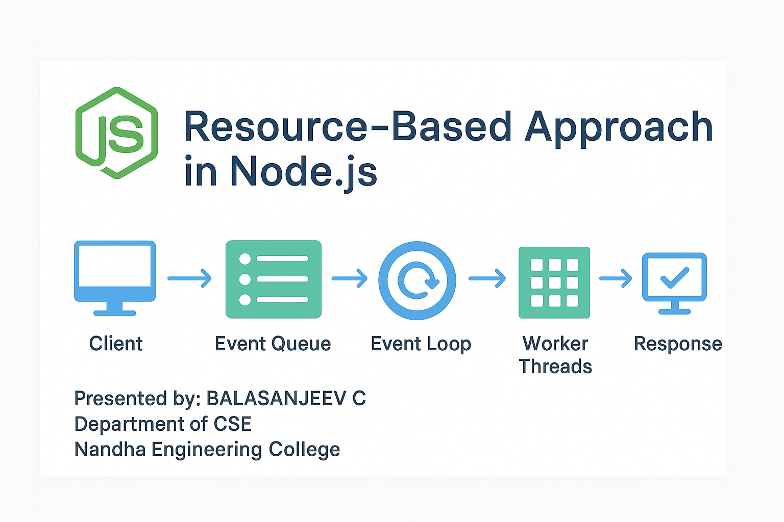
Node.js Resource-Based Working
Client sends a request to the server.
Node.js adds the request to the Event Queue.
The Event Loop checks and processes requests one by one.
Long operations are handled asynchronously using callbacks or promises.
Once completed, Node.js reuses the resource for new requests.

Slide 5
Advantages
Efficient use of CPU and memory.
Faster response time.
Handles many users at once.
Scalable and reliable.
Ideal for real-time applications.

Slide 6
Limitations
Not suitable for CPU-heavy tasks.
Single-threaded — errors can affect all processes.
Requires understanding of asynchronous programming.

Slide 7
Applications
Real-time chat apps.
Streaming platforms.
APIs and microservices.
IoT and cloud-based systems.

Slide 8
Conclusion
Node.js uses a resource-based, event-driven model.
This makes it efficient, fast, and ideal for modern applications.
It ensures maximum performance with minimum resources.

Slide 9
Thank You
Thank you for listening!

