Slide 1


SMART INDIA HACKATHON 2025
TITLE PAGE
Problem Statement ID – SIH25035
Problem Statement Title- Sentiment analysis of comments received through
E- consultation module
Theme- Miscellaneous
PS Category- Software
Team Name- Problem Solvers
Team Members- 1.Balasanjeev C 4.Ashwanth A
2.Ashwin S 5.Dhanusri G K
3.Gobinath M 6.Anitha AR
Mentor- Ms .S. Geetha (AP/CSE)

Slide 2
IDEA TITLE
Problem solvers
Proposed Solution
Explanation An AI-powered tool that can read comments from the E-Consultation module, classify them as Positive, Negative, or Neutral, and supports a variety of languages and emojis. A straightforward dashboard displays the results.
How It Addresses the Problem Saves time by avoiding manual reading, gives real-time insights into public opinion, and helps policymakers make faster, better decisions.
Innovation & Uniqueness Supports multilingual and code-mixed text, understands emojis/slang, provides real-time analysis, and displays results in an easy visual dashboard.

Slide 3
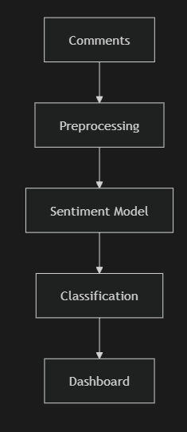
TECHNICAL APPROACH
Problem solvers
TECHSTACK:
Programming: Python
ML/NLP: TensorFlow / PyTorch, HuggingFace Transformers
Frontend/Dashboard: HTML or Streamlit
Backend/API: Node js or FastAPI
Database: MongoDB Atlas
WORKFLOW:
Comments → Preprocessing → Sentiment Model → Classification → Dashboard

Slide 4
FEASIBILITY AND VIABILITY
Problem solvers
Feasibility
Yes, it is technically possible because advanced AI/NLP models already exist for multiple languages.
Pretrained models like BERT can help handle Indian languages, code-mixing, and emojis.
Cloud services make it easy to scale the system to process thousands of comments at once.
Viability (Is it practical and useful?)
Cost-effective: Using open-source models and cloud deployment reduces expenses.
Time-saving: Automates manual work of reading and analyzing comments.
Usability: A simple dashboard ensures policymakers and officers can easily understand insights.
Challenges & Solutions
Challenge: Handling slang, spelling mistakes, and emojis.
Solution: Add custom dictionaries and emoji sentiment mapping.
Challenge: Maintaining high accuracy across many Indian languages.

Slide 5
IMPACT AND BENEFITS
Problem solvers
Faster insights – Policymakers get real-time public opinion.
Better decisions – Helps improve policies and services.
Time saving – Reduces manual effort in reading comments.
Social impact – Citizens’ voices are heard more effectively.
Scalable – Can be extended to other government feedback systems.

Slide 6
RESEARCH AND REFERENCES
Problem solvers
IndicNLP Library – Tools for Indian Language Processing
BERT Research Paper – Deep Bidirectional Transformers for Language Understanding
Indian Government Open Data Portal – Citizen Feedback & Public Data
Survey Papers on Sentiment Analysis – Techniques and Applications

Slide 7
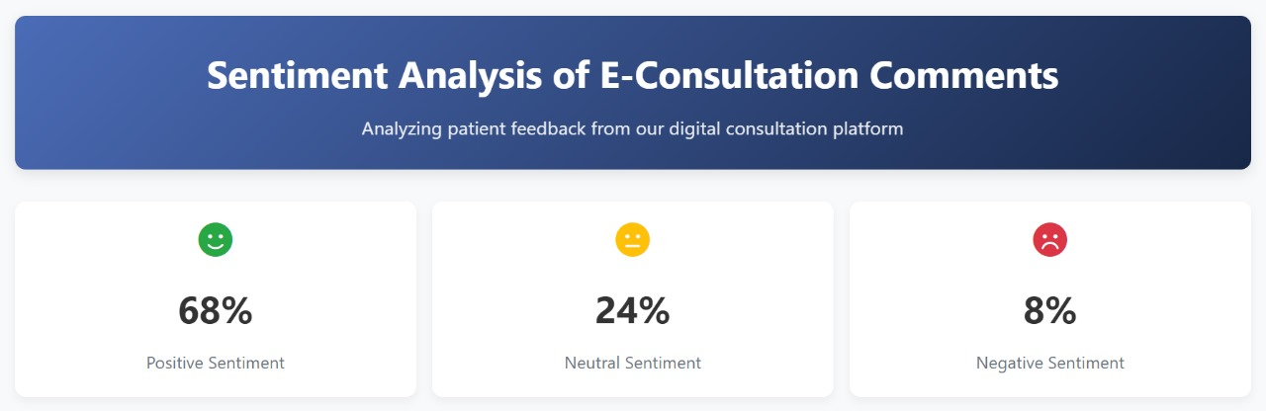
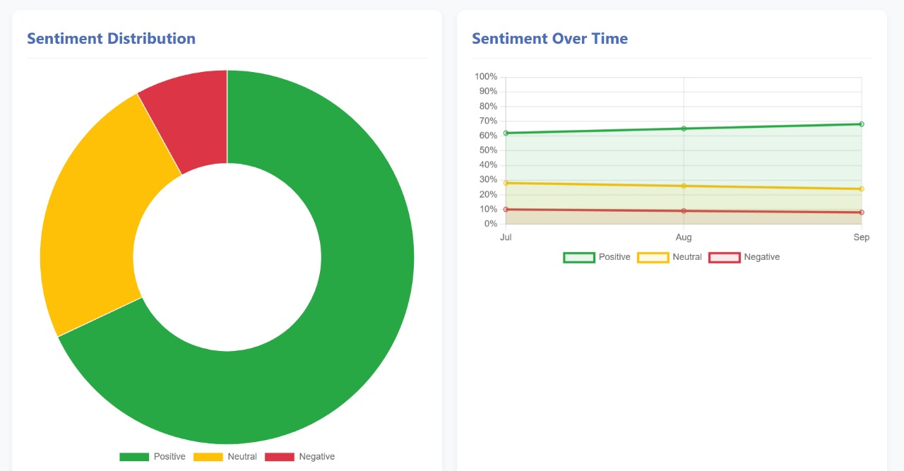
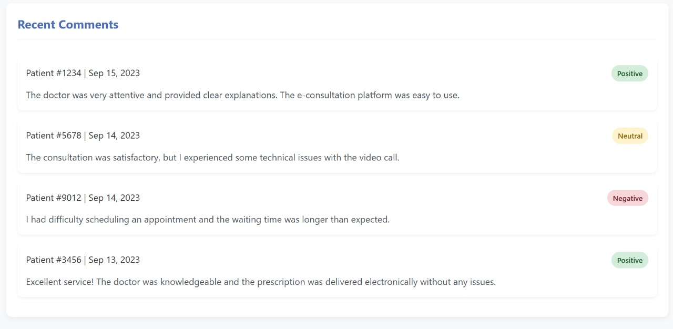
SAMPLE IMAGES

