Slide 1

SIKULIX
Larry Nung

Slide 2
AGENDA
Introduction Download & Setup Getting started
Matching & Target offset Global Settings
Global Functions Key Constants Shortcut Reference
Q & A
2

Slide 3
INTRODUCTION
3

Slide 4
INTRODUCTION
Automates anything you see on the screen of your desktop computer running Windows, Mac or some Linux/Unix
4

Slide 5
DOWNLOAD & SETUP
5

Slide 6
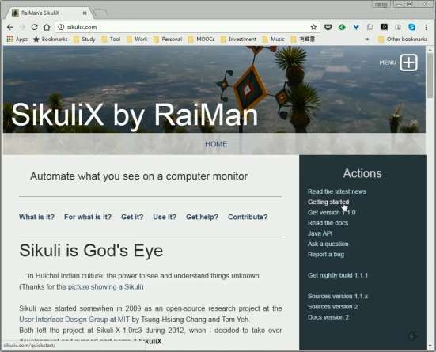
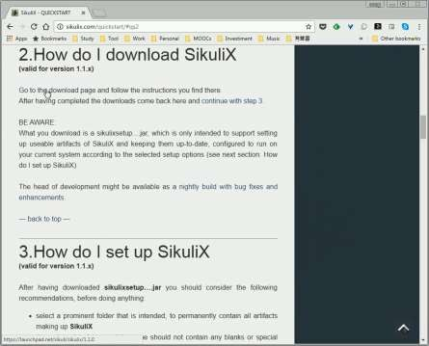
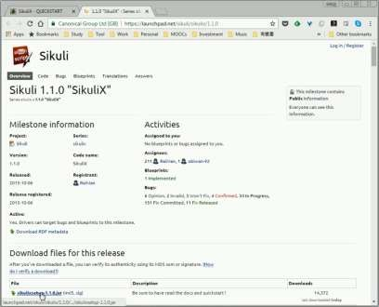
DOWNLOAD & SETUP
6

Slide 7
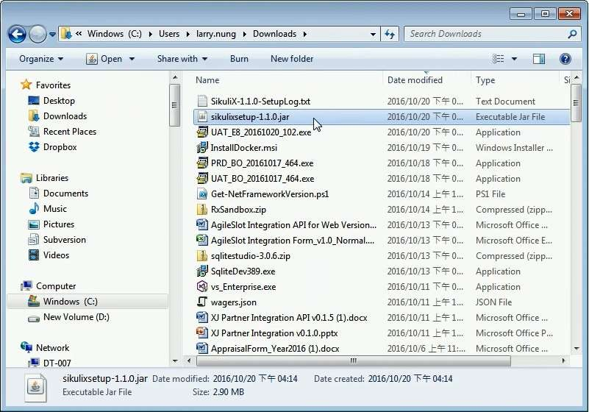
DOWNLOAD & SETUP
7

Slide 8
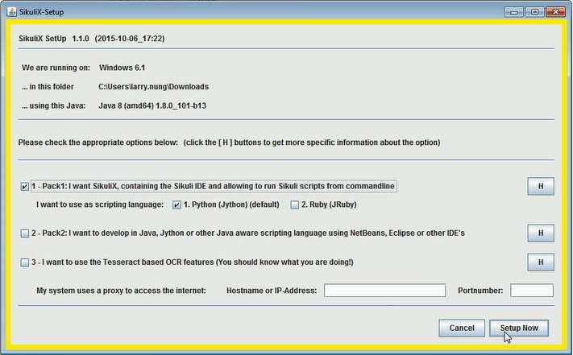
DOWNLOAD & SETUP
8

Slide 9
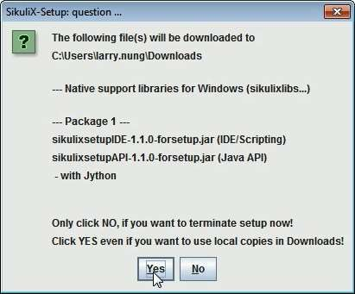
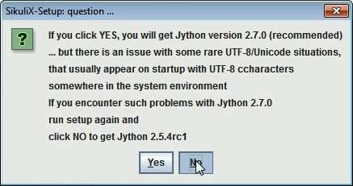
DOWNLOAD & SETUP
9

Slide 10


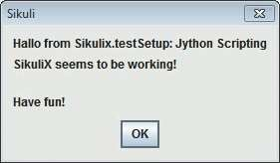
DOWNLOAD & SETUP
10

Slide 11
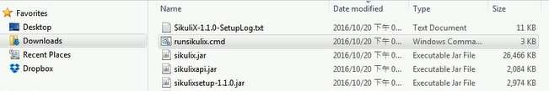
DOWNLOAD & SETUP
11

Slide 12
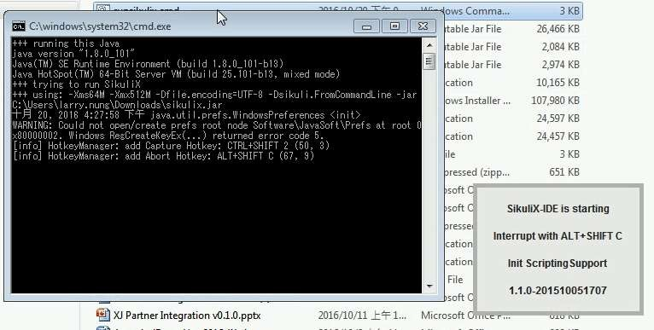
DOWNLOAD & SETUP
12

Slide 13
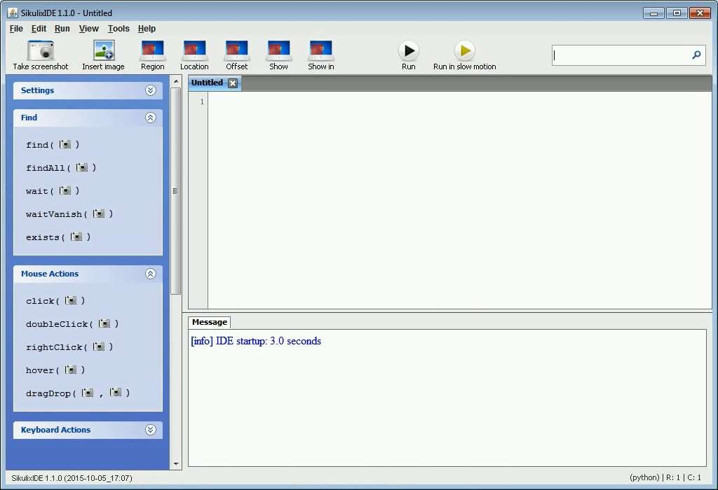
DOWNLOAD & SETUP
13

Slide 14
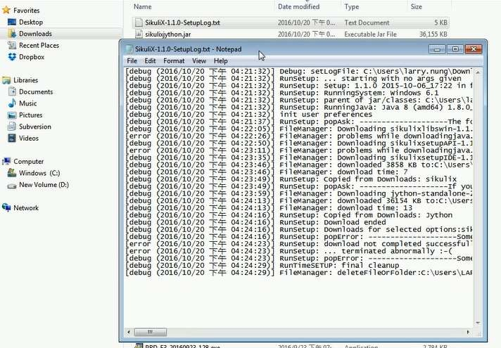
DOWNLOAD & SETUP
14

Slide 15
GETTING STARTED
15

Slide 16
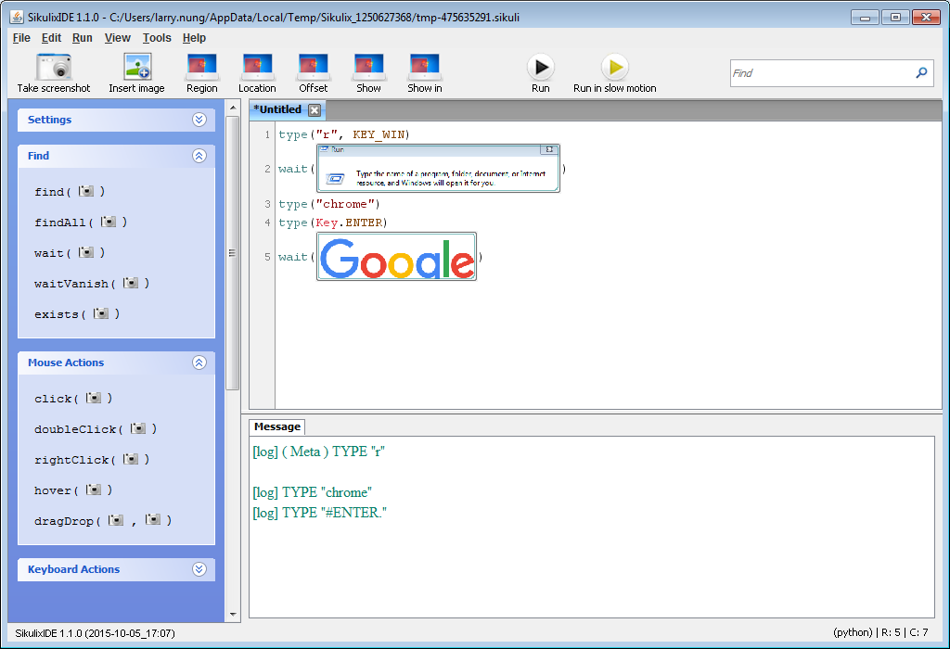
GETTING STARTED
1
6

Slide 17
MATCHING & TARGET OFFSET
17

Slide 18
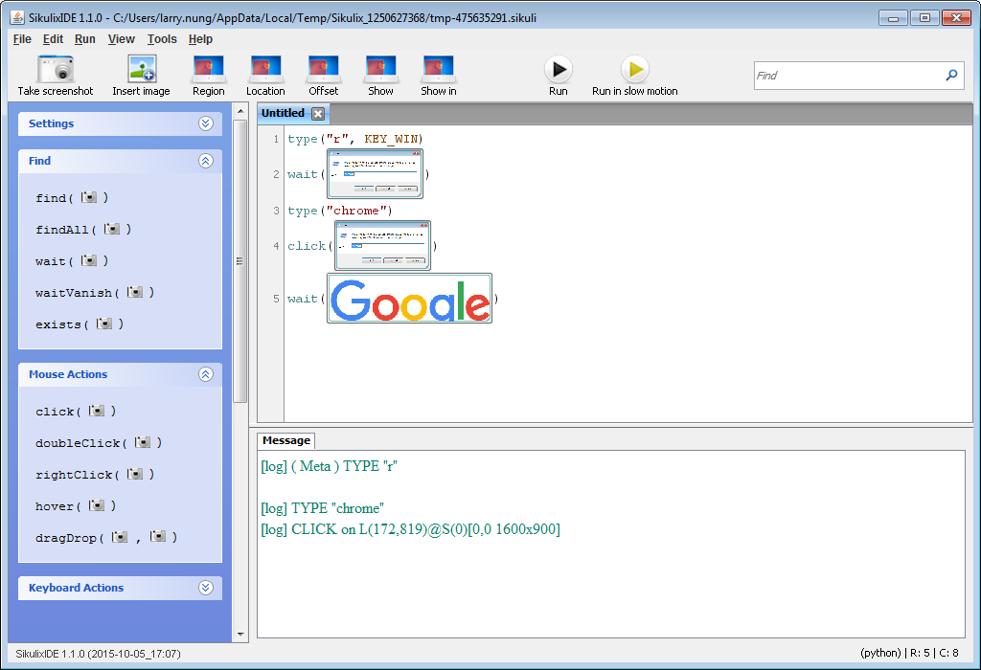
MATCHING & TARGET OFFSET
18

Slide 19
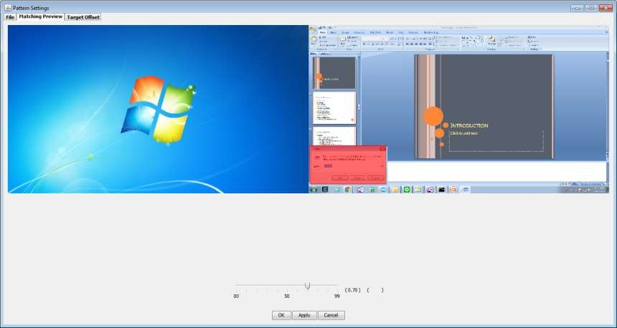
MATCHING & TARGET OFFSET
19

Slide 20
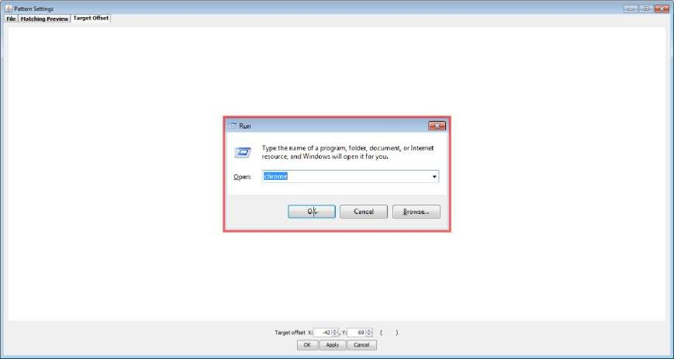
MATCHING & TARGET OFFSET
20

Slide 21
GLOBAL SETTINGS
21

Slide 22
GLOBAL SETTINGS
ActionLogs
InfoLogs
DebugLogs
MinSimilarity
MoveMouseDelay
DelayAfterDrag
DelayBeforeDrop
SlowMotionDelay
WaitScanRate
ObserveScanRate
ObserveMinChangedPixels
22

Slide 23
GLOBAL SETTINGS
Example
Settings.MoveMouseDelay = 0
Settings.ClickDelay = 0
Settings.DelayBeforeMouseDown = 0
Settings.TypeDelay = 0
Settings.AutoWaitTimeout = 30 * 1000
23

Slide 24
GLOBAL FUNCTIONS
24

Slide 25
OPENAPP(APPLICATION)
Open the specified application.
Parameters
application –a string containing the name of an application (case-insensitive), that can be found in the path used by the system to locate applications. Or it can be the full path to an application.
Note for Windows: (since X-1.0rc3) The string may contain commandline parameters for the specified program or batch file after the name or full path.
○
25

Slide 26
OPENAPP(APPLICATION)
Example
openApp("cmd.exe“)
openApp("C:\Program Files (x86)\Google\Chrome\Application\chrome.exe")
openApp(r'cmd.exe /c start c:\Program Files\myapp.bat‘)
openApp("c:\\Program Files\\Mozilla Firefox\\firefox.exe“)
openApp("Safari“)
26

Slide 27
SWITCHAPP(APPLICATION)
Switch to the specified application.
Parameters
 application – the name of an application (case- insensitive) or (part of) a window title (Windows/Linux).
27

Slide 28
SWITCHAPP(APPLICATION)
Example
switchApp("cmd.exe")
switchApp("c:\\Program Files\\Mozilla Firefox\\firefox.exe")
switchApp("mozilla firefox")
switchApp("Safari")
28

Slide 29
CLOSEAPP(APPLICATION)
Close the specified application.
Parameters
 application – the name of an application (case- insensitive) or (part of) a window title (Windows/Linux)
29

Slide 30
CLOSEAPP(APPLICATION)
Example
closeApp("cmd.exe")
closeApp("c:\\Program Files\\Mozilla Firefox\\firefox.exe")
closeApp("mozilla firefox")
closeApp("Safari")
30

Slide 31
POPUP(TEXT[, TITLE])
Display a dialog box with an OK button and text as the message. The script then waits for the user to click the OK button.
Parameters
text – text to be displayed as message
title – optional title for the messagebox
31

Slide 32
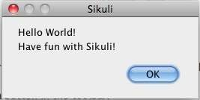
POPUP(TEXT[, TITLE])
Example
 popup("Hello World!\nHave fun with Sikuli!")
32

Slide 33
INPUT([TEXT][, DEFAULT])
Display a dialog box with an input field, a Cancel button, and an OK button. The optional text can be displayed as a caption. The script then waits for the user to click either the Cancel or the OK button.
Parameters
text – optional text to be displayed as message
default – optional preset text for the input field (new in later then X-1.0rc3)
Returns
the text, contained in the input field, when the user clicked OK
None, if the user pressed the Cancel button
33

Slide 34
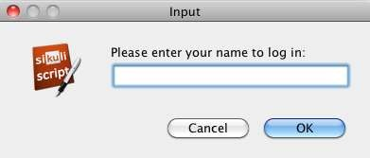
INPUT([TEXT][, DEFAULT])
Example
name = input("Please enter your name to log in:")
name = input("Please enter your name to log in:", "anonymous") # a preset input text
34

Slide 35
KEY CONSTANTS
35

Slide 36
MISCELLANOUS KEYS
Key.ENTER
Key.TAB
Key.ESC
Key.BACKSPACE
Key.DELETE
Key.INSERT
Key.SPACE
36

Slide 37
FUNCTION KEYS
Key.F1
Key.F2
Key.F3
Key.F4
Key.F5
Key.F6
Key.F7
Key.F8
Key.F9
Key.F10
Key.F11
Key.F12
Key.F13
Key.F14
Key.F15
37

Slide 38
NAVIGATION KEYS
Key.HOME
Key.END
Key.LEFT
Key.RIGHT
Key.DOWN
Key.UP
Key.PAGE_DOWN
Key.PAGE_UP
38

Slide 39
SPECIAL KEYS
Key.PRINTSCREEN
Key.PAUSE
Key.CAPS_LOCK
Key.SCROLL_LOCK
Key.NUM_LOCK
39

Slide 40
NUMPAD KEYS
Key.NUM0
Key.NUM1
Key.NUM2
Key.NUM3
Key.NUM4
Key.NUM5
Key.NUM6
Key.NUM7
Key.NUM8
Key.NUM9
Key.SEPARATOR
Key.ADD
Key.MINUS
Key.MULTIPLY
Key.DIVIDE
40

Slide 41
MODIFIER KEYS
Key.ALT
Key.CMD
Key.CTRL
Key.META
Key.SHIFT
Key.WIN
41

Slide 42
SHORTCUT
42

Slide 43
SHORTCUT
Alt+Shift+c
Stop
Ctrl+Shift+2
Capture
43

Slide 44
REFERENCE
44

Slide 45
REFERENCE
RaiMan's SikuliX
http://sikulix.com/
Global Functions and Features — Sikuli X 1.0 documentation
http://doc.sikuli.org/globals.html
45

Slide 46
Q&A
46

Slide 47

QUESTION & ANSWER
47

