Slide 1
7 secret patterns
Vue consultants don’t
want you to know!
By 1 member of the Vue core team
you’ll never believe is shorter in real life!

Slide 2
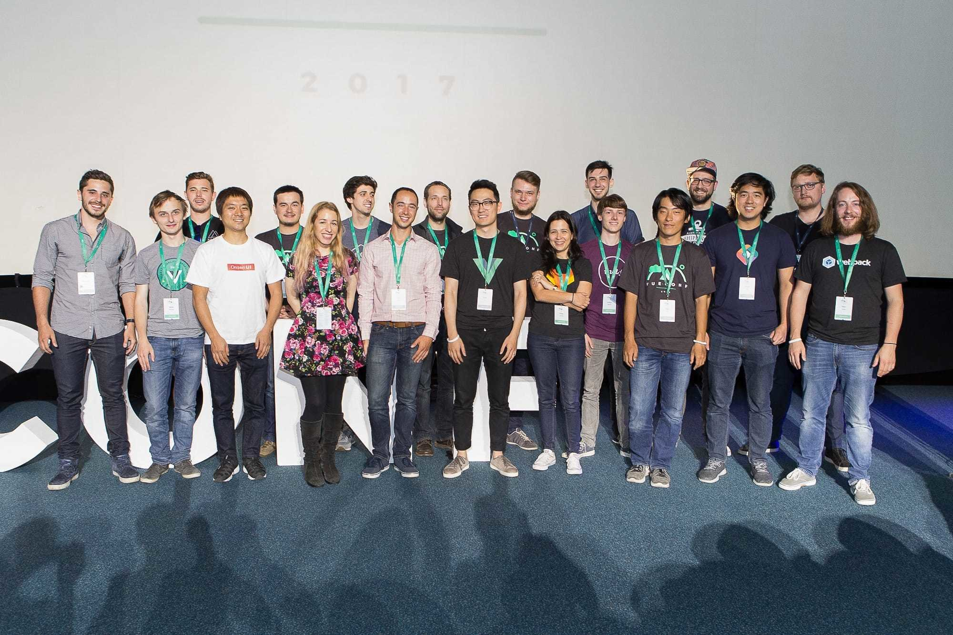
Me
Hi!

Slide 3
Me
Hi!

Slide 4
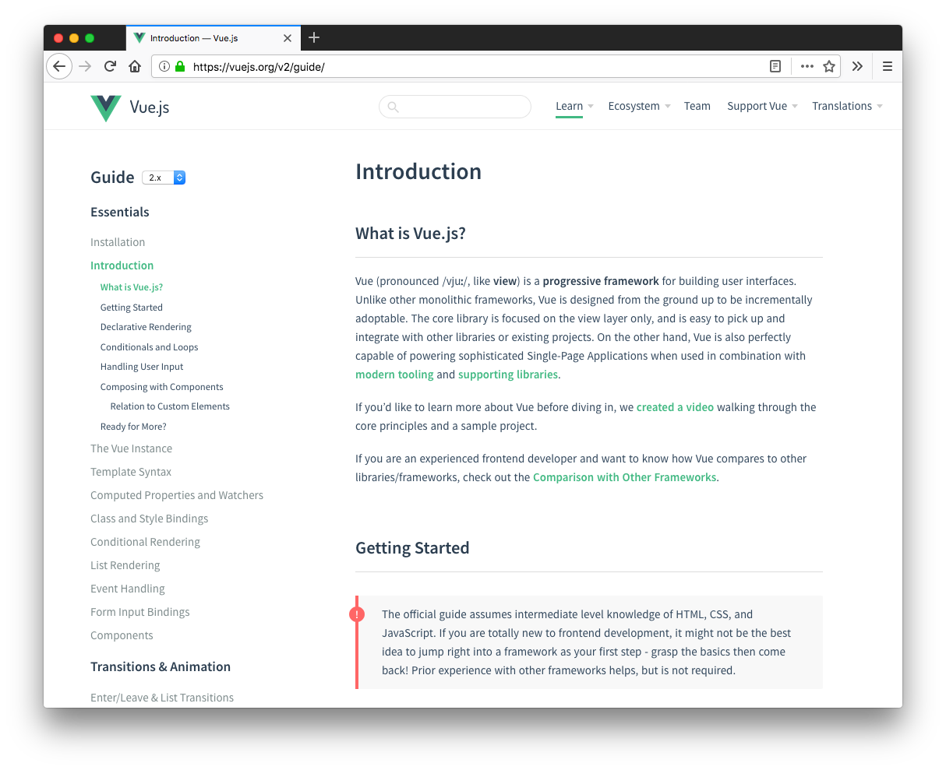

Slide 5



Secrets
No need to take notes!
Productivity Boosts
Productivity Boost
Radical Tweaks
Unlocked Possibilities

Slide 6
Productivity Boost
#1

Slide 7
Smarter Watchers
created() {
this.fetchUserList()
},
watch: {
() {
this. ()
}
searchText
fetchUserList
}
Fetch on created, then watch

Slide 8
Smarter Watchers
created() {
this.fetchUserList()
},
watch: {
searchText
:
' '
fetchUserList
}
Watchers accept method names

Slide 9
Smarter Watchers
created() {
this.fetchUserList()
},
watch: {
{
handler: ,
immediate: true
}
searchText
:
' '
fetchUserList
}
And can call themselves on created

Slide 10
Productivity Boost
#2

Slide 11
Component Registration
import BaseButton from './base-button'
import BaseIcon from './base-icon'
import BaseInput from './base-input'
export default {
components: {
BaseButton,
BaseIcon,
BaseInput
}
}
Frequently imported components

Slide 12
Component Registration
import BaseButton from './base-button'
import BaseIcon from './base-icon'
import BaseInput from './base-input'
export default {
components: {
BaseButton,
BaseIcon,
BaseInput
}
}
<BaseInput
v-model="searchText"
@keydown.enter="search"
/>
<BaseButton @click="search">
<BaseIcon name="search"/>
</BaseButton>
So much JS to support such a small template!

Slide 13
Component Registration
import Vue from 'vue'
import upperFirst from 'lodash/upperFirst'
import camelCase from 'lodash/camelCase'
// Require in a base component context
const requireComponent = require.context(
‘./components’, false, /base-[\w-]+\.vue$/
)
requireComponent.keys().forEach(fileName => {
// Get component config
const componentConfig = requireComponent(fileName)
// Get PascalCase name of component
const componentName = upperFirst(
camelCase(fileName.replace(/^\.\//, '').replace(/\.\w+$/, ''))
)
// Register component globally
Vue.component(componentName, componentConfig.default || componentConfig)
})
src/main.js

Slide 14
Component Registration
import BaseButton from './base-button'
import BaseIcon from './base-icon'
import BaseInput from './base-input'
export default {
components: {
BaseButton,
BaseIcon,
BaseInput
}
}
<BaseInput
v-model="searchText"
@keydown.enter="search"
/>
<BaseButton @click="search">
<BaseIcon name="search"/>
</BaseButton>

Slide 15
Component Registration
<BaseInput
v-model="searchText"
@keydown.enter="search"
/>
<BaseButton @click="search">
<BaseIcon name="search"/>
</BaseButton>

Slide 16
Productivity Boost
#3

Slide 17
Module Registration
import auth from './modules/auth'
import posts from './modules/posts'
import comments from './modules/comments'
// ...
export default new Vuex.Store({
modules: {
auth,
posts,
comments,
// ...
}
})
Tedious!

Slide 18
Module Registration
import camelCase from 'lodash/camelCase'
const requireModule = require.context('.', false, /\.js$/)
const modules = {}
requireModule.keys().forEach(fileName => {
// Don't register this file as a Vuex module
if (fileName === './index.js') return
const moduleName = camelCase(
fileName.replace(/(\.\/|\.js)/g, '')
)
modules[moduleName] =
requireModule(fileName)
})
export default modules

Slide 19
Module Registration
import camelCase from 'lodash/camelCase'
const requireModule = require.context('.', false, /\.js$/)
const modules = {}
requireModule.keys().forEach(fileName => {
// Don't register this file as a Vuex module
if (fileName === './index.js') return
const moduleName = camelCase(
fileName.replace(/(\.\/|\.js)/g, '')
)
modules[moduleName] =
modules[moduleName] = {
namespaced: true,
...requireModule(fileName),
}
requireModule(fileName)
})
export default modules

Slide 20
Module Registration
import auth from './modules/auth'
import posts from './modules/posts'
import comments from './modules/comments'
// ...
export default new Vuex.Store({
modules: {
auth,
posts,
comments,
// ...
}
})
export default new Vuex.Store({
modules
Say goodbye!
})

Slide 21
Module Registration
import modules from './modules'
export default new Vuex.Store({
modules
})

Slide 22

Secrets
Productivity Boosts
Radical Tweak
Radical Tweaks
Unlocked Possibilities

Slide 23
Radical Tweak
#1

Slide 24
Lazy-Loaded Routes
{
path: '/admin',
name: 'admin-dashboard',
component:
}
() => import
require .default
('@views/admin')

Slide 25
Lazy-Loaded Routes
{
path: '/admin',
name: 'admin-dashboard',
component:
}
() => import
require .default
('@views/admin')

Slide 26
Radical Tweak
#2

Slide 27
Transparent Wrappers
<template>
<input
:value="value"
@input="$emit('input', $event.target.value)"
>
</template>
<BaseInput @focus.native="doSomething">

Slide 28

Transparent Wrappers
<template>
<label>
{{ label }}
<input
:value="value"
@input="$emit('input', $event.target.value)"
>
</label>
<input
:value="value"
@input="$emit('input', $event.target.value)"
>
</template>
<BaseInput @focus.native="doSomething">

Slide 29
Transparent Wrappers
<template>
<label>
{{ label }}
<input
:value="value"
@input="$emit('input', $event.target.value)"
>
</label>
computed: {
listeners() {
return {
...this.$listeners,
input: event =>
this.$emit('input', event.target.value)
}
}
}
<input
:value="value"
v-on="listeners"
>
</template>
<BaseInput @focus
.native
="doSomething">

Slide 30
Transparent Wrappers
<template>
<label>
{{ label }}
<input
:value="value"
@input="$emit('input', $event.target.value)"
>
</label>
computed: {
listeners() {
return {
...this.$listeners,
input: event =>
this.$emit('input', event.target.value)
}
}
}
<input
:value="value"
v-on="listeners"
>
</template>
<BaseInput @focus
.native
="doSomething">

Slide 31
Transparent Wrappers
<template>
<label>
{{ label }}
<input
:value="value"
@input="$emit('input', $event.target.value)"
>
</label>
computed: {
listeners() {
return {
...this.$listeners,
input: event =>
this.$emit('input', event.target.value)
}
}
}
<input
:value="value"
v-on="listeners"
>
</template>
<BaseInput @focus
="doSomething">

Slide 32
Transparent Wrappers
<template>
<label>
{{ label }}
<input
:value="value"
@input="$emit('input', $event.target.value)"
>
</label>
computed: {
listeners() {
return {
...this.$listeners,
input: event =>
this.$emit('input', event.target.value)
}
}
}
<input
:value="value"
v-on="listeners"
>
</template>
<BaseInput @focus
="doSomething">

Slide 33

Transparent Wrappers
<template>
<label>
{{ label }}
<input
<template>
<label>
{{ label }}
<input
:value="value"
@input="$emit('input', $event.target.value)"
>
</label>
computed: {
listeners() {
return {
...this.$listeners,
input: event =>
this.$emit('input', event.target.value)
}
}
}
<input
:value="value"
v-on="listeners"
>
:value="value"
v-on="listeners"
>
</label>
</template>
</template>
<BaseInput
placeholder="What's your name?"
@focus="doSomething"
/>

Slide 34


Transparent Wrappers
<template>
<label>
{{ label }}
<input
v-bind="$attrs"
inheritAttrs: false
:value="value"
v-on="listeners"
>
</label>
</template>
Fully transparent wrappers!
<BaseInput
placeholder="What's your name?"
@focus="doSomething"
/>

Slide 35
Secrets
Productivity Boosts
Radical Tweaks
Unlocked Possibility
Unlocked Possibilities

Slide 36
Unlocked Possibility
#1

Slide 37
Single-Root Components
(Emitted value instead of an instance of Error)
Error compiling template:
<div></div>
<div></div>
- Component template should contain exactly one root element.
If you are using v-if on multiple elements, use v-else-if
to chain them instead.

Slide 38
Single-Root Components
<template>
<ul>
<NavBarRoutes :routes="persistentNavRoutes"/>
<NavBarRoutes
v-if="loggedIn"
:routes="loggedInNavRoutes"
/>
<NavBarRoutes
v-else
:routes="loggedOutNavRoutes"
/>
</ul>
</template>

Slide 39
Single-Root Components
<template>
<ul>
<NavBarRoutes :routes="persistentNavRoutes"/>
<NavBarRoutes
v-if="loggedIn"
:routes="loggedInNavRoutes"
/>
<NavBarRoutes
v-else
:routes="loggedOutNavRoutes"
/>
</ul>
</template>
<template>
<li
v-for="route in routes"
:key="route.name"
>
<router-link :to="route">
{{ route.title }}
</router-link>
</li>
</template>

Slide 40
Single-Root Components
<template>
<ul>
<NavBarRoutes :routes="persistentNavRoutes"/>
<NavBarRoutes
v-if="loggedIn"
:routes="loggedInNavRoutes"
/>
<NavBarRoutes
v-else
:routes="loggedOutNavRoutes"
/>
</ul>
</template>
functional: true,
render(h, { props }) {
return props.routes.map(route =>
<li key={route.name}>
<router-link to={route}>
{route.title}
</router-link>
</li>
)
}
Multi-root components!

Slide 41
Unlocked Possibility
#2

Slide 42

Coordinated Transitions

Slide 43
Coordinated Transitions
TheaterCurtain.vue
<template>
<transition>
<div
class="curtain"
:class="direction"
/>
</transition>
</template>
<TheaterCurtain v-if="showCurtain" direction="center"/>
<TheaterCurtain v-if="showCurtain" direction="left"/>
<TheaterCurtain v-if="showCurtain" direction="right"/>

Slide 44
Coordinated Transitions
TheaterCurtain.vue
<template>
<transition>
<div
class="curtain"
:class="direction"
/>
</transition>
</template>
<TheaterCurtains :show="showCurtains"/>

Slide 45
Coordinated Transitions
TheaterCurtain.vue
TheaterCurtains.vue
<template>
<transition>
<div
class="curtain"
:class="direction"
/>
</transition>
</template>
functional: true,
render (h, { props }) {
return props.show && [
<TheaterCurtain direction='center'/>
<TheaterCurtain direction='left'/>
<TheaterCurtain direction=‘right'/>
]
}
<TheaterCurtains :show="showCurtains"/>

Slide 46
Can’t get enough?
github.com/chrisvfritz/vue-enterprise-boilerplate

Slide 47
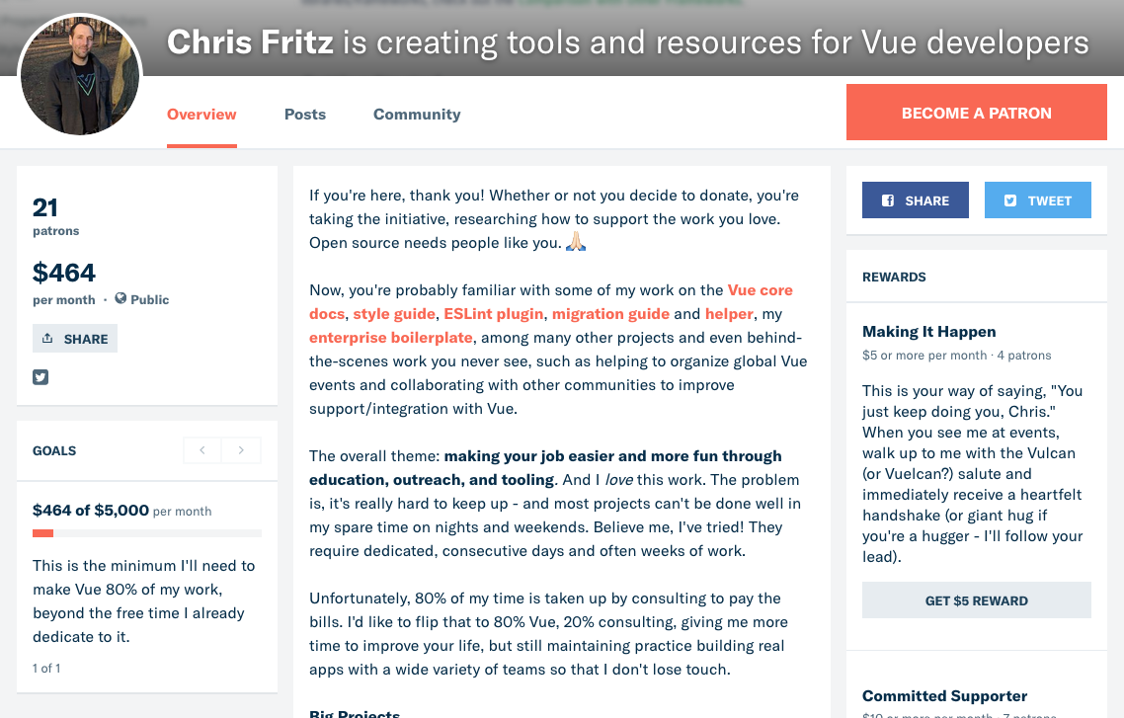
Docs roadmap
patreon.com/chrisvuefritz
vue

Slide 48
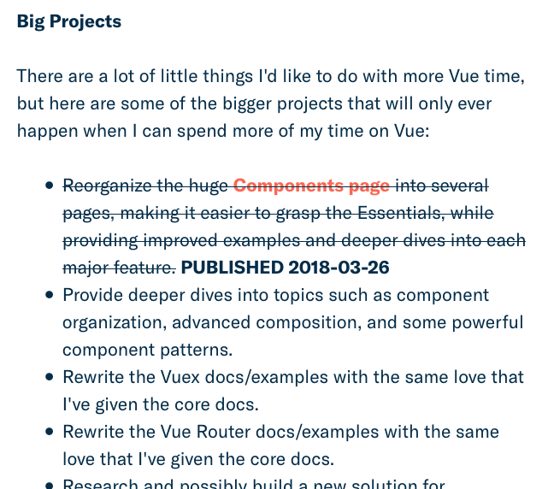
Components Rewrite!
Thanks to Cameron Adams the Vuesionary!!

Slide 49
github.com/chrisvfritz/7-secret-patterns
@chrisvfritz

