Slide 1
Voice Assistant Using Python
Balram
200150800007
Coe(A)

Slide 2
Table of content
What is python?
Project overview
Basic idea
Features
Project

Slide 3
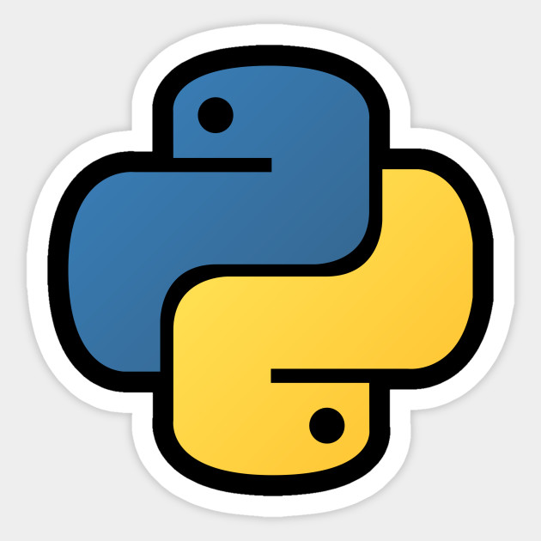
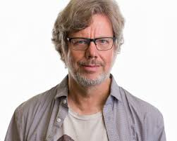
WHAT IS PYTHON?
Python is an interpreted, object-oriented, high-level programming language with dynamic semantic.
It was created by Guido van Rossum in 1991

Slide 4
Project Overview
Project Name | Voice Assistant
Define | This is a cmd based in python that includes basically make use of the pyttsx3,sppechrecognitionetc
Technologies Used | Python, speech recognition,pyttsx3,bueatifullsoup
IDE | Pycharm(Recommended)
Python version (Recommended): | 3.8 or 3.9

Slide 5
What Is Voice Assistant
A voice assistant is a digital assistant that uses voice recognition, language processing algorithms, and voice synthesis to listen to specific voice commands and return relevant information or perform specific functions as requested by the user
Examples of Voice Assistant:
Siri
Google
Cortana
Facebook “M”
Blackberry Assistant
Alexa

Slide 6
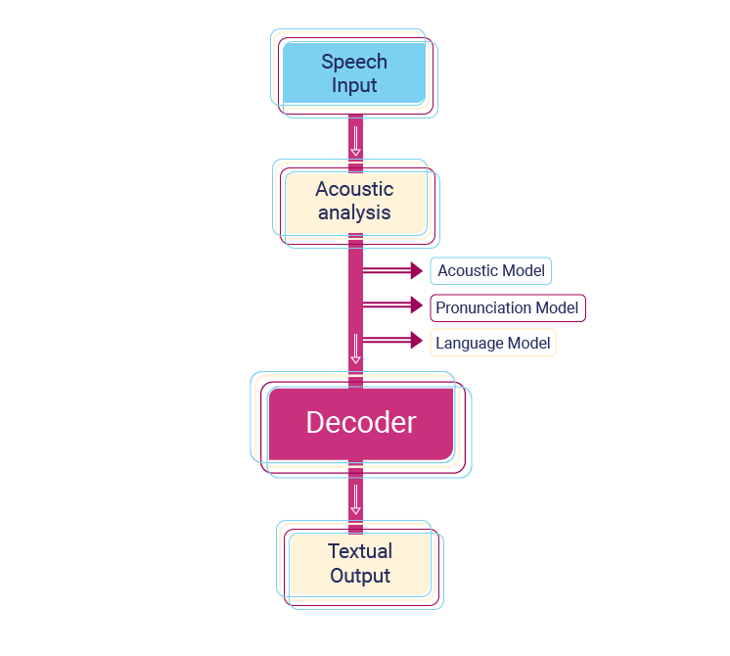
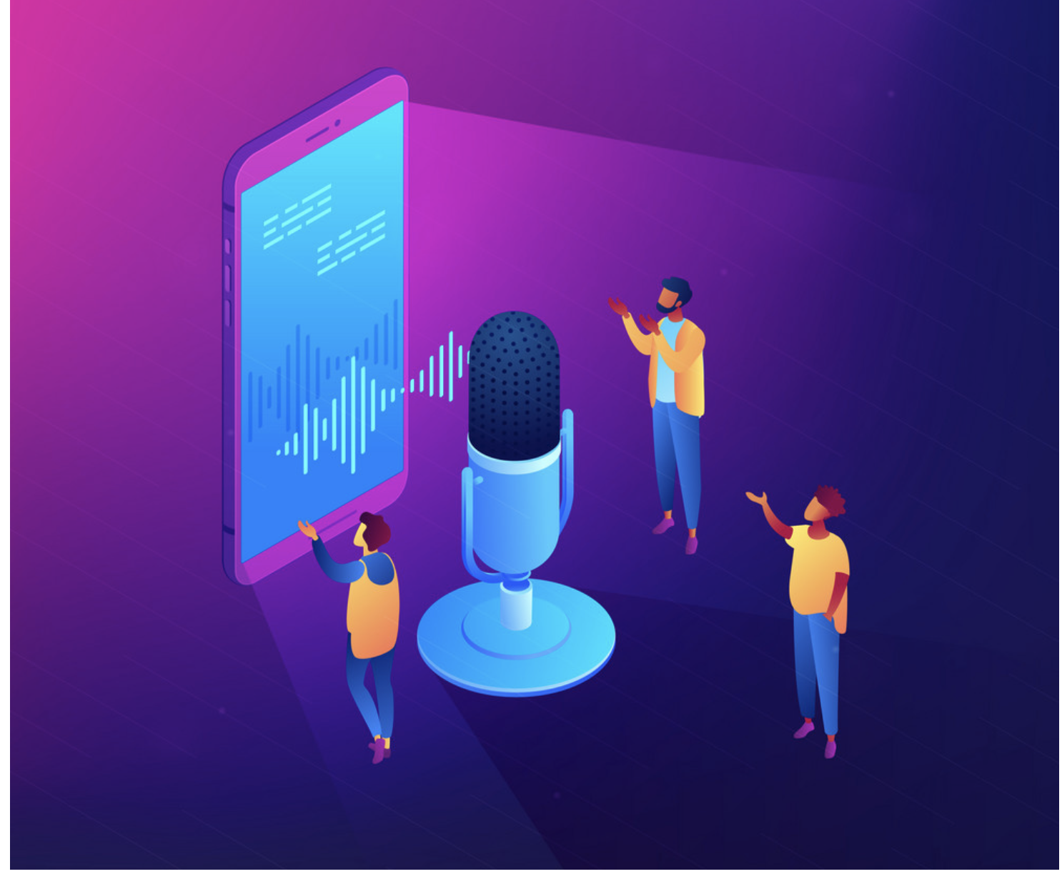
How Voice Assistant Works
Acoustic model
Pronunciation model
Language model

Slide 7
Features of Voice Assistant
Eradicates Language Barriers
Helps Streamline Operations
Saves Time by Automating Repetitive Tasks
Enables Smart Offices
Aids Hand-free Operation

Slide 8
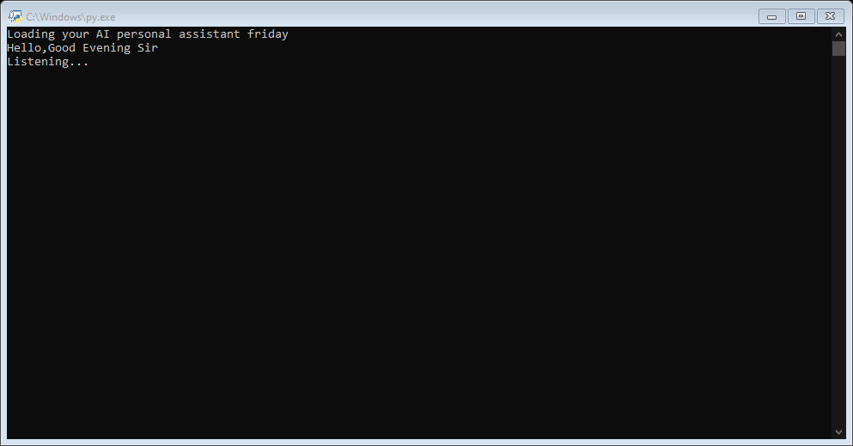
PROJECT :

