Slide 1
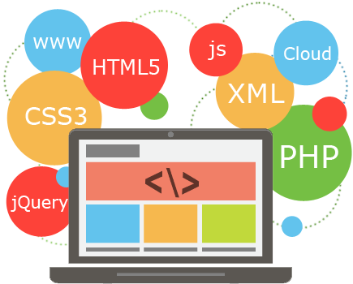
DEVVO
Whip your web development wits into shape for your next coding interview
A N.A.B.B. Product
Notes:
Slide 2&3 – Brit
Slide 4 – Amena
Slide 5&6 Noel
Slide 7 - Blake

Slide 2

Concept
A program to help aspiring and seasoned developers alike improve their web development skills and prepare for an interview in the field
Keep users active in interview preparation process via goal tracking and leaderboards
Consolidates resources
Name is a nod to popular task manager Trello with a developer twist - style followed naming convention
Notes:
A program to help web developers prepare for their next interview. Our tasks are designed to populate common programming concepts, and help developers by allowing them to brush up on familiar concepts, or review new learning resources
Successboards keep users active in accomplishing their preparation goals by tracking successful task completion
Prevents Google Fu fatigue by consolidating interview and review content into one application
Links directly to review resources, instructional videos, coding exercises, interview tips, and resume templates so the user can focus on content instead of the organizational process
Name is a nod to popular task manager Trello with a developer twist – with style choices that followed this naming convention

Slide 3

Motivation
Main goals: 1) Serve as a helpful resource or social good 2) Create a game or an concept that could be gamified 3) Produce a project to make our portfolio proud
Decided on an application that would help our peers, the larger web development community, and our own understanding of class materials
Novel approach
Notes:
Main goals: 1) Create something that could serve as a helpful resource or social good, with a scope size that was appropriate for our deadlines 2) Create a game or an concept that could be gamified 3) Produce a project to make our portfolio proud, and demonstrate a functional app that someone in our position could make use of
Decided on an application that would help our peers, the larger web development community, and our own understanding of class materials
We liked the idea of an interview prep site because it felt novel – we were unaware of other applications outside of bootcamps that provided interview prep and practice in a competitive way

Slide 4
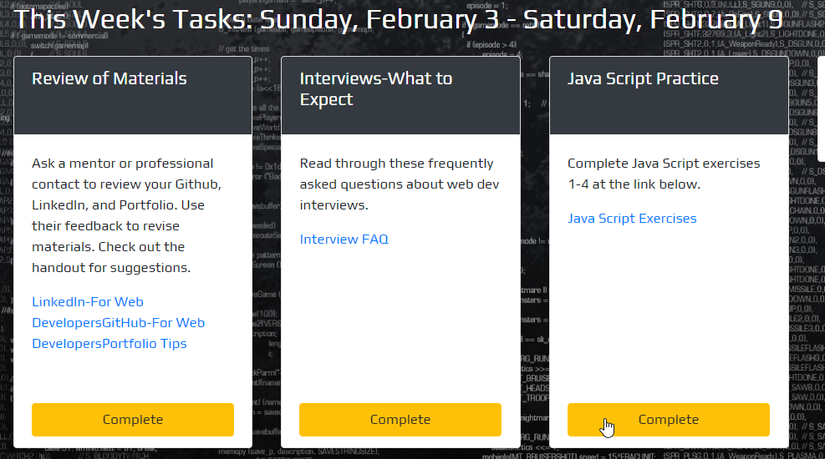
Design Process – Main Focus
UI in mind – playful, functional mobile-responsive interface is intended to be motivational and inviting
Gamifies the learning process
Limited tasks displayed at a time
Skill level options
Authentication
Notes:
Playful and functional interface is intended to be motivational, engaging, and inviting with user interaction in mind – mobile responsive
Front end feels clean, with smooth swipes on cards and visually appealing page interactions
Mechanisms like progress bars and successboards help users visualize goals
Successboards track completion dates of tasks, by category, against other developers
Task cards are limited to six on a page to avoid overwhelming user, which disappear and congratulate once complete
Skill level options provide additional content for new learners, allowing user to choose a route that fits their experience
Authentication allows unique user info to persist, allowing users to come back to their studies at any time – easy sign on/sign off

Slide 5


Slide 6
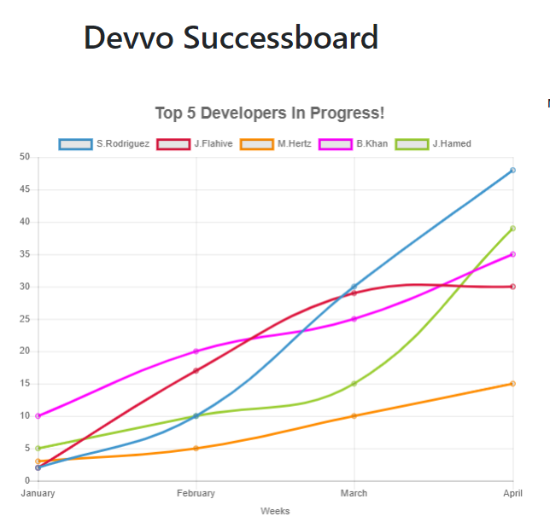
New Technologies
ChartJS
PopperJS
Nodemailer
DateJS
LoadingBarJS
ES Lint / Prettier
Hover CSS
Familiar technologies also used: Bootstrap, Node, jQuery, Handlebars, Dotenv, Firebase, Sequelize, Sequelize CLI
Notes:
ChartJS - flexible JavaScript charting for bar and line charts - provides clear visual distinction between datasets
PopperJS – manages poppers in web applications
Nodemailer – a module for Node.js applications to send emails
DateJS – date and time management
LoadingBarJS – open source progress bar builder
ES Lint – linter for identifying and reporting JS patterns
Hover CSS – dynamic animations for buttons

Slide 7
Future Directions
Scheduled weekly emails with progress and reminders
Custom content
Custom tasks (based on skill levels and specific technologies)
Timeline to track review completed tasks
Twitter stream with developer news
Google Calendar integration
Job board aggregator
Authentication options outside of Google
Copyright and monetize to make content profitable
Get Mark Mothersbaugh on board for more sound clips

