Slide 1
Your first Neural Network in PyTorch – An Introduction
03.09.2026
Alexander Kister, Simon Müller from VP.1 eScience

Slide 2
We will use existing code
https://github.com/BAMeScience/workshop_neural_nets/

Slide 3
What we will do today
(1) Learn the theory of Machine Learning and Neural Networks.
(2) Follow a simple Neural Network implementation and adapt yourself.
Key take-away:
Machine Learning, Neural Networks and how to use PyTorch to train and run a Neural Network

Slide 4
General approach to data centric modeling
What approach can/should we use?
Problem
What do we actually want to do and why?
Data
What data do we have?
How much data do we have?
Validation
Machine Learning might be one possible approach.
Highly dependent on available data. For new projects: think of this before starting!
How can we make sure that our model is any good?
Notes:
More emphasis on machine learning! When does it make sense, what can it do?
Data key point! They are not there out of thin air!

Slide 5



Specific example today
With enough data, Machine Learning is one (!) way to approach this.
For learning, data must include the image and the corresponding digit
Problem
We work for the postal service and get a lot of mail with handwritten postal codes
We want automatic sorting of letters according to their postal code
Data
Images of handwritten digits
Validation
Does our model identify the correct digit?
How can we ensure this?
We need a program to identify the digits from images
. . .

Slide 6

An illustration
Dataset
The program needs to predict the digit from new images
Image
Digit
1
?
3
Machine Learning is one (!) way to approach this.
3

Slide 7

Data creation
Please open paint and draw all digits of your postal code letter by letter
Save every letter as a new .png file
Save the images in your workshop project folder
How could we do the prediction and evaluation?

Slide 8
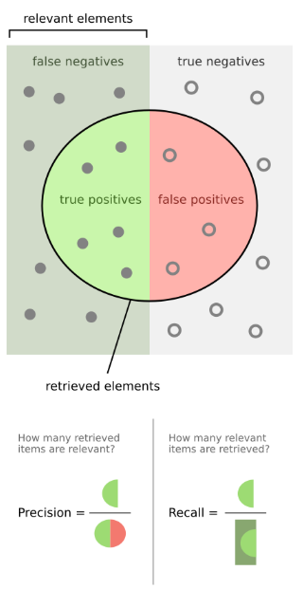
Confusion Matrix – Evaluation Metrics
Confusion matrices are common for classification
Predicted digit
 | 0 | 1 | 2 | 3 | 4 | …
0 | 971 | 0 | 2 | 1 | 2
1 | 0 | 1123 | 2 | 3 | 0
2 | 4 | 4 | 999 | 8 | 5
3 | 0 | 0 | 1 | 999 | 0
4 | 0 | 0 | 1 | 0 | 968
…
TP
TN
True digit
©wikipedia
FN
FP

Slide 9
Confusion Matrix – Evaluation Metrics
Confusion matrices are common for classification
Predicted digit
Normally, we aim for a combination of both, high precision and high recall, but often, one is more important
Questions in our example:
What values are good enough for automated postal code detection?
What is more important for us: higher recall or higher precision?
Do we have further constraints that can help us?
 | 0 | 1 | 2 | 3 | 4 | …
0 | 971 | 0 | 2 | 1 | 2
1 | 0 | 1123 | 2 | 3 | 0
2 | 4 | 4 | 999 | 8 | 5
3 | 0 | 0 | 1 | 999 | 0
4 | 0 | 0 | 1 | 0 | 968
…
TP
TN
True digit
FN
FP

Slide 10
Confusion Matrix – Evaluation Metrics
Confusion matrices are common for classification
Predicted digit
Metrics used often:
 | 0 | 1 | 2 | 3 | 4 | …
0 | 971 | 0 | 2 | 1 | 2
1 | 0 | 1123 | 2 | 3 | 0
2 | 4 | 4 | 999 | 8 | 5
3 | 0 | 0 | 1 | 999 | 0
4 | 0 | 0 | 1 | 0 | 968
…
Recall = TP / (TP + FN)
TP
Precision = TP / (TP + FP)
TN
Accuracy =
(TP + TN) / (TP + TN + FP + FN)
True digit
FN
F1 =
(2 x TP) / (2 x TP + FP + FN)
FP
Jaccard index =
TP / (TP + FP + FN)

Slide 11
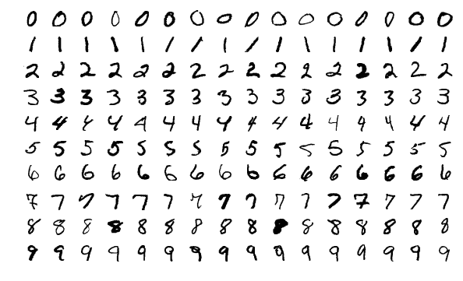
MNIST dataset for training for our example
Images and labels of 60.000 handwritten digits for training
10.000 images and labels for validation
Size of images: 28 x 28

Slide 12
PyTorch
Powerful Python package designed specifically for working with Neural Networks
Works with so-called tensors -> compatible with numpy
Easy usage with GPU (more specifically: NVIDIA GPU)
Handles all math (derivatives and chain rule!) internally in an efficient manner
Necessary building blocks of all basic Neural Network architectures included

Slide 13
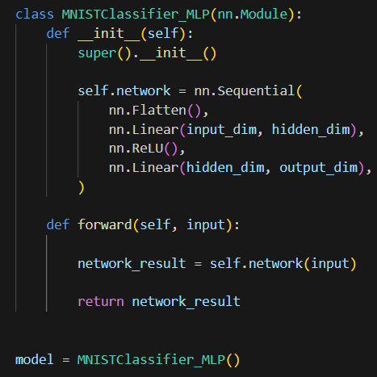
We create a new class for our model (nn.Module important!)
We need at least an __init__ and a forward methods
We stack the building blocks of the models architecture in the “__init__” method
We call the wanted blocks in the “forward” method
Notes:
Methods = functions that belong to objects or classes
Tracks Parameters: It automatically finds and tracks all weights and biases inside your layers.
Enables .to() and .cuda(): It lets you move your whole model and all its variables to a GPU with one command.
Manages Training Modes: It lets you switch between training and testing behavior using .train() and .eval().

Slide 14
makes everything trackable
All components of the network architecture are individual modules
Common to include the modules that make up the network in “__init__” (not strictly necessary!)
Sequential: container that stacks all modules and handles them according to their order
We call the container in forward
Notes:
nn.Modules are python classes that have internal attributes like self.weight or self.bias
these are tuned automatically with internal functions and do not have to be defined or given every time this module is called
Internally the modules will usually call their functional counterpart in the forward method somewhere.
Easier than using nn.functional.linear(), which would just be a function. But: more flexibility

Slide 15
Notes:
Questions:
What are input dimensions? 784
What are the output dimensions? 10
What are the hidden dimensions? arbitrary

Slide 16
Flatten
.
.
.
input_dim
Notes:
Questions:
What are input dimensions? 784
What are the output dimensions? 10
What are the hidden dimensions? arbitrary

Slide 17
values
-
+
.
.
.
Flatten
.
.
.
.
.
.
.
.
.
Linear
.
.
.
Linear: f(x) = xW
input_dim
hidden_dim
Notes:
Questions:
What are input dimensions? 784
What are the output dimensions? 10
What are the hidden dimensions? arbitrary

Slide 18
values
-
+
.
.
.
0
Flatten
.
.
.
ReLU
0
.
.
.
.
.
.
.
.
.
Linear
.
.
.
Linear: f(x) = xW
ReLU: f(x) = max(0,x)
input_dim
hidden_dim
Notes:
Questions:
What are input dimensions? 784
What are the output dimensions? 10
What are the hidden dimensions? arbitrary

Slide 19
values
-
+
.
.
.
0
0
Flatten
1
.
.
.
ReLU
2
0
3
.
.
.
.
.
.
4
.
.
.
.
.
.
.
.
.
Linear
Linear
9
.
.
.
Linear: f(x) = xW
input_dim
hidden_dim
output_dim
Notes:
Questions:
What are input dimensions? 784
What are the output dimensions? 10
What are the hidden dimensions? arbitrary

Slide 20
Notes:
nn.Modules are python classes that have internal attributes like self.weight or self.bias
these are tuned automatically with internal functions and do not have to be defined or given every time this module is called
Internally the modules will usually call their functional counterpart in the forward method somewhere.
Easier than using nn.functional.linear(), which would just be a function. But: more flexibility

Slide 21
We need to call the defined container(s) in the forward function
Notes:
nn.Modules are python classes that have internal attributes like self.weight or self.bias
these are tuned automatically with internal functions and do not have to be defined or given every time this module is called
Internally the modules will usually call their functional counterpart in the forward method somewhere.
Easier than using nn.functional.linear(), which would just be a function. But: more flexibility

Slide 22
We need to call the defined container(s) in the forward function
The input in the forward function is our model input
Defines input dimensions
We could also call everything individually (see Jupyter Notebook)
Notes:
nn.Modules are python classes that have internal attributes like self.weight or self.bias
these are tuned automatically with internal functions and do not have to be defined or given every time this module is called
Internally the modules will usually call their functional counterpart in the forward method somewhere.
Easier than using nn.functional.linear(), which would just be a function. But: more flexibility

Slide 23
When we now create an object of this class, we can use this object to call the model with the input

Slide 24
How do we now train and use this?

Slide 25
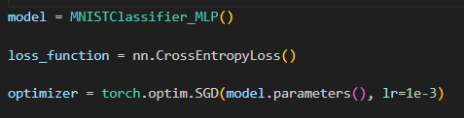
PyTorch - Training
First, we need to:
Create an object that holds our architecture and the forward pass
Define the loss function thats applicable for our problem (here: cross entropy)
Define the optimizer function that updates the weights according to the gradients. We need to set the learning rate (lr)!

Slide 26
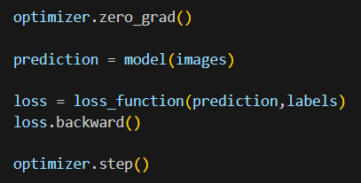
PyTorch - Training
Then, we can do the training. For one step of training, we need to call:
We need to set gradients from previous batch to 0 before calculating gradients for the current batch
We call the model with the training samples as input
We calculate the loss using the defined loss function
We calculate the gradients for the current loss via backpropagation
We update the models training parameters according to the gradients and the optimizer function
Notes:
We train for multiple “epochs” -> one epoch runs with batches
Epoch: One full cycle where the model sees every single sample in the training data. Training usually requires multiple epochs so the model can learn patterns accurately.
Batch: A specific portion of the dataset chosen to compute predictions and update internal model parameters.
Batch Size: The number of data samples contained inside a single batch.
Iteration (Step): The single process of feeding one batch through the model and updating its weights. [1, 2, 3, 4, 5, 6, 7, 8]

Slide 27
PyTorch - Training
We need to iterate over multiple epochs
Every epoch is trained using batches
One batch contains one or multiple samples
Larger batches allow faster training
Notes:
We train for multiple “epochs” -> one epoch runs with batches
Epoch: One full cycle where the model sees every single sample in the training data. Training usually requires multiple epochs so the model can learn patterns accurately.
Batch: A specific portion of the dataset chosen to compute predictions and update internal model parameters.
Batch Size: The number of data samples contained inside a single batch.
Iteration (Step): The single process of feeding one batch through the model and updating its weights. [1, 2, 3, 4, 5, 6, 7, 8]

Slide 28
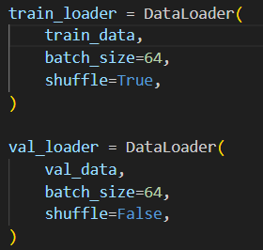
PyTorch - Dataloader
We need to iterate over multiple epochs
Every epoch is trained using batches
One batch contains one or multiple samples
Larger batches allow faster training
PyTorch creates batches with the DataLoader function
In our case: Dimensions are then (64, 1, 28, 28)
Notes:
We train for multiple “epochs” -> one epoch runs with batches
Epoch: One full cycle where the model sees every single sample in the training data. Training usually requires multiple epochs so the model can learn patterns accurately.
Batch: A specific portion of the dataset chosen to compute predictions and update internal model parameters.
Batch Size: The number of data samples contained inside a single batch.
Iteration (Step): The single process of feeding one batch through the model and updating its weights. [1, 2, 3, 4, 5, 6, 7, 8]

Slide 29
PyTorch – After training: Inference
For inference, we only need to call the trained model
We call the trained model to predict new instances of data

