Slide 1
RECODe – Crash Course On Research Coding & Development

Slide 2

The trainers
José Pizarro Blanco (VP.1): SHORT BACKGROUND IMAGE
Ingo Breßler (6.5): SHORT BACKGROUND IMAGE
Simon Müller (VP.1): Background in Geosciences. Used Python to pre-process, analyse or model data in various fields.

Slide 3
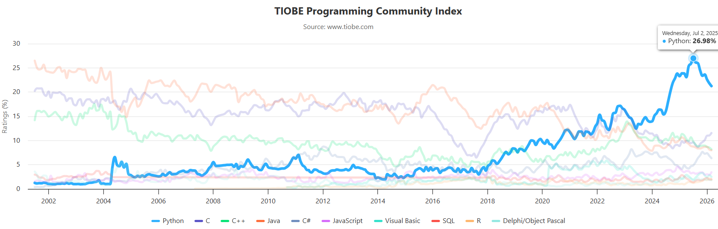
Why Python?

Slide 4
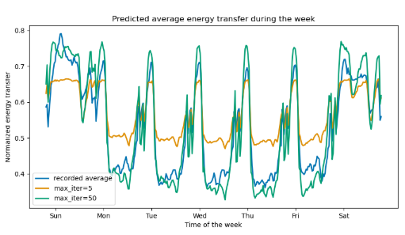
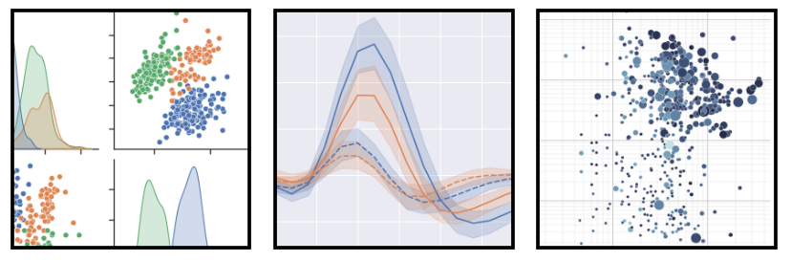
Why Python?
Very popular in scientific programming
Huge number of available packages for:
Easy handling of all kinds of Data Formats
Beautiful Data Visualization
Off the shelf Data Modeling
Deep Learning

Slide 5
What to expect from the course?
Covers most important aspects of Python programming.
Module 1: basics of the foundations of Python Coding
Module 2: introduction into version control with Git and GitHub
Module 3: Large Language Models (LLMs) for coding assistance
Module 4: practical guidance on packaging and distributing scientific software
Module 5: setting up productive development environments.

Slide 6
What to expect from the course?
Covers most important aspects of Python programming.
Module 1: basics of the foundations of Python Coding
Module 2: introduction into version control with Git and GitHub
Module 3: Large Language Models (LLMs) for coding assistance
Module 4: practical guidance on packaging and distributing scientific software
Module 5: setting up productive development environments.

Slide 7
Plan for today
Setting up the Python and Development Environment:
Installing VSCode, Python via Miniforge3, and checking the GitHub accounts
Configuring VSCode for Python development
Creating and managing virtual environments (conda, venv)
Jupyter Notebooks introduction

Slide 8
Useful ressources
NEEDS TO BE FILLED

