Slide 1
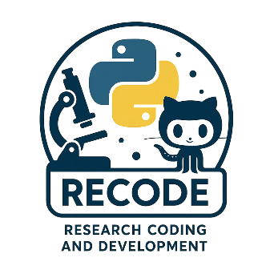
RECODe – Crash Course On Research Coding & Development
Welcome to RECODE

Slide 2



The trainers
José M. (Chema) Pizarro (VP.1)
Physics | Research Data Manager | Research Software Engineer
+10 years coding in Python, Fortran, C, C++, JS, GitHub...
Ingo Breßler (6.5)
Computer Engineering | Research Software Developer | Data Scientist
+25 years coding in Python, C/C++, Tcl/Tk, Shell/Bash, JS, ...
Simon Müller (VP.1)
Geoscience | Data Scientist
+XX years coding in Python for pre-processing, analyze, model data

Slide 3
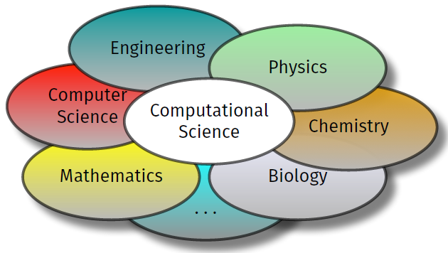
Why this course?
Coding is key for supporting scientific activities: analysis, pre- and post-processing, simulations, AI
Beyond academic life: basic to find a job (they will not hire you if you don't know these concepts)
Very affected by AI coding assistants --> productivity and impact increases if you know how to use these tools
But programming training often missing -> often not in curricula in Natural Science courses (or at least, not modern training)

Slide 4
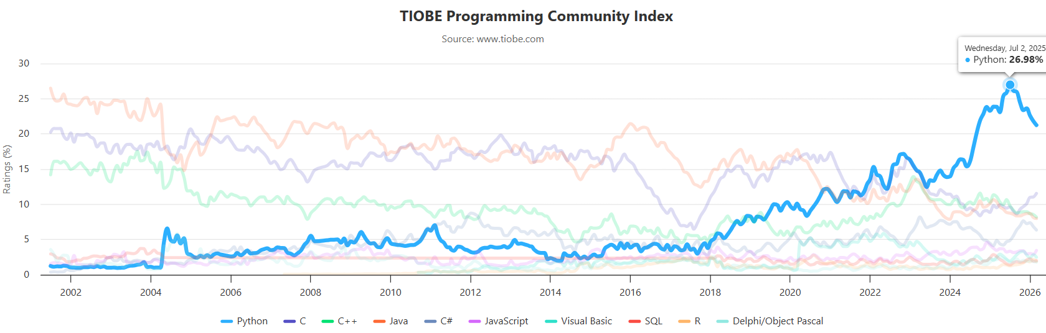
Why Python?

Slide 5
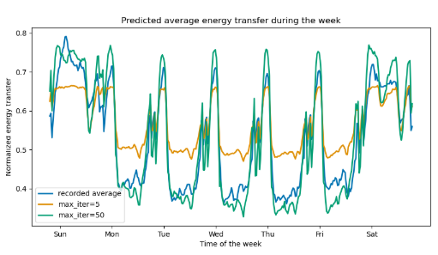
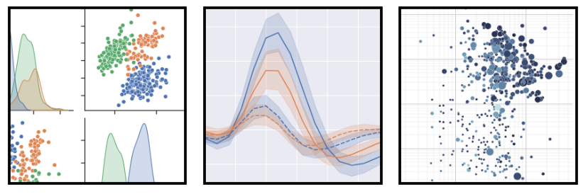
Why Python?
Easy language to start with
Very popular in scientific programming
Huge number of available packages for:
Easy handling of all kinds of Data formats
Beautiful Data visualization
Data modeling
Machine Learning / LLM applications
Easy to learn / use with GPTs
Easy to create nice, useful applications

Slide 6
What to expect from the course?
Covers most important aspects of basic and modern Python programming.
Module 1: Foundations of Python Coding
Module 2: Introduction into version control with Git and GitHub
Module 3: Large Language Models (LLMs) for coding assistance
Module 4: Packaging and distributing scientific software
Module 5: ...

Slide 7
What to expect from the course?
Each module is divided in 1h30min Sessions
You are welcome to ask (don't be afraid!)
In the Teams channel
Directly to us
We will go from:
Very basic stuff (what is a variable in Python, how to create a function),
to intermediate usage (class design, libraries),
and finish with advanced concepts (creating a Python package, good software design, modern techniques, AI-assisted coding)

Slide 8

What to expect from the course?
Use LLMs whenever you need or something is unclear.
Main goal of this course:
Give you the minimal, yet necessary skills to critically assess any AI code-assistant tool

Slide 9

What to expect from the course?
You can find more detailed information (incl. these slides) in the GitHub repository

Slide 10
RECODE Programming Course Overview
Project-oriented training for practical skills in scientific software development:
For maintainable, reusable, production-ready code
Teaches Python • Git/GitHub • AI-assisted coding • Packaging • Dev. Environments
Enable the participants to:
develop functional applications independently
structure code professionally, use version control
work with modern AI coding assistants
deliver end-to-end solutions: design → build → test → publish
For beginners/students to intermediate learners and professionals upskilling into software development
Learning in interactive hands-on sessions, weekly (~2h each)
A modular format combining theory, live coding, and project work

