Slide 1

RECODe – Crash Course On Research Coding & Development
Welcome to RECODE

Slide 2




The trainers
José M. (Chema) Pizarro (VP.1)
Physics | Research Data Manager | Research Software Engineer
+10 years coding in Python, Fortran, C, C++, JS, GitHub...
Ingo Breßler (6.5)
Computer Engineering | Research Software Developer | Data Scientist
+25 years coding in Python, C/C++, Tcl/Tk, Shell/Bash, JS, ...
Esma B. Boydas (VP.1)
Quantum Chemistry | Data Scientist | Research Software Engineer
+5 years coding in Python, TypeScript, Fortran, C++, Shell/Bash, Git...
Simon Müller (VP.1)
Geoscience | Data Scientist
+6 years coding in Python for pre-processing, analyze, model data

Slide 3
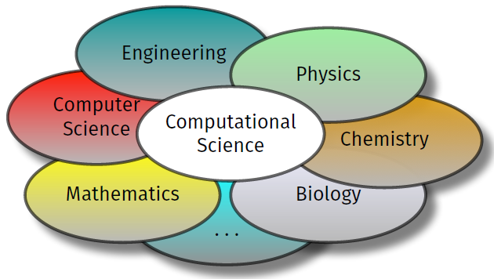
Why this course?
Coding is key for supporting scientific activities: analysis, pre- and post-processing, simulations, AI
Beyond academic life: basic to find a job (they will not hire you if you don't know these concepts)
Very affected by AI coding assistants --> productivity and impact increases if you know how to use these tools
But programming training often missing -> often not in curricula in Natural Science courses (or at least, not modern training)

Slide 4
Why Git?
Track what changed, when, and why → versioning → reproducibility
Rollback to previous working versions
Collaborate with others (no exchange of „analysis_final_final_v2_thistimeistrulyfinal_maybenot_final_v3.py“ via emails)
Make your research code easier to share, reuse, cite, and maintain
Modern software projects require knowing: branches, issues, pull requests, review, releases, automation

Slide 5
And why GitHub?
Most used Git online platform: remote repositories, collaboration
Connected with many services (e.g., PyPI, VSCode, …)
Many functionalities in the free tier for public repositories:
GH actions are free (for public repositories)
GH Copilot for some changes
Free GH pages for documentation
Easy to learn and to use
All open source packages are there
Social network-like system, but without the issues of social networks (no fascists controlling this either)!

Slide 6
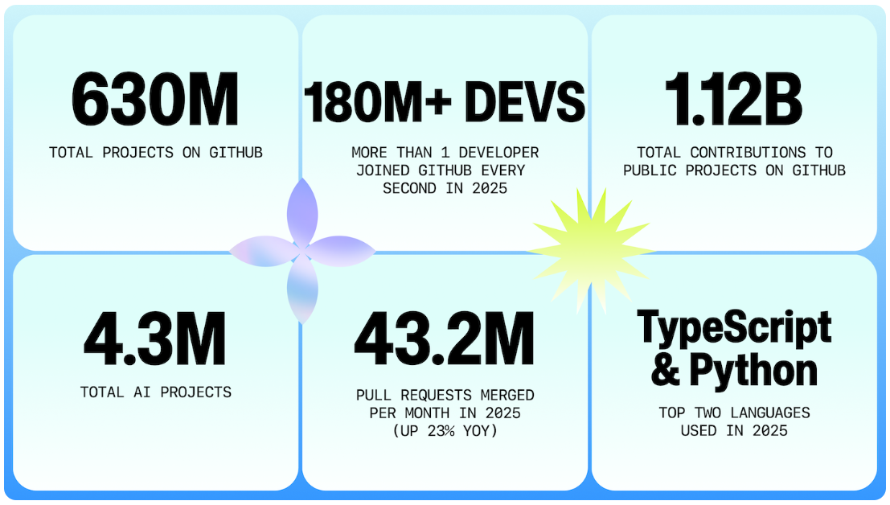
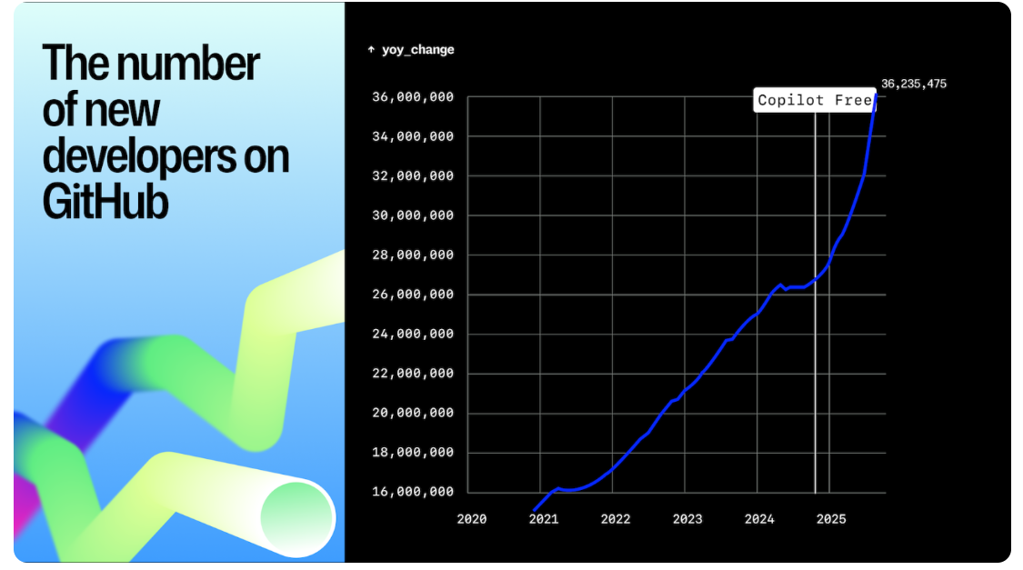
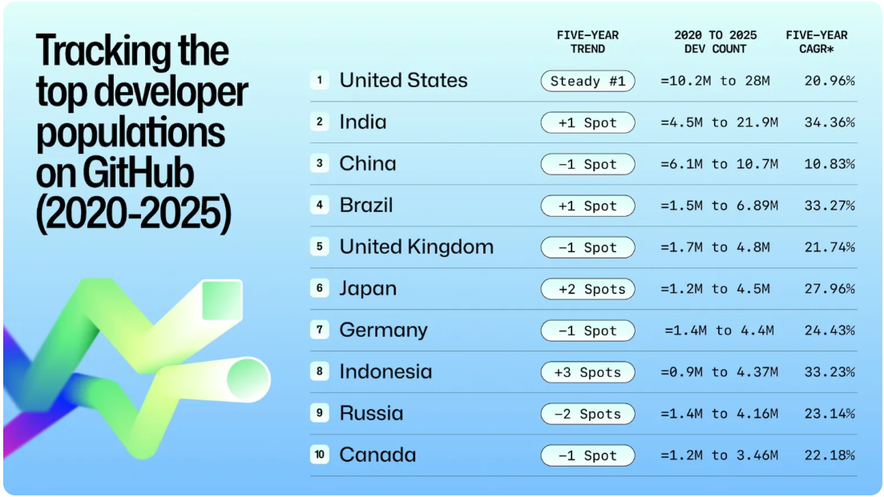
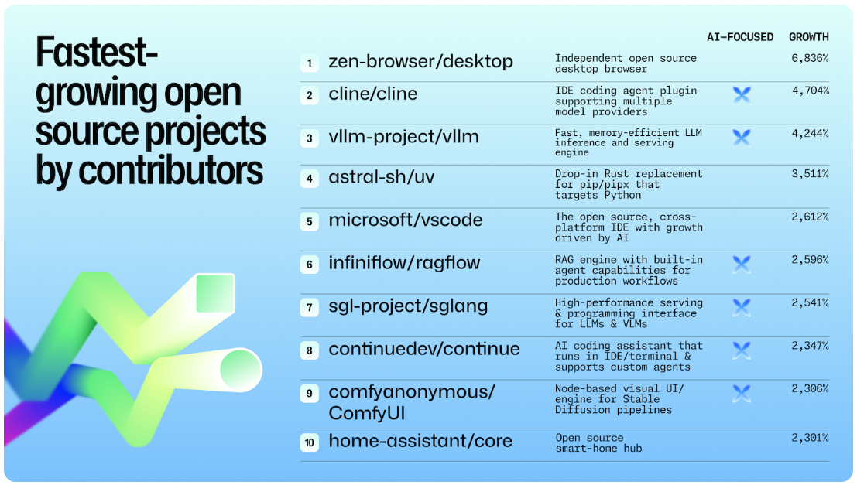
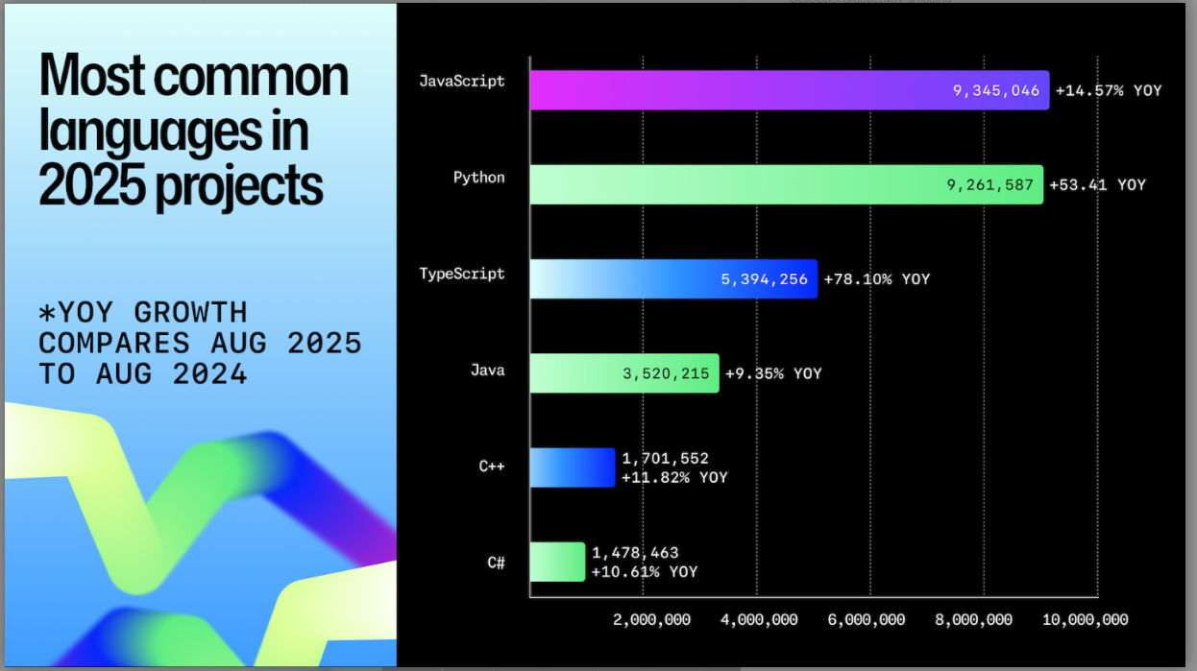
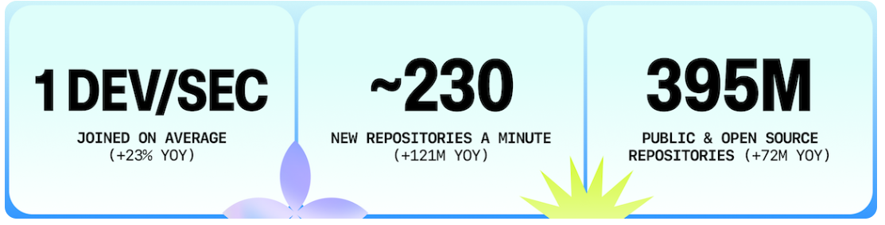
Why Git and GitHub?

Slide 7
What to expect from the course?
Covers most important aspects of basic and modern Python programming.
Module 1: Foundations of Python Coding (finished in July 2026 | to be repeated next year)
Module 2: Introduction into version control with Git and GitHub
Module 3: Large Language Models (LLMs) for coding assistance
Module 4: Packaging and distributing scientific software
Module 5: ...

Slide 8
What to expect from the course?
Each module is divided in 1h30min Sessions
You are welcome to ask (don't be afraid!)
In the Teams channel
Directly to us
We will go from:
Very basic stuff (what are branches in GitHub, how to create a repository…),
to intermediate usage (issues and pull requests, GitHub workflow…),
and finish with advanced concepts (GitHub actions, automation, rebasing…)

Slide 9

What to expect from the course?
Use LLMs whenever you need or something is unclear.
Main goal of this course:
Give you the minimal, yet necessary skills to critically assess any AI code-assistant tool

Slide 10

What to expect from the course?
You can find more detailed information (incl. these slides) in the GitHub repository

Slide 11
RECODE Programming Course Overview
Project-oriented training for practical skills in scientific software development:
For maintainable, reusable, production-ready code
Teaches Python • Git/GitHub • AI-assisted coding • Packaging • Dev. Environments
Enable the participants to:
develop functional applications independently
structure code professionally, use version control
work with modern AI coding assistants
deliver end-to-end solutions: design → build → test → publish
For beginners/students to intermediate learners and professionals upskilling into software development
Learning in interactive hands-on sessions, weekly (~2h each)
A modular format combining theory, live coding, and project work

