Slide 1
Pybis training – part I (beginner)
24.01.2024

Slide 2
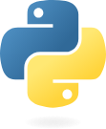
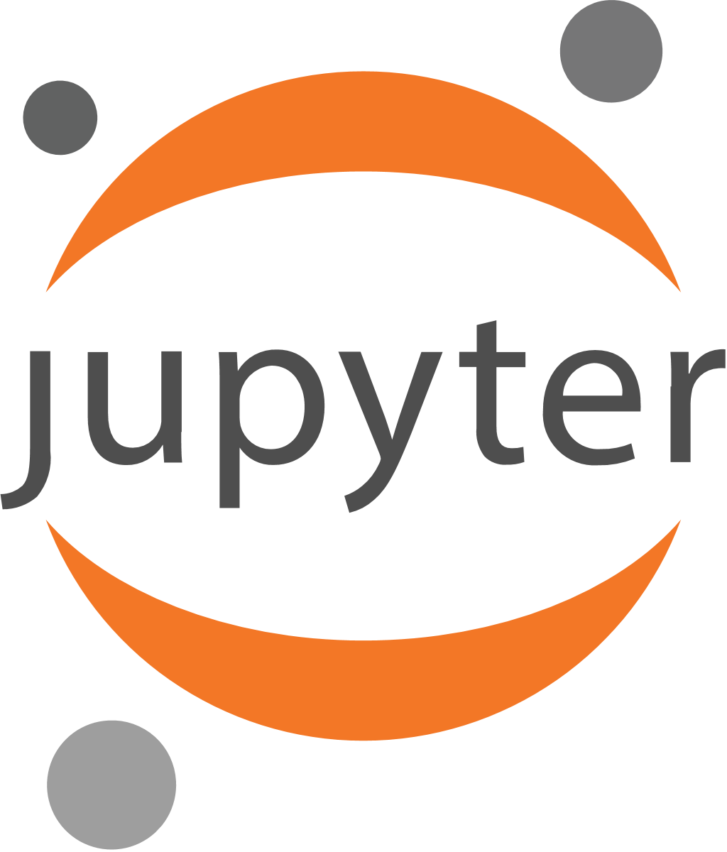
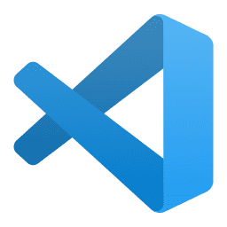
Prerequisites / Installation Overview
Python: programming language and environment
Required:
Python
Python Package pyBIS
Highly Recommended:
JupyterLab for interactive use
Recommended:
MS Visual Studio Code (or other IDE) for development
Python module/package: package of code for a specific purpose to be used in python (may depend on other packages)
pyBIS: python package for interaction with openBIS
IDE: Integrated Development Environment – code editor and tools for software development

Slide 3
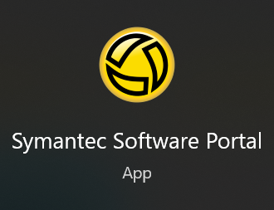
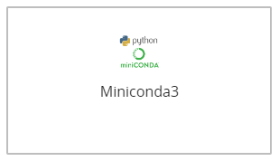
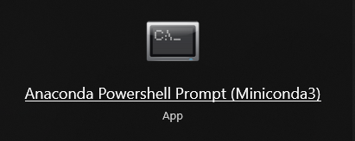
Prerequisites / Installation Python with Anaconda / Miniconda
Preferred method:
Request installation of Miniconda3 in the Software Portal
Wait for installation to finish
Check if Anaconda Powershell Prompt is available
Anaconda: software system to install and manage python and python packages and it's dependencies (not free for BAM)
Miniconda: stripped down version of Anaconda without graphical tools - free to use at BAM!
Hint: manual Miniconda/Anaconda or pure python installations may also work, but on the BAM client the Software Portal should be used to install python

Slide 4
Prerequisites / Installation pyBIS package
Open Anaconda Powershell Prompt, a terminal window with a command prompt will appear: (base) PS C:\Users\mmusterm>
Type pip install pybis and press ENTER.
The pybis package and ist dependencies will be installed. This may run for some seconds or even minutes, depending on your system and internet connection, please be patient
After installtion there will be output like Successfully installed… and the command prompt.
Hint: if the newest/default version of pyBIS has some errors, try enforce installation of a specific version:
pip install pybis=1.36.3
Expert Hint: if you already use Anaconda you may create a special environment just for the datastore without changing your existing environment(s):
conda create dst python=3.11
conda activate dst
pip install pybis
Don’t forget to activate this environment when you need it.

Slide 5
Prerequisites / Installation JupyterLab package
JupyterLab: browser-based system to handle code, documentation and results in one document (a.k.a. Notebook).
Open Anaconda Powershell Prompt, a terminal window with a command prompt will appear: (base) PS C:\Users\mmusterm>
Type pip install jupyterlab and press ENTER.
The jupyter-lab package and its dependencies will be installed. This may run for some minutes, depending on your system and internet connection, please be patient
After installtion there will be output like Successfully installed… and the command prompt.
Jupyter: a large software ecosystem that deals with notebooks (Jupyter-Notebooks, Jupyter-Hub, JupyterLab, JupyterLab-Desktop, …).
Hint: there is a JupyterLab extension for openBIS (jupyterlab-openbis). Unfortunately it is not compatible with recent JupyterLab versions. Pleas do not try to install it!

Slide 6
Python Interpreter How to start python … and how to get out again…
Open Anaconda Powershell Prompt, a terminal window with a command prompt will appear: (base) PS C:\Users\mmusterm>
Enter python, some version information and a typical python prompt will appear: >>>
Enter print(“Hello“), the output Hello will appear
Enter exit(), the python system will quit.
Congratulations! You just started python, executed a command and managed to exit from python in a clean way!
As this is not a python tutorial we will not show more of this.
If you need to learn python you will find a lot of tutorials in the web.
You will find a lot of python tutorials in the web. If in doubt use the official source to learn the python basics:
https://docs.python.org/3/tutorial/

Slide 7
PyBIS – the Bare Minimum Communicate with openBIS in five lines
Please note the ELN analogy:
Instead of opening a browser we open python and load pyBIS.
Rather than opening a tab and entering the URL we create an Openbis-object with the URL. This object o now corresponds to the browser tab – a handle to interact with a specific server. But in both cases we have to login first. After login this tab/object is ready to perform multiple actions – until we logout.
Open python again (now you know how to do it) and enter the following lines, one after another. from pybis import Openbis
o = Openbis('https://schulung.datastore.bam.de')
o.login('mmusterm', 'bamisgreat')
print(o.get_spaces())
o.logout()
The first line loads code from a package (pybis) and makes it available (Openbis is now defined and usable). The second line connects to an openBIS instance using the URL and stores the connection in the object o. The third line uses this connection and performs a login on the server, the connection is now ready to perform actions. In the next line a list of spaces is requested and printed (just an example action). At the end a logout is perfomed.
Entering cleartext passwords is not a good idea. Don’t worry, we will learn better methods later.

Slide 8
PyBIS – Executing Scripts Automation
If you need to develop and run scripts we recommend using an IDE like MS Visual Studio Code, which offer a lot more developer tools than simple text editors.
Just copy the five lines of code into a plain text file. You can use something like Windows Editor, Notepad, Notepad++ or similar. Save this file as pybistest.py in your Documents folder.
Open Anaconda Powershell Prompt and run the following command:
python Documents\pybistest.py
Now you can edit the code file (e.g. replace get_spaces with get_objects) and run it again, using the same command.

Slide 9
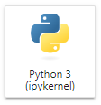
PyBIS – JupyterLab Interactive work with notebooks
Notebooks - combining advantages of interactive and scripted usage
Easy editing
Formatted output (partially)
Execute in different order
Add Documentation
Results may be included
Client-Server-Architecture
Collaboration (via plugin)
Open Anaconda Powershell Prompt
Enter jupyter lab
After some seconds a browser window will appear
Create a new Notebook using the following button unter Notebook
Copy the same five lines from the example above into the cell and press CTRL+ENTER (STRG+ENTER)
For a complete introduction to JupyterLab read the section GetStarted at https://jupyterlab.readthedocs.io/

Slide 10
PyBIS – JupyterLab More interactive work with notebooks
Some basics before we advance to the example Notebook:
Splitting code in cells
Executing in different orders
Nicer output without print()
Use Markdown cells for comments, documentation, and hierarchical structure
Hint: JupyterLab offers more than just Notebooks, there are also command line interfaces, text editors and much more.
Expert Hint: Jupyter is widely known as a Python tool, but a lot of other programming languages can be used within Jupyter.
If you already have code in MATLAB, R, Julia or another language you might try to migrate it to a jupyter notebook.

