Slide 1



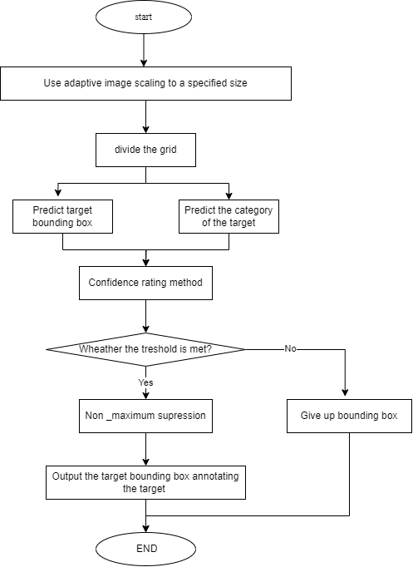
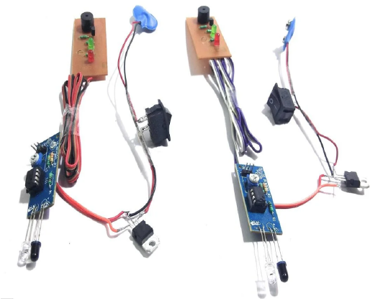
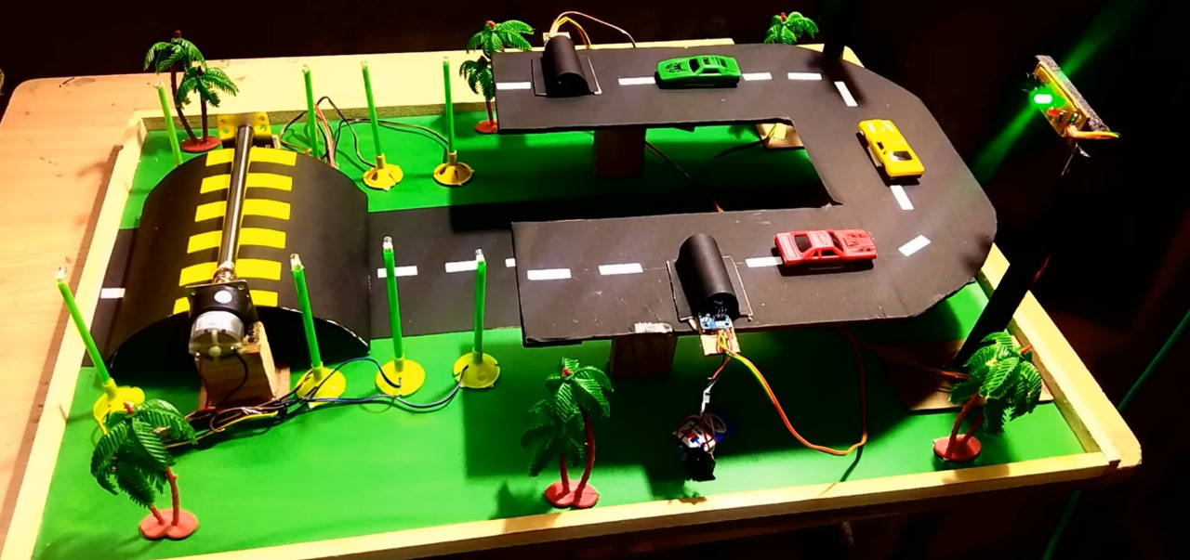
ACCIDENT PREVENTION AT STEEPY AREA
Department of Computer Science and Design
School of Computing
Minor Project-1
ABSTRACT
Solution
RESULTS
Technology Stack
This project aims to develop aIn the developing countries there are many dangerous roads where accidents and
causes very lethal effects now a day. If we talk about dangerous roads in the world
then all of them are mountain roads, T roads, narrow roads. Some mountain roads are
narrow, having many curves and very tight, this cause of the most hazards.Vehicle accident prevention system can be crucial step inaccident safety on hilly and mountain roads. That have recognized the past, thousands of accidents and death on mountain road, some even fall of the cliff and after that can not view even be traced.
Terrain Analysis: Implement algorithms or models that can analyze steep and rugged terrains to better understand the challenges posed by the environment.
Adaptive Detection: Modify the human detection module to adapt to the specific features of the steep landscape, considering variations in elevation, irregular surfaces, and potential obstacles.
Search and Rescue: Consider applications related to search and rescue missions in mountainous or steep areas where the system can assist in identifying individuals in distress.
Navigation for Robotics: If applicable, adapt the system for autonomous robotic systems operating in challenging terrains.
Posture Estimation: Enhance the anomaly detection module by incorporating advanced pose estimation techniques that can accurately capture human postures in steep environments.
Terrain-specific Rules: Define anomaly rules considering the unique aspects of accidents in steep areas. For instance, a sudden change in posture or a fall might be considered an anomaly in such contexts.
The project's success provides a solid foundation for future refinements and enhancements. Continuous improvements in algorithms, integration of additional data sources, and adaptation to new technologies can further elevate the system's performance and applicability.
Versatility for Security and Surveillance:
Beyond emergency response, the system's capabilities extend to security and surveillance applications, offering a versatile solution for monitoring and addressing incidents on roadways.
The project employs a versatile technology stack, featuring computer vision libraries like OpenCV and TensorFlow for image processing. Deep learning frameworks, such as PyTorch and TensorFlow, drive state-of-the-art object detection models like YOLO and Faster R-CNN. Advanced tracking algorithms like the Kalman filter and SORT ensure robust target tracking despite occlusions. Machine learning techniques, including CNNs and RNNs, enable precise anomaly detection, collectively forming the foundation for robust outdoor human target acquisition and behaviour analysis.
Figure 1. DESIGN INPUT
Figure 2. FINAL VIEW OF THE PROJECT.
DEPENDENCIES
USECASES
TEAM MEMBER DETAILS
The use cases for our system are broad and varied, given its ability to Accidents at steepy area. Here are a few examples
Traffic Management Systems.
Emergency Response Services.
Law Enforcement and Forensic Analysis.
Fleet Management for Autonomous Vehicles.
The dependencies for our project include OpenCV, NumPy, and a pre-trained model such as YOLO, SSD, or Faster R-CNN. These dependencies can be installed using pip.
The show stopper for our project is the availability of a suitable dataset for training and testing the system. The dataset should be large and diverse enough to ensure that the system can detect Accident in a wide range of outdoor operational scenarios. Additionally, the dataset should include examples of human behaviour that constitute an anomaly so that the anomaly detection module can be trained effectively. Obtaining such a dataset can be challenging and time-consuming, but it is essential for the success of your project.
[KORRA VAMSHI ,VTU19677,9948139186]
[BANDI ANOD KUMAR REDDY,VTU20428,6302797874]
[B.SHAHEED,VTU20415,7396476851]
ACKNOWLEDGEMENT
Dr.K.Seethalakshmi /Associate Professor
9840017225
Seethalakshmi@veltech.edu.in
Flow Chart1:Detecting the Accidents

