Slide 1
BANDI SREEKUMAR
KEYLOGGER AND SECURITY
3/21/2024 Annual Review

Slide 2
KEYLOGGER
(An art of capturing the keystrokes)
3/21/2024 Annual Review

Slide 3


AGENDA
To know the functionality of the keylogger.
Implementation of the keylogger with python programming.
To know the advantages and disadvantages of the keylogger.
To understand Mitigation techniques to avoid keylogging.
By the end of this project, we can understand the pro’s and con’s of the keylogger and its implementation.
3/21/2024 Annual Review

Slide 4

PROBLEM STATEMENT
1) PROBLEM
To develop a keylogger which can’t be detected by the firewall and antivirus software's.
2) BACKGROUND
Key-logger is wonderful tool, which is used by a pen-tester or an attacker to capture the live keystrokes, which are done by the victim/user.
3) RELEVANCE
Mostly, in an malware attack the attacker try to gain the access of victim’s keyword by injecting a malware in his system.
The scop of this keylogging may occurs when a user install any software/drivers from the unknow sources. Which result the attacker to gain access to the victim machine.
4) OBJECTIVE
The main theme is to capture the keystrokes done by the user.
Storing the captured keystrokes in the format of text and Json file(which stores the keyboard operations like pressed or released)
3/21/2024 Annual Review

Slide 5

PROJECT OVERVIEW
Developing a keylogger program ,which is GUI based application we can run it by simply pressing “START” in the GUI and similarly for “STOP”.
When the keylogger is running, it will capture all the keystrokes which were happened on they keyboard.
Which gives a clear picture on what we are entering in any search fields and moreover it store the captured keystrokes in files.
In the output of the operation, we have two files in the folder:
1)key-logger.txt
2)key-logger. Json.
First file is a text file, which stores the keys pressed on the keyboard and second file store the actions done by the keyboard like key pressed ,released or hold.
When the “STOP” button is pressed, the two files will be saved in the active directory specified.
3/21/2024 Annual Review

Slide 6

WHO ARE THE END USERS?
The End-User’s of this projects are:
Cybersecurity Enthusiastic: These guys most of script kiddie’s, they are very much interested to do some stuff in order to become an ethical hackers. In their learning process, they may come across these types of projects, which may boost their skills in cyber security.
Cybersecurity Researcher: Mostly a security researcher is a person, who look after the company security . As these peoples do keylogging to their employee, with the admin permission to monitor the employee activity.
Parental-Control: Tech parents, who were busy with their works mostly do these kind of stuff to their kids to monitor the online activity. In order to protect their kids from harmful websites, they make sure that their kids are in a right path.
3/21/2024 Annual Review

Slide 7

YOUR SOLUTION AND ITS VALUE PROPOSITION
The result of the keylogger is constant and static . As it make sure that it capture all the keys accurately, when we use digits, characters and special symbols.
The program gives us the 100% accuracy and capture the special symbols also.
The model can bypass the antiviruses and moreover, the windows defender can’t detect the advanced program.
It can be access through the remote server also. The captured keystrokes can be sent to the attacker, without knowing the users.
Simply by importing some modules and modifying the code, will results the program to run as per the attacker’s wish.
3/21/2024 Annual Review

Slide 8

THE WOW IN YOUR SOLUTION
My program can’t be detected by the windows antivirus software.
Moreover, it can bypass the antivirus scanners and protect it from the victim’s by hiding itself.
It can capture the keystrokes and special symbol of the keyboard, including the (shift+keys) and spacebars also.
It can be accessed through remotely by installing in the victim’s machine.
The keylogger may be injected via a masked malware through the internet.
Moreover, the model can be be 100% precise and it can be remotely accessed by the attacker.
Moreover it is user friendly with a clean GUI based application.
3/21/2024 Annual Review
8

Slide 9
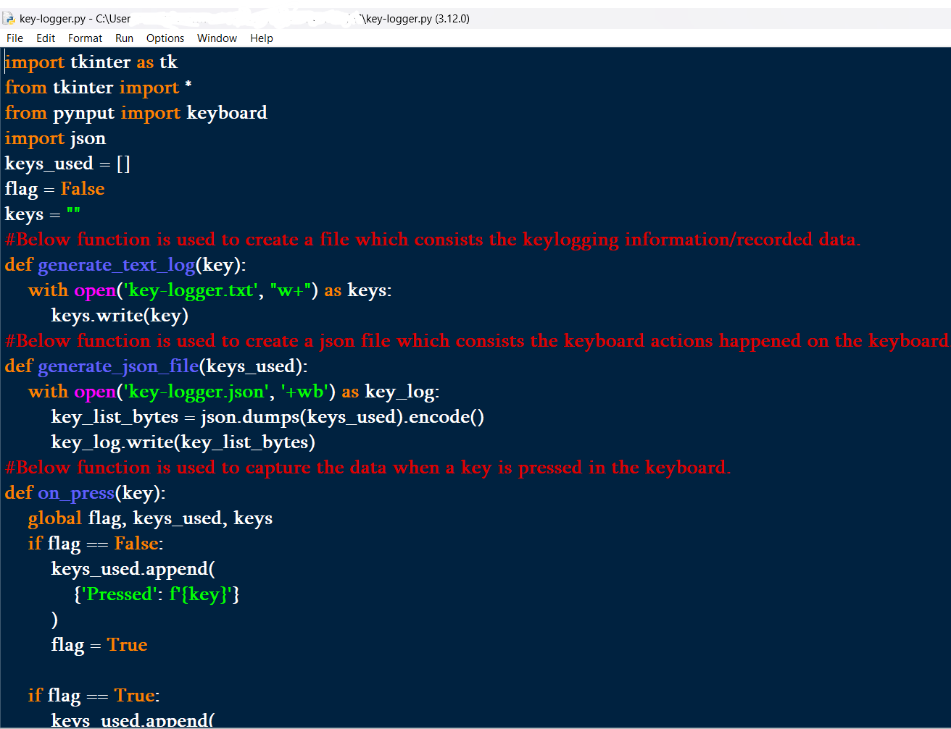
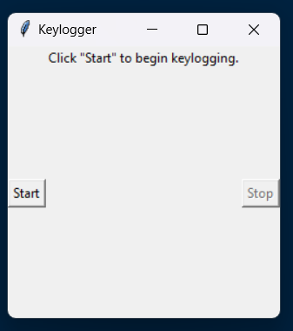
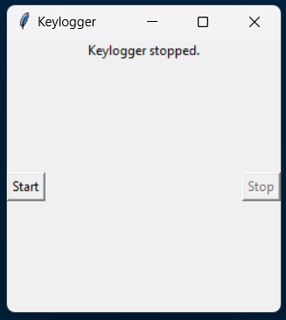
MODELLING
Teams cam add wireframes
Run the python program
Write a python program in the IDLE(IN MY CASE)
The keylogger captures all the keystrokes and keyboard action saves to a files
Click on start to activate the keylogger
3/21/2024 Annual Review
9

Slide 10
RESULTS
The developing and implementing a keylogger by python program is successfully executed.
The implementation can be done easily by anyone, without any prerequisite knowledge.
Moreover the tool can be misused by an individual, as it can be steal individual privacy.
As the keylogger can be beneficial from one side, on the other side it may be destructible.
As it is GUI –based application, it offers user-friendly environment to do the task.
It is a legal tool to be used in the society, with the owners permission.
Remote-Code Execution is also possible.
3/21/2024 Annual Review
10

Slide 11
GITHUB PROJECT LINK --
https://github.com/BANDISREEKUMAR/APSSDC_EDUNET_PROJECTS.git

