Slide 1
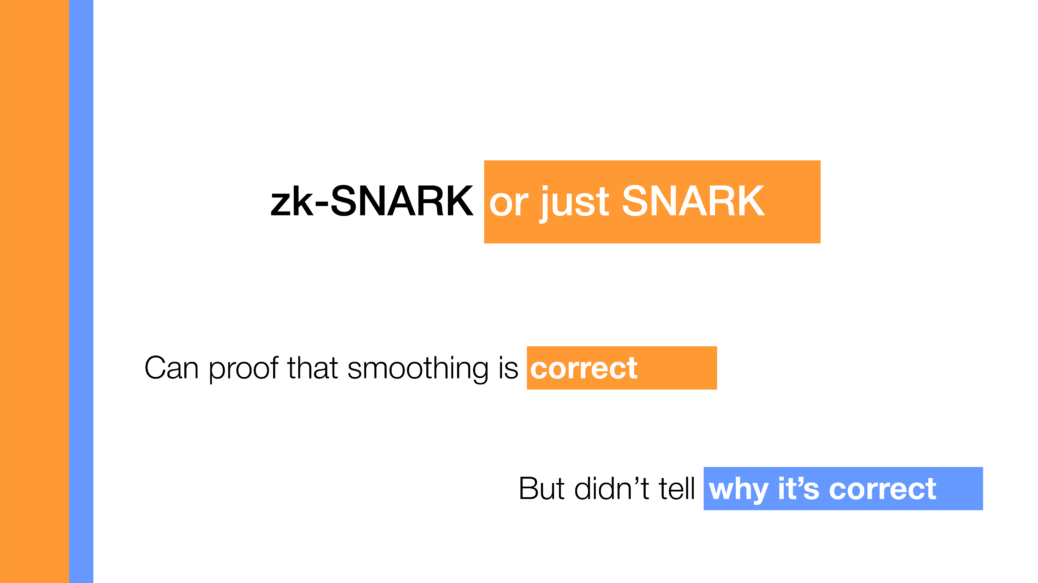

Slide 2
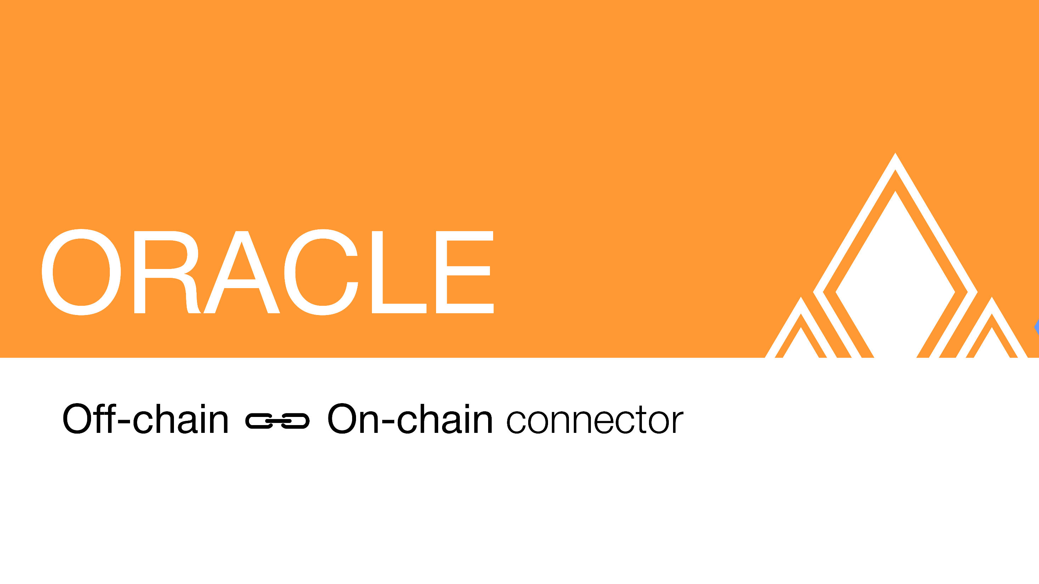

Slide 3


Slide 4
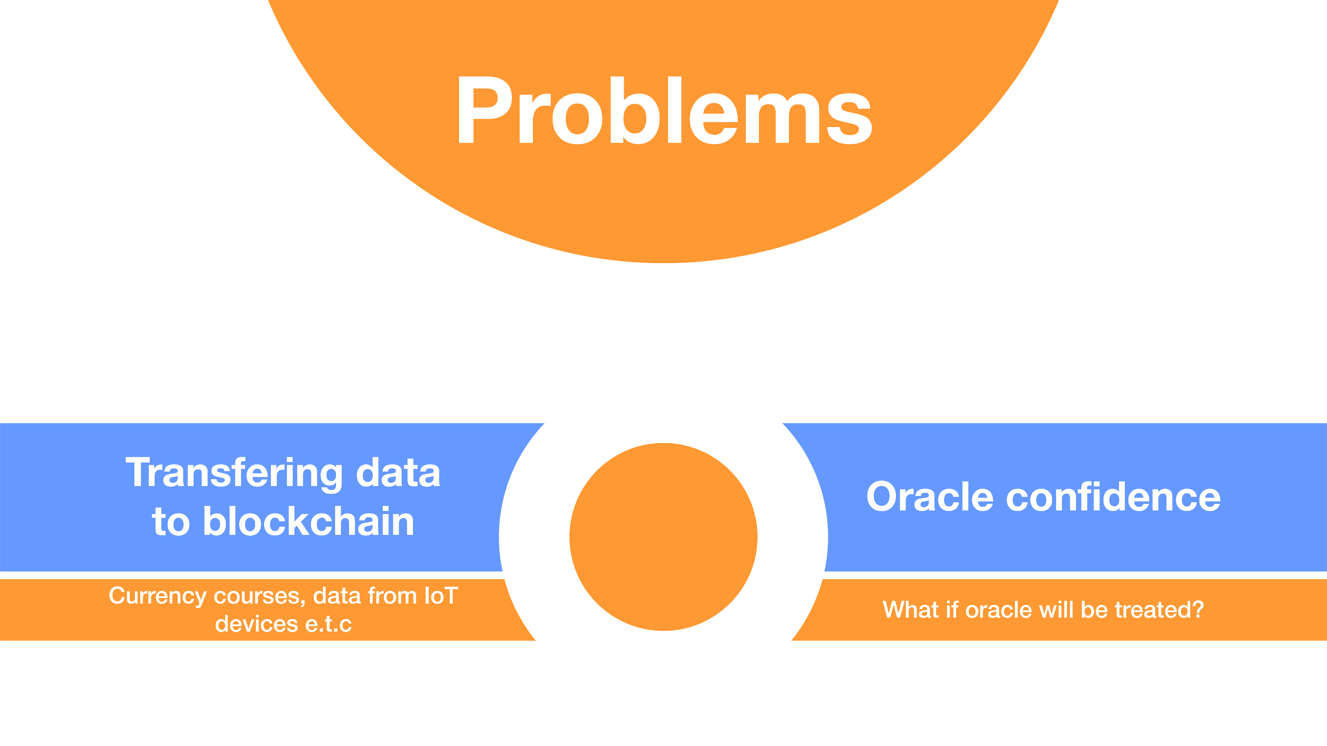

Slide 5

How it works currently
Oracle
Ethereum

Slide 6
How it works currently
Oracle
Oracle
Ethereum
Oracle
Oracle

Slide 7
Some problems there:
Complex and not Scalable
Expensive: we use a lot of gas

Slide 8
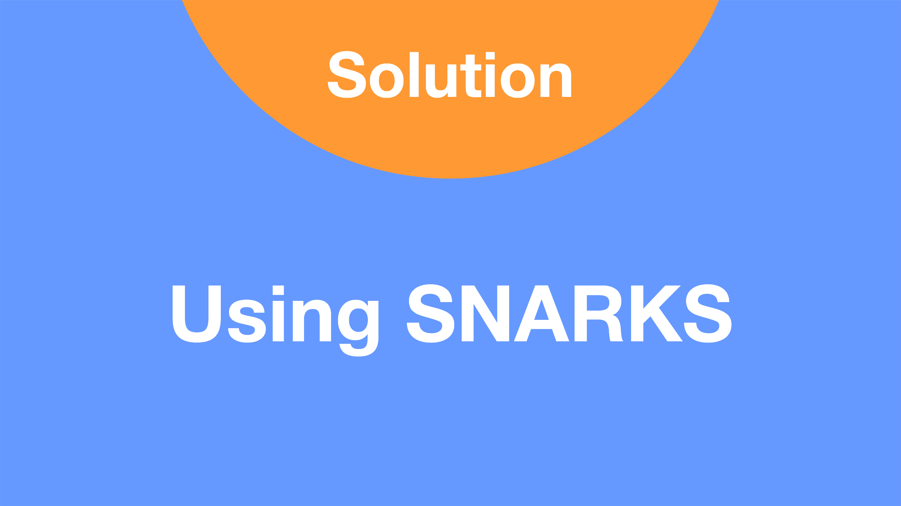

Slide 9
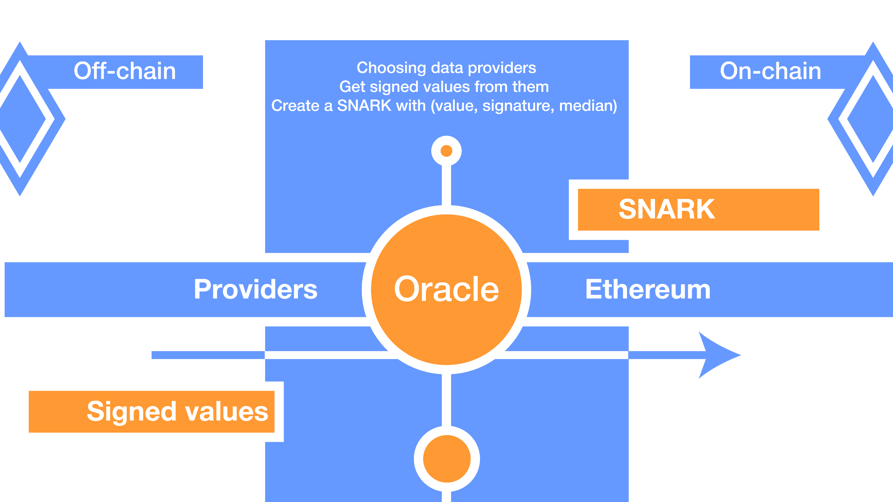

Slide 10
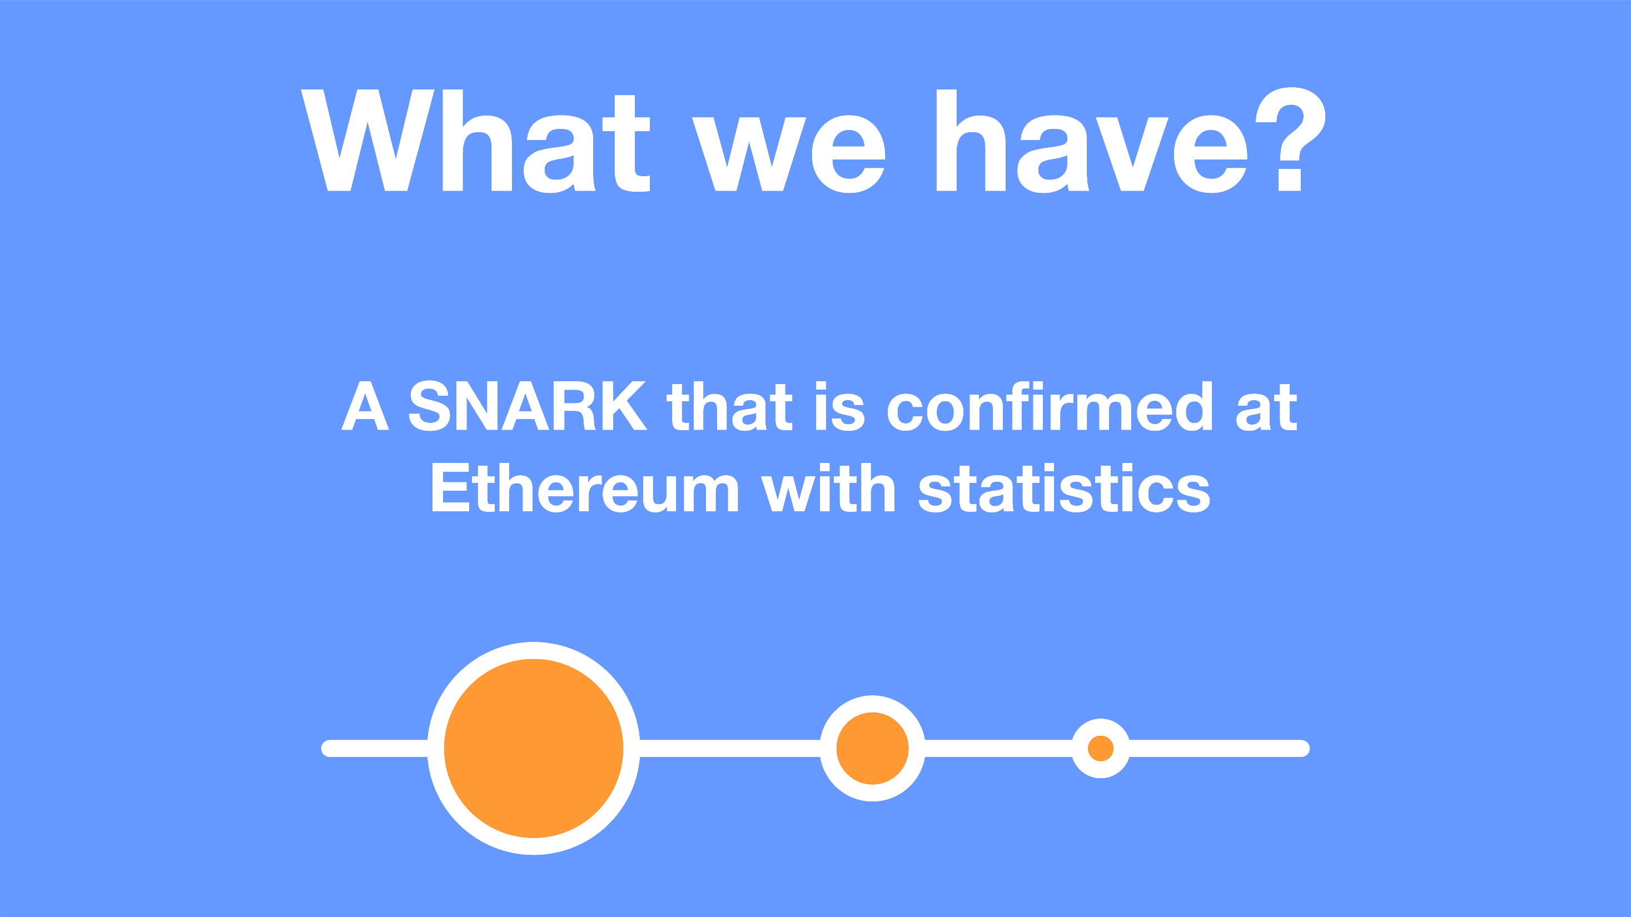

Slide 11
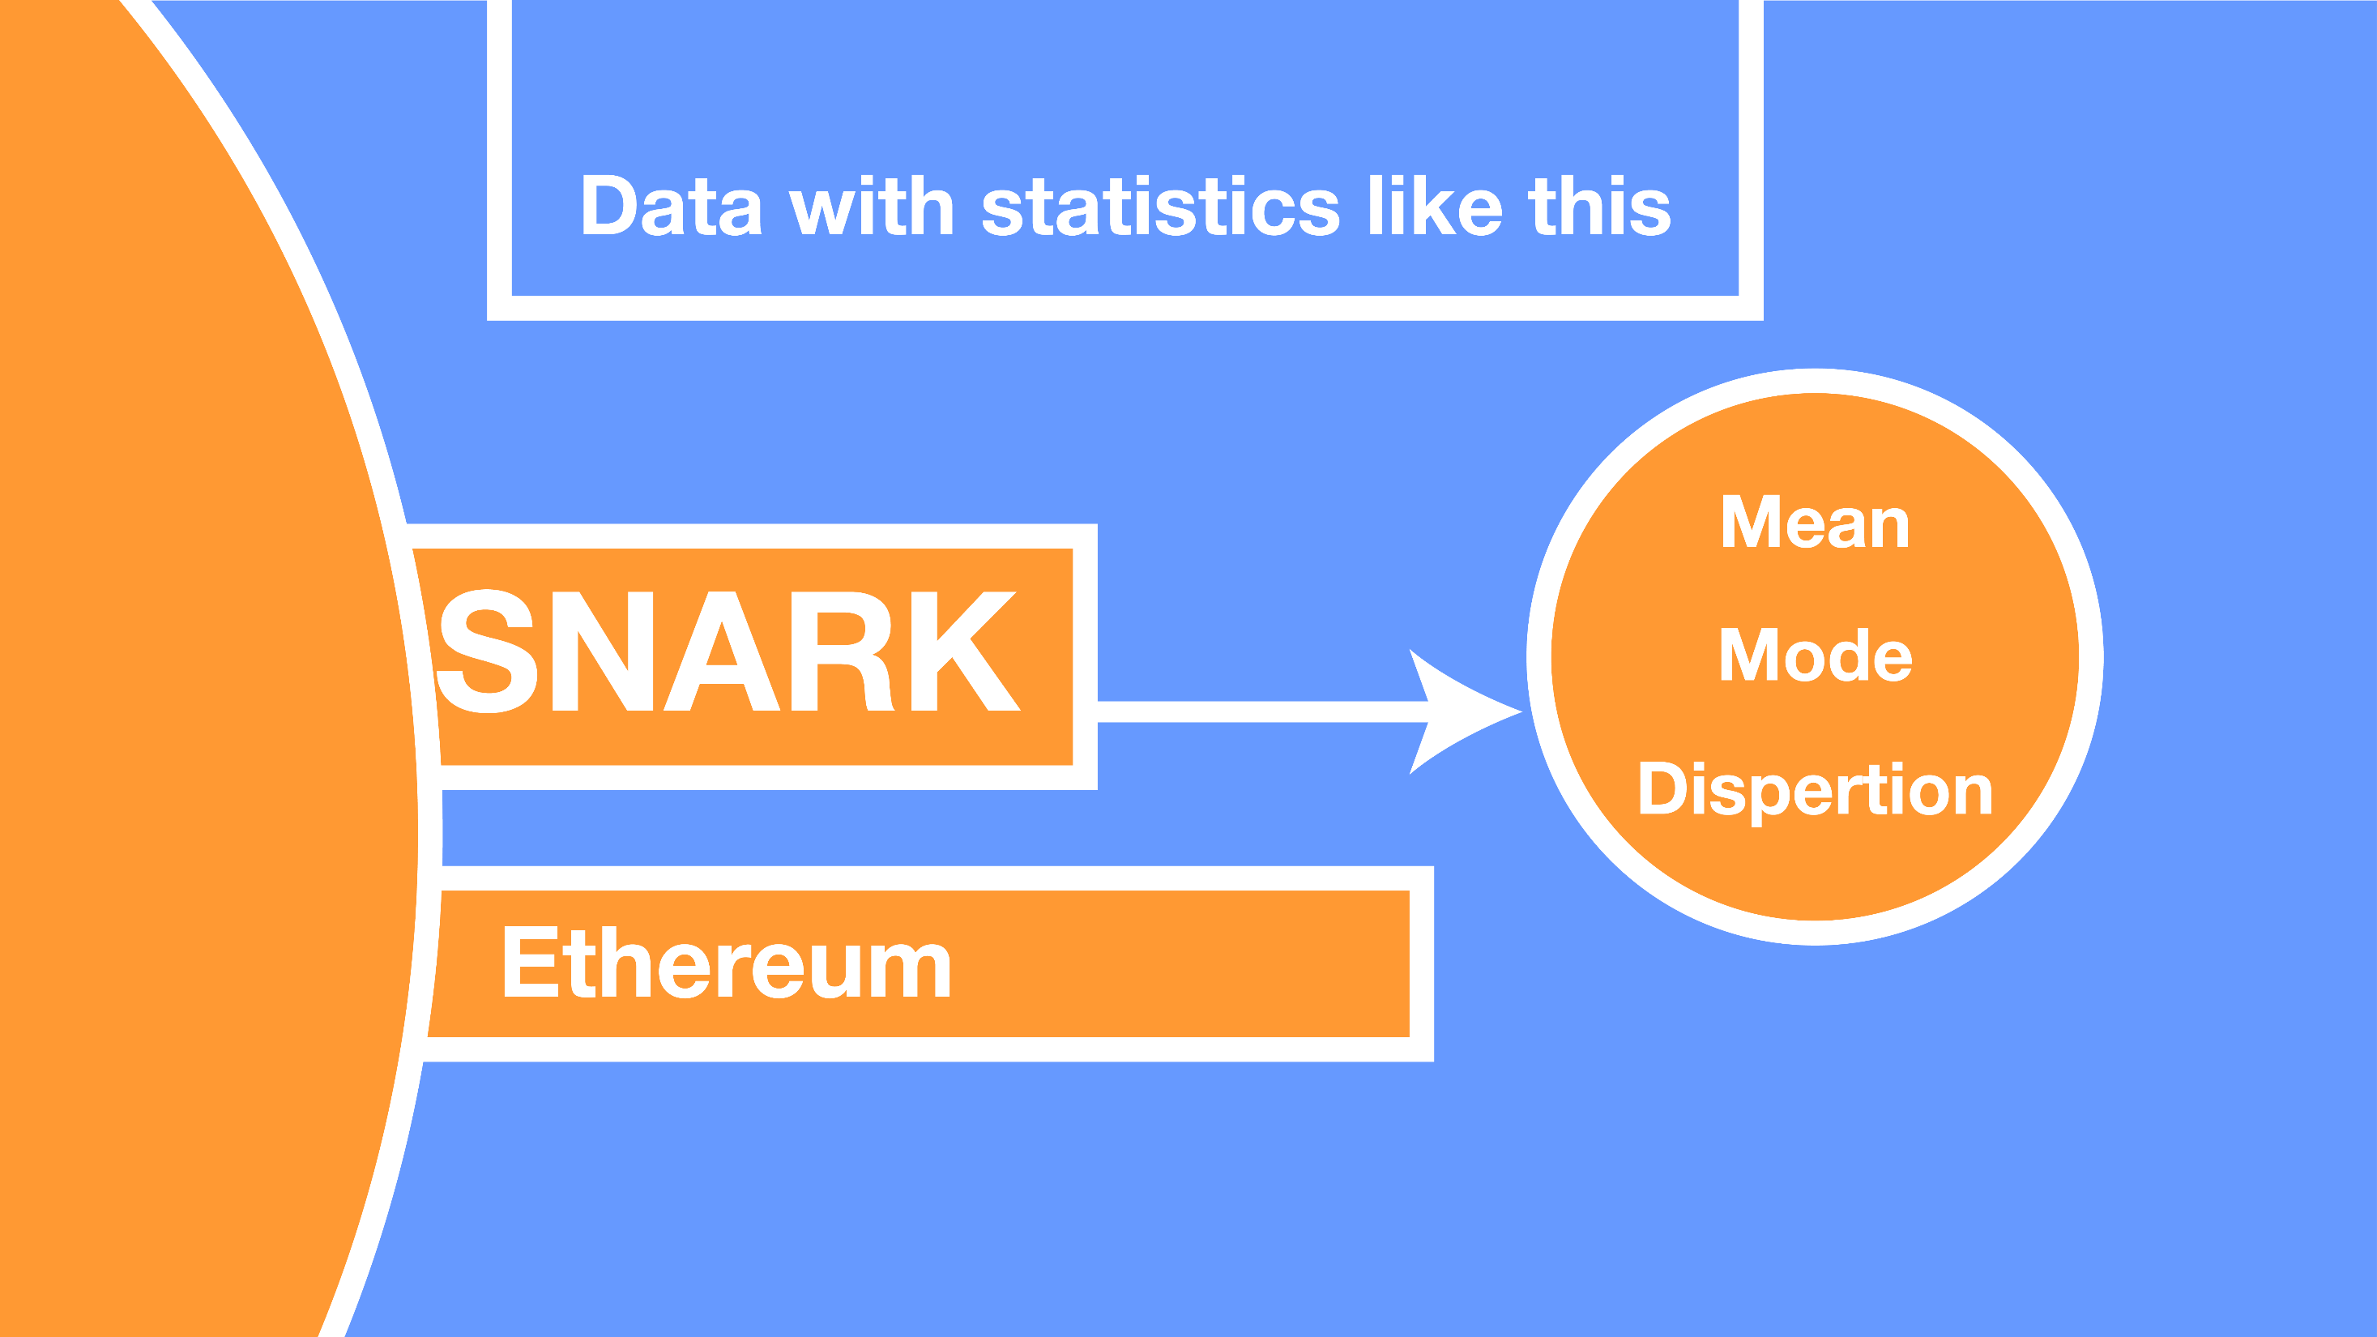

Slide 13
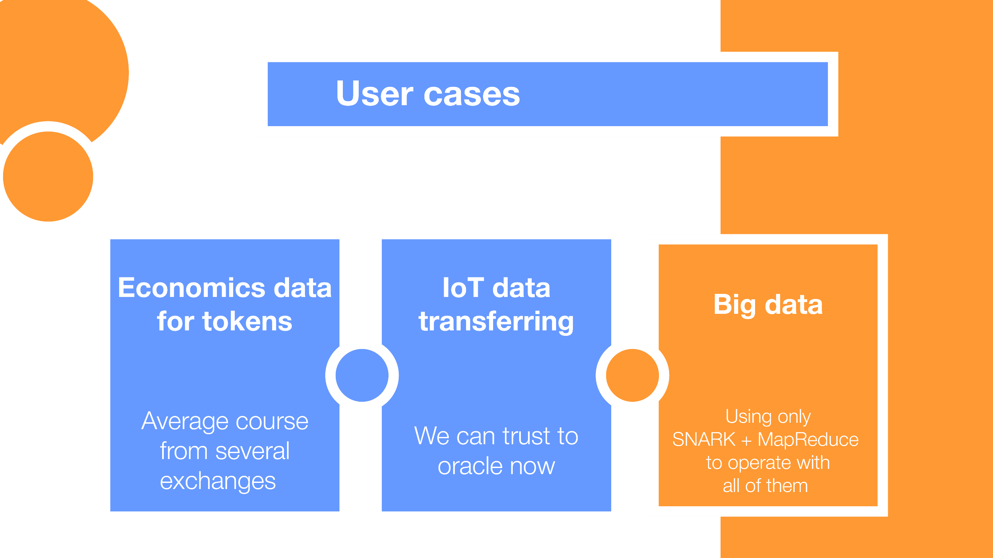

Slide 14

@barryWhiteHat

