Slide 1
Summer Internship 2017 Pallavi Bansal PICT College
07/14/2017

Slide 2
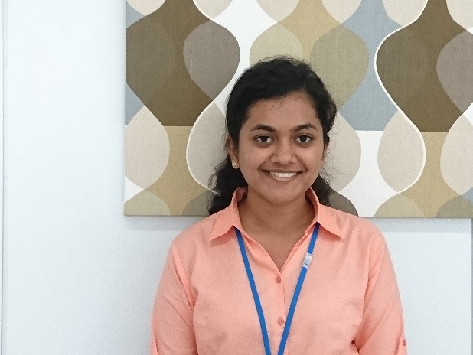
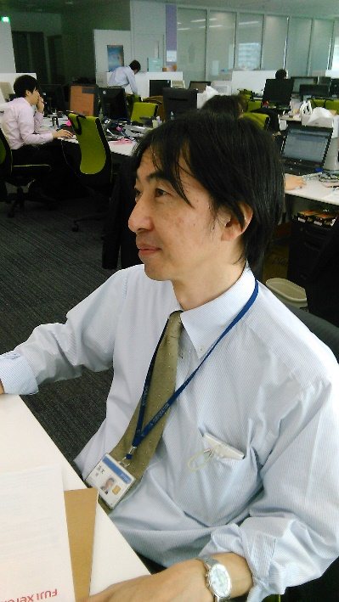
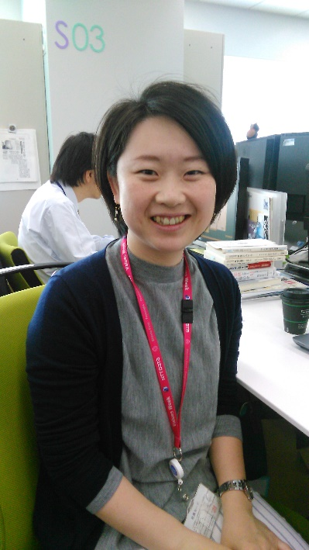
INTRODUCTION
My name is Pallavi Bansal. I am currently pursuing my under-graduation in Information Technology from PICT, Pune. I come from Dahod, Gujarat. I like to watch Hollywood movies and listen to songs. I can adapt to new situations well. My interests in the field of computer science are – Data Analytics, Machine learning and Artificial Intelligence.
AT NTT DATA
My Manager : Takaki San
My Trainer : Yoko San

Slide 3
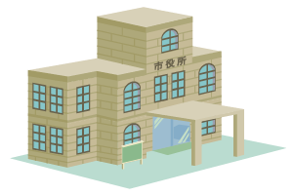





Image Search Engine
Patent Office
Company
Apply For Trademark Right
Results of Screening
Image Search Engine
Search
Employees working at the Patent Office use Image Search Engine to Search for similar trademarks.

Slide 4
CURRENT IMAGE SEARCH SYSTEM
Dataset Description : Consisted of 10,000 images for all the issues of the image search system. A file for the query image and the corresponding correct image. Model Description :
No. of Convolutional layers : 11
Loss Function : Triplet loss – Takes anchor, positive example and negative example as input. Computes relative similarity between the samples.
Activation Function : RELU (Rectified Linear Unit) -
Optimiser : ADAM
Pooling : Max-Pooling (How is it better than Average Pooling ?)
No. of Fully Connected layers :

Slide 5
Model

Slide 6
PROBLEMS OF THE CURRENT IMAGE SEARCH SYSTEM
- Similarity according to concepts derived from figures
- The direction of the figures varies.

Slide 7
ACCUARCY OF THE CURRENT IMAGE SEARCH SYSTEM
-The output of the similarity computation was in the form :
query_image database_image similarity
-For every query image I found the rank of the correct image.
-For eg: The output of the similarity computation is this :
23450.jpg 00005 0.9865, 23449 0.9999, 00008 0.8976
Query image
Database image
Similarity
Correct image
- When I arrange the databases images based on the descending order of the similarity values I get rank of image – 23449 (ie. Correct image) as 1. I saved this rank for every query image in a list.
[1, 7, 2, 2432, 6, 58, 10, 200, 131, 2, 97, 3, 14, 4, 1, 16, 515, 4, 4, 137, 592, 4, 1, 24, 195, 26, 526, 5, 1, 490, 1304, 1042, 1, 1, 65, 86, 1092, 19, 5, 1, 1, 1, 18, 1924, 9, 1, 5, 376, 11, 3502, 113, 187, 9, 5, 1, 346, 214, 6, 2, 1, 1, 9, 213, 384, 1, 3543, 283, 1117, 4976, 1954, 49, 3, 14, 2248, 5, 2444, 9, 5, 2368, 5, 192, 7034, 1, 990, 91, 187, 2872, 1, 2, 690, 38, 5, 4, 17, 76, 1, 7, 1, 1, 1, 326, 1208, 11, 2, 3011, 7, 1, 567, 1, 32, 1966, 3, 2237]
57070

Slide 8
WAYS TO IMPROVE THE CURRENT IMAGE SEARCH SYSTEM
DROPOUT
WEIGHT DECAY
REGULARISATION
EARLY STOPPING
WEIGHT INITIALIZATION
LEARNING RATE
BATCHES AND EPOCHS

Slide 9
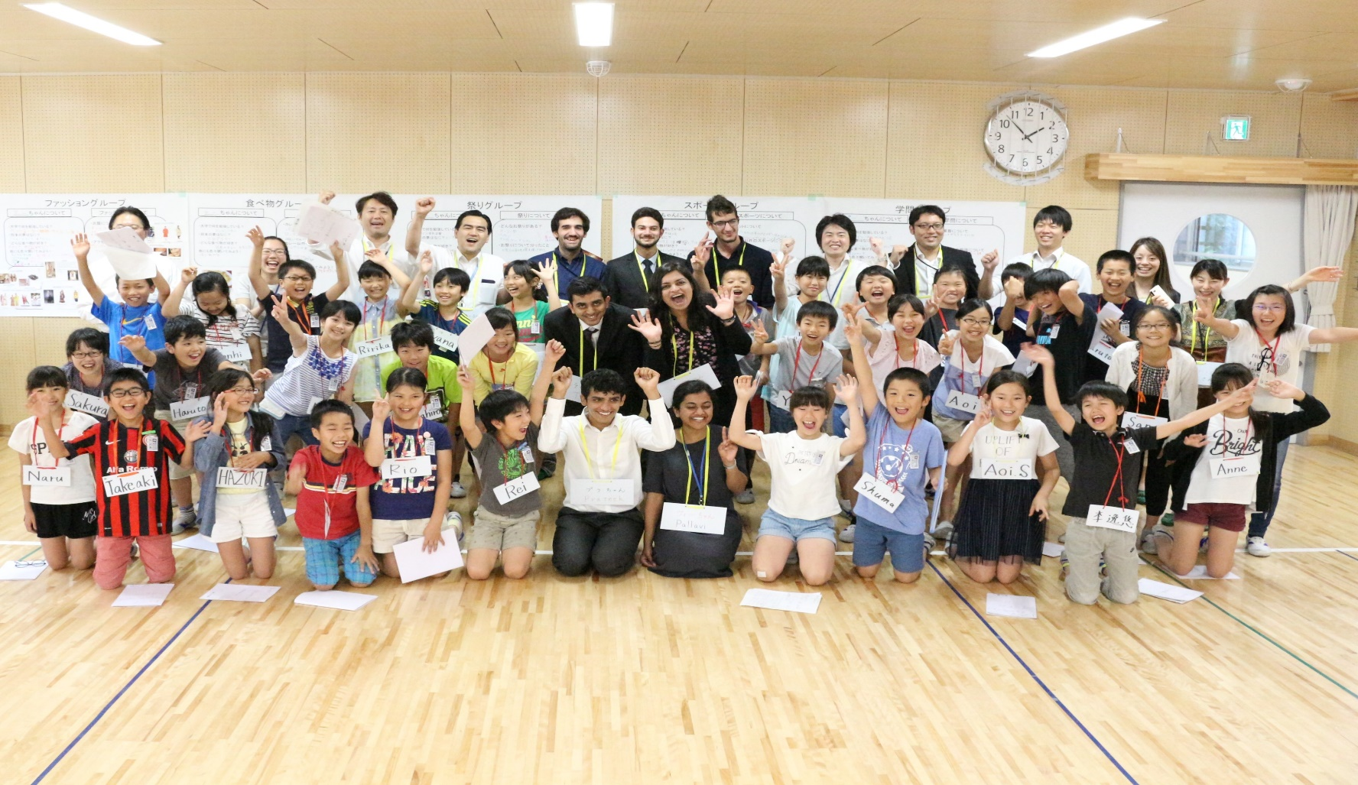
TOYOSU KIDS EVENT AND THE THANKS GIVING EVENT
Introduced Indian Fashion to the students.
Students were excited to know about Saree.
Thanks giving letter picture.

Slide 10
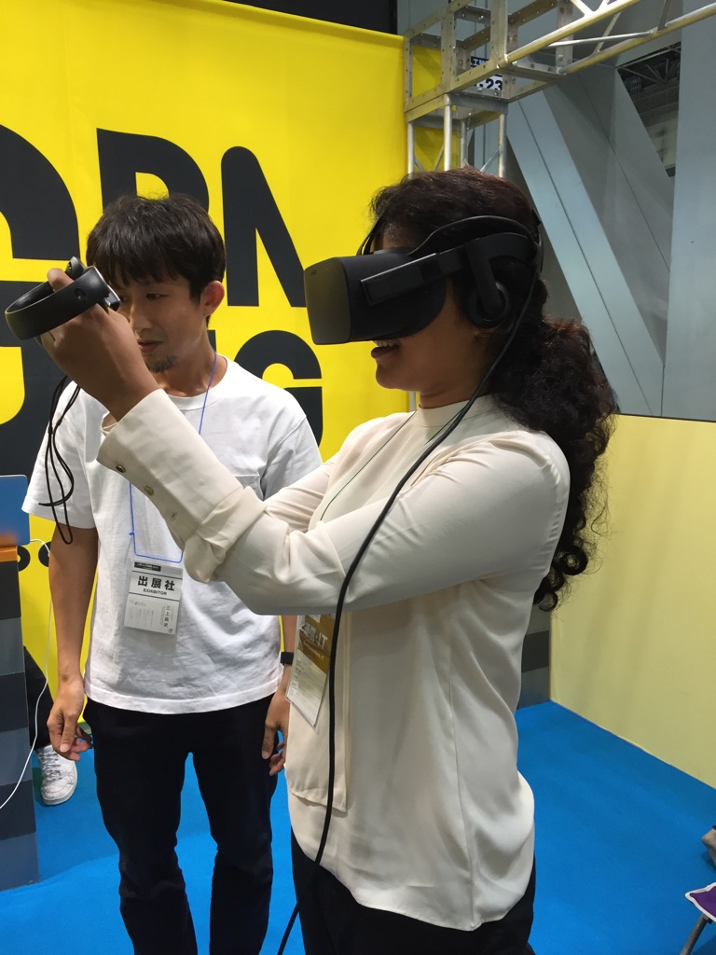
AI EXPO AT TOKYO BIG SIGHT
Various projects on Artificial Intelligence
Most of the projects were intelligent question and answer systems
Startup GRID exhibited projects of HOME AUTOMATION, SMART ENERGY CONSERVATION.

Slide 11
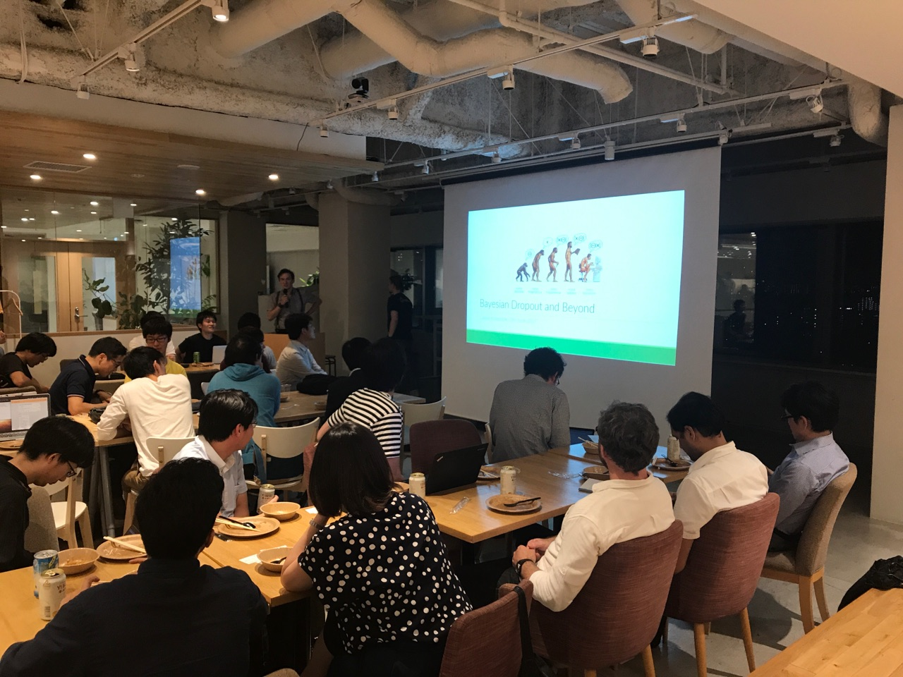
ML KITCHEN – MEETUP AT COOKPAD
- What did I learn ? Neural Networks Evolution, Bayesian Neural Networks and Tensorflow Serving.
- Good opportunity to talk with people in the field of Machine Learning.

Slide 12
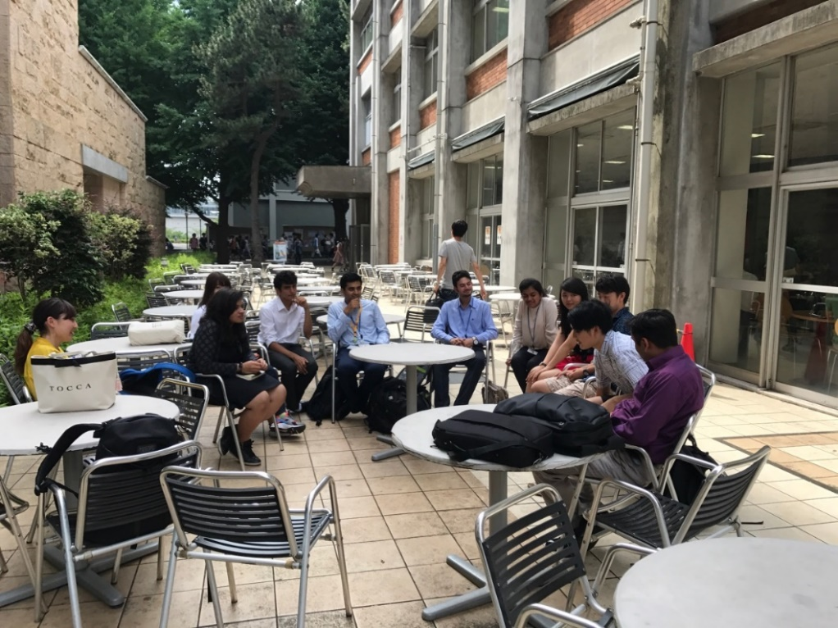
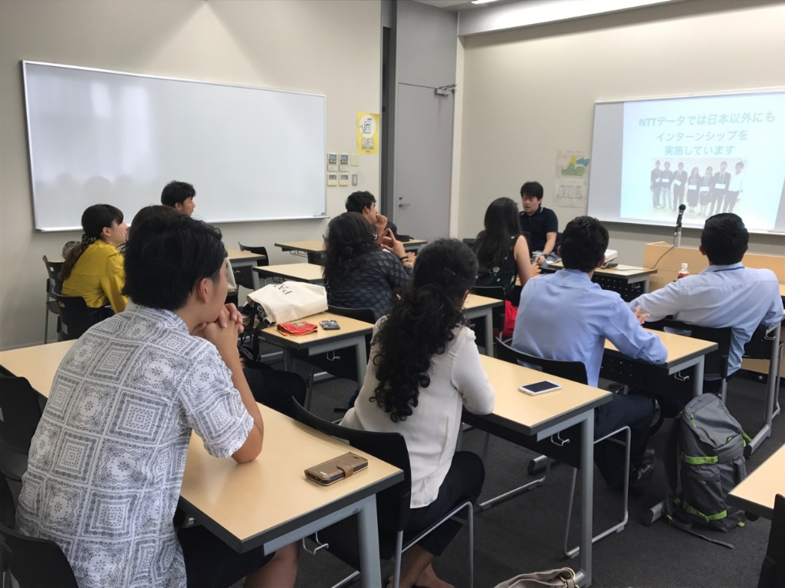
KEIO UNIVERSITY VISIT
Purpose of visit : Interact with students who are going to visit India in the month of September.
We talked about work culture in Japan and in India.
What did I learn ? Importance of Volunteering, advantages of working in a foreign country, etc.

