Slide 1
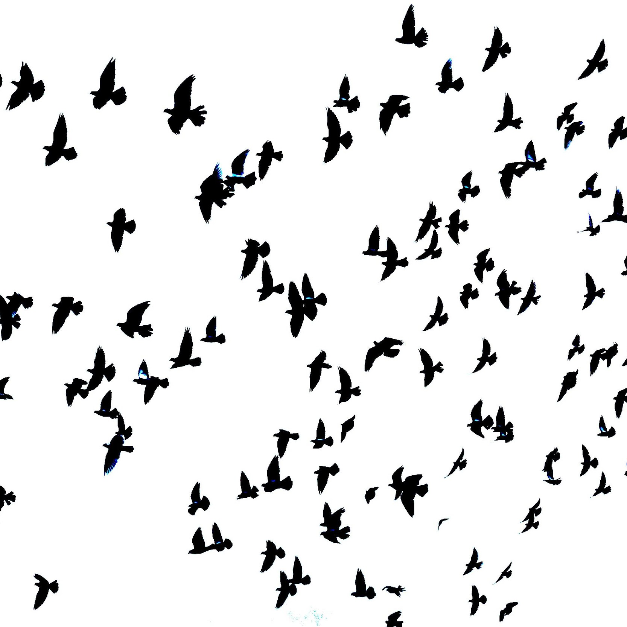
Smart Water Monitoring and Distribution System
ICPS Project
Group- 6
Prudhvi Raj Chitta
Subash J
V. Banu Theja

Slide 2
Introduction
• The major problem which is faced by people is lack of water .
• Wastage of water is minimized by effectively segregating and distributing it to various purposes based on its quality
• We have divided this project into two sub parts-
1.Monitoring the water quality
2.Distribution to three different tanks
2
2

Slide 3
M
O
B
I
L
E
CLOUD
Source 1
Source 2
Source 3
Main Tank
Arduino
Node MCU
Water
Pump 1
Water
Pump 2
Water
Pump 3
ESP8266WiFi.h
ThingSpeak.h
WiFiClient.h
ESP8266WebServer.h
ArduinoJson.h
<WiFiClientSecure.h> <UniversalTelegramBot.h>
OneWire.h
DallasTemperature.h
ArduinoJson.h
Tank1
Tank2
Tank3
Rain sensitive sensor
Turbidity sensor
Temperature sensor
Water level sensor probe
3

Slide 4
Deliverables
Till mid evaluation
After mid evaluation
Monitoring of water using sensors
Displaying the values of the parameters in Thingspeak cloud
Temporary website to display the values
Distribution of water using motors.
Creating a telegram bot to get the readings easily
App for user to monitor the water quality and quantity
Database to store values in real time
Implementing collection of rainwater
4

Slide 5
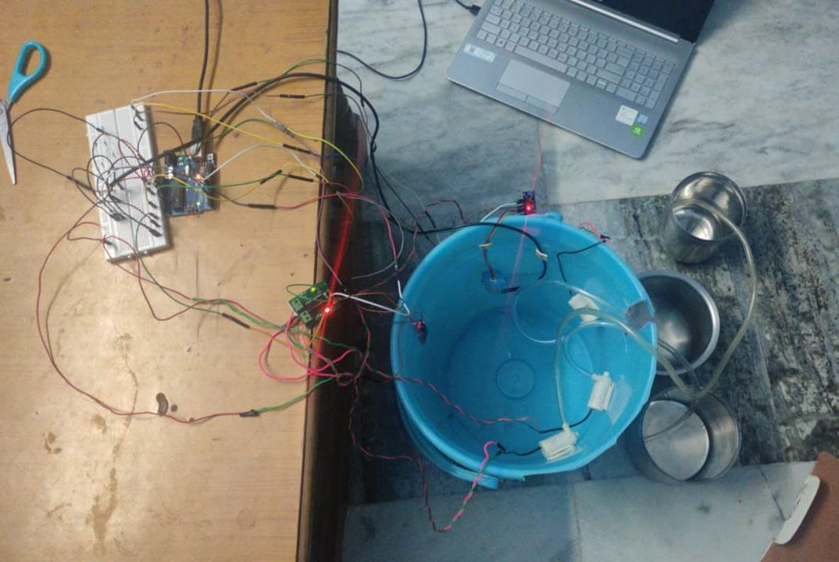
Hardware
5
5

Slide 6
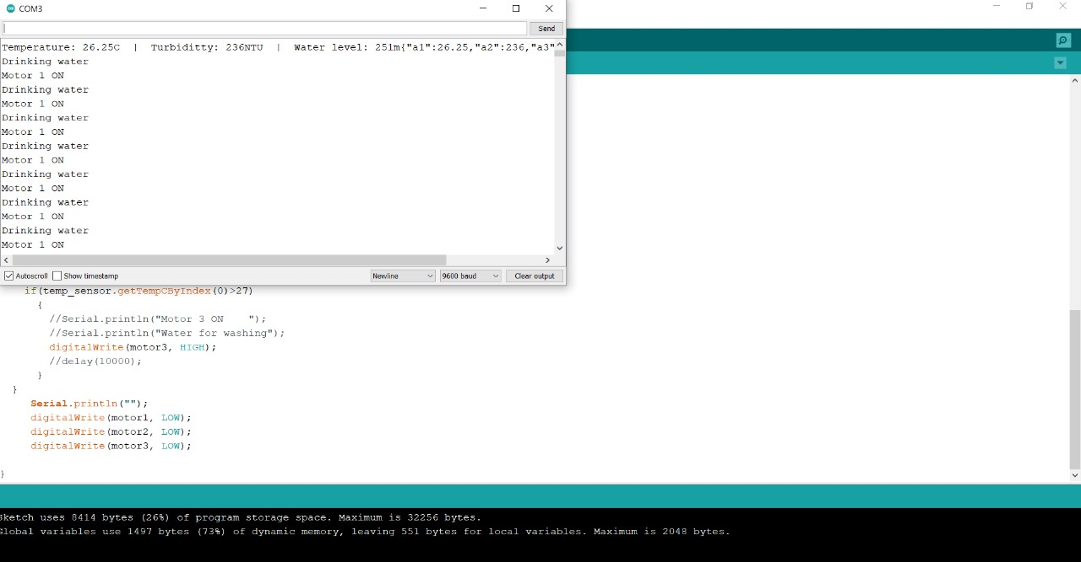
Serial Monitor Output
6
6

Slide 7
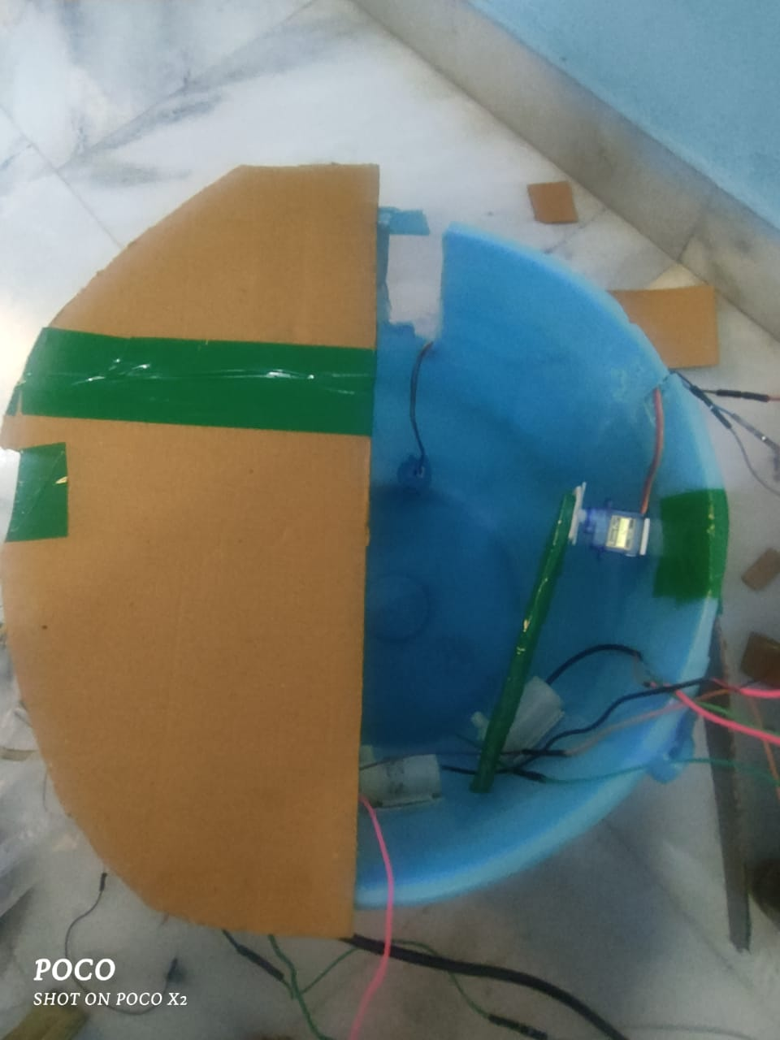
Rainwater Harvesting

Slide 8
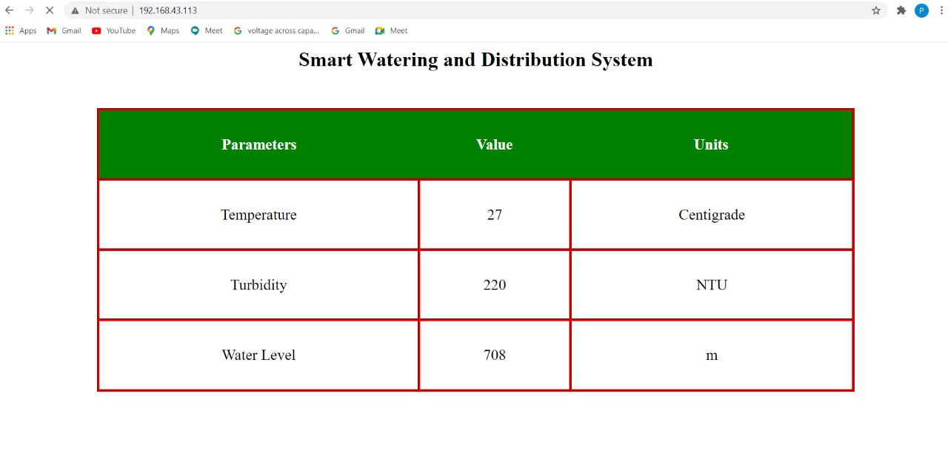
Website
THANK YOU
8
8

Slide 9
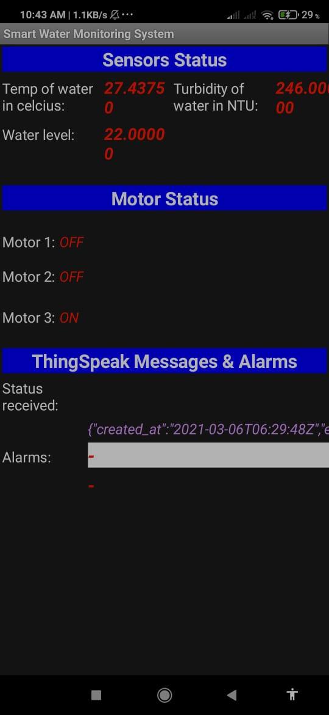
APP
9

Slide 10
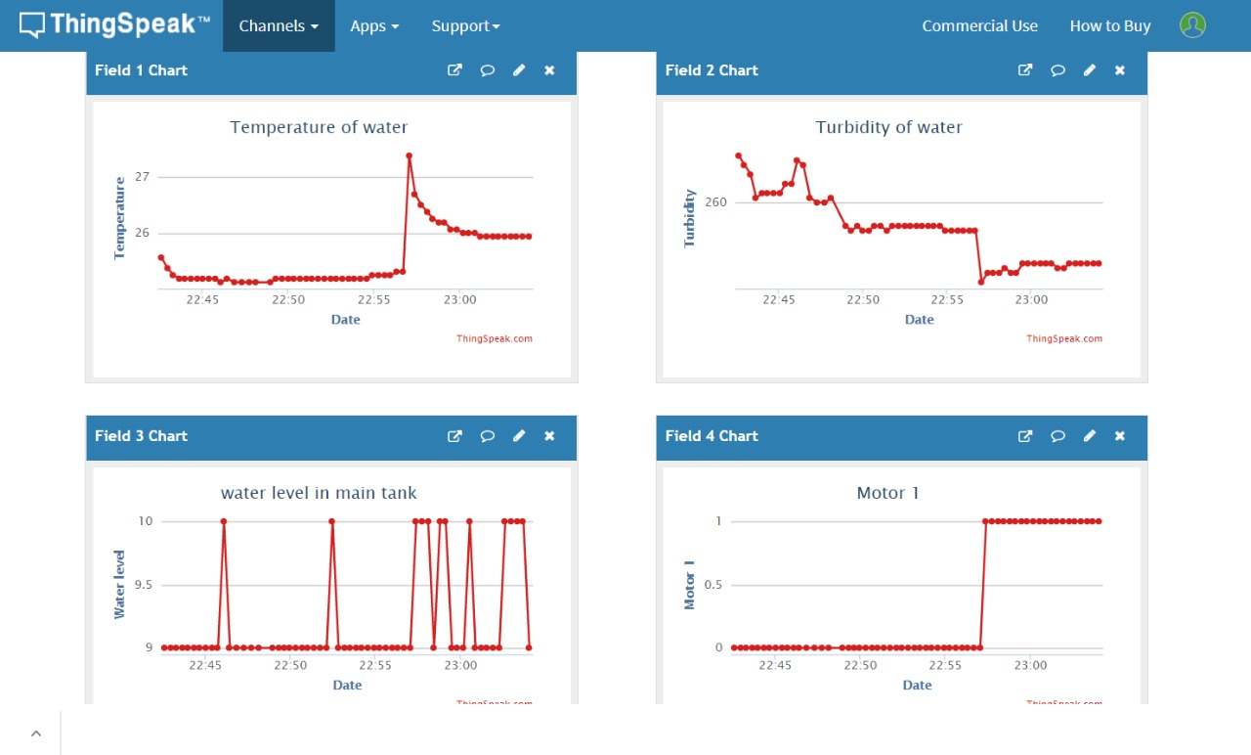
ThingSpeak Cloud
10

Slide 11
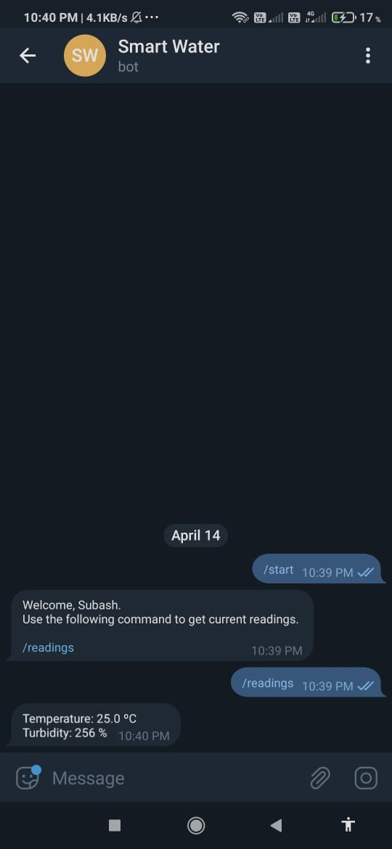
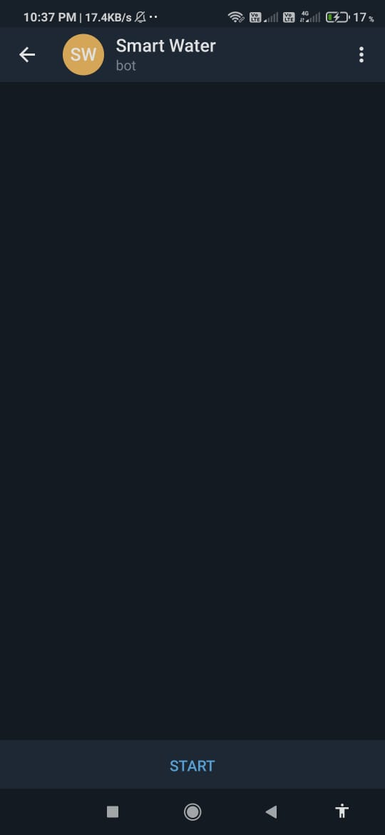
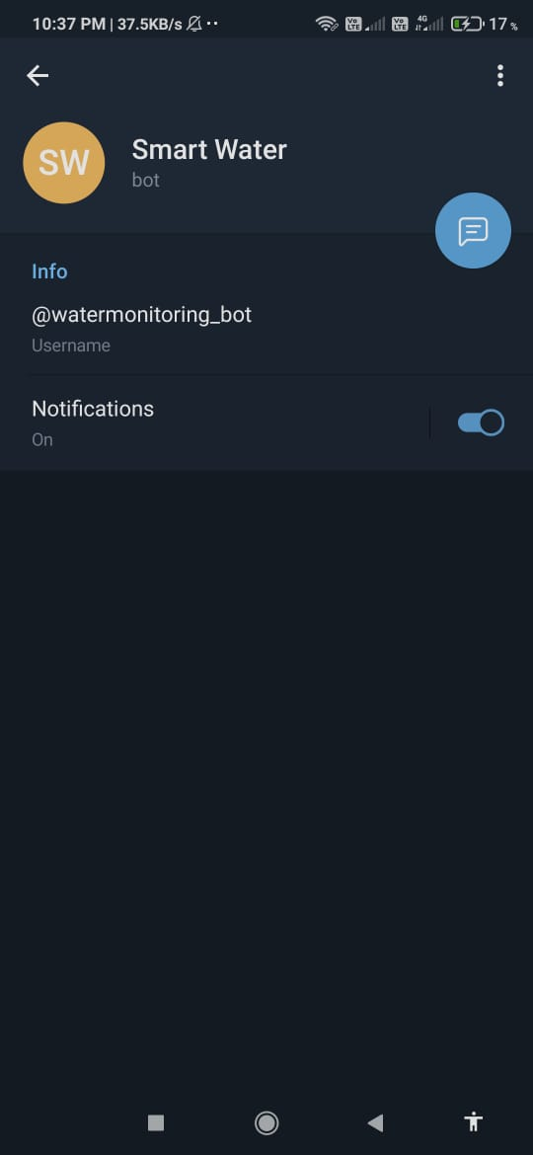
Telegram
11

Slide 12
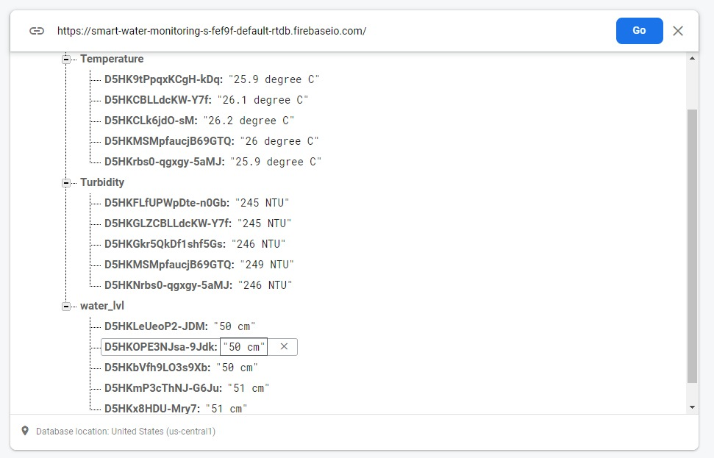
Firebase

Slide 13
Challenges Faced
One of the main challenges in smart water managing system is managing the cost, energy and efficiency required for water distribution system
Delay in updating values(11 seconds)
Needs more Power for motor(L293D)
Delay in updating values in Telegram bot
Weight factor of the cardboard in rainwater harvesting
13

Slide 14
THANK YOU
References-
https://www.meity.gov.in/content/ict-grand-challenge-development
14

