Slide 1
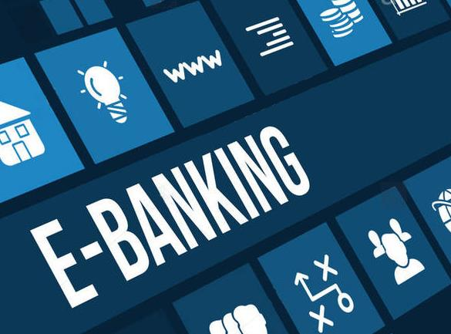
E-banking
BARATH.P
192121147
IT 2ND YEAR

Slide 2

AIM:
TO VERIFY AND VALIDATION FOR E-BANKING

Slide 3
REQUIREMENTS:
USER ID AND PASSWORD
BANK ACCOUNT
E BANK
NETWORK FACILITIES
BENEFICIARY ACCOUNT
FUND TRANSFER

Slide 4
TEST CASE SCENARIO:
CAN THE USER LOGIN WITH A VALID EMAIL ID AND PASSWORD?
TO VERIFY THE MTPIN IS VALID OR NOT?
CAN THE USER CHECK BALANCE OF OUR BANK ACCOUNT OR NOT?
TO CHECK THE USER GO CORRECT FOR BANK TO BANK TRANSFER OR NOT
CAN THE USER ENTERED A ACCOUNT NUMBER FOR TRANSFER ?
CAN USER ENTERED THE MAXIMUM AMOUNT OF TRANSFER?
CAN THE USER ADD THE BENEFICIARY ACCOUNT?
CAN THE USER ENTERED A UPI ID?
TO VERIFY THE USER FINISH THE FINAL PROCESS FOR FUND TRANSFER
CAN THE USER CHECK THE BANK BALANCE IN E-BANKING?

Slide 5
POSITIVE SCENARIO:
CAN THE USER ENTERED A VALID USER ID AND PASSWORD?
TO VERIFY THE MTPIN IS VALID?
CAN THE USER CHECKS A BANK BALANCE?
CAN THE USER ENTERED CORRECT OPTION FOR FUND TRANSFER ?
TO VERIFY THE USER ENTERED VALID ACCOUNT NUMBER?
CAN THEIR USER SELECTED THE VALID MAXIMUM AMOUNT TRANSFER?
CAN THE USER ADD VALID BENEFICIARY ACCOUNT?
TO VERIFY THE FINAL PROCESS WAS VALID?
CSN THE USER ENTERED VALID UPI ID?
TO CHECK THEIR BANK BALANCE WITH A VALID ACCOUNT

Slide 6
NEGATIVE SCENARIO:
WHAT HAPPENEND WHEN THE USER ENTRED INVALID AND PASS?
FORGOT PASSWORD ,IS THE OPTION WORKING?
WHAT HAPPEN WHEN THE USER ENTERED VALID ID AND INVALID PASS?
CAN USER ENTERED THE INVALID MTPIN?
TO VERIFY THE USER ENTRES THE WRONG OPTION FOR FUND TRANSFER?
CAN THE USER ENTERED INVALID MAXIMUM AMOUNT?
CAN THE USER ENTERED INVALID BENEFECIARY ACCOUNT?
WHAT HAPPENED WHEN THE USER ENTERED INVALID UPI ID?
WHAT HAPPENED WHEN THE NETWORK FALLS DOWN?
CAN THE USER CHECK INVALID BANK BALANCE.

Slide 7
TEST CASE:
CAN THE USER ENTERED VALID USER ID PASS = POSITIVE
WHAT HAPPENED WHEN THE USER ENTERED INVALID MTPIN = NEGATIVE
CAN THE USER ENTERED VALID BENEFICIARY ACCOUNT = POSITIVE
WHAT HAPPENED WHEN THE USER ENTERED INVALID UPI PIN = NEGATIVE
CAN THE USER ENTERED A VALID AMOUNT TO TRANSFER = POSITIVE

Slide 8
THANK YOU
.

