Slide 1

RAG Fundamentals
An Introduction to Retrieval-Augmented Generation for Cross-Functional Teams
Java | UI | DevOps | Data Science

Slide 2






AGENDA
The Problem
The Pipeline
Your Role
Understanding why LLMs need help and what they fail at.
Breaking down the core components of RAG step-by-step.
How Java, UI, DevOps, and DS integrate into the RAG system.

Slide 3



WHY RAG EXISTS
LLMs Hallucinate: They sound confident even when they are completely wrong.
No Real-Time Knowledge: Their training data has a strict cutoff date.
No Private Data: They don't know your company's internal wikis, code, or policies.
"LLMs are incredibly smart... but they take exams completely closed-book."

Slide 4


WHY NOT FINE-TUNE?
Fine-Tuning
RAG (Retrieval-Augmented)
•
Expensive: Requires significant GPU compute.
•
Cost-Effective: Only costs API tokens for search/generation.
•
Static: Once trained, the knowledge is baked in. Hard to update daily.
•
Dynamic: Instantly update knowledge by adding docs to a DB.
•
Concept: Modifying the model's internal memory.
•
Concept: Giving the model an external memory drive.
•
Best For: Teaching an LLM a new tone, format, or language.
•
Best For: Question-answering over custom, factual data.

Slide 5

WHAT IS RAG?
Search First, Generate Second
Retrieval-Augmented Generation (RAG) is a technique that combines an information retrieval system with a generative AI model.
Instead of guessing, the system searches your private database for relevant facts, and then generates a final answer based strictly on what it found.

Slide 6
RAG PIPELINE OVERVIEW
2. Embed
4. Prompt
Question converts to numerical vectors.
Combine context + query for the LLM.
1. Query
3. Retrieve
5. Generate
User asks a specific question via UI.
Vector DB finds similar data chunks.
LLM streams final synthesized answer.

Slide 7
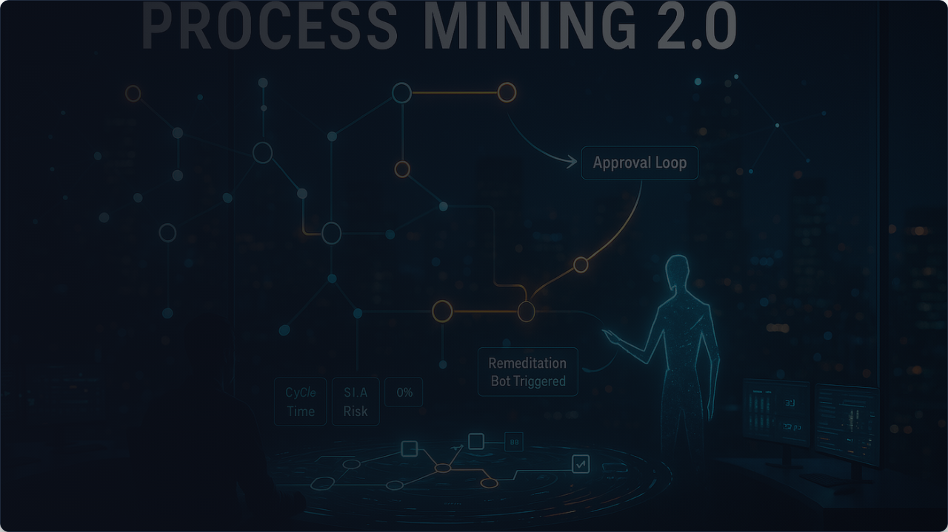
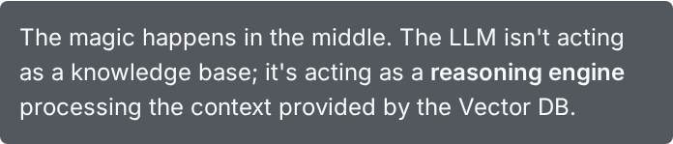
Visualizing the Flow

Slide 8








CORE COMPONENTS
Embeddings
Vector Database
Captures semantic meaning (Data Science focus).
The specialized search engine (DevOps/Backend).
Retriever
LLM
Logic for top-k selection and ranking (Backend focus).
Generates final readable answer (Full Stack/UI).

Slide 9


WHAT ARE EMBEDDINGS?
The Intuition
Computers don't understand English, they understand numbers. Embeddings translate text into high-dimensional arrays of numbers (vectors).
The Golden Rule: Words or sentences with similar meanings are plotted closer together in this mathematical space.
Analogy: Like converting sentences into GPS coordinates. "Apple" (fruit) is close to "Banana", but far from "Apple" (company).

Slide 10


VECTOR SEARCH (RETRIEVAL)
Keyword Search (Old Way)
Vector Search (New Way)
Searches for exact string matches.
Searches using Cosine Similarity (Nearest Neighbors).
•
Query: "Can I work from home?"
•
Query: "Can I work from home?"
•
Database has: "Remote work policy"
•
Database has: "Remote work policy"
•
Result: Zero matches. The words don't overlap.
•
Result: Match found! The vectors are mathematically close in meaning.

Slide 11
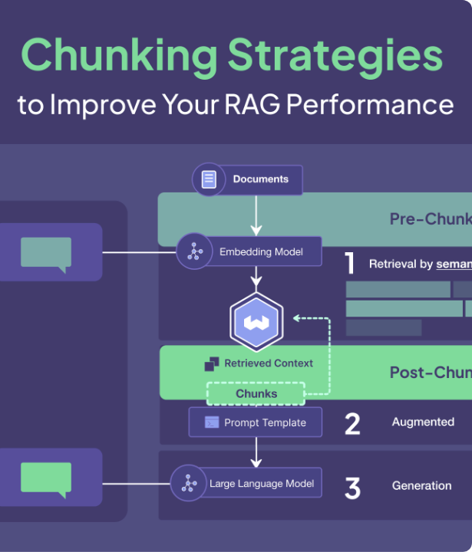
CHUNKING: THE HIDDEN HERO
Why split data?
You can't stuff a 100-page PDF into an LLM. We must break it into paragraphs.
Too Small: Lose context (e.g., "He said yes" - who is he?).
Too Big: Retrieval pulls in irrelevant noise, diluting the answer.

Slide 12


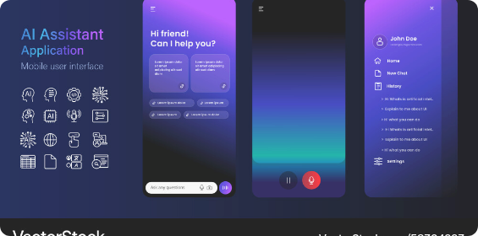
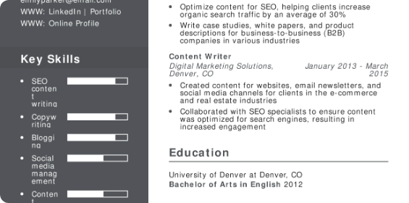
REAL-WORLD EXAMPLES
Company Policy Chatbot
Automated Resume Q&A
Upload HR handbooks → chunk → embed → store. Employees query "Maternity leave" → retrieve exact policy clause → LLM formats response.
Upload candidate CVs. Recruiter asks "Does this person know Spring Boot?" → vector search finds tech stack → LLM answers yes/no.

Slide 13
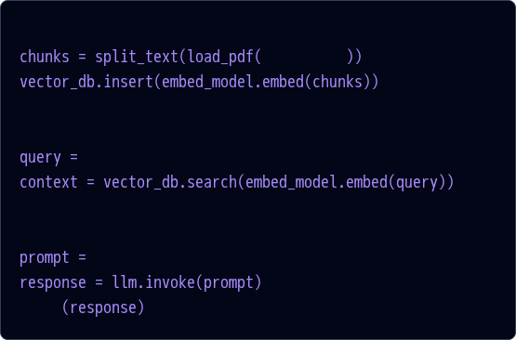
MINIMAL CODE IMPLEMENTATION
Simpler Than You Think
# 1. Ingest Data
Whether in Python, Java (LangChain4j), or Node, the orchestration is usually just a few lines tying libraries together.
"data.pdf"
# 2. Retrieve
We avoid writing raw embedding algorithms; we use API wrappers.
"What is the vacation policy?"
# 3. Generate
f"Answer {query} using {context}"
print

Slide 14






HOW YOUR ROLE FITS IN
Java / Backend
UI / Frontend
Building the API layer (Spring AI), managing secure DB connections, and orchestration logic.
Managing streaming chat interfaces, typing effects, and displaying citation sources clearly.
DevOps
Data Science
Deploying Vector DBs (Milvus/pgvector), handling cold starts, and managing API rate limits securely.
Optimizing embedding models, improving chunking strategies, and evaluating hallucination rates.

Slide 15
LIMITATIONS OF RAG
Retrieval Failure = Generation Failure: If the Vector DB returns the wrong document chunk, the LLM will confidently give the wrong answer.
Latency Issues: Embedding the query, searching the DB, and waiting for the LLM to generate text adds significant network overhead.
Context Window Limits: You cannot pass infinite retrieved documents to the LLM. You must strictly limit results to top-K chunks.

Slide 16






ADVANCED CONCEPTS (SNEAK PEEK)
Hybrid Search
Re-ranking
Agents
Combining old-school Keyword Search + modern Vector Search for better accuracy.
Using a secondary ML model to re-order search results before sending them to the LLM.
Giving the LLM "tools" to decide when to use RAG vs when to calculate math or hit APIs.

Slide 17


WHEN TO USE RAG
Use RAG When:
Avoid RAG When:
•
Data is dynamic and updates frequently.
•
The task is purely reasoning (e.g., "Write a poem", "Refactor this code").
•
You need to query private or highly specific documents.
•
No external factual knowledge is needed.
•
You need explainability (the system must cite its sources).
•
The LLM already knows the subject deeply.

Slide 18



FINAL TAKEAWAYS
1
2
3
External Brain
Retrieval > Generation
System Design
RAG acts as an external memory drive for LLMs, stopping hallucinations.
The quality of your search dictates the quality of the AI's final answer.
Building AI isn't just modeling anymore; it's robust software engineering.

Slide 19
Questions?
Thank you for your attention.
github.com/your-profile

Slide 20






IMAGE SOURCES
https://png.pngtree.com/png-clipart/20250103/original/pngtree-futuristic-robot-using-laptop-cartoon-vector-artwork-png-image_20059325.png
Source: pngtree.com
https://media.istockphoto.com/id/2234389834/photo/businessman-holding-magnifying-glass-focusing-on-target-with-customer-icons-digital-marketing.jpg?s=612x612&w=0&k=20&c=_S987UNkN1ZY9UWvxSqlVy3UVsD4D5IQTwAhNt6l-mg=
Source: www.istockphoto.com
https://www.babylonjs.com/assets/videos/clusteredLights.jpg
Source: www.babylonjs.com
https://weaviate.io/assets/images/hero-372a1930c6d24f89e7d7189207c42125.png
Source: weaviate.io
https://cdn.vectorstock.com/i/1000v/49/93/ai-chatbot-interface-dark-theme-vector-58304993.jpg
Source: www.vectorstock.com
https://www.resumebuilder.com/wp-content/uploads/2025/09/FreelanceWriter.pdf.jpeg
Source: www.resumebuilder.com

Slide 21

IMAGE SOURCES
https://miro.medium.com/v2/resize:fit:1400/1*rM_iP_jYQEVlfCZeXOaLZw.png
Source: medium.com

