Slide 1
pyMack
Compressible Linear Stability Theory
Verification against published benchmarks
20 validation cases · 8 independent sources
Mack (1984) · Malik (1990) · Balakumar & Malik (1992) · Ma & Zhong (2003) · Egorov et al. (2006) · Sivasubramanian & Fasel (2015) · Özgen & Kırcalı (2008)
June 2026

Slide 2
Validation overview
pyMack run at each benchmark's exact conditions, overlaid on the published / independent reference
20
11
9
8
successful cases
second-mode
first-mode
sources
What each slide shows
pyMack result overlaid on the benchmark
— for neutral curves, the pyMack cᵢ = 0 contour vs. the digitized paper curve; for growth rates / eigenvalues, the pyMack curve vs. the reference points.
Full run conditions
— Mach, gas, wall BC (with adiabatic recovery Tw/Te), edge temperature, Prandtl, transport / viscosity law, Reynolds scaling, and formulation.
An honest agreement metric
— median relative error or eigenvalue match, at the digitization noise floor where applicable.

Slide 3
Second (Mack) mode
11 validation cases — pyMack's design target

Slide 4
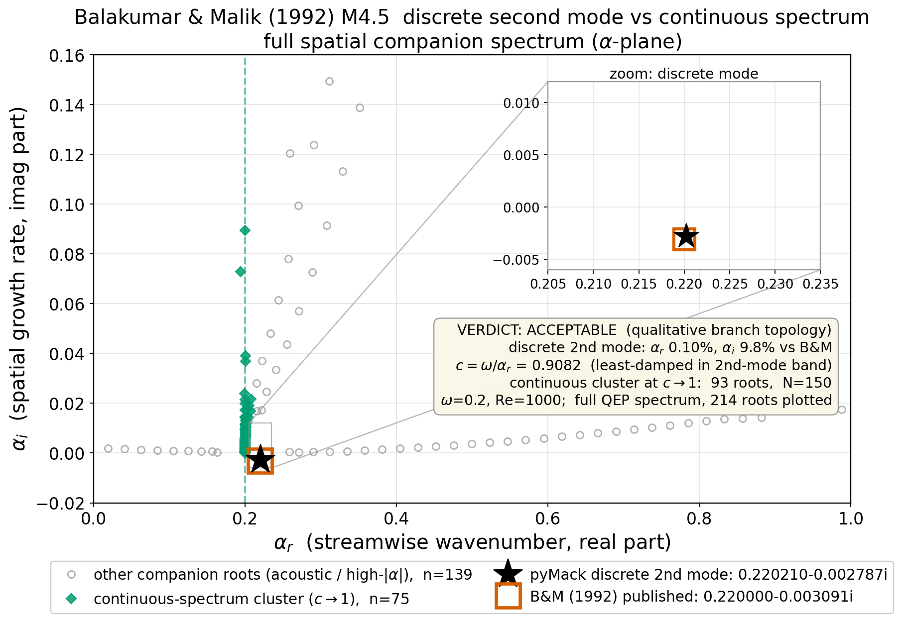
Balakumar & Malik (1992)
M = 4.5 · discrete vs continuous spectrum
RUN CONDITIONS
Mach: 4.5
Gas / γ: air / 1.4
Wall BC: adiabatic (recovery Tw/Te ≈ 4.44)
Edge temp Te: 61.6 K (T0 = 311 K)
Prandtl Pr: 0.72
Reynolds: R = 1000 (= √Re_x)
Frequency ω: 0.2
Length scale: L* = √(νₑ x / Uₑ)
2nd viscosity λ: 1.2 (λμ/μ; 0 = Stokes)
Collocation / domain: N = 150 Cheb.; y_max = 40 L*
Disturbance T BC: isothermal
AGREEMENT
ACCEPTABLE
discrete_c_phase=0.908; disc_alpha_r_rel_err=0.000953
balakumar_malik1992_branches · pyMack vs. benchmark — verification audit

Slide 5
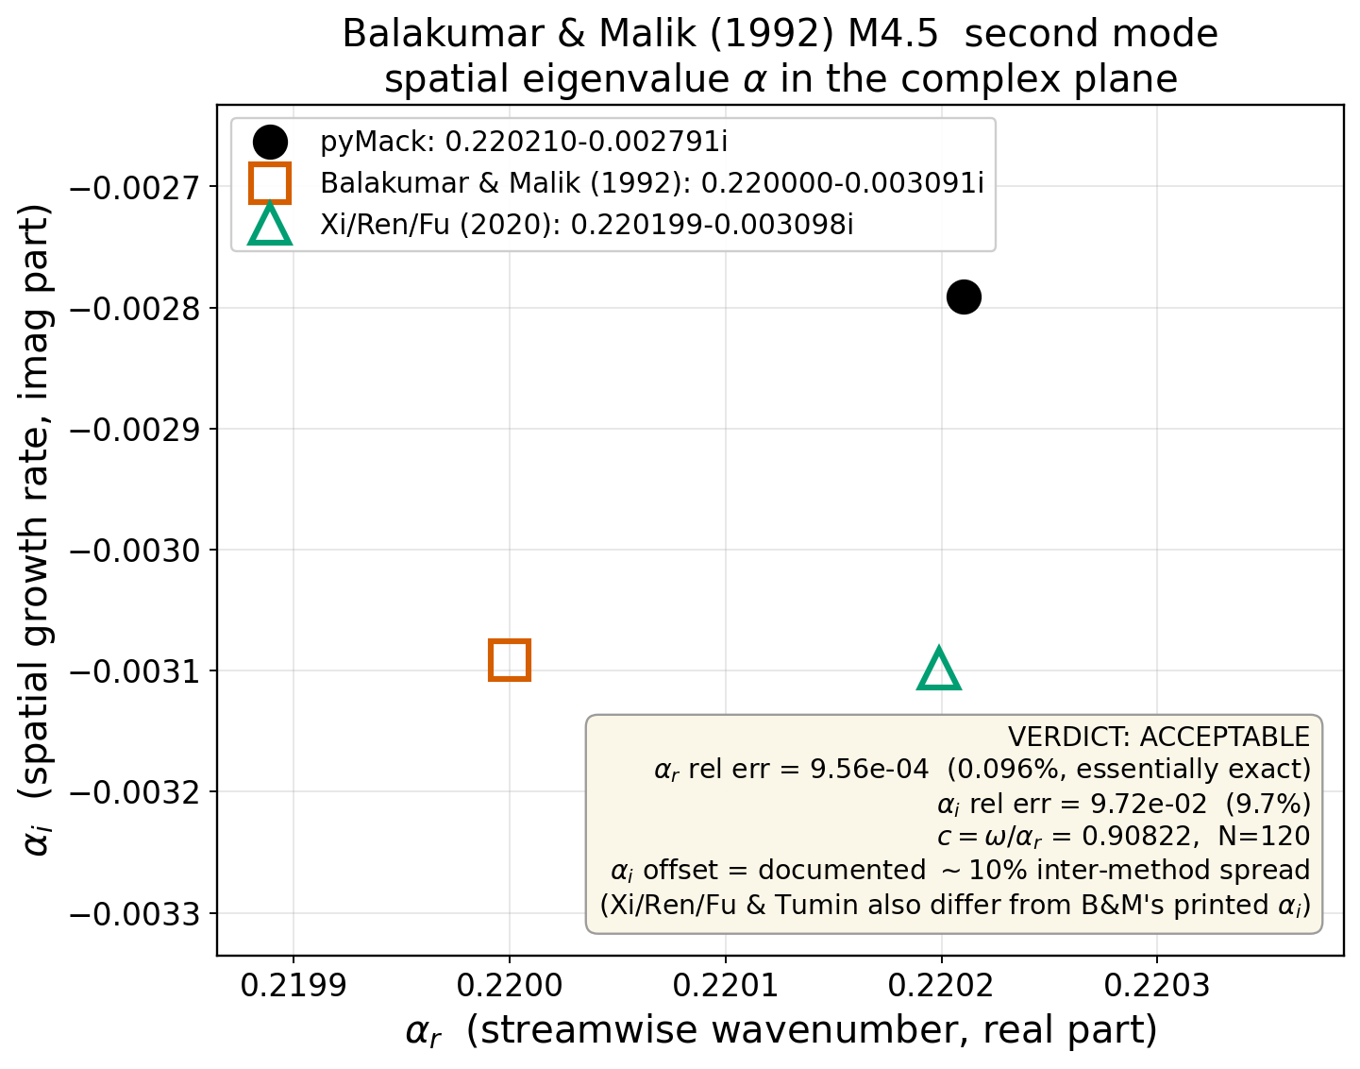
Balakumar & Malik (1992)
M = 4.5 · spatial eigenvalue α
RUN CONDITIONS
Mach: 4.5
Gas / γ: air / 1.4
Wall BC: adiabatic (recovery Tw/Te ≈ 4.44)
Edge temp Te: 61.6 K (T0 = 311 K)
Prandtl Pr: 0.72
Reynolds: R = 1000 (= √Re_x)
Frequency ω: 0.2
Length scale: L* = √(νₑ x / Uₑ)
2nd viscosity λ: 1.2 (λμ/μ; 0 = Stokes)
Collocation / domain: N = 120 Cheb.; y_max = 40 L*
AGREEMENT
ACCEPTABLE
α_r 0.1%, α_i 9.7% (N=120)
balakumar_malik1992_via_xirenfu · pyMack vs. benchmark — verification audit

Slide 6
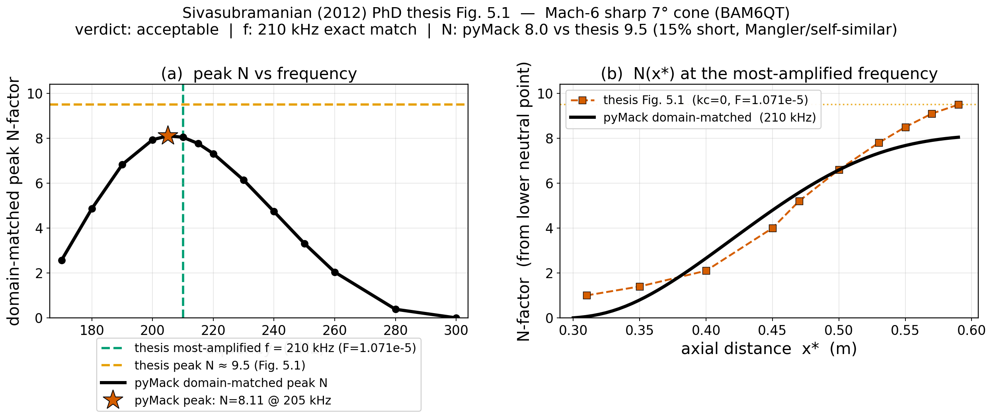
Sivasubramanian & Fasel (2015)
7° cone, M_e = 5.36 · 2nd-mode growth / N
RUN CONDITIONS
Mach: 5.356 (edge; M∞ = 6)
Gas / γ: air / 1.4
Wall BC: isothermal Tw=300 K (Tw/Te=4.70)
Prandtl Pr: 0.72
Viscosity / transport: Sutherland (S=110.4 K), Pr=0.72, gamma=1.4
Formulation: spatial 2nd mode (L* scale, lambda_mu_ratio=1.2), cone Mangler N=int 6 sigma_L dR_eq, clip_negative (envelope from lower neutral point)
2nd viscosity λ: 1.2 (λμ/μ; 0 = Stokes)
Collocation / domain: N = 90 Cheb.; y_max = 40 L*
AGREEMENT
ACCEPTABLE
f: 210 kHz EXACT match (pyMack peak-N at 205 kHz; N=8.05 at the thesis 210 kHz). N: pyMack domain-matched 8.0-8.1 vs thesis 9.5 -> ~15% short (Mangler …
cone_sivasubramanian_fasel_2015 · pyMack vs. benchmark — verification audit

Slide 7
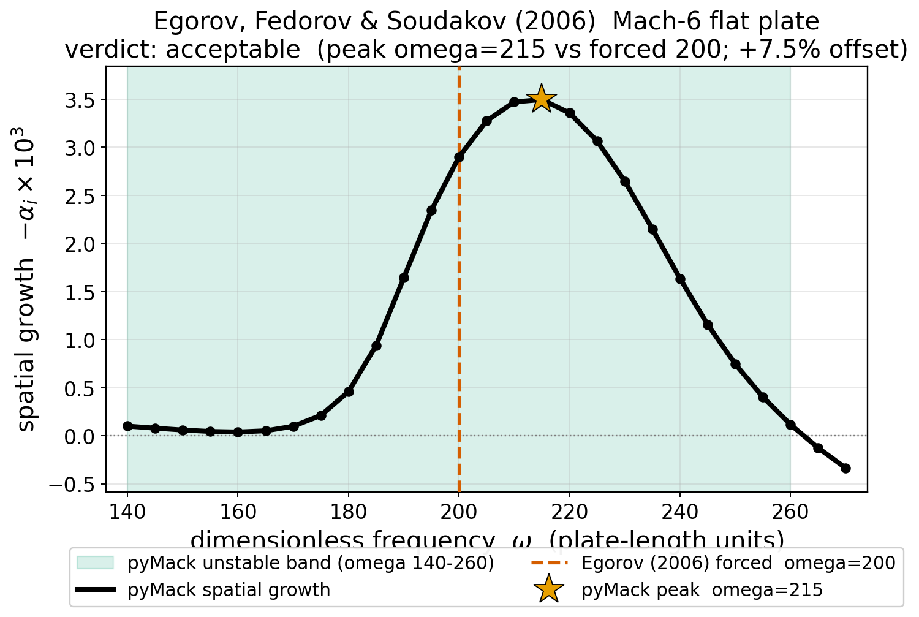
Egorov, Fedorov & Soudakov (2006)
M = 6 · 2nd-mode growth band
RUN CONDITIONS
Mach: 6
Gas / γ: air (perfect gas) / 1.4
Wall BC: adiabatic (recovery Tw/Te ≈ 7.11)
Prandtl Pr: 0.72
Viscosity / transport: power_law(0.7)
Reynolds: Re_x = 2×10⁶ (R = √Re_x)
Formulation: spatial 2D second mode (solve_spatial, L*)
2nd viscosity λ: 1.2 (λμ/μ; 0 = Stokes)
Collocation / domain: N = 140 Cheb.; y_max = 40 L*
AGREEMENT
ACCEPTABLE
rel_err=0.075; pymack_value=215
egorov2006_m6 · pyMack vs. benchmark — verification audit

Slide 8
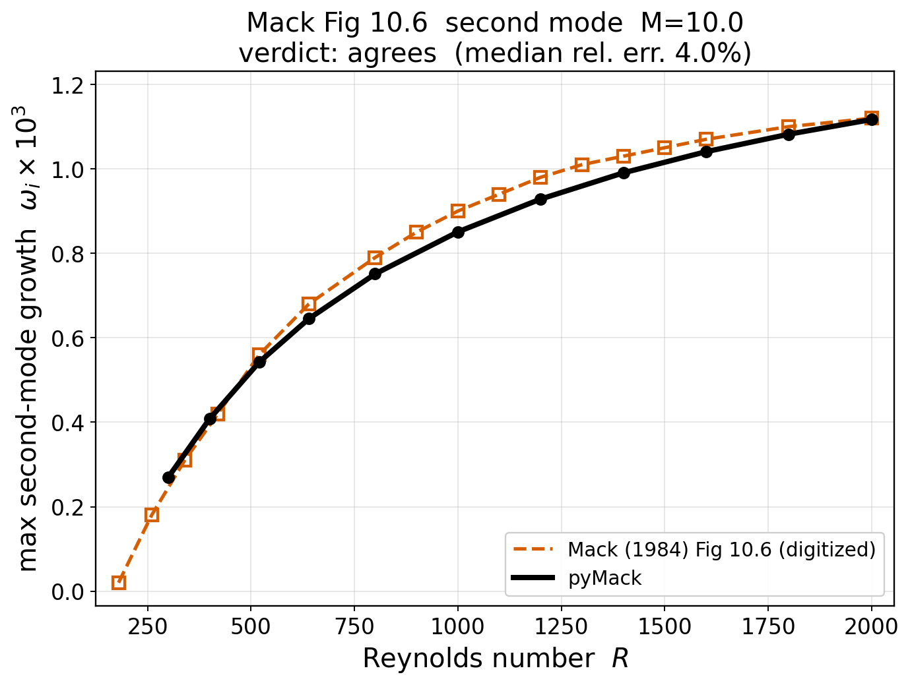
Mack (1984) Fig 10.6
M = 10 · max 2nd-mode temporal growth
RUN CONDITIONS
Mach: 10
Gas / γ: air / 1.4
Wall BC: adiabatic (recovery Tw/Te ≈ 17.97)
Prandtl Pr: 0.72
Viscosity / transport: Mack
Formulation: temporal 2D max second-mode growth
2nd viscosity λ: 0 (λμ/μ; 0 = Stokes)
Collocation / domain: N = 200 Cheb.; y_max = 140 L*
AGREEMENT
AGREES
curve median 4.0%
mack_fig10_6_M100 · pyMack vs. benchmark — verification audit

Slide 9
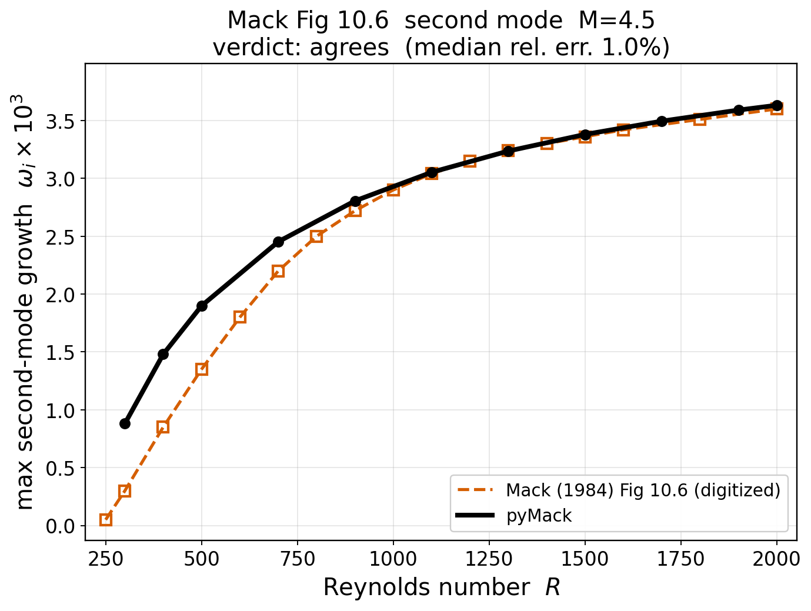
Mack (1984) Fig 10.6
M = 4.5 · max 2nd-mode temporal growth
RUN CONDITIONS
Mach: 4.5
Gas / γ: air / 1.4
Wall BC: adiabatic (recovery Tw/Te ≈ 4.44)
Prandtl Pr: 0.72
Viscosity / transport: Mack
Formulation: temporal 2D max second-mode growth
2nd viscosity λ: 0 (λμ/μ; 0 = Stokes)
Collocation / domain: N = 120 Cheb.; y_max = 40 L*
AGREEMENT
AGREES
curve median 1.0%
mack_fig10_6_M45 · pyMack vs. benchmark — verification audit

Slide 10
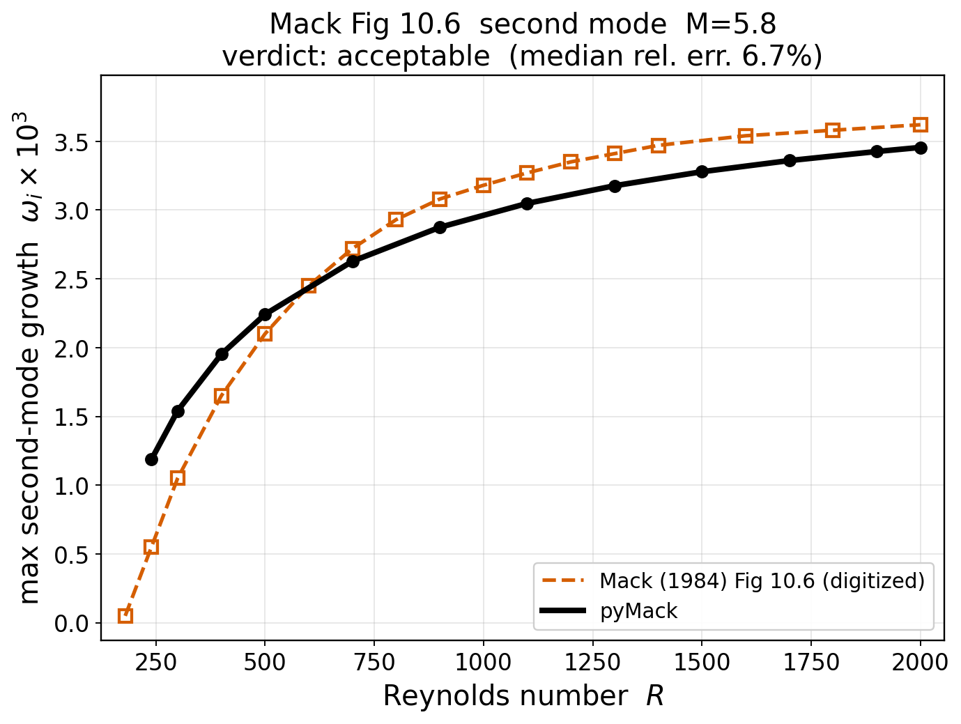
Mack (1984) Fig 10.6
M = 5.8 · max 2nd-mode temporal growth
RUN CONDITIONS
Mach: 5.8
Gas / γ: air / 1.4
Wall BC: adiabatic (recovery Tw/Te ≈ 6.71)
Prandtl Pr: 0.72
Viscosity / transport: Mack
Formulation: temporal 2D max second-mode growth
2nd viscosity λ: 0 (λμ/μ; 0 = Stokes)
Collocation / domain: N = 150 Cheb.; y_max = 64 L*
AGREEMENT
ACCEPTABLE
curve median 6.7%
mack_fig10_6_M58 · pyMack vs. benchmark — verification audit

Slide 11
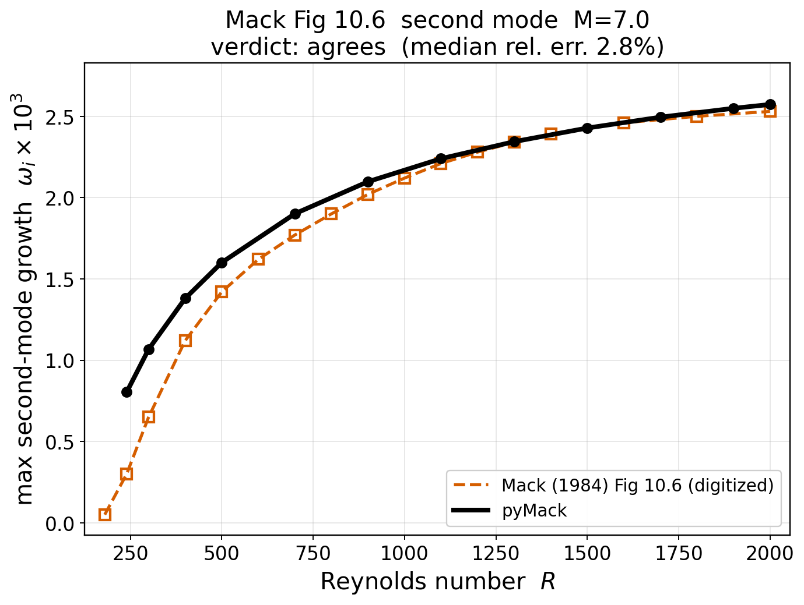
Mack (1984) Fig 10.6
M = 7.0 · max 2nd-mode temporal growth
RUN CONDITIONS
Mach: 7
Gas / γ: air / 1.4
Wall BC: adiabatic (recovery Tw/Te ≈ 9.32)
Prandtl Pr: 0.72
Viscosity / transport: Mack
Formulation: temporal 2D max second-mode growth
2nd viscosity λ: 0 (λμ/μ; 0 = Stokes)
Collocation / domain: N = 170 Cheb.; y_max = 88 L*
AGREEMENT
AGREES
curve median 2.8%
mack_fig10_6_M70 · pyMack vs. benchmark — verification audit

Slide 12
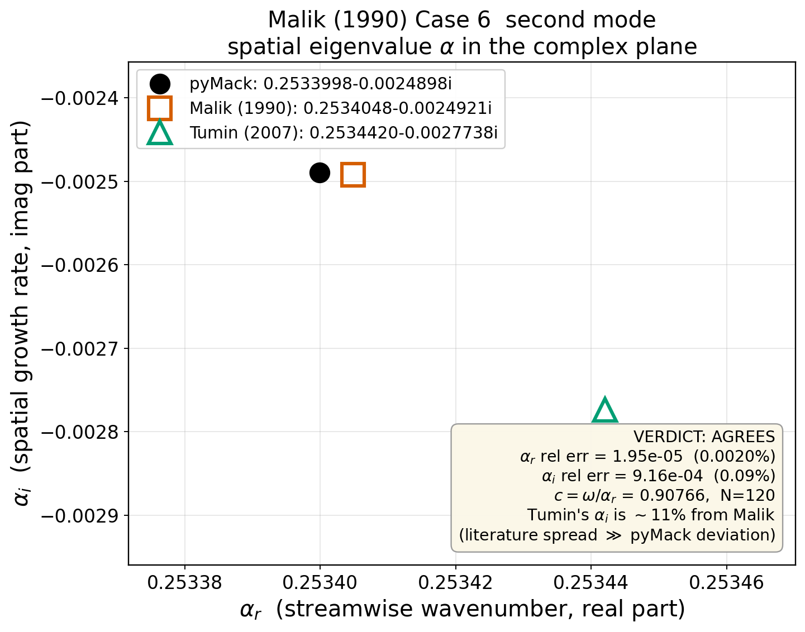
Malik (1990) Case 6
M = 4.5 · spatial eigenvalue α
RUN CONDITIONS
Mach: 4.5
Gas / γ: air / 1.4
Wall BC: adiabatic (recovery Tw/Te ≈ 4.39)
Edge temp Te: 121.0 K (T0 = 611 K)
Prandtl Pr: 0.7
Reynolds: R = 1500 (= √Re_x)
Frequency ω: 0.23
Length scale: L* = √(νₑ x / Uₑ)
2nd viscosity λ: 1.2 (λμ/μ; 0 = Stokes)
Collocation / domain: N = 120 Cheb.; y_max = 40 L*
AGREEMENT
AGREES
α_r 0.0%, α_i 0.1% (N=120)
malik_case6 · pyMack vs. benchmark — verification audit

Slide 13
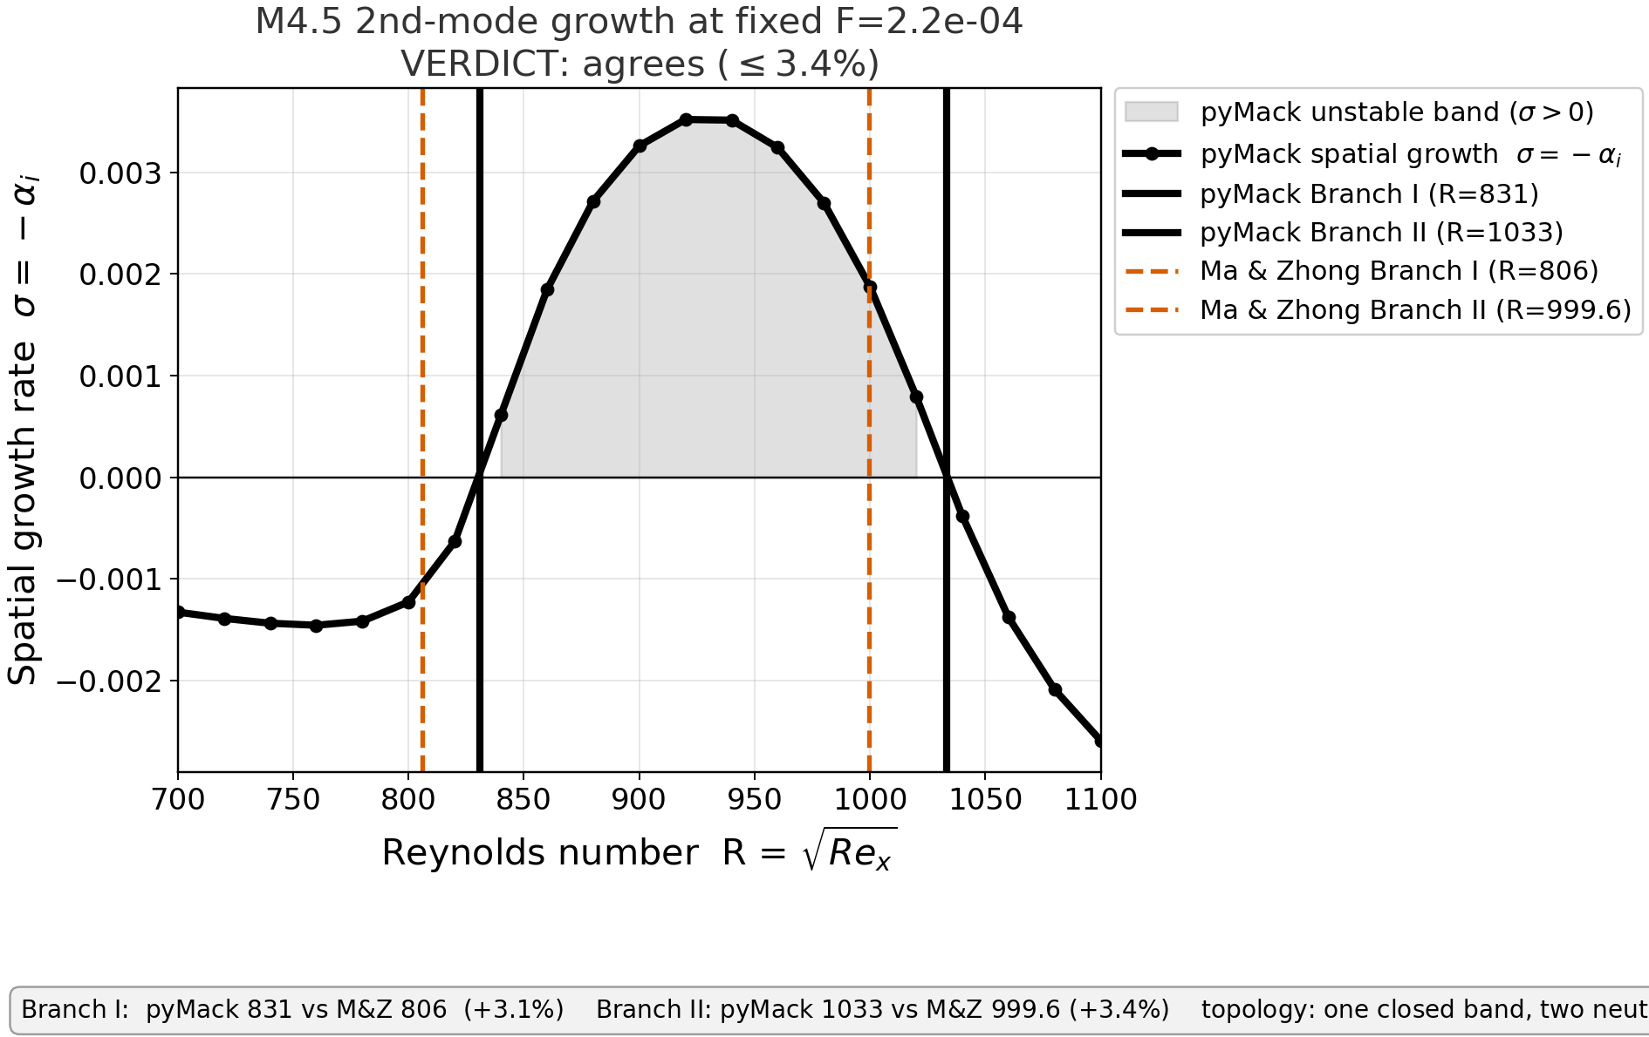
Ma & Zhong (2003), JFM
M = 4.5 · 2nd-mode neutral curve
RUN CONDITIONS
Mach: 4.5
Gas / γ: air / 1.4
Wall BC: adiabatic (recovery Tw/Te ≈ 4.44)
Edge temp Te: 65.2 K
Prandtl Pr: 0.72
Viscosity / transport: Sutherland viscosity (S=110.33 K), constant Pr=0.72
Reynolds: unit Re = 7.2×10⁶ /m
Reduced freq F: 0.00022 (ω = R·F)
Formulation: spatial second mode (Mack), F fixed
2nd viscosity λ: 1.2 (λμ/μ; 0 = Stokes)
Collocation / domain: N = 130 Cheb.; y_max = 40 L*
Disturbance T BC: adiabatic (Fig.15 neutral curve)
AGREEMENT
AGREES
2nd-mode neutral band matches Fig.15 across full omega-R range (branch I/II 3.1%/3.4% at F=2.2e-4, anchors 806/999.6); 1st-mode cutoff branch tracks, onset …
mazhong2003_m4p5 · pyMack vs. benchmark — verification audit

Slide 14
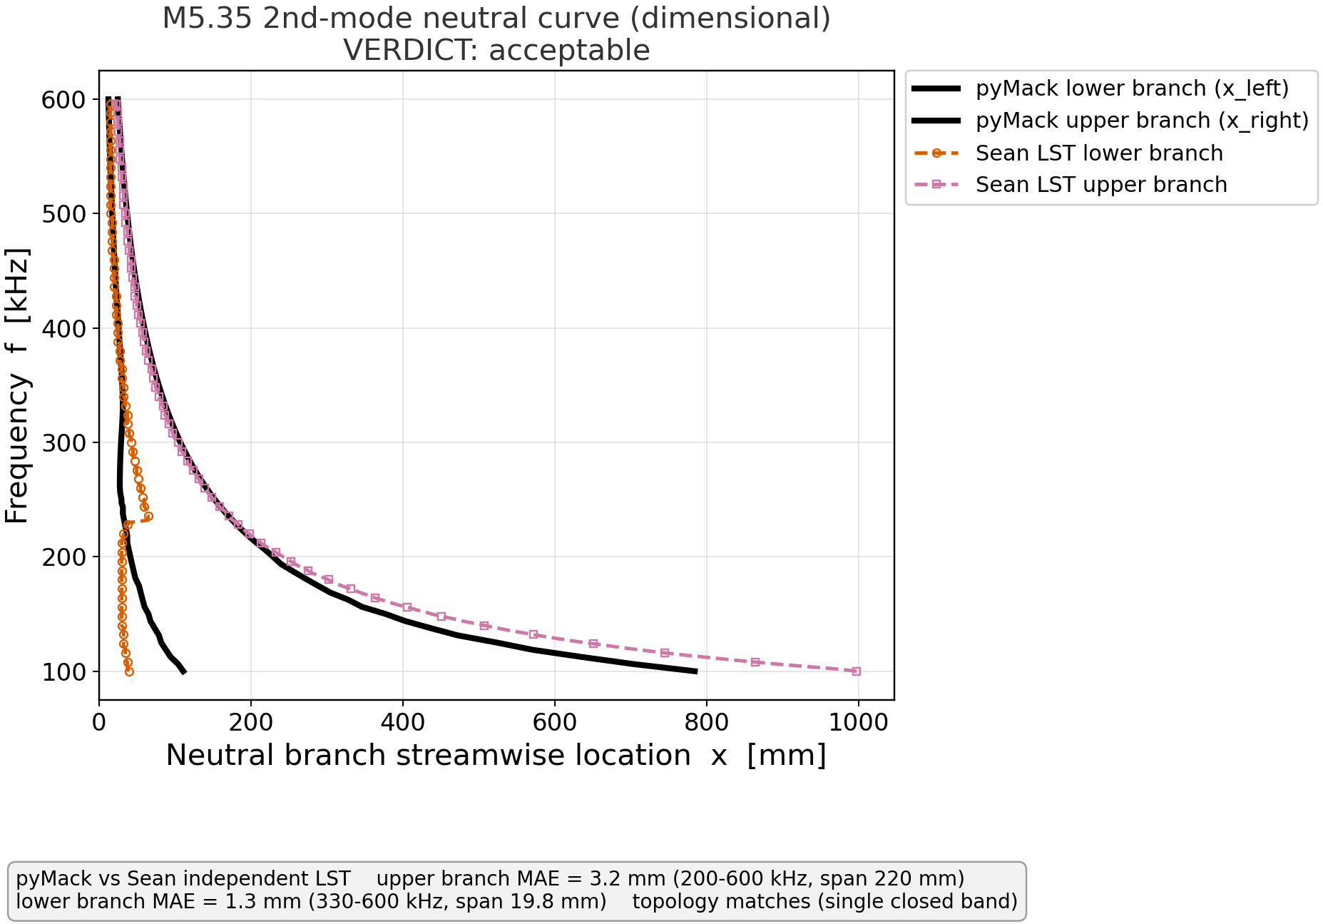
Independent collaborator LST
M = 5.35 · N₂ · 2nd-mode neutral curve
RUN CONDITIONS
Mach: 5.35
Gas / γ: nitrogen / 1.4
Wall BC: adiabatic (recovery Tw/Te ≈ 5.86)
Edge temp Te: 64.0 K
Prandtl Pr: 0.72
Viscosity / transport: power-law Blasius (viscosity exponent 0.74, Pr 0.72)
Reynolds: unit Re = 11.76×10⁶ /m
Formulation: spatial second mode
AGREEMENT
ACCEPTABLE
upper 3.2 mm; lower 1.3 mm (gated bands)
sean_m5p35 · pyMack vs. benchmark — verification audit

Slide 15
First mode
9 validation cases — Özgen Fig 3 + Mack oblique first mode

Slide 16
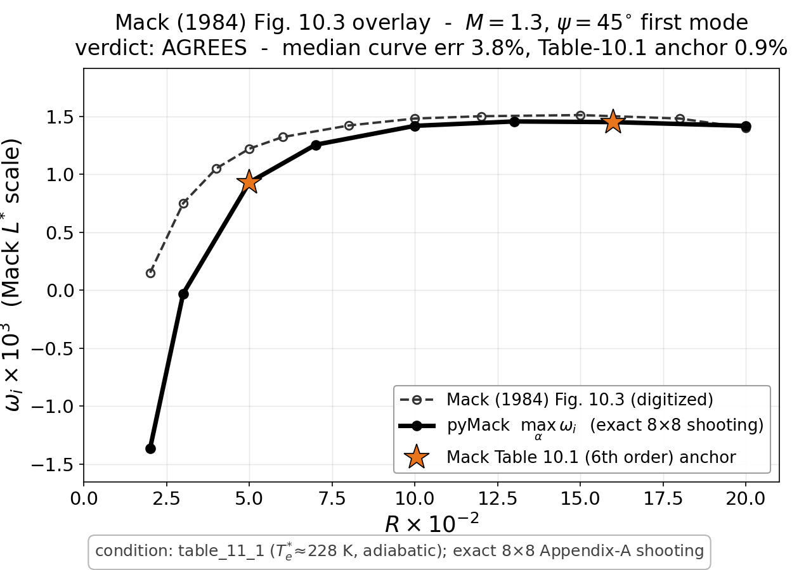
Mack (1984) Fig 10.3
M = 1.3, ψ = 45° · max 1st-mode growth
RUN CONDITIONS
Mach: 1.3
Gas / γ: air (ideal, Pr=0.72) / 1.4
Wall BC: adiabatic (recovery Tw/Te ≈ 1.29)
Edge temp Te: 228.0 K
Prandtl Pr: 0.72
Viscosity / transport: Sutherland viscosity, compressible boundary layer
Length scale: L* = √(νₑ x / Uₑ)
Formulation: temporal first mode, max growth over alpha (3D oblique), ψ = 45.0°
Collocation / domain: y_max = 26 L*
AGREEMENT
AGREES
curve median 3.8%; Table-10.1 anchor 0.9%
mack_fig10_3_m1p3 · pyMack vs. benchmark — verification audit

Slide 17
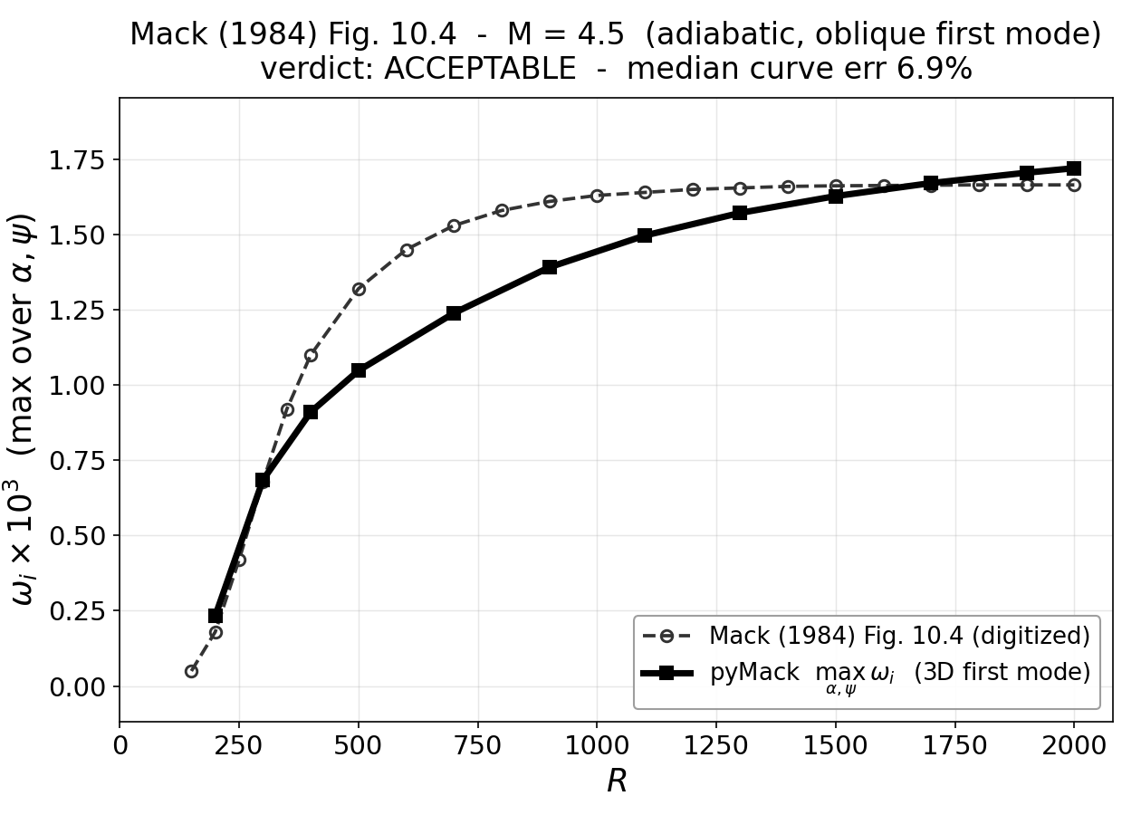
Mack (1984) Fig 10.4
M = 4.5 · max 1st-mode growth (oblique)
RUN CONDITIONS
Mach: 4.5
Gas / γ: air / 1.4
Wall BC: adiabatic (recovery Tw/Te ≈ 4.44)
Prandtl Pr: 0.72
Viscosity / transport: Mack
Formulation: temporal 3D max first-mode growth over (alpha, psi)
2nd viscosity λ: 0 (λμ/μ; 0 = Stokes)
Collocation / domain: N = 130 Cheb.; y_max = 42 L*
AGREEMENT
ACCEPTABLE
curve median 6.9%
mack_fig10_4_M45 · pyMack vs. benchmark — verification audit

Slide 18
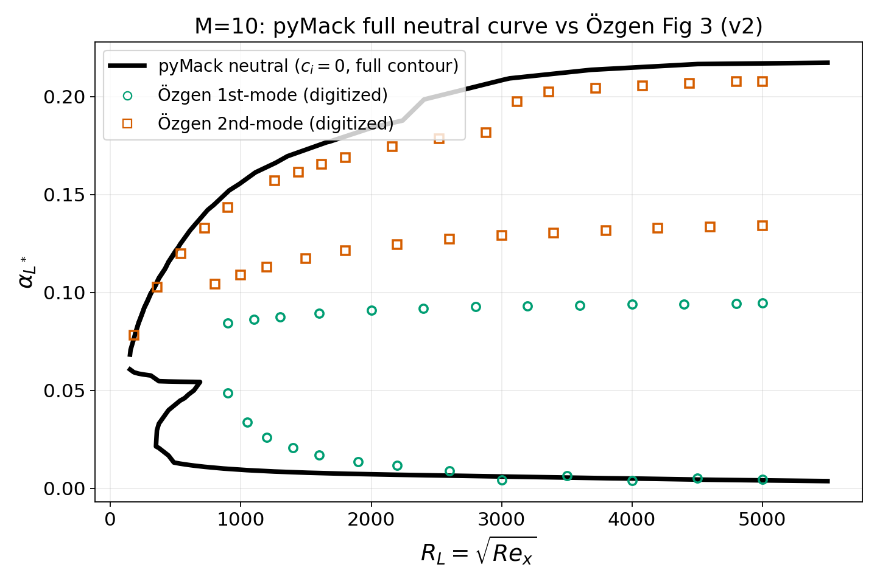
Özgen & Kırcalı (2008) Fig 3
M = 10 · neutral curve
RUN CONDITIONS
Mach: 10
Gas / γ: air / 1.4
Wall BC: adiabatic (recovery Tw/Te ≈ 17.97)
Edge temp Te: 288 K
Prandtl Pr: 0.72
Viscosity / transport: Özgen T-dependent μ, κ (Sutherland-type)
Length scale: L* = √(νₑ x / Uₑ), R = √Re_x
Formulation: temporal 2D
Collocation / domain: N ≈ 180–240 Cheb.; y_max 8–45 δ*/L*
Disturbance T BC: isothermal T̂(0)=0 (Özgen Eq. 19)
Mode selection: eigenfunction-decay + y_max-stationarity
AGREEMENT
ACCEPTABLE
full-contour match: robust branches median 50.0%; second_upper 5%(84%cov); second_lower 62%(77%cov); first_upper 95%(85%cov); first_lower 53%(85%cov)
ozgen_m10 · pyMack vs. benchmark — verification audit

Slide 19
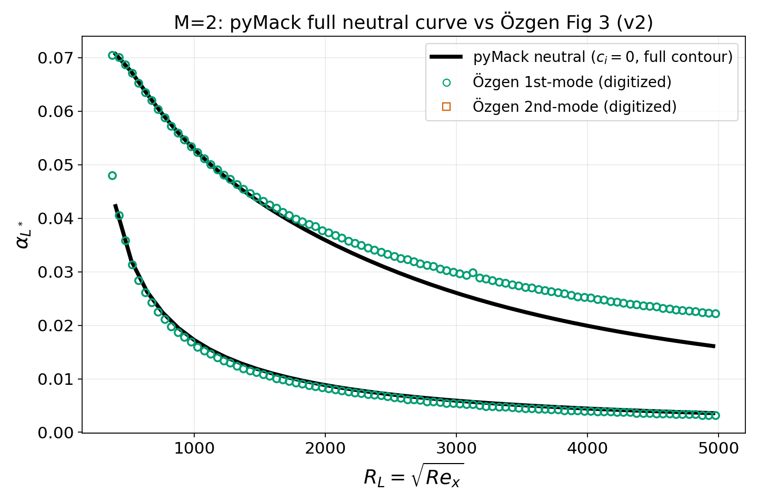
Özgen & Kırcalı (2008) Fig 3
M = 2 · neutral curve
RUN CONDITIONS
Mach: 2
Gas / γ: air / 1.4
Wall BC: adiabatic (recovery Tw/Te ≈ 1.68)
Edge temp Te: 288 K
Prandtl Pr: 0.72
Viscosity / transport: Özgen T-dependent μ, κ (Sutherland-type)
Length scale: L* = √(νₑ x / Uₑ), R = √Re_x
Formulation: temporal 2D
Collocation / domain: N ≈ 180–240 Cheb.; y_max 8–45 δ*/L*
Disturbance T BC: isothermal T̂(0)=0 (Özgen Eq. 19)
Mode selection: eigenfunction-decay + y_max-stationarity
AGREEMENT
ACCEPTABLE
full-contour match: robust branches median 8.0%; first_upper 8%(100%cov); first_lower 7%(100%cov)
ozgen_m2 · pyMack vs. benchmark — verification audit

Slide 20
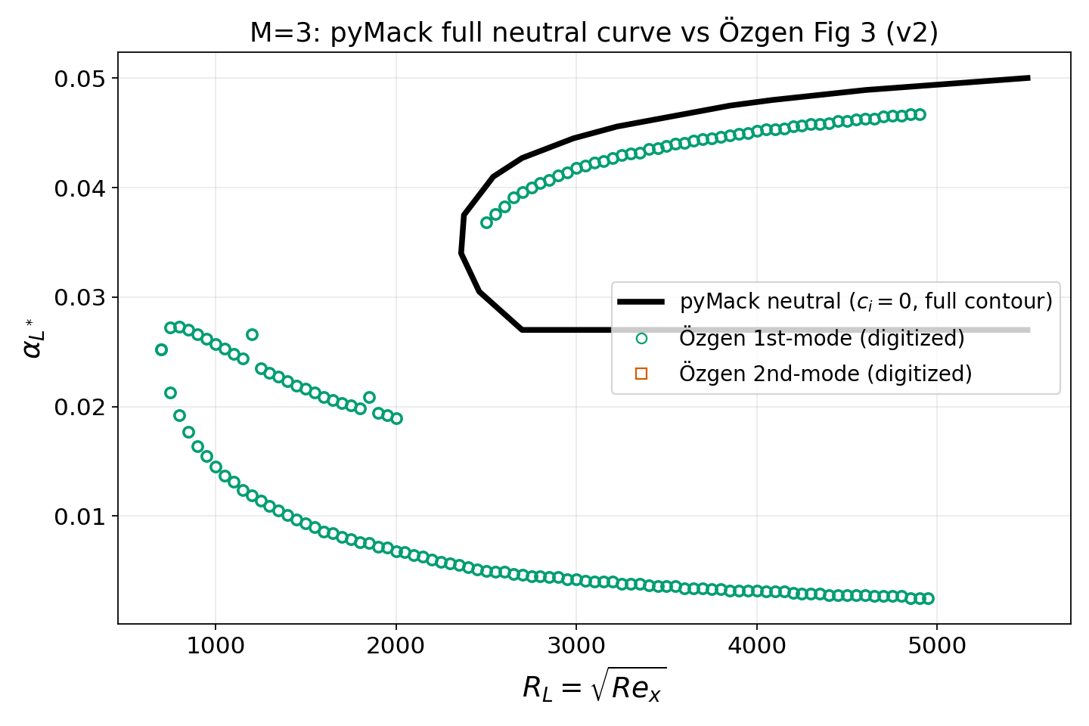
Özgen & Kırcalı (2008) Fig 3
M = 3 · neutral curve
RUN CONDITIONS
Mach: 3
Gas / γ: air / 1.4
Wall BC: adiabatic (recovery Tw/Te ≈ 2.53)
Edge temp Te: 288 K
Prandtl Pr: 0.72
Viscosity / transport: Özgen T-dependent μ, κ (Sutherland-type)
Length scale: L* = √(νₑ x / Uₑ), R = √Re_x
Formulation: temporal 2D
Collocation / domain: N ≈ 180–240 Cheb.; y_max 8–45 δ*/L*
Disturbance T BC: isothermal T̂(0)=0 (Özgen Eq. 19)
Mode selection: eigenfunction-decay + y_max-stationarity
AGREEMENT
ACCEPTABLE
full-contour match: robust branches median 6.0%; first_upper 6%(41%cov); first_lower 731%(42%cov)
ozgen_m3 · pyMack vs. benchmark — verification audit

Slide 21
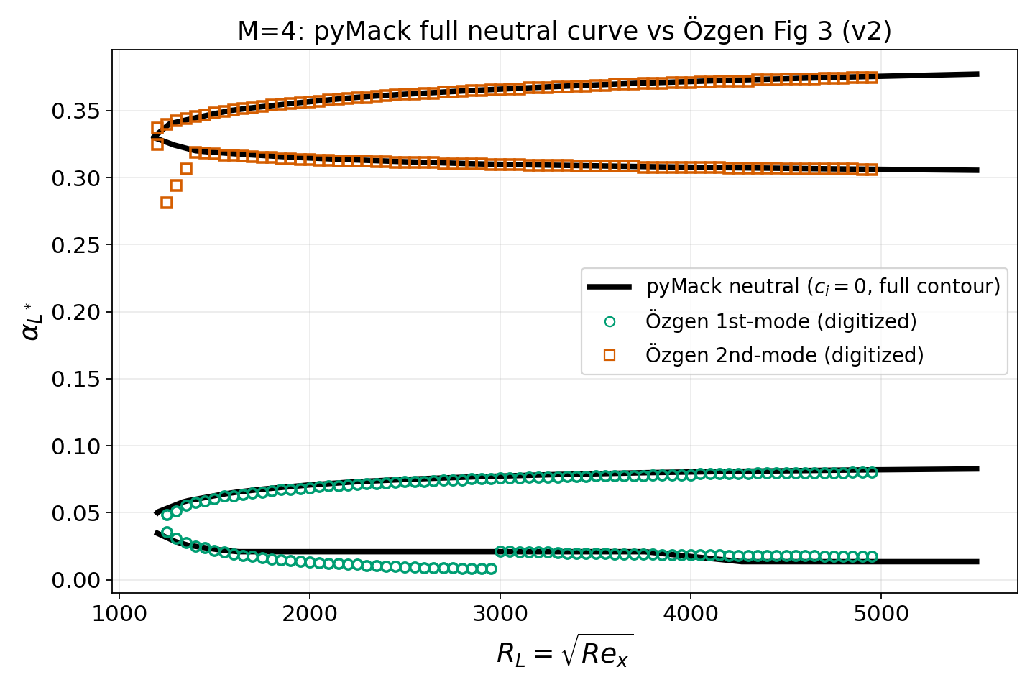
Özgen & Kırcalı (2008) Fig 3
M = 4 · neutral curve (two lobes)
RUN CONDITIONS
Mach: 4
Gas / γ: air / 1.4
Wall BC: adiabatic (recovery Tw/Te ≈ 3.72)
Edge temp Te: 288 K
Prandtl Pr: 0.72
Viscosity / transport: Özgen T-dependent μ, κ (Sutherland-type)
Length scale: L* = √(νₑ x / Uₑ), R = √Re_x
Formulation: temporal 2D
Collocation / domain: N ≈ 180–240 Cheb.; y_max 8–45 δ*/L*
Disturbance T BC: isothermal T̂(0)=0 (Özgen Eq. 19)
Mode selection: eigenfunction-decay + y_max-stationarity
AGREEMENT
AGREES
full-contour match: robust branches median 1.3%; first_lower 32%(85%cov); first_upper 2%(85%cov); second_upper 0%(86%cov); second_lower 0%(86%cov)
ozgen_m4 · pyMack vs. benchmark — verification audit

Slide 22
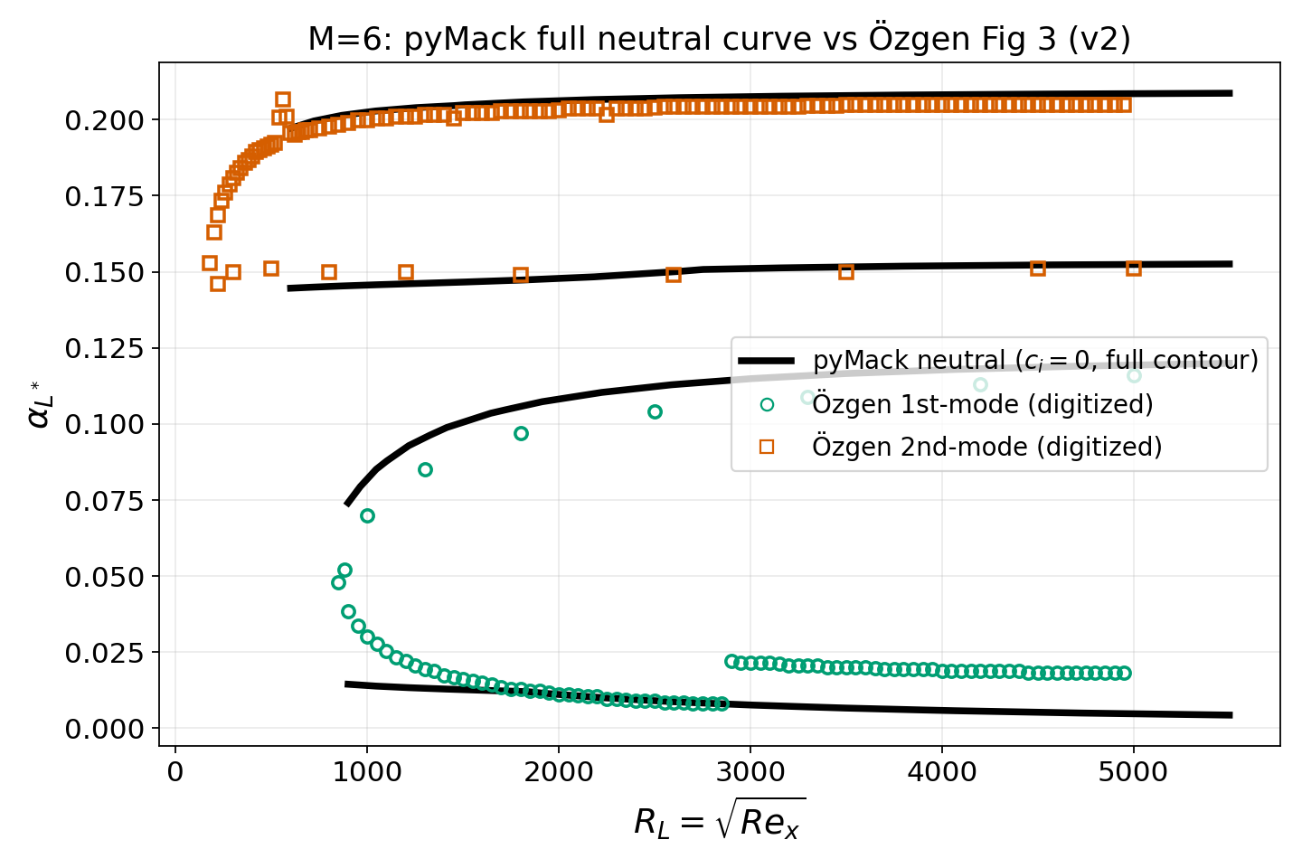
Özgen & Kırcalı (2008) Fig 3
M = 6 · neutral curve (two lobes)
RUN CONDITIONS
Mach: 6
Gas / γ: air / 1.4
Wall BC: adiabatic (recovery Tw/Te ≈ 7.11)
Edge temp Te: 288 K
Prandtl Pr: 0.72
Viscosity / transport: Özgen T-dependent μ, κ (Sutherland-type)
Length scale: L* = √(νₑ x / Uₑ), R = √Re_x
Formulation: temporal 2D
Collocation / domain: N ≈ 180–240 Cheb.; y_max 8–45 δ*/L*
Disturbance T BC: isothermal T̂(0)=0 (Özgen Eq. 19)
Mode selection: eigenfunction-decay + y_max-stationarity
AGREEMENT
ACCEPTABLE
full-contour match: robust branches median 5.3%; second_upper 2%(77%cov); first_lower 50%(88%cov); second_lower 3%(70%cov); first_upper 9%(75%cov)
ozgen_m6 · pyMack vs. benchmark — verification audit

Slide 23
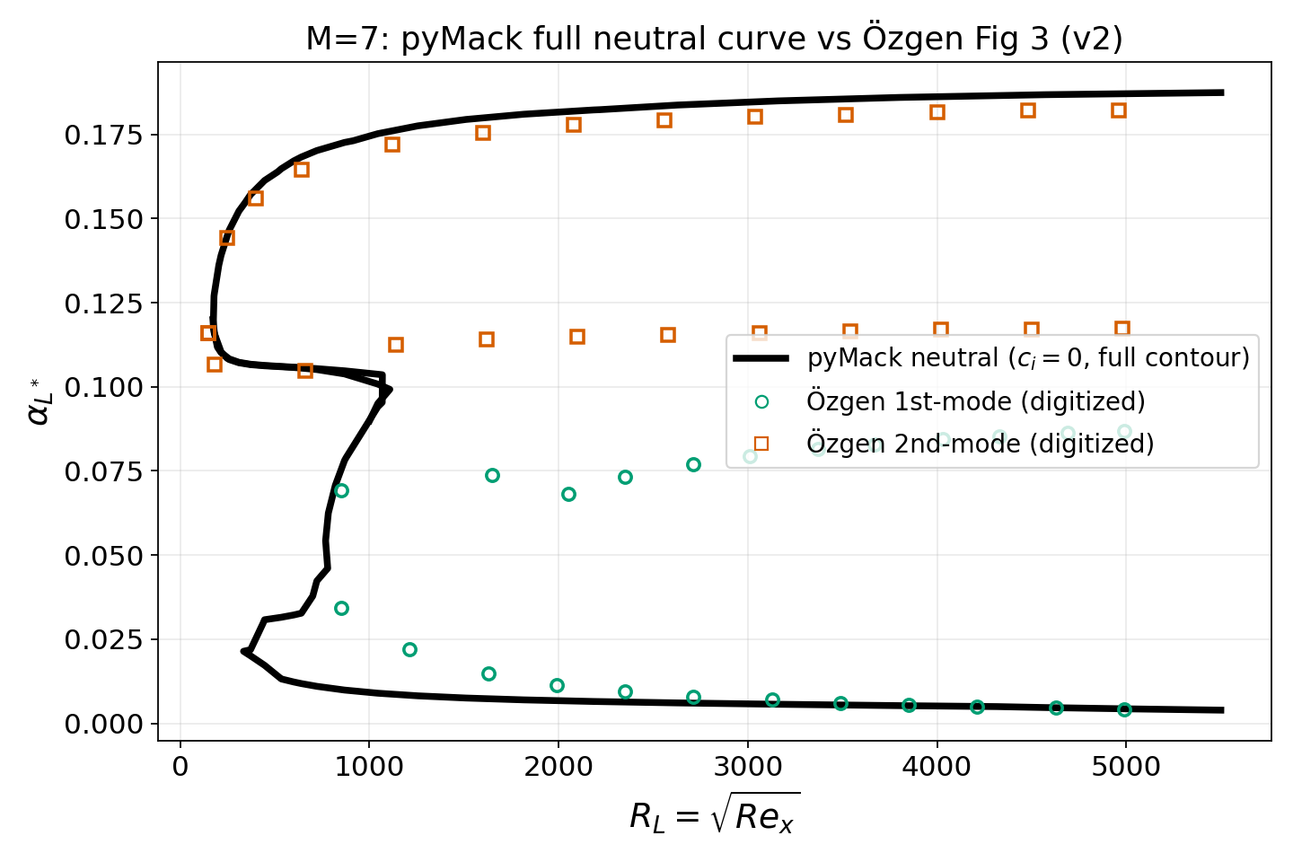
Özgen & Kırcalı (2008) Fig 3
M = 7 · neutral curve
RUN CONDITIONS
Mach: 7
Gas / γ: air / 1.4
Wall BC: adiabatic (recovery Tw/Te ≈ 9.32)
Edge temp Te: 288 K
Prandtl Pr: 0.72
Viscosity / transport: Özgen T-dependent μ, κ (Sutherland-type)
Length scale: L* = √(νₑ x / Uₑ), R = √Re_x
Formulation: temporal 2D
Collocation / domain: N ≈ 180–240 Cheb.; y_max 8–45 δ*/L*
Disturbance T BC: isothermal T̂(0)=0 (Özgen Eq. 19)
Mode selection: eigenfunction-decay + y_max-stationarity
AGREEMENT
ACCEPTABLE
full-contour match: robust branches median 48.1%; second_upper 2%(77%cov); second_lower 58%(83%cov); first_upper 94%(42%cov); first_lower 20%(75%cov)
ozgen_m7 · pyMack vs. benchmark — verification audit

Slide 24
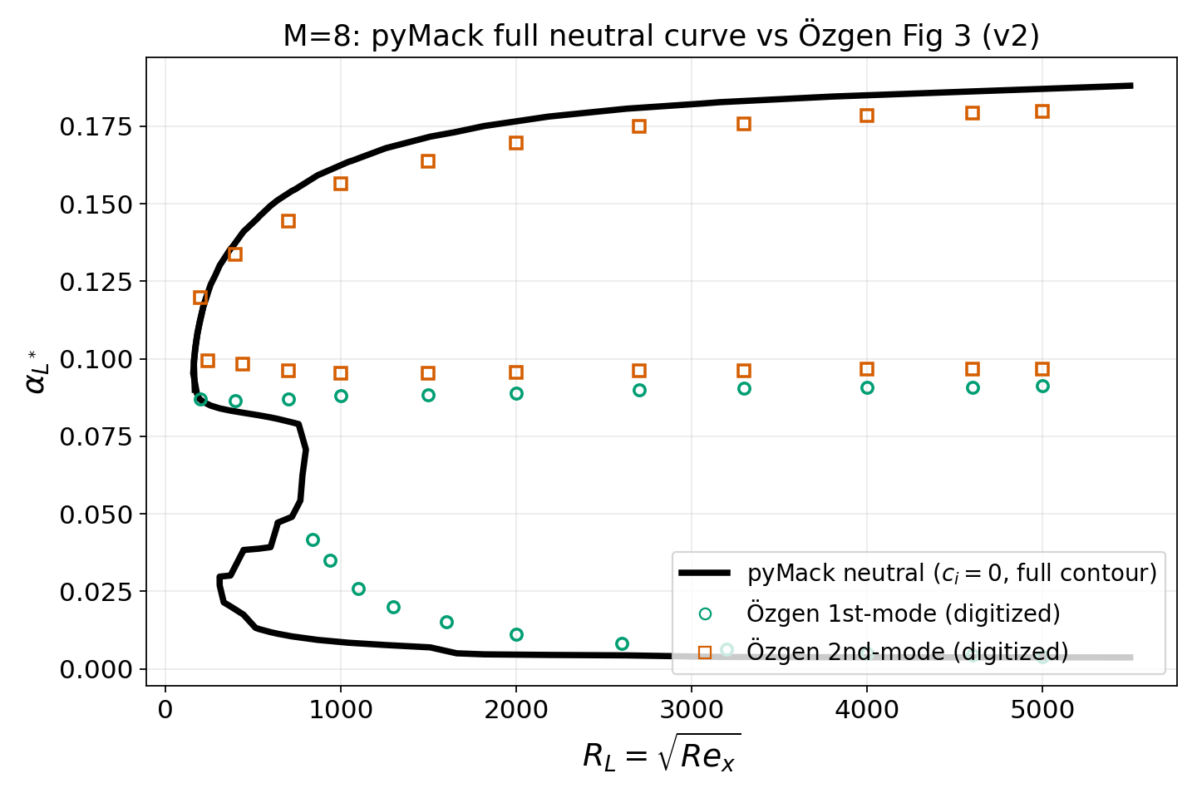
Özgen & Kırcalı (2008) Fig 3
M = 8 · neutral curve
RUN CONDITIONS
Mach: 8
Gas / γ: air / 1.4
Wall BC: adiabatic (recovery Tw/Te ≈ 11.86)
Edge temp Te: 288 K
Prandtl Pr: 0.72
Viscosity / transport: Özgen T-dependent μ, κ (Sutherland-type)
Length scale: L* = √(νₑ x / Uₑ), R = √Re_x
Formulation: temporal 2D
Collocation / domain: N ≈ 180–240 Cheb.; y_max 8–45 δ*/L*
Disturbance T BC: isothermal T̂(0)=0 (Özgen Eq. 19)
Mode selection: eigenfunction-decay + y_max-stationarity
AGREEMENT
ACCEPTABLE
full-contour match: robust branches median 44.7%; second_upper 4%(64%cov); second_lower 72%(64%cov); first_upper 86%(64%cov); first_lower 51%(73%cov)
ozgen_m8 · pyMack vs. benchmark — verification audit

Slide 25
Summary
Second (Mack) mode — validated.
Agrees with Mack (1984), Malik (1990), Balakumar & Malik (1992), Ma & Zhong (2003), Egorov (2006), an independent collaborator solver, and a cone (Sivasubramanian & Fasel 2015), across Mach 4.5–10.
First mode — agrees where the discrete mode is resolvable.
Özgen & Kırcalı (2008) neutral curves M = 2–10: second-mode branches and the first-mode cutoff agree once a discrete-mode (eigenfunction-decay) extractor replaces the phase-speed-band classifier.
Honest open items.
The low-α first-mode onset at low Mach is continuous-spectrum-limited; at high Mach pyMack marginally over-predicts the inter-mode region. Mack Fig 10.1/10.4 low-Mach first modes await the same discrete-mode scrutiny.

