Slide 1
Embedding Geometric Heuristics for Improving RAG Systems
M.SC. RESEARCH PROPOSAL · SEMINAR
Bar Mordechai Damri
The Stein Faculty of Computer and Information Science, Ben-Gurion University of the Negev
Supervisors: Prof. Roni Stern · Prof. Rami Puzis
October 2026
Notes:
Introduce yourself, the program and the supervisors. One sentence: this talk presents the proposal and the preliminary results that motivate it.

Slide 2
A RAG answer is only as good as its retriever
WHAT IS RAG
1
2
3
Indexer
Retriever
Generator
Runs once in advance. Turns every document into an embedding, a vector of numbers that captures its meaning, and stores the vectors.
Runs for every question. Embeds the question the same way and returns the documents whose vectors are closest to it.
The language model. Receives the question with the retrieved documents and writes the answer from them.
Embedding. Texts with similar meaning get similar vectors. Each question and each document is one point in a 768-dimensional space, and the retriever returns the nearest points.
If the right document is not retrieved, the generator cannot answer correctly, and irrelevant documents push it toward wrong answers. The retriever is an upper bound on the whole system.
Notes:
Standard RAG pipeline. The retrieval step is the bottleneck: the generator can never fix a retrieval miss. Lewis 2020; Shi 2023 on distractors.

Slide 3
Every retriever searches from an anchor
HOW RETRIEVERS SEARCH
A bi-encoder embeds the question and each document separately, scales every vector to length 1, and ranks documents by cosine similarity: the cosine of the angle between the two vectors.
The point the search runs from is the search anchor. In a standard retriever the anchor is the question itself. The whole design assumes a question lands close to the documents that answer it.
anchor
returned: the nearest points to the anchor
Methods that move the anchor
Rewriting the question before embedding it (HyDE: embed a hypothetical answer). Relevance feedback: pull the question toward the top results (Rocchio). LLM-guided updates: TOUR, ReDE-RF, BAGEL.
Methods that do not
Re-rankers re-order what the anchor already found. A document the anchor misses stays missed.
Notes:
Define bi-encoder, cosine similarity and nearest-neighbor search in one breath. The anchor is the concept the whole talk works on: rewriting and feedback methods move it; re-rankers never do.

Slide 4
Nobody has measured where a question lands
THE GAP
What is known about the space
What is not known
Embeddings crowd into a narrow cone, so even unrelated texts look fairly similar.
Some points are hubs: nearest neighbors of many others for no semantic reason.
Questions and documents are placed differently: the encoder never sees them together.
Where one question sits relative to the documents that answer it, and to its labeled correct answer.
If questions systematically land away from their answers, nearest-neighbor search from the question is looking in the wrong place, and no re-ranker can fix that.
Measuring instrument. An LLM judge scores every question-document pair from 0.1 to 1.0. It agrees with human assessors about as well as they agree with each other. It also shows that most questions have several equally good answers, so success is counted twice: exact (the labeled answer) and soft (any fully relevant document).
Notes:
Known facts describe the space as a whole (Ethayarajh 2019 on the narrow cone; Radovanovic 2010 on hubs; Li 2021 and Dong 2022 on question/document placement). The per-question picture is missing. The LLM judge is the instrument that lets us measure it.

Slide 5
Measure first, design second: three goals
OUR APPROACH
1
Study the geometry
2
Geometric heuristics
3
Iterative search for the failures
How dense is a question's neighborhood, how far is it from its answers, and which of these properties separate the questions the retriever solves from those it fails.
Move the search anchor from the question toward the region where the relevant documents lie, by an amount set from the measured geometry rather than fixed in advance.
Inspect documents one at a time, ask the judge about each, and move the anchor again after each answer, so the search follows the evidence it collects.
Output: a model that predicts failure from geometry alone.
Output: a better starting point any bi-encoder can use, no retraining.
Output: fewer inspections exactly where the retriever needs help.
Notes:
The geometry is the goal (as in the title). The LLM judge is an instrument, the biomedical collection is the benchmark. Each goal already has a first result behind it, shown in the next slides.

Slide 6
The benchmark: a fully judged biomedical collection
PHASE 1
196
5,035
~1M
768
questions, each with one abstract labeled as the correct answer
PubMed abstracts in the shared pool
question-document pairs scored by an LLM judge (six levels, 0.1 to 1.0)
dimensions, all-mpnet-base-v2 bi-encoder
Why a biomedical collection
Why judge every pair
The gap between questions and documents is largest here: general retrievers lose the most on biomedical tasks, and the questions are short expert queries against dense abstracts. A large gap makes the geometry easier to measure. The domain is not the object of study; every phase ends with a validation on TREC-COVID and MS MARCO.
A retrieval method is a rule for the order in which documents are inspected. With the judge's answer stored for every document, any method runs offline on all 196 questions in seconds, with no new LLM calls. The judging also shows the answer is rarely unique: on average 17 documents per question receive the top score.
Notes:
Biomedical is the benchmark, not the object of study: chosen because the question-document gap is largest there (BEIR, BioASQ, MedCPT). Exhaustive judging turns every retrieval method into an offline simulation.

Slide 7
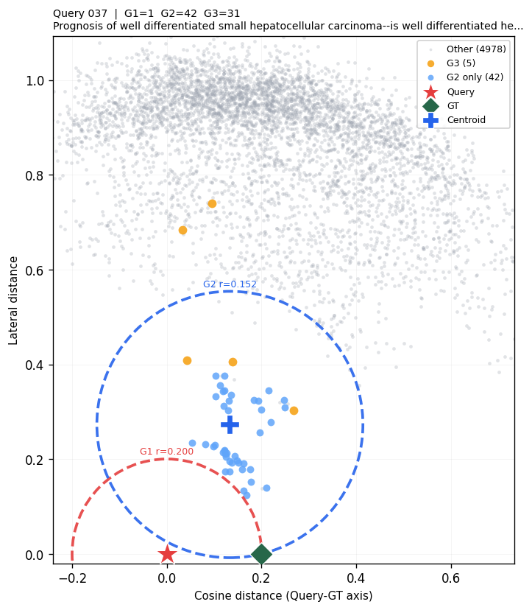
Questions are outliers
FINDING 1
3.1 vs 9.7
44%
documents inside a circle of radius d(·,GT) around the question vs around the centroid C of the relevant documents (random points: 0.8)
closer: the centroid is at distance 0.10 from the correct answer, the question at 0.17
0.39
74%
the correct answer sits off the straight line between the question and the centroid (mean perpendicular offset)
of failed questions have the correct answer inside the question's own circle, against 89% of solved ones
The question sits in a sparse region, far from its own answer. Neither the question nor the centroid alone is the right place to search from.
Question 37. One document inside the question's circle, 42 inside the centroid's.
Notes:
Trilateration plot of question 37: distances to the question (red star) and to the correct answer (green diamond) are exact. Red circle: everything inside is returned before the correct answer by the standard retriever. Blue circle: the same construction around the centroid C of the documents scored 1.0. Numbers are means over 196 questions.

Slide 8
Relevance is graded by distance
FINDING 2
Holds in every question
Within each of the 196 questions, higher scores lie closer to the correct answer.
The judge is a reliable instrument
When it says 'fully relevant', the document is geometrically near the answer.
But it cannot replace geometry
Re-ordering B1's top-5 purely by judge score drops Top-1 from 70.4% to 40.8%: about 17 documents per question tie at the top score.
Notes:
Mean cosine distance from the correct answer, by judge score. Monotone in every step and negative within every one of the 196 questions (Spearman median -0.29). The judge is a good instrument but cannot replace geometry: about 17 documents per question tie at 1.0.

Slide 9
Fixed rules barely help, and most failures are soft
FINDING 3
Method (ranks the pool by ...) | Mean rank | Top-1 | Top-10
B1: distance to the question (standard retriever) | 3.29 | 70.4% | 91.8%
B2: distance to the oracle centroid C | 9.87 | 14.8% | 62.8%
H1: 0.93 d(Q) + 0.07 d(C) | 3.35 | 71.4% | 90.8%
H2: B1 order, centroid breaks ties | 3.29 | 70.4% | 91.8%
H3: B1's top-10 re-ordered by d(C) | 5.05 | 17.9% | 91.8%
Relevance feedback: centroid of judged top-5 | 4.90 | 31.1% | -
LLM re-ranking of B1's top-5 | 2.35 | 40.8% | -
79%
of B1's 58 'failures' return first a document the judge scores 1.0, as relevant as the labeled answer
100%
of the failing questions have a fully relevant document in their top 10
Over 196 questions. Mean rank = average position of the correct document.
A fixed pull toward the centroid gains one point at best. The rule has to adapt to the geometry of each question, and success has to be counted both exactly and softly.
Notes:
Walk the table top to bottom. H1 gains one point; everything stronger loses. Of the 58 questions B1 fails, 46 return a document the judge scores 1.0 first. Exact and soft success are reported side by side throughout.

Slide 10
Three questions, one per goal
RESEARCH QUESTIONS
What does the embedding space look like around a question, and does that geometry tell us when the retriever will fail?
Expected contribution. A measured description of the space and a failure predictor that needs no relevance labels at run time.
RQ1
Can a geometric heuristic that moves the search anchor improve retrieval?
Expected contribution. A one-shot anchor heuristic, the amount of movement set from the measured geometry, and the conditions under which it helps.
RQ2
For the questions where the retriever fails, does an iterative search that keeps moving the anchor do better at the same inspection budget?
Expected contribution. An iterative algorithm, its cost-accuracy curve, and a comparison with the closest published methods.
RQ3
Notes:
RQ1 = Phase 2, RQ2 = Phase 3, RQ3 = Phase 4. Generalization to TREC-COVID and MS MARCO is validation inside each phase, not a separate question.

Slide 11
Predict retriever failure from geometry alone
PHASE 2 · RQ1
Problem
Approach
Evaluation
For each question q: y = 1 if the standard retriever does not rank the correct document first (58 of 196).
x = features computed only from the question's embedding and the pool, with no labels, so a running system could compute them.
Learn f(x) that estimates P(y = 1). Measure: AUC on held-out questions.
Three groups of features:
How far: distance to the 1st, 5th and 20th nearest document.
How crowded: documents within a radius; tightness of the top-20 around their center.
How coherent: distance to the top-20 center; share of mutual neighbors.
Logistic regression and gradient-boosted trees, cross-validated over the 196 questions.
Cross-validated AUC against a no-feature predictor and the closest existing method, coherence-based predictors for bi-encoders.
Repeated on TREC-COVID and MS MARCO with human labels.
The predictor becomes a gate for Phases 3 and 4: which questions to act on, which to leave to the standard retriever.
Notes:
Features use only the question and pool embeddings, never a label. Baselines: no-feature predictor and coherence-based query-performance predictors (Vlachou and Macdonald 2024). The predictor then gates Phases 3 and 4.

Slide 12
A one-shot anchor set by the measured geometry
PHASE 3 · RQ2
A = normalize( Q + λ · (C_{k} − Q) ) C_{k} = centroid of the inspected documents judged relevant. The pool is ranked by distance to A.
λ is set per question, from
Guard rails and variants
Evaluation
Support: how many of the k inspected documents were judged relevant. One is a noisy estimate; five are not.
Spread: how tightly the relevant ones cluster. A tight cluster justifies a larger step.
Example: k = 5, three relevant and tight: about a third of the way. One relevant: barely moves.
Gate: questions the Phase 2 predictor marks as solved keep A = Q and are never touched (70% of questions).
Variant: start the move from the HyDE embedding instead of Q.
Variant: repulsion, also push A away from the centroid of documents judged irrelevant.
Budgets of 1, 2, 3, 5 and 10 inspections.
Inspections until the correct document (exact) and until the first fully relevant one (soft); Top-1 and Top-10 per budget; the cost-accuracy curve.
Against B1, H1-H3, Rocchio, HyDE, ReDE-RF. Paired bootstrap; split by solved and failed questions; re-run on TREC-COVID and MS MARCO.
Notes:
After k inspections the anchor moves once. Rocchio uses a fixed fraction lambda; we set lambda per question from support and spread, and the Phase 2 predictor gates which questions move at all.

Slide 13
Iterative anchoring for the failing cases
PHASE 4 · RQ3
1
Start like B1
2
Scored 1.0?
3
Else: start moving
4
Collect evidence
5
Pick the next
Anchor = the question. Inspect B1's top-1.
Done. Nothing was lost on the 70% B1 solves.
The question's neighborhood is misleading; from now on the anchor may move.
Documents scored above θ join R; recompute their centroid C(t), once |R| ≥ m.
The uninspected document nearest to the anchor A = normalize(a·Q + (1−a)·centroid(R)); a falls as R grows. Stop at the first 1.0 or at budget B.
What the failed prototype taught us
Evaluation
Fixed α, moving after the first relevant hit, centroid from whatever it had: mean inspections rose from 3.29 (B1) to 4.55.
So the algorithm moves only after a miss, only with at least m relevant documents, with a schedule α(t) instead of a constant, and records exact and soft success in the same run.
Same measures and budgets as Phase 3. Against B1, the one-shot heuristic (value of iterating), iterative Rocchio, TOUR and BAGEL. θ, m and the schedule swept exhaustively offline, failures reported too. Validated on TREC-COVID and MS MARCO.
Notes:
Follow one question through the loop. Each design decision answers a flaw of the first prototype (fixed alpha, moved after the first relevant hit): 3.29 to 4.55 inspections on average. All parameters are swept offline.

Slide 14
Three semesters, October 2026 to March 2028
TIME SCHEDULE
 | S1 Oct 26 - Mar 27 | S2 Apr - Sep 27 | S3 Oct 27 - Mar 28
Phase 1: remaining baseline retrievers
Phase 2: geometry and failure prediction, validation
Phase 3: geometry-guided anchor heuristic
Phase 4: iterative search algorithm, validation
Paper writing and submission
Thesis writing
Done
Validation inside every phase
Benchmark, judging of ~1M pairs, B1/B2/H1-H3, relevance feedback and LLM re-ranking, geometric measurements.
TREC-COVID and MS MARCO, so the conclusions are about retrievers, not one dataset.
Notes:
Phase 1 is largely done; its open item is implementing ReDE-RF, TOUR and HyDE as baselines. The phases overlap because all run on the same offline benchmark; nothing waits for new data.

Slide 15
Questions land away from their answers. The search should start from where the answers are.
IN ONE SENTENCE
Measure the geometry, predict the failures, move the anchor by what the geometry says, and keep moving it where the retriever fails.
Bar Mordechai Damri · Supervisors: Prof. Roni Stern, Prof. Rami Puzis · Ben-Gurion University of the Negev
Notes:
Close with the one-sentence thesis and open for questions.

