Slide 1
Internet structure and naming

Slide 2
Contents
What is a network
what is an “internet”
What is “The Internet”
Servers and clients
IP addresses
DNS – Domain Name System

Slide 3
What is a network?

Slide 4

What is an internet

Slide 5
What is “The Internet”

Slide 6
Servers and clients
Vocabulary: “Client/Server”
What is a server?
A computer
A program
An address
What is a client?

Slide 7
IP addresses
How do we find computers on our networks?
Dotted Decimal – xxx.xxx.xxx.xxx
128.0.7.254 = 01111111000000000000011111111110 = 2,147,485,694
256*256*256*256 = 4,294,967,296
Class A, B, and C networks

Slide 8
DNS – Domain Name System
Because IP addresses are too hard to remember
subdomain.domain.tld (top-level-domain)
“dot-com”
Six original TLDs: com,net,org,edu,gov,mil
Country TLDs: us,uk,fr,de,ru,cn, etc
Expanded TLDs: .info, .biz, .me, .mobi, .io, .recipe, .media, .club .photography, etc
Ref: http://w3techs.com/technologies/overview/top_level_domain/all

Slide 9
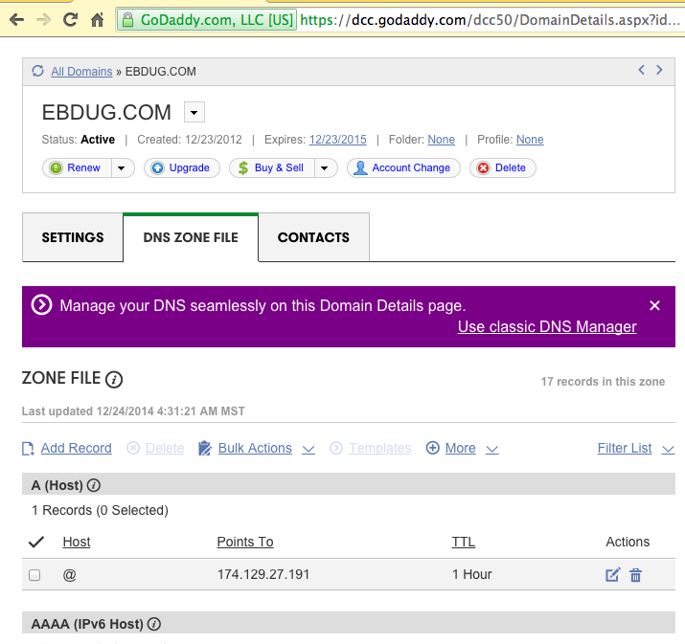
Registering a domain name

Slide 10
Whois
http://www.register.com/whois.rcmx
Domain Name: KIZA.COM
Registry Domain ID: 10236768_DOMAIN_COM-VRSN
Registrar WHOIS Server: whois.godaddy.com
Registrar URL: http://www.godaddy.com
Update Date: 2014-09-15T21:03:29Z
Creation Date: 1999-09-15T21:24:52Z
Registrar Registration Expiration Date: 2015-09-15T21:24:52Z
Registrar: GoDaddy.com, LLC
...
Registrant Name: Kiza Communications
Registrant Organization: 3260 Market St
Registrant Street: Suite K0999
...
Admin Name: Edward McCormick
...
Tech Name: Edward McCormick
...
Name Server: EDNS1.TEAMHOLISTIC.COM
Name Server: EDNS2.TEAMHOLISTIC.COM

Slide 11
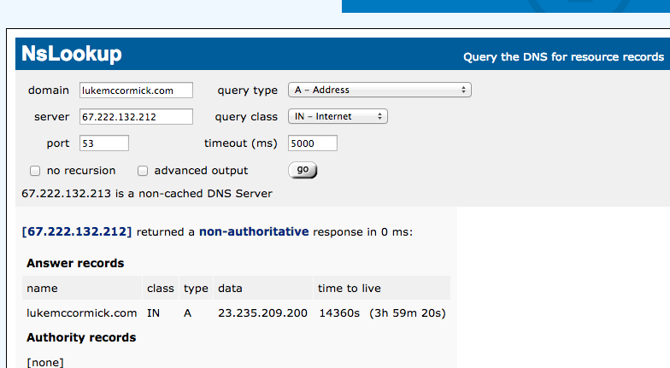
NSLookup

Slide 12
Ports
The “Apartment number” of the address
A number between 0 and 65535
Allows server software (typically) to identify how to route network packets
Standard web port: 80

