Slide 1
WebDev class 5
Jquery and online tools

Slide 2
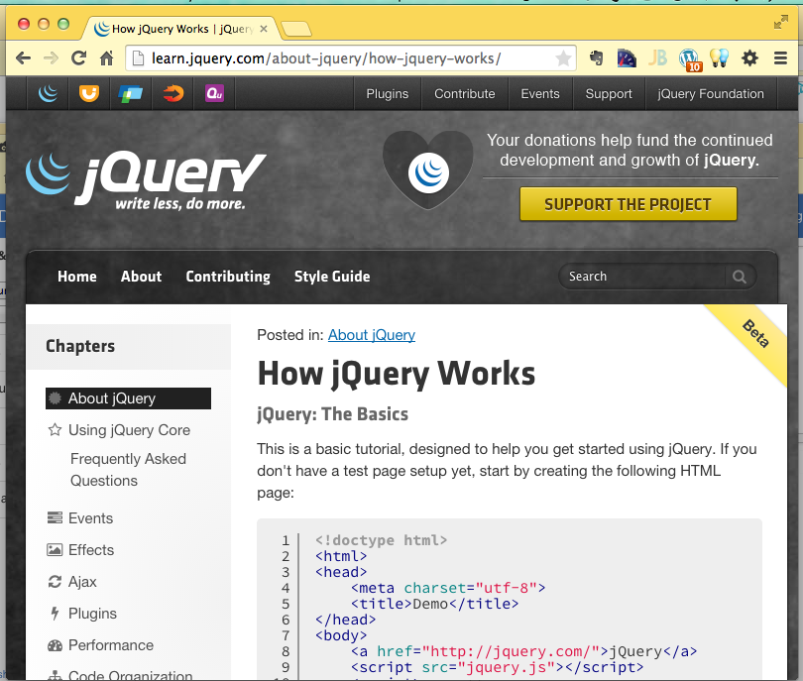
Feb 23 – Jquery
Easier javascript
Cross-platform compatability - made JavaScript practical!
Inspired other frameworks, whole new world of “web applications”
http://jquery.com/

Slide 3
Load jQuery from Google
<script src="http://ajax.googleapis.com /ajax/libs/jquery/1.11.2/jquery.min.js"> </script>

Slide 4
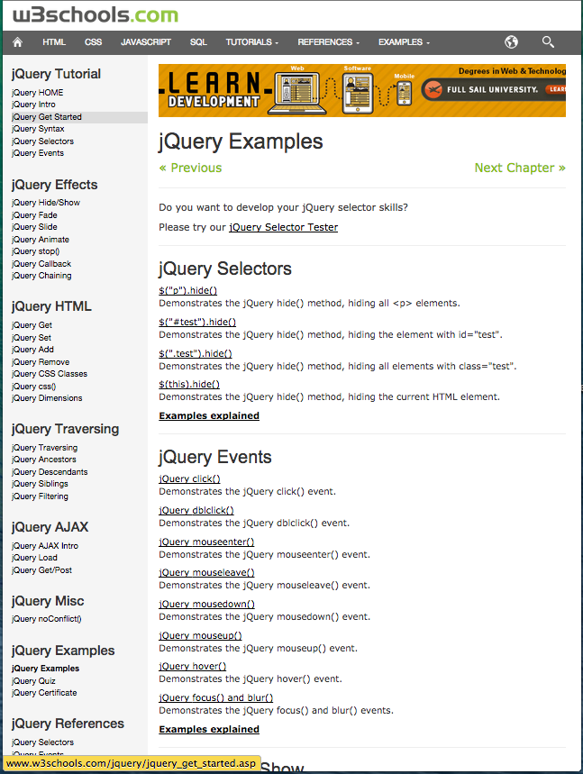
List of Examples
http://www.w3schools.com
/jquery/jquery_examples.asp

Slide 5
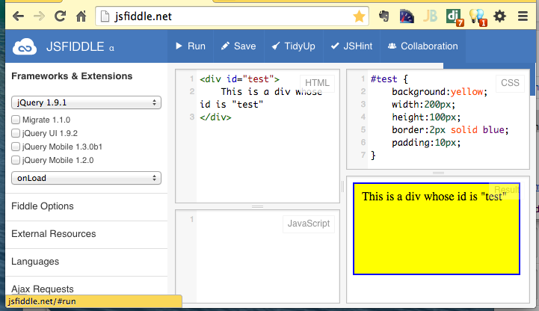
JS Fiddle
Online editor/demo environment
Automatically creates shortcut URL
http://jsfiddle.net/afe8xyof/1/

Slide 6
Move (animate) a DIV
http://www.w3schools.com/jquery/tryit.asp?filename=tryjquery_animation1
$(document).ready(function(){
$("button").click(function(){
$("div").animate({left: '250px'});
});
});
http://jsfiddle.net/rze9g623/

Slide 7
Hide and show
http://www.w3schools.com/jquery/tryit.asp?filename=tryjquery_hide_show
$(document).ready(function(){
$("#hide").click(function(){
$("p").hide();
});
$("#show").click(function(){
$("p").show();
});
});
<button id="hide">Hide</button>
<button id="show">Show</button>
http://jsfiddle.net/f6qn0g2n/1/

Slide 8
Fade
http://www.w3schools.com/jquery/tryit.asp?filename=tryjquery_fadetoggle
$(document).ready(function(){
$("button").click(function(){
$("#div1").fadeToggle();
$("#div2").fadeToggle("slow");
$("#div3").fadeToggle(3000);
});
});
http://jsfiddle.net/zyn61v79/1/

Slide 9
Slide
http://www.w3schools.com/jquery/tryit.asp?filename=tryjquery_slide_toggle
$(document).ready(function(){
$("#flip").click(function(){
$("#panel").slideToggle("slow");
});
});
http://jsfiddle.net/yxoq9v3a/

Slide 10
Animate
http://www.w3schools.com/jquery/tryit.asp?filename=tryjquery_animation
$(document).ready(function(){
$("button").click(function(){
var div=$("div");
div.animate({height: '300px', opacity: '0.4'}, "slow");
div.animate({width: '300px', opacity: '0.8'}, "slow");
div.animate({height: '100px', opacity: '0.4'}, "slow");
div.animate({width: '100px', opacity: '0.8'}, "slow");
});
});
http://jsfiddle.net/mboja5yo/
http://jsfiddle.net/930b9b3j/

Slide 11
Chain
http://www.w3schools.com/jquery/tryit.asp?filename=tryjquery_chaining
$(document).ready(function(){
$("button").click(function(){
$("#p1").css("color", "red").slideUp(2000).slideDown(2000);
});
});
http://jsfiddle.net/bguxpzsh/

Slide 12
More on Jquery
W3Schools
http://www.w3schools.com/jquery/jquery_examples.asp
Code Academy
http://www.codecademy.com/en/tracks/jquery
Code School
https://www.codeschool.com/courses/try-jquery

