Slide 1
Web Design & Construction
Berkeley Art Studio

Slide 2
Why CSS?
Styling
Size and shape
Positioning

Slide 3

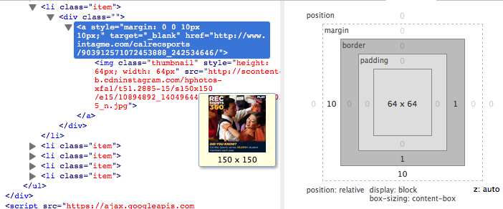
CSS EXAMPLE
http://recsports.berkeley.edu/

Slide 4
Borders

Slide 5
Background

Slide 6
Margin and Padding

Slide 7
Positioning
Static
Fixed
Relative
Absolute

