Slide 1
Web Design & Construction
Berkeley Art Studio

Slide 2
last CSS
selector types:
By element type: p div span h1
By id: #my-id selects id=“my-id”
By class: .my-class selects class=“my-class”
But that’s not all – you can combine them.

Slide 3
CSS - Combining selectors
<div id=“an-id”> <span class=“some-class”>
<h2>My Heading</h2>
<p>La Dee Da</p>
</span>
</div>
#an-id .some-class h2 {background:blue;}
#an-id .some-class p {background:yellow;}

Slide 4

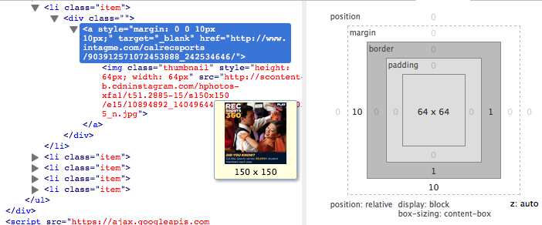
CSS EXAMPLE
http://recsports.berkeley.edu/

Slide 5
Borders

Slide 6
Background

Slide 7
Margin and Padding

Slide 8
Positioning
Static
Fixed
Relative
Absolute

