Slide 1
Last Class – Summary and Roadmap
March 16

Slide 2
What have we covered?
The big three:
HTML
CSS
JavaScript
And Also...
Jquery
Git
Bootstrap
Wordpress

Slide 3
HTML – Concepts
Tags: <tag param=“value”>content</tag>
<html>
<head>
...tags...
</head>
<body>
...tags...
</body>
</html>

Slide 4
HTML – Example
<html>
<head>
<title>This is my page</title>
</head>
<body>
<h1>A basic page</h1>
<p>
Text goes here
</p>
</body>
</html>

Slide 5
HTML – Resources
HTML “Cheat sheet”
https://www.addedbytes.com/cheat-sheets/html-cheat-sheet/
W3Schools
http://www.w3schools.com/html/
View Source!
Firebug/Chrome tools (“Inspect element”)

Slide 6
CSS – Concepts
Controls look of HTML elements
Classes:
<tag class=“my-class”> .my-class { background:blue; color:#F9F;
}
Ids:
<tag id=“my-class”> #my-class { border:1px solid black; padding:10px;
}

Slide 7
CSS – Example
<h2>Divs</h2>
<div id="mick" class="band stones">Mick</div>
<div id="keith" class="band stones">Keith</div>
<div id="ron" class="band stones">Ron</div>
<div id="Charlie" class="band stones">Charlie</div>
<div id="Bill" class="band stones">Bill</div>
<h2>Spans</h2>
<span id="pete" class="band who">Pete</span>
<span id="roger" class="band who">Roger</span>
<span id="john" class="band who">John</span>
<span id="keith" class="band who">Keith</span>
.beatles {
background: #FCC;
}
.stones {
background: #CFC;
}
.who {
background: #CCF;
}
.band {
width:200px;
height: 30px;
}

Slide 8
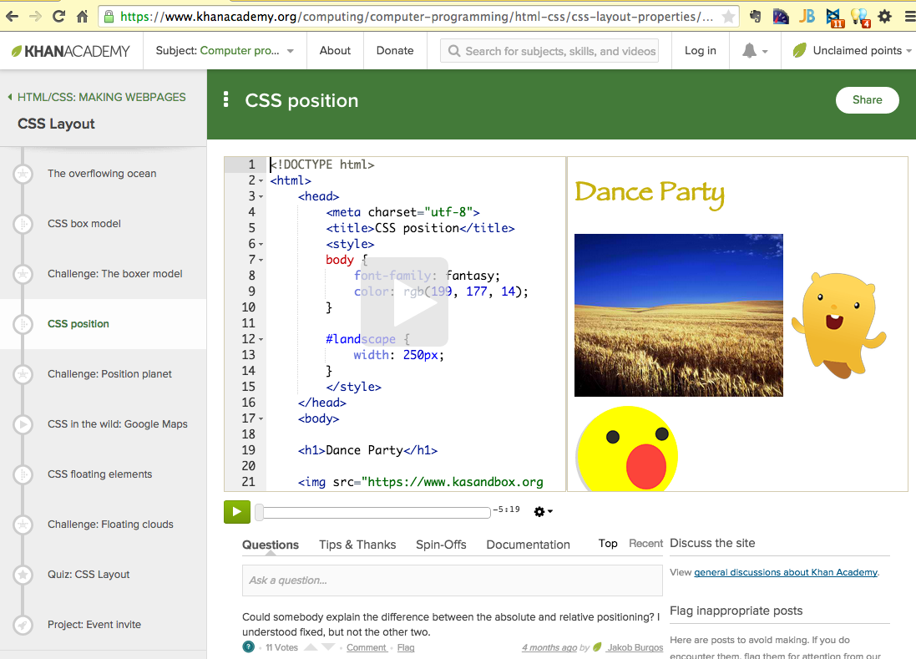
HTML/CSS - Resources
Kahn Academy https://www.khanacademy.org/computing/computer-programming/html-css

Slide 9
JavaScript – Concepts
Adds behavior to web pages
Picky about syntax
Variables
Functions

Slide 10
JavaScript – Example
<!DOCTYPE html>
<html>
<body>
<h1>What Can JavaScript Do?</h1>
<p id="demo">JavaScript can change HTML content.</p>
<button type="button"
onclick="document.getElementById('demo').innerHTML = 'Hello JavaScript!'">
Click Me!</button>
</body>
</html>

Slide 11
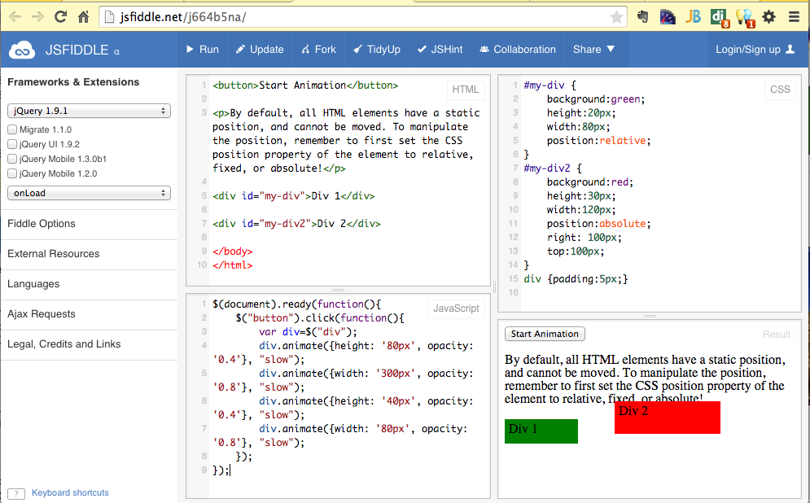
JavaScript – Resources
JSFiddle: (http://jsfiddle.net/j664b5na/)

Slide 12
Jquery – Concepts
Easier javascript
Cross-platform compatability - made JavaScript practical!
Inspired other frameworks, whole new world of “web applications”
http://jquery.com/

Slide 13
JQuery – Example
http://www.w3schools.com/jquery/tryit.asp?filename=tryjquery_animation1
$(document).ready(function(){
$("button").click(function(){
$("div").animate({left: '250px'});
});
});

Slide 14
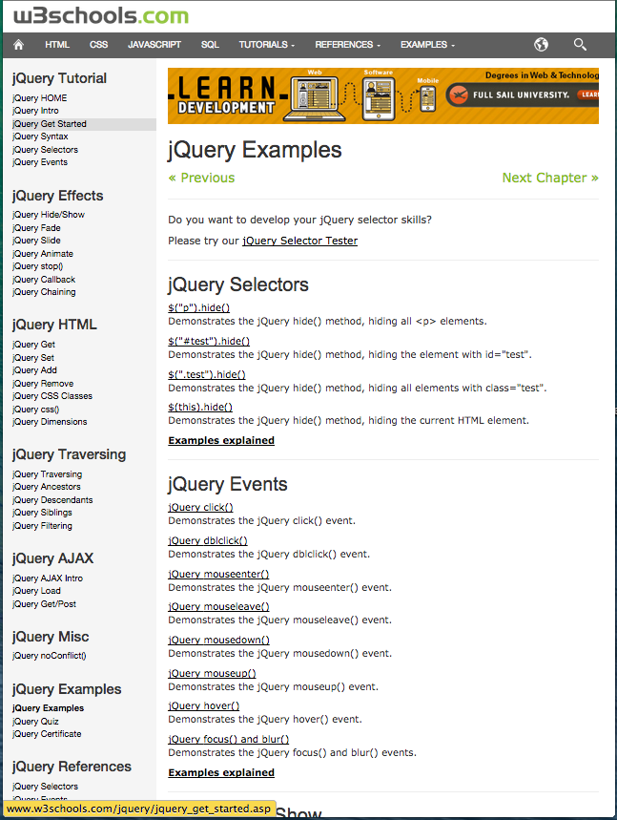
JQuery – Resources
http://www.w3schools.com/jquery/jquery_examples.asp

Slide 15
Git – Concepts
Store “versions” of code
Collaborate and share
Github.com
Gaining in popularity

Slide 16
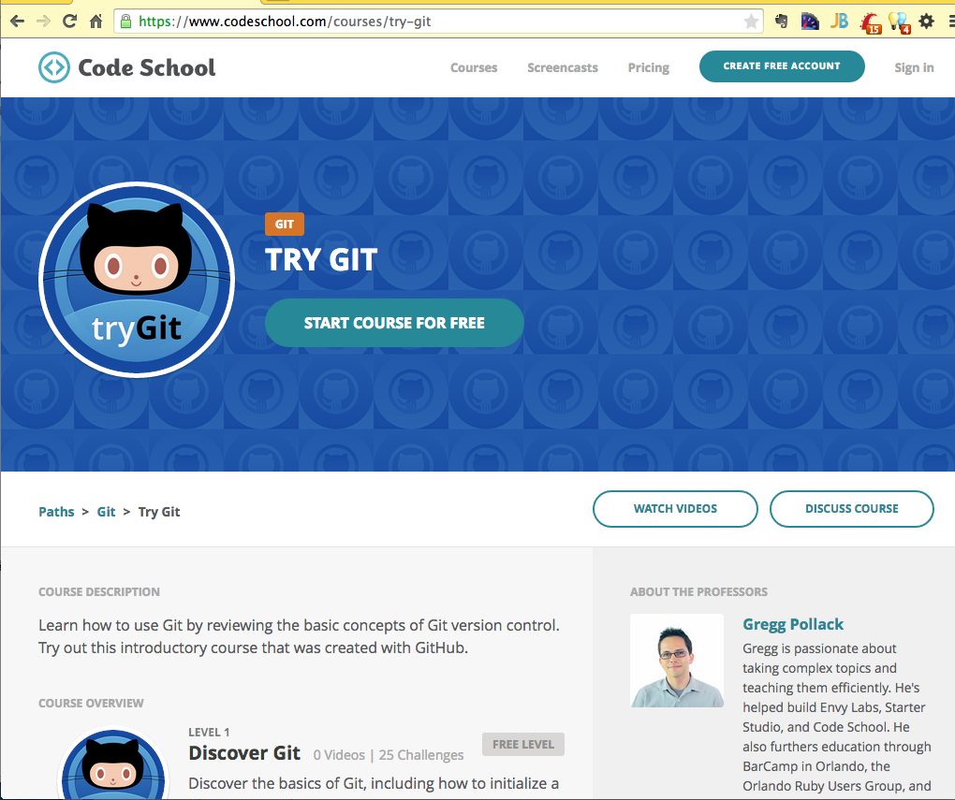
Git – Resources
http://git-scm.com/book/en/v2
https://www.codeschool.com/courses/try-git

Slide 17
Bootstrap – Concepts
Sensible defaults
Responsive templates
CSS-based

Slide 18
Bootstrap – Example
<!-- Bootstrap core CSS -->
<link href="bootstrap/dist/css/bootstrap.min.css" rel="stylesheet">
<!-- Bootstrap theme -->
<link href="bootstrap/dist/css/bootstrap-theme.min.css" rel="stylesheet">
<!-- Custom styles for this template -->
<link href="theme.css" rel="stylesheet">

Slide 19
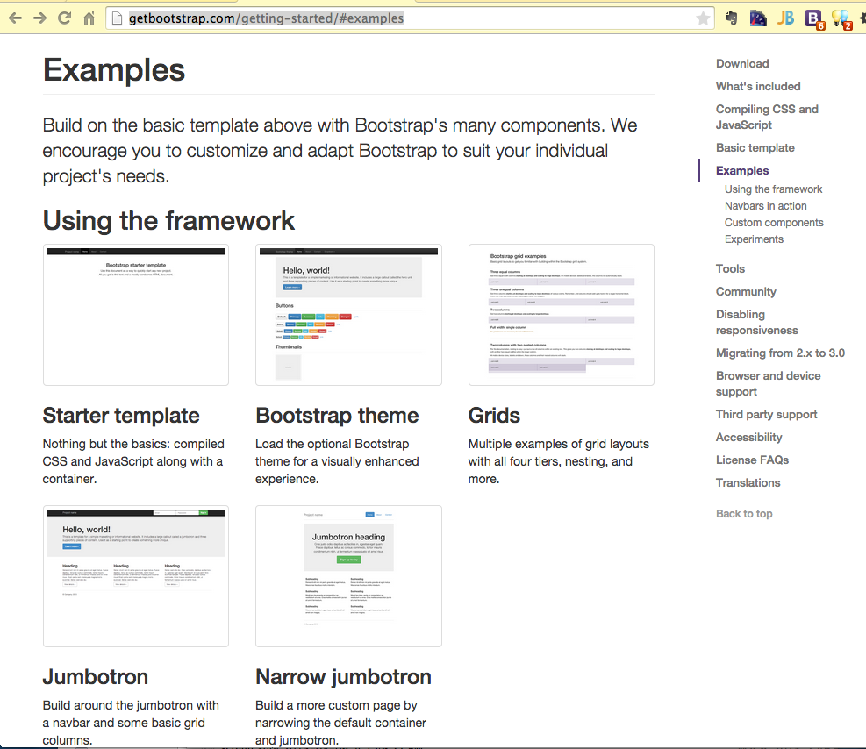
Bootstrap – Resources
http://getbootstrap.com/getting-started/#examples

Slide 20
Wordpress/CMS – Concepts
Content management system
Structure as code, content in the database
Database
(MySQL, Oracle, etc)
Web Server
(Apache)
Language
(PHP, Java, Ruby, Python,etc)

Slide 21
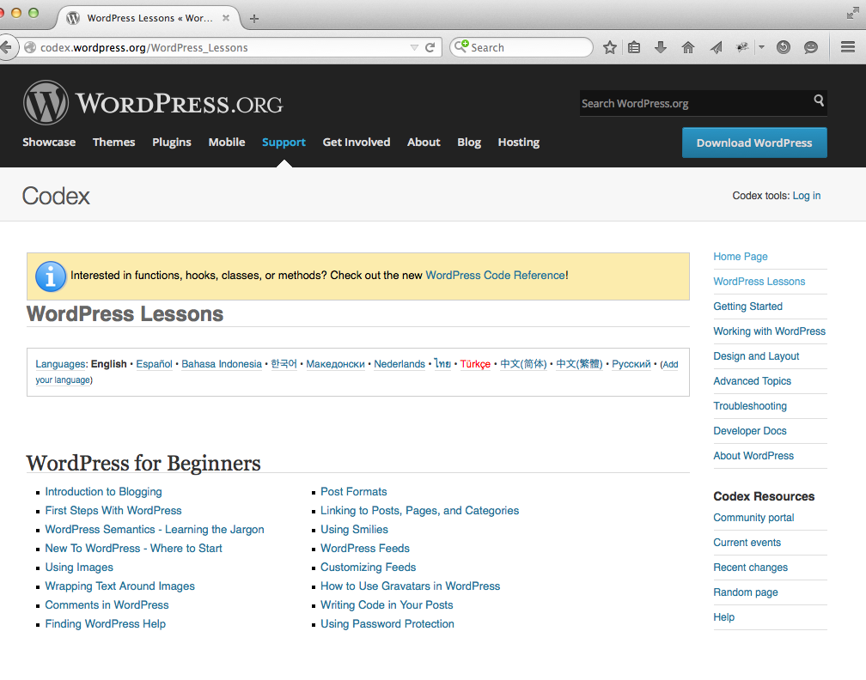
Wordpress – Resources
Wordpress.org
Wordpress.com
Pantheon.io

Slide 22
Things we didn’t cover
Languages – many of them!
Frameworks
Projects
Editors/IDEs

Slide 23
Languages
JavaScript
PHP
Java
Python
Ruby
Objective C
Haskall (!)
Perl
C/C++
LISP (Cloture)
Pascal
FORTRAN
TCL
Cold Fusion
C#
Swift
Go
Bash/csh

Slide 24
Frameworks

Slide 25
Projects

Slide 26
Editors/IDEs

