Slide 1
Class 5 – Grids

Slide 2
Bootstrap Grids
Reponsive
Mobile-first
HTML changes, CSS stays the same
Four sizes:
xs (Extra Small)
sm (Small)
md (Medium)
lg (Large)

Slide 3
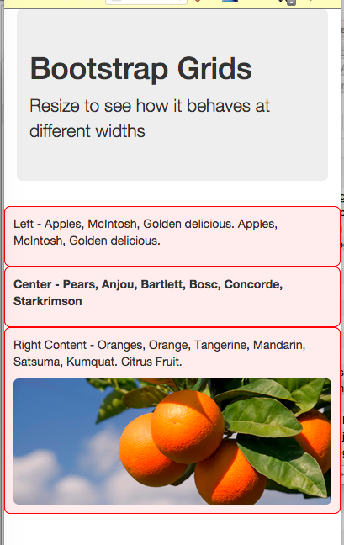
Extra-small (Phones)
<div class="col-xs-12">
...
</div>
<div class="col-xs-12">
...
</div>
<div class="col-xs-12">
...
</div>

Slide 4
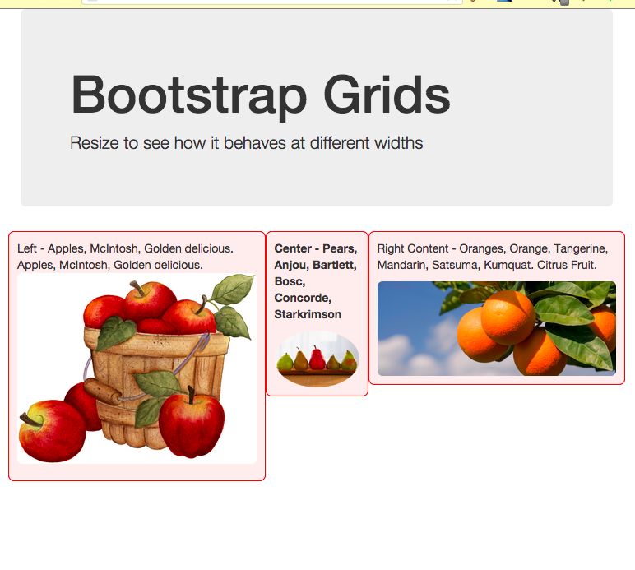
Small (Tablets)
<div class="col-sm-5 col-xs-12">
...
</div>
<div class="col-sm-2 col-xs-12">
...
</div>
<div class="col-sm-5 col-xs-12">
...
</div>

Slide 5
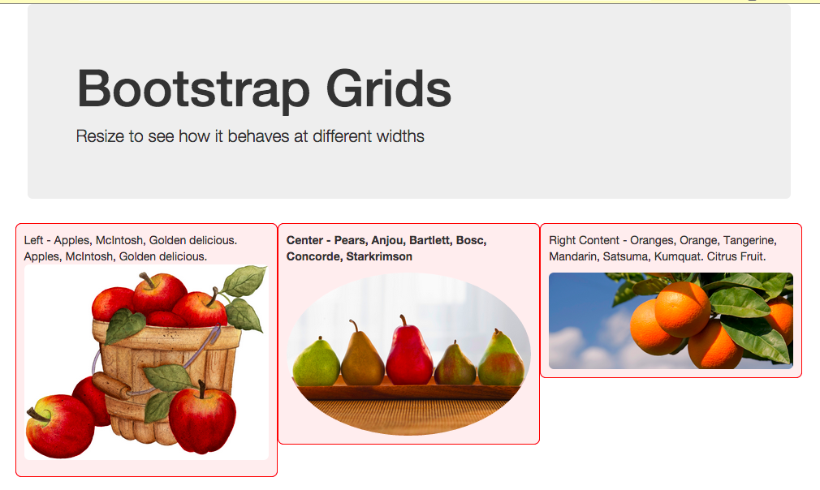
Medium (Desktop)
<div class="col-md-4 col-sm-5 col-xs-12">
...
</div>
<div class="col-md-4 col-sm-2 col-xs-12">
...
</div>
<div class="col-md-4 col-sm-5 col-xs-12">
...
</div>

Slide 6
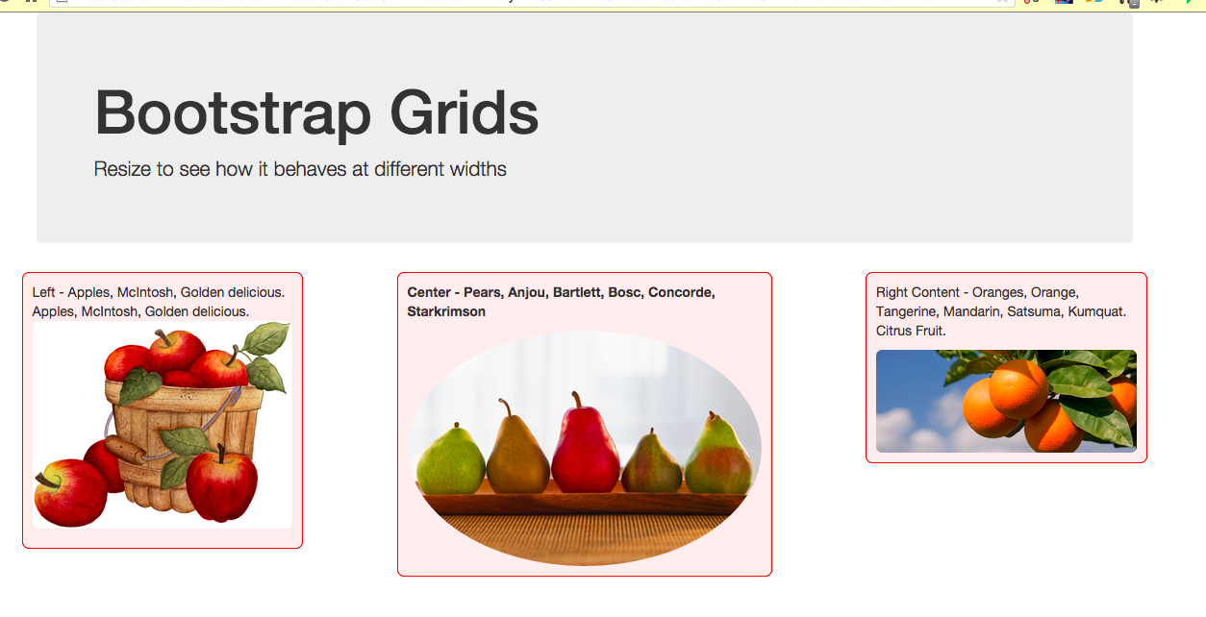
Large (Big Monitors)
<div class="col-lg-3 col-md-4 col-sm-5 col-xs-12">
<div class="col-lg-4 col-md-4 col-sm-2 col-xs-12">
<div class="col-lg-3 col-md-4 col-sm-5 col-xs-12">

Slide 7
Hide and Show
.visible-xs Extra small (less than 768px) visible
.visible-sm Small (up to 768 px) visible
.visible-md Medium (768 px to 991 px) visible
.visible-lg Larger (992 px and above) visible
.hidden-xs Extra small (less than 768px) hidden
.hidden-sm Small (up to 768 px) hidden
.hidden-md Medium (768 px to 991 px) hidden
.hidden-lg Larger (992 px and above) hidden

Slide 8
More Info
Bootstrap:
http://getbootstrap.com/css/#grid
W3 Schools
http://www.w3schools.com/bootstrap/bootstrap_grid_basic.asp
Tutorials Point
http://www.tutorialspoint.com/bootstrap/bootstrap_grid_system.htm
Code Academy
http://www.codecademy.com/courses/web-beginner-en-yjvdd/0/5?content_from=make-a-website%3Abootstrap-components

