Slide 1



Unveiling YouTube Trends: Analyzing Engagement Metrics
Welcome, data enthusiasts! I've been deeply immersed in a project focused on analyzing trends within YouTube videos, especially looking at engagement metrics. This analysis is vital for understanding what drives viewer interaction and how content can be optimized for better reach and engagement. In this presentation, I will share the intricacies of my project, including insights into video metrics, data collection, and preparation.
As we explore the findings, I hope to engage content creators and fellow data analysts keen on leveraging these insights to enhance their strategies on YouTube.
Basanagouda Ballolli
https://shorturl.at/flmAA

Slide 2

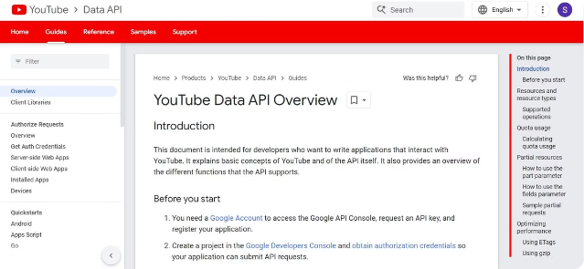
Data Collection: Utilizing the YouTube Data API
1
Comprehensive Data Gathering
Utilized the YouTube Data API to extract essential details for the top 200 trending videos in the US.
2
Engagement Metrics
Collected metrics including views, likes, comments, titles, descriptions, and more for thorough insights.
3
Video Specifics
Included additional data such as publish dates, channel info, tags, and duration for enriched analysis.

Slide 3

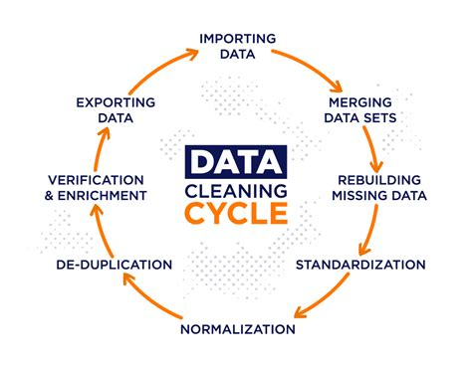
Data Preparation: Ensuring Quality and Consistency
Loading Data
Loaded the data extracted from the YouTube Data API into a structured pandas DataFrame.
Handling Missing Values
Implemented techniques to handle missing values, ensuring our data quality remained high.
Data Type Conversion
Converted columns to their appropriate data types, allowing efficient analysis and visualization.

Slide 4
Data Exploration: Revealing Insights
Dataset Inspection
Engagement Metric Visualizations
Dataset Inspection
Engagement Metric Visualizations
Conducted a thorough inspection of the dataset's structure and content through descriptive statistics.
Visualized distributions of engagement metrics to identify patterns and trends.
Conducted a thorough inspection of the dataset's structure and content through descriptive statistics.
Visualized distributions of engagement metrics to identify patterns and trends.

Slide 5

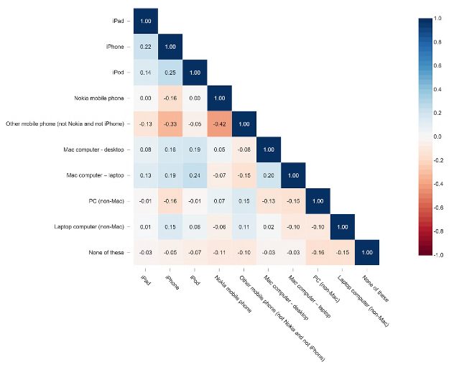
Correlation Analysis: Understanding Relationships
Metric
Views
Likes
Comments
Views
1.0
0.65
0.50
Likes
0.65
1.0
0.55
Comments
0.50
0.55
1.0
This matrix represents the relationships between different engagement metrics. As seen above, there's a strong correlation between views and likes, suggesting that more views can lead to increased likes.

Slide 6
Category Analysis: Trending by Genre
Video Categories
Trending Video Counts
Average Engagement Metrics
Analyzed the performance of trending videos categorized into genres like Music, Entertainment, and Education.
Recorded the number of trending videos per category to gauge popularity dynamics.
Visualized average engagement metrics like views, likes, and comments per video category.

Slide 7

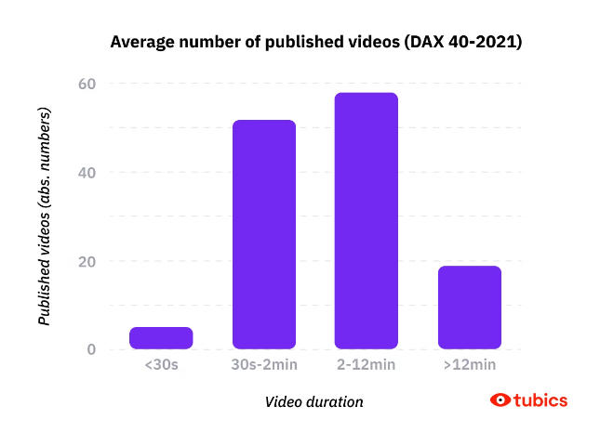
Duration Analysis: Impact of Video Length
1
Length Conversion
Converted video durations into seconds to facilitate a more direct analysis of length.
2
Duration Ranges
Categorized videos into different duration ranges to better understand performance.
3
Length vs Engagement
Analyzed how video length affects engagement metrics, revealing trends in viewer behavior.

Slide 8
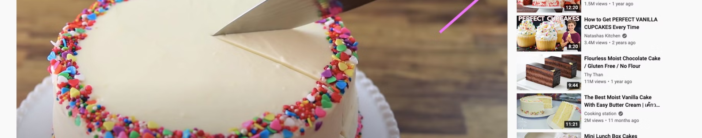



Tags Analysis: Exploring Metadata Impact
Tags Examination
Viewing Patterns
Optimizing Tags
Investigated how the number of tags associated with a video relates to its view count.
Examined patterns to see if there’s a direct correlation between more tags and higher view counts.
Insights suggest that strategically using tags can enhance visibility and engagement.

Slide 9


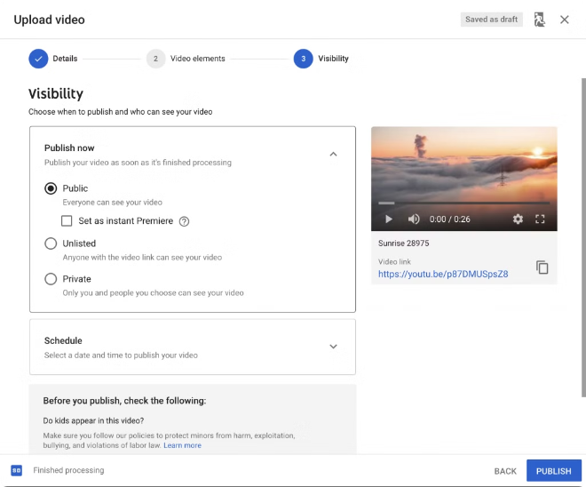


Publish Time Analysis: Timing is Key
Timing Strategy
Analyzed the optimal publish times for maximizing view count, notably between 2 PM and 8 PM.
Consumer Behavior
Insights suggested that publishing during peak hours significantly enhances initial engagement.
Engagement Metrics
Engagement rates were noticeably higher when videos were shared around peak times, affirming strategic timing.

Slide 10

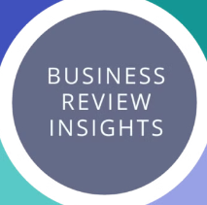
Key Insights and Recommendations
1
Engagement Encouragement
Encourage viewers to engage with content by liking and commenting to bolster video interaction metrics.
2
Shorter Video Preference
Focus on creating concise videos (under 5 minutes) as they yield better engagement, particularly in Music and Entertainment categories.
3
Timing Considerations
Strategically plan video releases during peak viewing hours to maximize reach and viewer engagement from the outset.

