Slide 1
Intelligent Classification of Rural Infrastructure Projects under PMGSY using Machine Learning on IBM Cloud
CAPSTONE PROJECT
Presented By:
Bashaboina Renuka- Chaitanya Bharathi Institute of Technology(CBIT)- Computer Science and Engineering (Artificial Intelligence and Machine Learning)

Slide 2
OUTLINE
Problem Statement (Should not include solution)
Proposed System/Solution
System Development Approach (Technology Used)
Algorithm & Deployment
Result (Output Image)
Conclusion
Future Scope
References

Slide 3
Problem Statement
The Pradhan Mantri Gram Sadak Yojana (PMGSY) is a rural development initiative aimed at improving road and bridge connectivity across India. The program includes multiple schemes like PMGSY-I, PMGSY-II, and RCPLWEA, each with distinct characteristics.
Manually classifying thousands of infrastructure projects into the correct scheme is time-consuming, error-prone, and not scalable.
This challenge affects project monitoring, budget allocation, and policy planning.
An efficient and intelligent classification method is needed to streamline this process.

Slide 4
Proposed Solution
The proposed system aims to address the challenge of automatically classifying rural infrastructure projects under their appropriate PMGSY schemes (PMGSY-I, PMGSY-II, RCPLWEA, etc.). This involves leveraging machine learning techniques and structured government data to streamline the classification process and reduce manual errors.The solution will consist of the following components:
Data Collection:
Gather and utilize historical project data provided through the AI-KOSH platform, which contains structured information such as state, district, road/bridge type, total cost, project length, and number of bridges or road segments.Gather and utilize historical project data provided through the AI-KOSH platform, which contains structured information such as state, district, road/bridge type, total cost, project length, and number of bridges or road segments.
Data Preprocessing:
Prepare the dataset for model training by cleaning missing or inconsistent values, encoding categorical variables (e.g., project type, state), and selecting the most relevant features. Techniques such as one-hot encoding and normalization may be applied where necessary.
Machine Learning Algorithm:
Implement a multi-class classification model, such as a Random Forest Classifier or use IBM’s AutoAI tool, which automatically selects and tunes the best model. The model will learn from historical project data to predict the most appropriate scheme for new or unlabelled projects.
Deployment:
The trained model will be deployed using IBM Watson Machine Learning, exposing a RESTful API that can be integrated into other government dashboards or used for batch processing of new project data.
Evaluation:
Evaluate the model’s accuracy, precision, recall, and F1-score using test data. The model will be fine-tuned and monitored periodically to ensure consistent performance and adaptability to new data patterns.

Slide 5
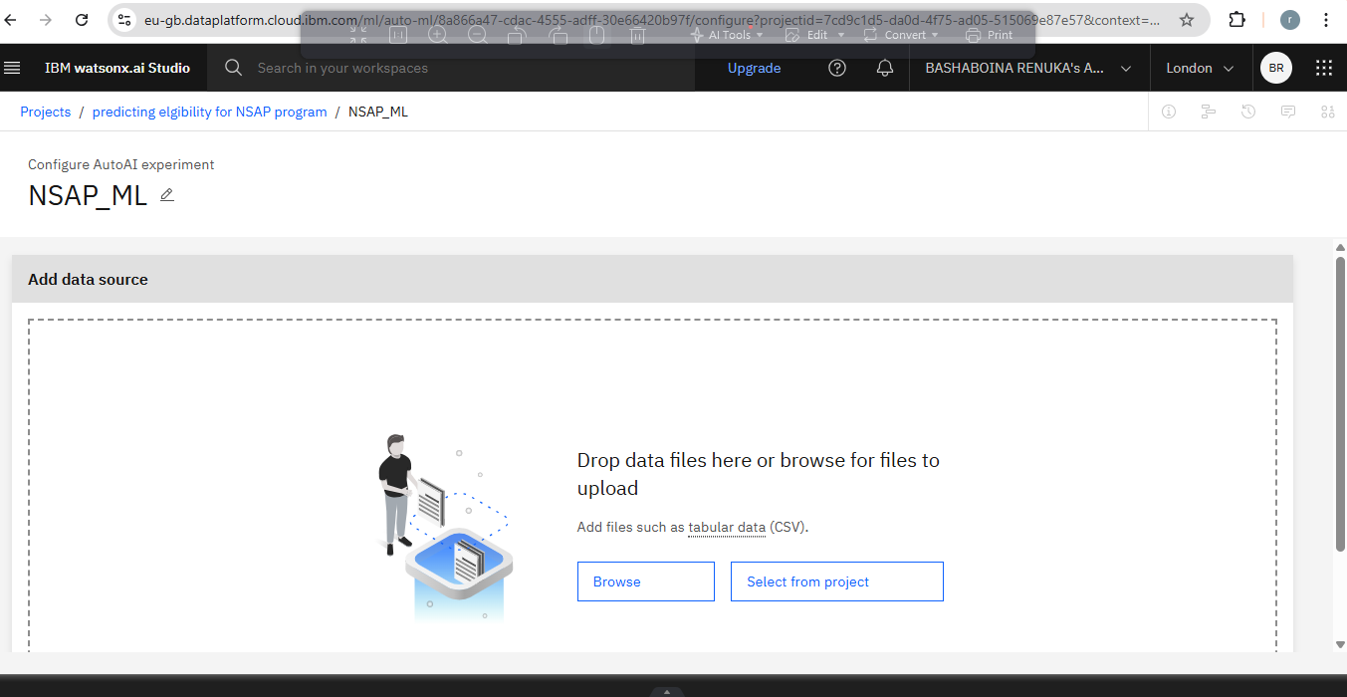
Selecting data

Slide 6
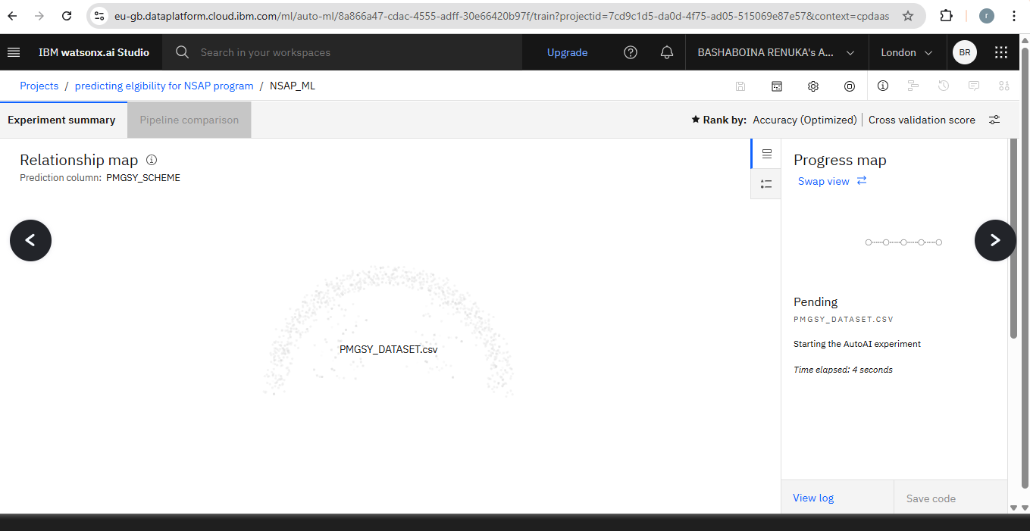
Uploaded dataSET

Slide 7
System Approach
The System Approach section outlines the overall strategy and methodology for developing and implementing the PMGSY scheme classification model. The solution is built using IBM Cloud services along with standard data science tools and machine learning libraries.
System requirements:
IBM Cloud Lite Account (Free tier)
Watson Studio – for data analysis, notebook execution, and AutoAI
Cloud Object Storage – to store datasets
Watson Machine Learning – for model deployment
Library required to build the model:
pandas – For data loading, preprocessing, and manipulation
numpy – For numerical computations and array handling
scikit-learn –
For machine learning algorithms (e.g., RandomForestClassifier)
For model evaluation (accuracy, precision, recall, etc.)
matplotlib / seaborn – For data visualization (optional but useful for EDA)
joblib – For saving/training the ML model (model serialization)

Slide 8
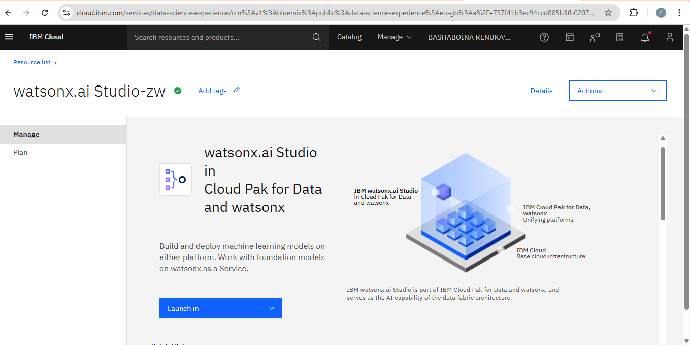
LAUNCHING WATSONX.AI STUDIO

Slide 9
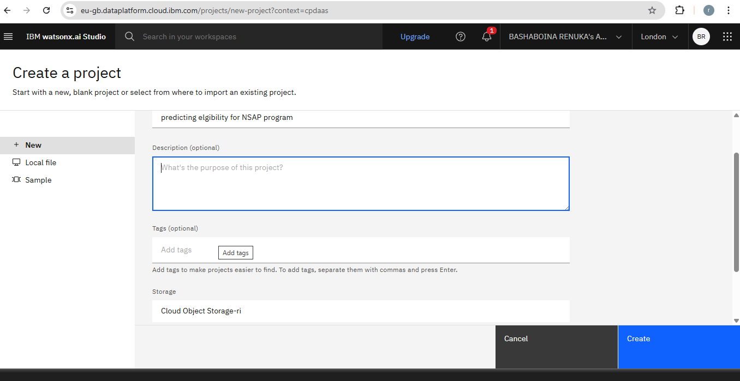
tITLE OF PROJECT

Slide 10
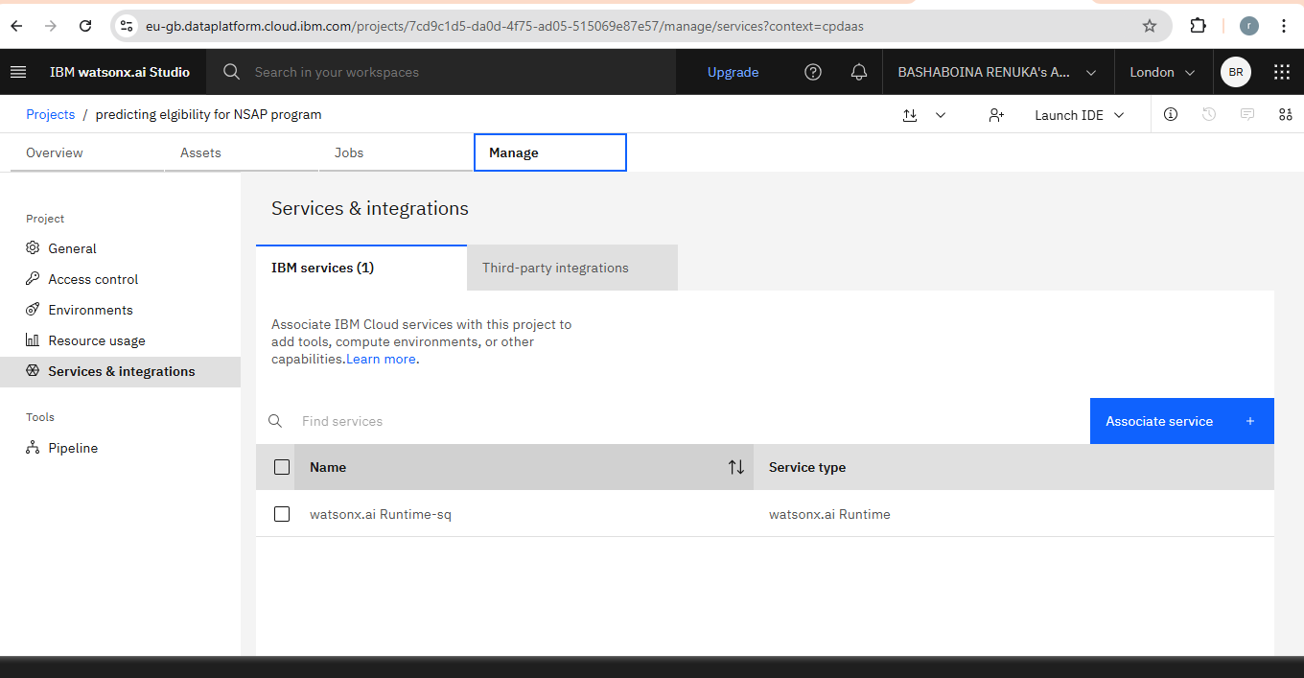
ASSOCIATE SERVICES

Slide 11
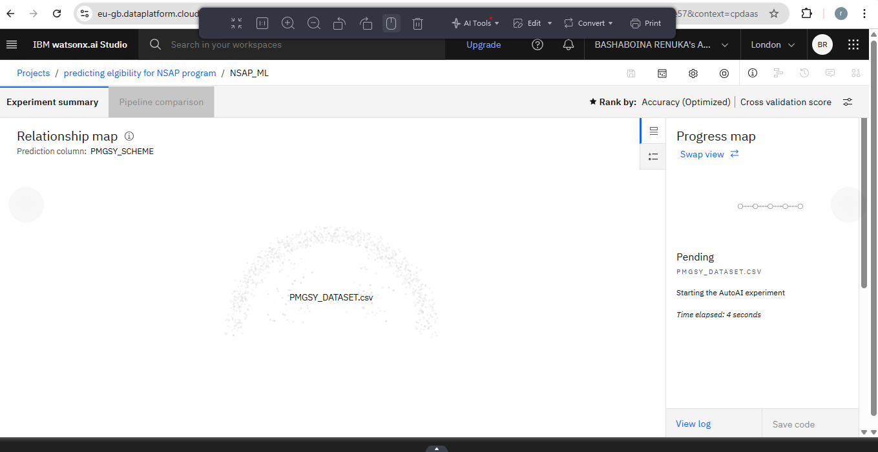
BUILDING MODEL

Slide 12
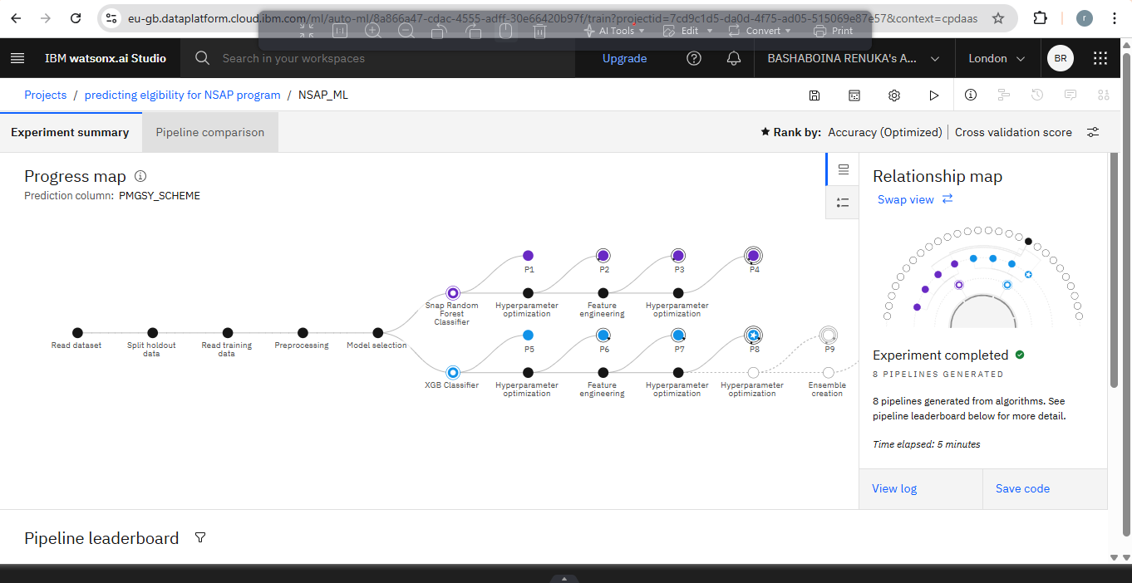
PROCESSING DATA

Slide 13
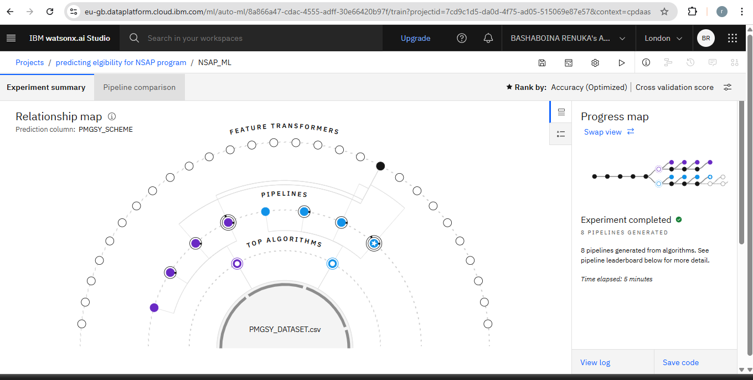
SELECTING BEST ALGORITHM

Slide 14
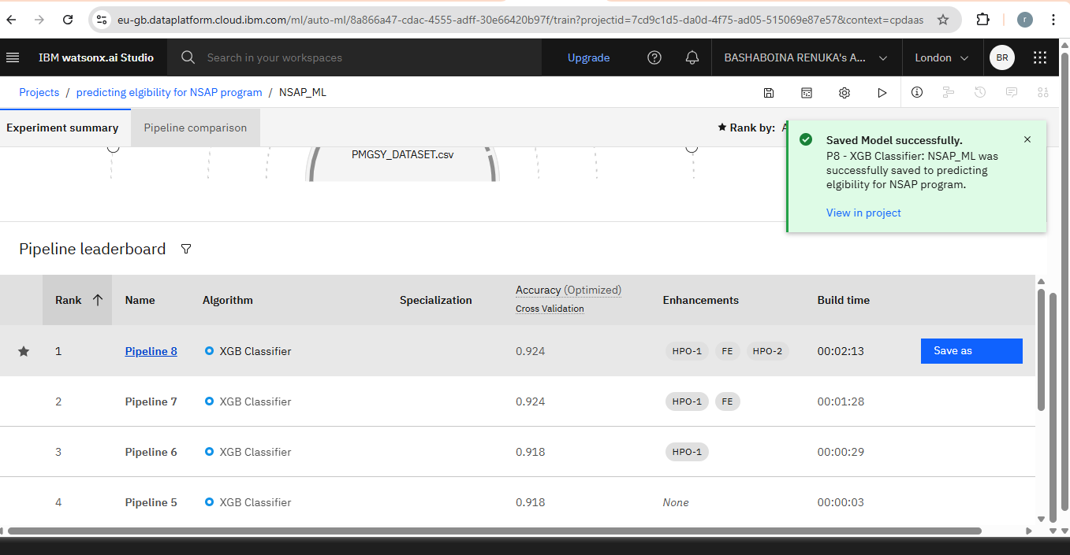
SELECTING BEST PIPELINE

Slide 15
Algorithm & Deployment
In the Algorithm section, we describe the machine learning algorithm chosen for classifying rural infrastructure projects under their respective PMGSY schemes.
Algorithm Selection:
Provide a brief overview of the chosen algorithm (e.g., time-series forecasting model, like ARIMA or LSTM) and justify its selection based on the problem statement and data characteristics.
Data Input:
Specify the input features used by the algorithm, such as historical bike rental data, weather conditions, day of the week, and any other relevant factors.
Training Process:
Explain how the algorithm is trained using historical data. Highlight any specific considerations or techniques employed, such as cross-validation or hyperparameter tuning.
Prediction Process:
Detail how the trained algorithm makes predictions for future bike counts. Discuss any real-time data inputs considered during the prediction phase.

Slide 16
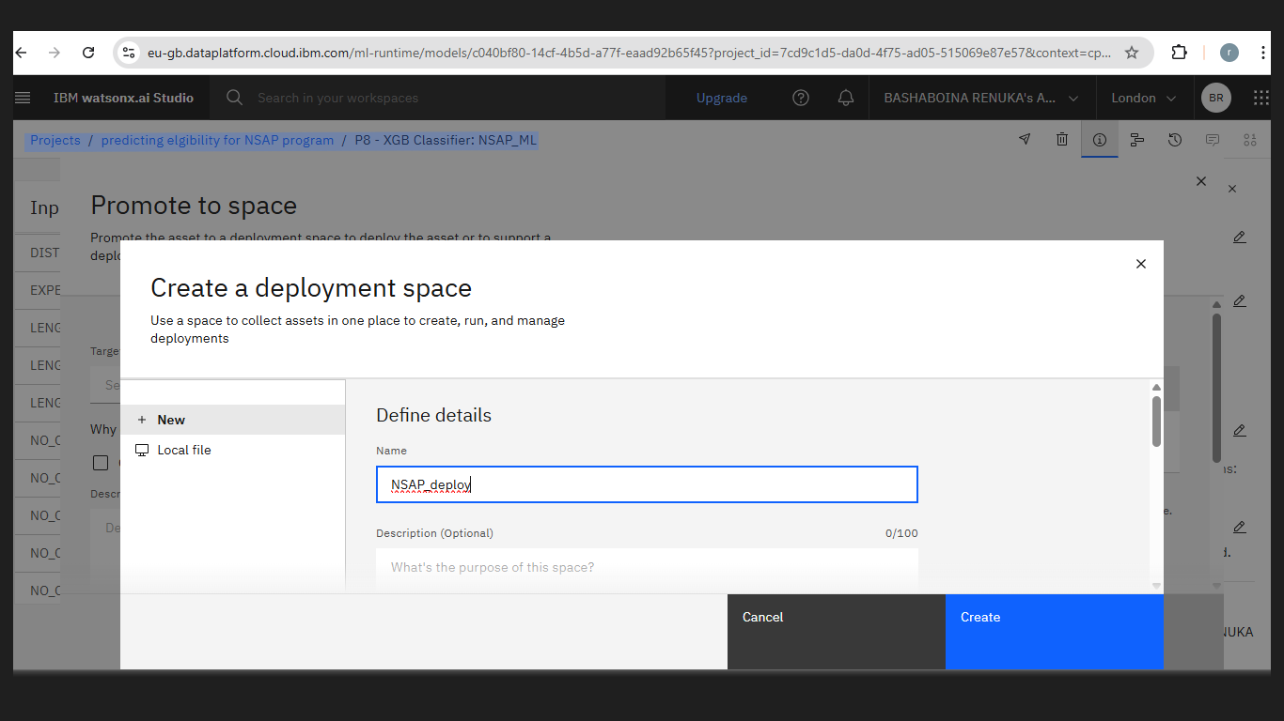
DEPLOYMENT SPACE

Slide 17
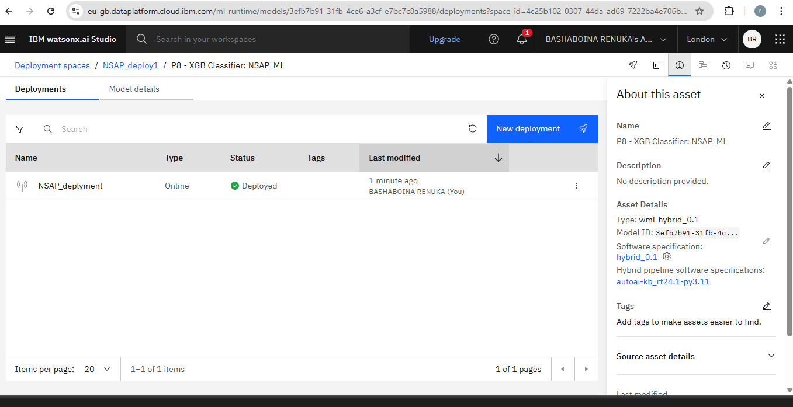

Slide 18
Result
The machine learning model was trained to classify rural infrastructure projects into appropriate PMGSY schemes based on features such as cost, length, number of bridges, and state information. The model’s performance was evaluated using standard classification metrics.

Slide 19
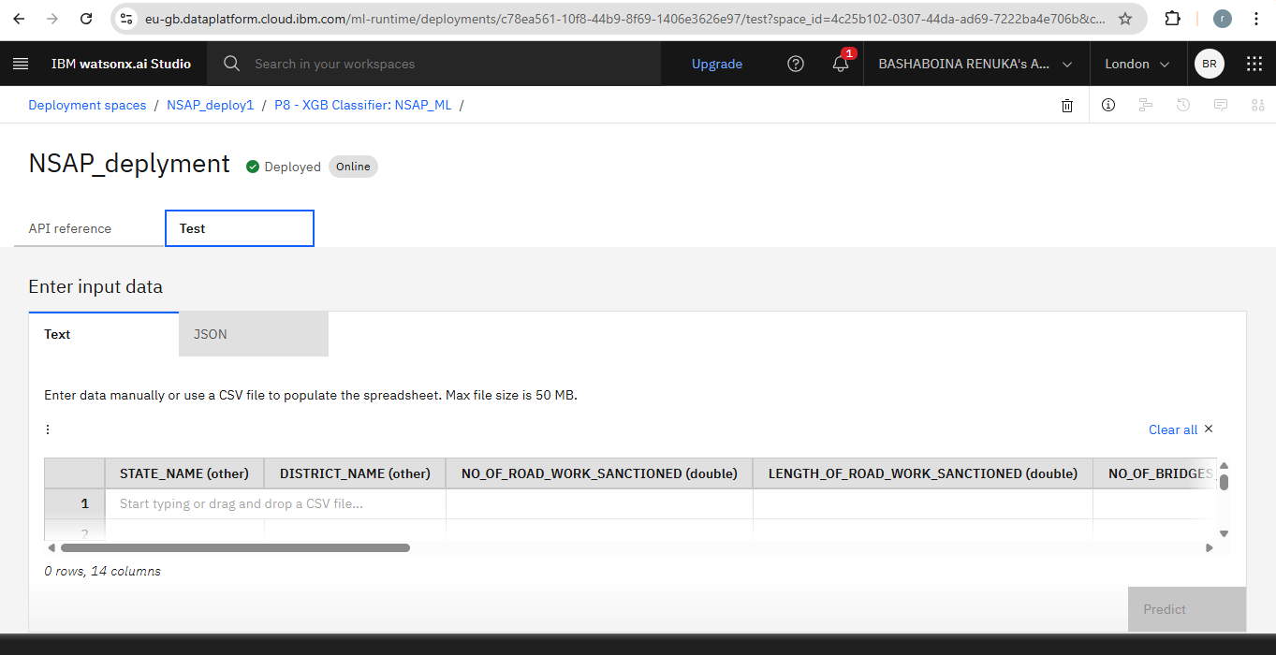

Slide 20
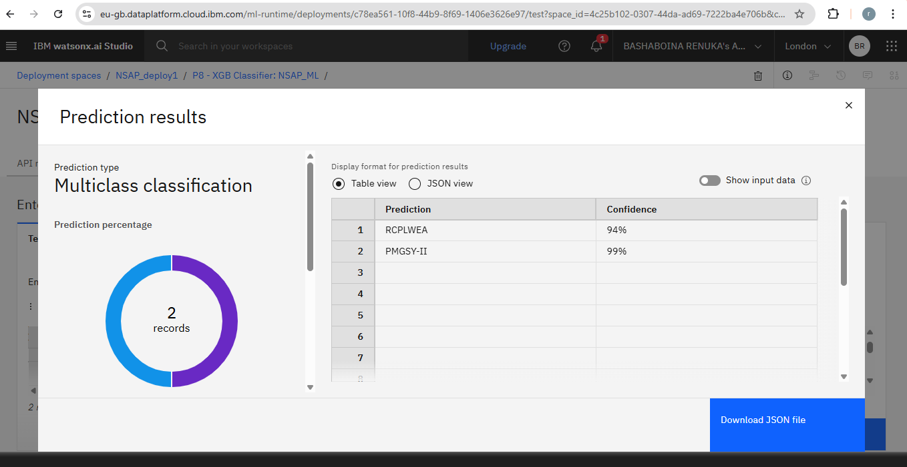

Slide 21
Conclusion
In this project, we developed a machine learning model to automatically classify rural infrastructure projects under the appropriate PMGSY scheme (PMGSY-I, PMGSY-II, RCPLWEA, etc.). By using structured data from the AI-KOSH dataset and applying classification algorithms such as Random Forest, we were able to build a system that reduces manual effort and improves accuracy in scheme identification.
The project demonstrated the potential of using AI to support government planning and monitoring processes. With features like project cost, road length, and number of bridges, the model successfully predicted the scheme with good accuracy. The model was deployed using IBM Watson Machine Learning, allowing real-time predictions through an API.
This system can save time, reduce human errors, and help decision-makers better allocate resources. Overall, the project shows how data and AI can be effectively used in rural development planning and governance.

Slide 22
Future scope
The current system effectively classifies rural infrastructure projects under appropriate PMGSY schemes based on existing physical and financial characteristics. However, there are several ways this system can be further enhanced and expanded:
Adding More Data
Right now, your model uses basic project info like cost and road length.
In the future, we can add:
Start and end dates of the project
Weather or terrain (hill, forest, etc.)
Delays or contractor quality
This will help the model give more accurate predictions.

Slide 23
References
AI-KOSH Dataset – PMGSY Project Data
Government of India, National AI Portal
URL: https://aikosh.indiaai.gov.in
Scikit-learn: Machine Learning in Python
Pedregosa et al., Journal of Machine Learning Research, 2011
URL: https://scikit-learn.org/
A key library used for classification models like Random Forest, Decision Trees, etc.
IBM Watson Studio Documentation
IBM Cloud Docs
URL: https://dataplatform.cloud.ibm.com/docs
Random Forests
Breiman, L. (2001). Random forests. Machine learning, 45(1), 5-32.
Foundational paper explaining how Random Forest classifiers work.
A Survey on Classification Techniques in Data Mining
S. Kotsiantis, Informatica, 2007
URL: https://www.informatica.si/PDF/31-3/05_Kotsiantis%20-%20Classification%20techniques.pdf
Useful for understanding and comparing various classification algorithms.
Data Preprocessing Techniques in Machine Learning
Dhanalakshmi et al., International Journal of Computer Applications, 2016
Covers standard techniques for cleaning and preparing structured datasets.

Slide 24
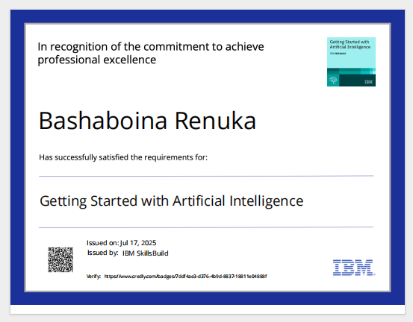
IBM Certifications

Slide 25
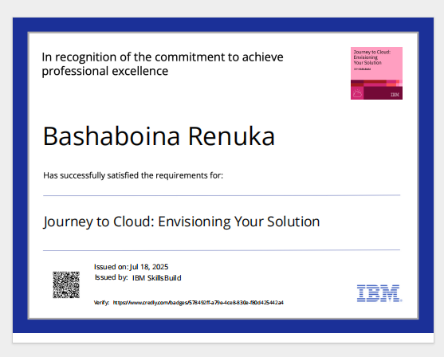
IBM Certifications

Slide 26
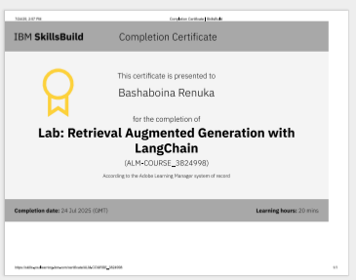
IBM Certifications

Slide 27
THANK YOU

