Slide 1
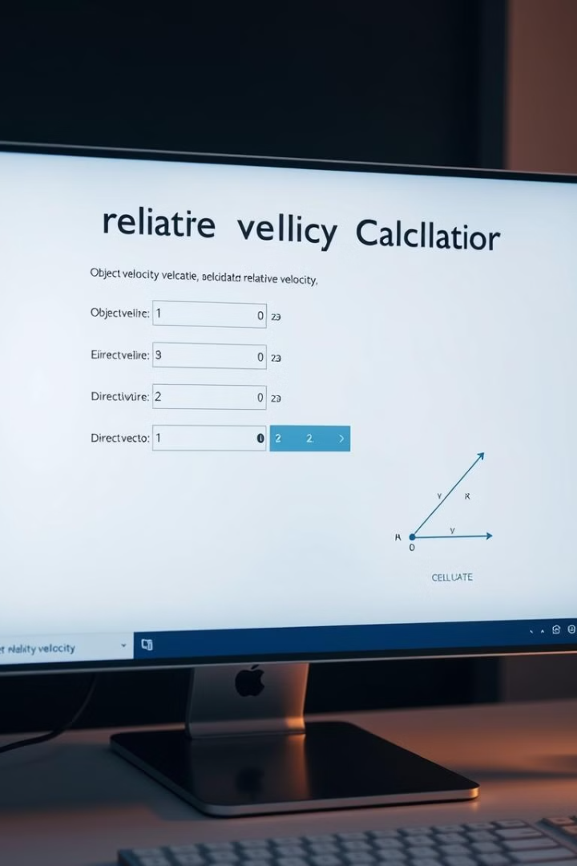
Relative Velocity Calculator
This document presents a relative velocity calculator, a useful tool for analyzing the motion of objects in relation to each other. It explores the concepts behind relative velocity, provides basic formulas and equations, and outlines the code used in its development.

Slide 2

Introduction to Relative Velocity
Relative velocity refers to the velocity of an object as observed from a reference frame that itself is in motion. For example, the speed of a train moving at 60 miles per hour, as perceived by a person standing on the platform, will be different from its speed as observed by a passenger inside the train.
1
Understanding Frames of Reference
2
Vector Addition and Subtraction
Choosing a reference frame is crucial in determining relative velocity. It's the point from which motion is observed. For instance, the ground can be considered a stationary frame, while a moving car would be a non-stationary frame.
Relative velocity calculations involve vector addition and subtraction. This means that both magnitude and direction of the velocities must be considered.
3
Applications in Physics and Engineering
Relative velocity concepts are essential in diverse fields like physics, engineering, and aviation for understanding motion, analyzing collisions, and predicting trajectories.

Slide 3

Basic Formulas and Equations
Relative velocity calculations rely on fundamental principles of motion and vector algebra. The core formula used to calculate relative velocity is derived from vector addition and subtraction, taking into account the velocity of the observer and the velocity of the object.
Formula
Description
Vrel = Vobj - Vobs
Relative velocity of an object (Vrel) is equal to the velocity of the object (Vobj) minus the velocity of the observer (Vobs).

Slide 4

Program Code for Relative Velocity Calculator
The relative velocity calculator is implemented using programming languages like Python, C++, or Java. The program utilizes user input to specify the velocities of the object and the observer, and the directions of their movement. It then performs vector operations to calculate the relative velocity.
#include <stdio.h> double relativeVelocity(double v1, double v2, int direction) { if (direction == 1) { return v1 - v2; } else { return v1 + v2; } } int main() { double v1, v2, relVel; int direction; printf("Enter the velocity of the first object (m/s): "); scanf("%lf", &v1); printf("Enter the velocity of the second object (m/s): "); scanf("%lf", &v2); printf("Enter 1 if the objects are moving in the same direction, 2 if in opposite directions: "); scanf("%d", &direction); relVel = relativeVelocity(v1, v2, direction); printf("The relative velocity is: %.2lf m/s\n", relVel); return 0; }

Slide 5
Input Parameters and Assumptions
The calculator takes inputs for the velocities of both the object and the observer, as well as their directions. It assumes that the velocities are constant and that the motion occurs in a straight line. The user is responsible for providing accurate input values and selecting appropriate units.
Object Velocity
Observer Velocity
Direction
The speed and direction of the object whose motion is being analyzed.
The speed and direction of the observer who is measuring the object's motion.
The angle between the object's and observer's velocities, which can be horizontal, vertical, or a specific angle.

Slide 6
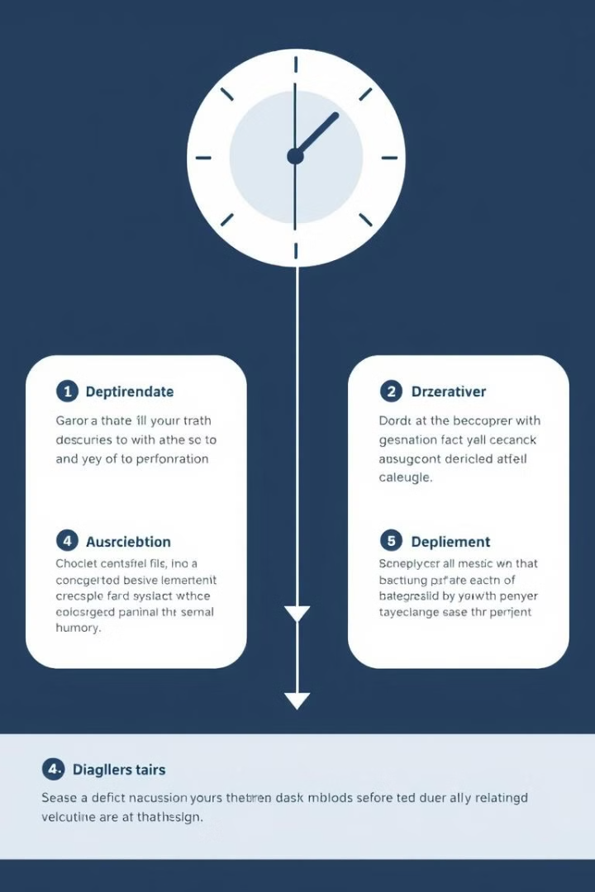




Calculation Process
The calculator uses the provided input to perform the necessary calculations. The velocities are broken down into their horizontal and vertical components, and vector addition or subtraction is applied based on the directions of the object and the observer.
Input Velocities and Directions
The user enters the velocities and directions of the object and observer.
Resolve Velocities into Components
The velocities are broken down into their horizontal and vertical components.
Apply Vector Addition/Subtraction
The calculator performs vector addition or subtraction based on the directions.
Calculate Resultant Velocity
The calculator calculates the magnitude and direction of the relative velocity.

Slide 7

Potential Errors and Limitations
Potential errors can arise from incorrect input values or invalid assumptions. For example, if the user inputs a velocity that is not physically possible or if the directions are not specified accurately, the calculation will be inaccurate. The calculator is limited to calculating relative velocities in a straight line and assumes constant velocities.
Incorrect Input
Unrealistic Assumptions
Limitations of the Model
Invalid input values, such as negative velocities or unrealistic angles, can lead to errors.
The calculator assumes constant velocities and straight-line motion, which may not always be true in real-world scenarios.
The calculator is designed for a specific type of relative velocity calculation and may not be suitable for all situations.

Slide 8





Conclusion and Applications
The relative velocity calculator is a valuable tool for understanding and quantifying the motion of objects in relation to each other. Its applications are numerous, ranging from analyzing the movement of vehicles to predicting the outcome of collisions and understanding the behavior of fluids.
Aviation
Navigation
Space Exploration
Physics Research
Analyzing the relative velocity of aircraft during takeoff, landing, and in-flight maneuvers.
Calculating the relative velocity of ships in relation to currents and other vessels.
Determining the relative velocity of spacecraft in orbit or during interplanetary travel.
Studying the relative motion of particles in atomic and subatomic systems.

