Slide 1
DIAGNOSIS OF GASTRIC CANCER USING MIFNET ALGORITHM
BATCH A4
H.DHIVYADHARSHINI – 2018PECCS126
R.DIVYA DHARSHINI – 2018PECCS127
S.KEERTHANA – 2018PECCS149
PROJECT GUIDE: Dr.K.Sangeetha
PROJECT COORDINATOR: Dr.L.Jaba Sheela

Slide 2
OVERVIEW
Gastric cancer (GC) is one of the most common malignant tumors with poor prognostic results. It remains one of the deadly diseases with poor prognosis.
The worldwide shortage of pathologists offers a unique opportunity for the use of artificial intelligence assistance systems to alleviate the workload and increase diagnostic accuracy.
Most gastric cancer (GC) show genetic instability, either microsatellite instability or chromosomal instability, which is considered an early event in gastric carcinogenesis.
New classification of gastric cancers based on histologic features, genotypes and molecular phenotypes helps better understand the characteristics of each subtype, and improve early diagnosis, prevention and treatment.
To overcome this problem, this project develops a method using deep learning algorithms to assist the pathological diagnosis of gastric cancer as it involves numerous tests to arrive at a conclusion.
Thus, this project helps in effective diagnosis of gastric cancer with higher accuracy than the existing models.

Slide 3
LITERATURE REVIEW
TITLE OF THE PAPER | JOURNAL & AUTHOR NAME | METHODOLOGY USED | ADVANTAGE | DISADVANTAGE
Leveraging Multimodal Semantic Fusion for Gastric Cancer Screening via Hierarchical Attention Mechanism [2021] | IEEE Transactions on Systems, Man, and Cybernetics: Systems Shuai Ding , Member, IEEE, Shikang Hu, Xiaojian Li , Youtao Zhang , Member, IEEE, and Desheng Dash Wu , Senior Member, IEEE | ID-GCS Accuracy 94% https://ieeexplore.ieee.org/abstract/document/9492312/ | ID-GCS captures the clinical thinking and diagnostic approaches of physicians and integrates objective medical data and subjective experiential knowledge obtained from gastroscopy reports for GC screening. | The ID-GCS method had slightly worse complexity and fitting.

Slide 4
LITERATURE REVIEW
TITLE OF THE PAPER | JOURNAL & AUTHOR NAME | METHODOLOGY USED | ADVANTAGE | DISADVANTAGE
NGA-Inspired Nanorobots-Assisted Detection of Multifocal Cancer, [2020] | IEEE Transactions on Cybernetics Shaolong Shi , Student Member, IEEE, Yifan Chen , Senior Member, IEEE, and Xin Yao,Fellow, IEEE | NGA-Inspired Nanorobots https://ieeexplore.ieee.org/abstract/document/9226097/ | NGA-inspired MCDP in order to locate the tumor targets efficiently while taking into account realistic in vivo propagation and controlling of nanorobots, which is different from the use scenario of the standard NGA. | The performance of the algorithm has to be improved to accomplish the deduction of all the cancer areas with many more nanorobots. It is also important to examine further the impact of nanorobot nonidealities, such as finite lifespan, imprecise steering, and inaccurate tracking.

Slide 5
LITERATURE REVIEW
TITLE OF THE PAPER | JOURNAL & AUTHOR NAME | METHODOLOGY USED | ADVANTAGE | DISADVANTAGE
Chip-Scale Angle-Selective Imager for In Vivo Microscopic Cancer Detection[2020] | IEEE Transactions on Biomedical Circuits and Systems Efthymios P. Papageorgiou; Bernhard E. Boser; Mekhail Anwar | CMOS image sensor incorporating angle selective gratings(AGS) for resolution enhancement in contact imaging applications. https://ieeexplore.ieee.org/abstract/document/8931582/ | chip-scale fluorescence imaging ASIC that uses ASGs to enhance image resolution and has the ability to detect small foci containing less than 200 cancer cells. | Miniaturized optical elements are difficult to fabricate and they often suffer from increased aberrations.

Slide 6
LITERATURE REVIEW
TITLE OF THE PAPER | JOURNAL & AUTHOR NAME | METHODOLOGY USED | ADVANTAGE | DISADVANTAGE
Comparison of three radio-frequency discharge modes on the treatment of breast cancer cells in vitro[2020] | IEEE Transactions on Radiation and Plasma Medical Sciences Jean-S´ebastien Boisvert, Julie Lafontaine, Audrey Glory, Sylvain Coulombe and Philip Wong | Three modes, namely the Ω and γ modes of the capacitively coupled radio-frequency (CCRF) discharge and a RF plasma jet mode. Accuracy 80% https://ieeexplore.ieee.org/abstract/document/9094221/ | In order to observe the different discharge modes, the light distribution between the electrodes is measured with the help of a CCD camera. short-lived reactive species are expected to play an important role in the anti-cancer effect of all three discharge modes. | But the treatment time required to reach the same efﬁcacy is more than ten times longer using the Ω and the γ modes than using the jet mode.

Slide 7
LITERATURE REVIEW
TITLE OF THE PAPER | JOURNAL & AUTHOR NAME | METHODOLOGY USED | ADVANTAGE | DISADVANTAGE
D-TSVR Recurrence Prediction Driven by Medical Big Data in Cancer[2020] | IEEE Transactions on Industrial Informatics Ai-Min Yang, Yang Han, Chen-Shuai Liu, Jian-Hui Wu, Dian-Bo Hua | TSVR algorithm Accuracy 91% https://ieeexplore.ieee.org/abstract/document/9147031/ | They got score of each index by the physical health evaluation of each patients under established the cancer recurrence prediction model based on D-TSVR ALGORITHM. They compared e-tsvr and cnn algorithm and found that tsvr algorithm produced highest prediction accuracy rate is 91% | To improve the algorithm to further improve the accuracy of the model prediction, and then through nutrition intervention, change the patient's nutritional indicators and other indicators to further improve the patient's survival time and quality of life.

Slide 8
LITERATURE REVIEW
TITLE OF THE PAPER | JOURNAL & AUTHOR NAME | METHODOLOGY USED | ADVANTAGE | DISADVANTAGE
A CMOS VEGF Sensor for Cancer Diagnosis Using a Peptide Aptamer-Based Functionalized Microneedle [2019] | IEEE Transactions on Biomedical Circuits and Systems Seungwoo Song, Student Member, IEEE, Jukwan Na, MoonHyung Jang, Student Member, IEEE, Hyeyeon Lee, Student Member, IEEE | Peptide Aptamer-Based Functionalized Microneedle https://ieeexplore.ieee.org/abstract/document/8908680/ | The sensor system successfully detects the VEGF in both phosphate-buffered saline (PBS) and human blood serum | Can cause vascular disease in the retina of the eye

Slide 9
LITERATURE REVIEW
TITLE OF THE PAPER | JOURNAL & AUTHOR NAME | METHODOLOGY USED | ADVANTAGE | DISADVANTAGE
Texture-Map Based Branch-Collaborative Network for Oral Cancer Detection, [2019] | IEEE Transactions on Biomedical Circuits and Systems Chih-Hung Chan, Pau-Choo Chung, Chih-Yang Chen, Chein-Chen Lee, Man-Yee Chan, Tze-Ta Huang | Branch-Collaborative Network for Oral Cancer Detection https://ieeexplore.ieee.org/abstract/document/8719967/ | It can be used as the input data to the deep convolutional network model. | A major disadvantage of R-CNN(Region-based Convolutional Neural Network) since it is not significantly flexible.

Slide 10
LITERATURE REVIEW
TITLE OF THE PAPER | JOURNAL & AUTHOR NAME | METHODOLOGY USED | ADVANTAGE | DISADVANTAGE
Predicting Invasive Disease-Free Survival for Early Stage Breast Cancer Patients Using Follow-Up Clinical Data [2019] | IEEE Transactions on Biomedical Engineering Bo Fu; Pei Liu; Jie Lin; Ling Deng; Kejia Hu; Hong Zheng, | Invasive Disease-Free Survival (iDFS) for early-stage breast cancer patients called MP4Ei is proposed. XGBoost algorithm. Accuracy 84% https://ieeexplore.ieee.org/abstract/document/8543186/ | It could be used in clinical practice to predict patient’s prognosis and future surviving state. | The classical algorithms have their disadvantages because of the lack of regularization. More clinical data is required to improve the model.

Slide 11
LITERATURE REVIEW
TITLE OF THE PAPER | JOURNAL & AUTHOR NAME | METHODOLOGY USED | ADVANTAGE | DISADVANTAGE
Stage-Dependent Gene Expression Profiling in Colorectal Cancer [2019] | IEEE Transactions on Computational Biology and Bioinformatics Man-Sun Kim; Dongsan Kim; Jeong-Rae Kim, | Linear mixed-effect regression model (LMER) https://ieeexplore.ieee.org/abstract/document/8310030/ | To find specific gene expression changes according to cancer stage. Can be used to understand underlying the mechanisms of cancer development such as cancer growth and metastasis. | Genes that show large difference between LMER and LM are limited from the result. Investigation of causative relationship between cancer stage and gene expression level based on correlative analysis is one of the limitation.

Slide 12
LITERATURE REVIEW
TITLE OF THE PAPER | JOURNAL & AUTHOR NAME | METHODOLOGY USED | ADVANTAGE | DISADVANTAGE
Systematic Inspection of the Clinical Relevance of TP53 Missense Mutations in Gastric Cancer, [2018] | IEEE Transactions on Computational Biology and Bioinformatics SeongRyeol Moon, Curt Balch, Sungjin Park, Jinhyuk Lee, Jiyong Sung, and Seungyoon Nam | TP53 Missense Mutations In Gastric Cancer https://ieeexplore.ieee.org/abstract/document/8310003/ | Patients having mutations at R248 showed poorer survival than other patients having mutations at different TP53 positions | Discusses only about treating the cancer.

Slide 13
EXISTING SYSTEM
They propose a novel intelligent decision-making method for GC screening (ID-GCS), a multimodal semantic fusion based data-driven decision-making system.
ID-GCS exploits a hybrid attention mechanism to extract textual semantics from multimodal gastroscopy reports and performs semantic fusion to integrate the semantics of textual gastroscopy reports and images, resulting in improved interpretability of gastroscopy findings.

Slide 14
DISADVANTAGES OF EXISTING SYSTEM
The ID-GCS method had slightly worse complexity and fitting.
The accuracy of prediction is less which is not real time applicable.

Slide 15
PROPOSED SYSTEM
This project develops a method using deep learning algorithms to assist the diagnosis of gastric cancer as it involves numerous tests to arrive at a conclusion.
Advanced algorithm such as MIFNET is used to diagnose the presence of cancer more accurately.
MIFNET is a combination of three different algorithm such as Multi task Net, Fusion Net and Global Net, the combination of which gives accurate prediction of gastric cancer without any additional diagnosis.
Thus, this project helps in effective diagnosis of gastric cancer with higher accuracy than the existing models.

Slide 16
ADVANTAGES OF PROPOSED SYSTEM
Effective solution for gastric cancer diagnosis.
Accurate diagnosis helps pathologist with easier prediction.
Multi algorithm combination in MIFNET provides the best results.

Slide 17
PROBLEM DEFINITION
The traditional diagnosis of cancer images, relying on pathologists’ visual observation, is time-consuming and labor-intensive.
To develop a method using deep learning algorithms to assist the diagnosis of gastric cancer.
To effectively involves numerous tests to arrive at a conclusion
To diagnose the presence of cancer more accurately using advanced algorithm such as MIFNET
To helps in effective diagnosis of gastric cancer with higher accuracy

Slide 18
SYSTEM ARCHITECTURE

Slide 19
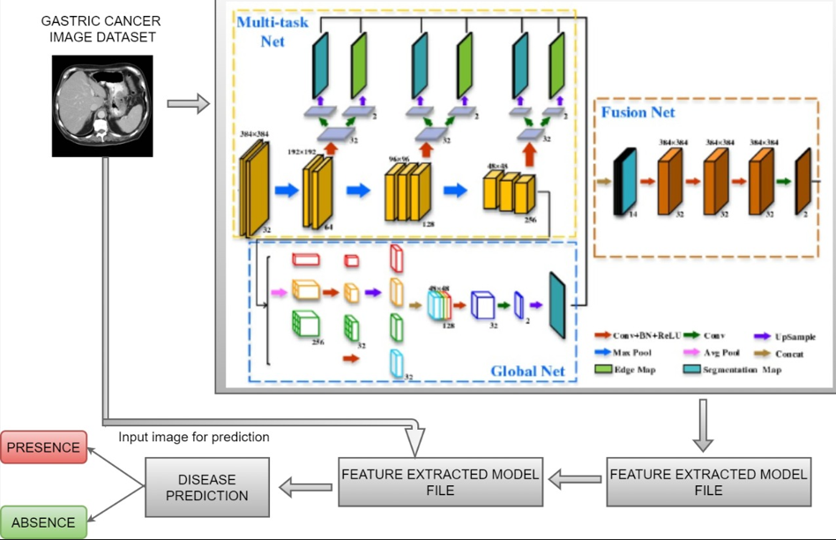
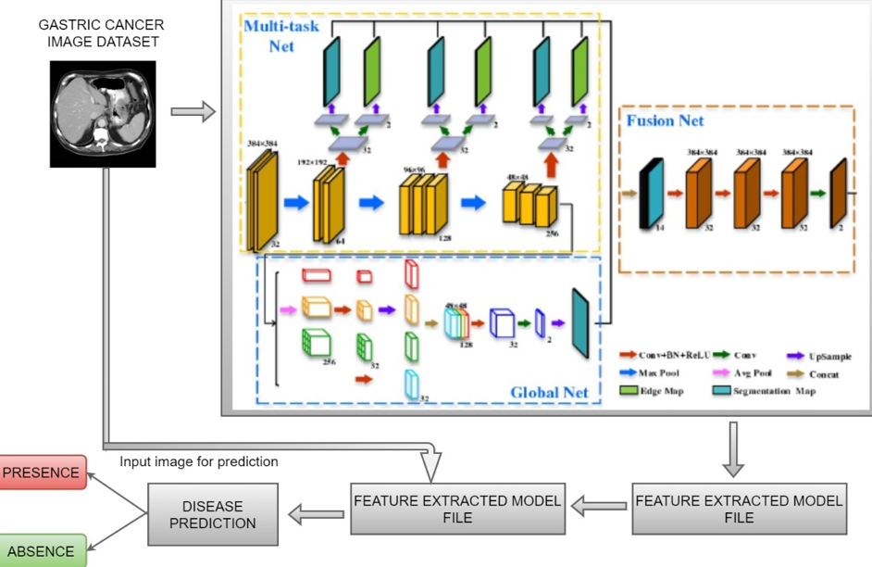

Slide 20
TECHNICAL FEASIBILITY STUDY
This project is a complete deep learning based application. The main technologies associated with this are
Deep learning algorithms
Python
Annotation tools
Make sence.AI
UI
React js
IDE
Google COLAB
Each of the technologies are freely available and the technical skills required are manageable.
From these it’s clear that the project is technically feasible.

Slide 21
SOCIAL FEASIBILITY STUDY
This project has successfully implemented a model to predict the presence of the disease and determine whether the person has gastric cancer and provide prior measures to avoid the disease.
Due to non availability of pathological doctors analyzing the scans will be delayed and due to this treating the patients will be prolonged.
In order to prevent this situation we proposed this system which can be used in hospitals, laboratories, day care centers, test centers
Since this new system eliminates the effort to predict the disease and will have a great impact in the society.

Slide 22
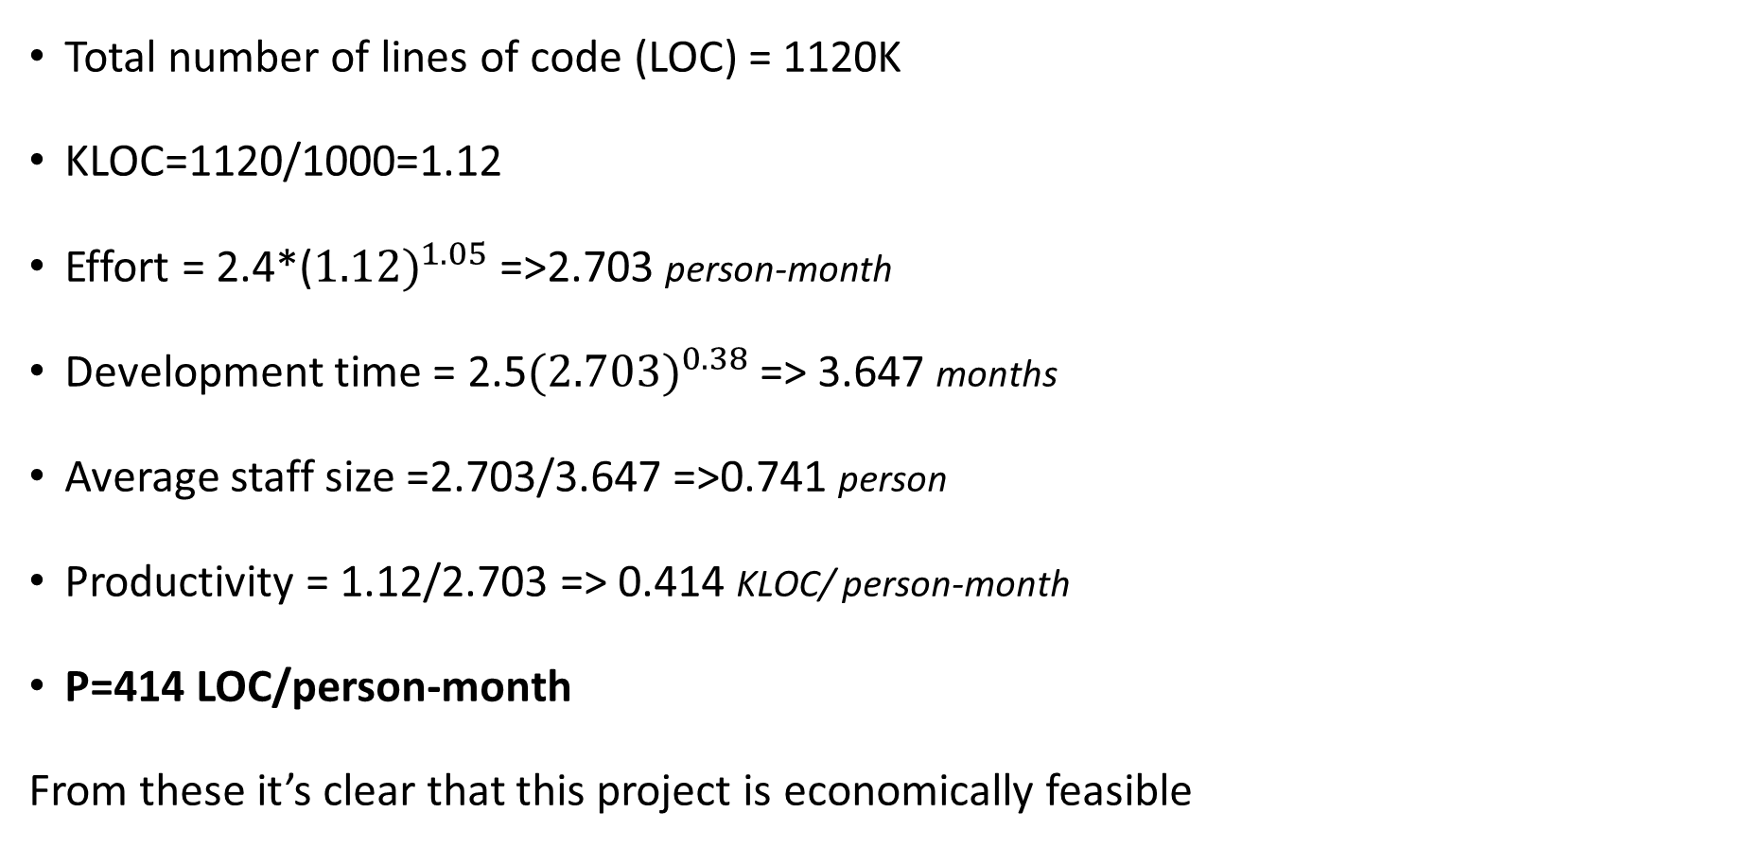
ECONOMICAL FEASIBILITY STUDY (COCOMO MODEL)
Total number of lines of code (LOC) = 1120K
KLOC=1120/1000=1.12
Effort = 2.4*(${1.12)}^{1.05}$ =>2.703 person-month
Development time = 2.5${(2.703)}^{0.38}$ => 3.647 months
Average staff size =2.703/3.647 =>0.741 person
Productivity = 1.12/2.703 => 0.414 KLOC/ person-month
P=414 LOC/person-month
From these it’s clear that this project is economically feasible

Slide 23
REFERENCE
[1] Shuai Ding , Member, IEEE, Shikang Hu, Xiaojian Li , Youtao Zhang , Member, IEEE, and Desheng Dash Wu,Senior Member, IEEE,(2021),“Leveraging Multimodal Semantic Fusion for Gastric Cancer Screening via Hierarchical Attention Mechanism”,IEEE Transactions on Systems, Man,and Cybernetics:Systems,Page 1 - 14
DOI: 10.1109/TSMC.2021.3096974
[2] Shaolong Shi , Student Member, IEEE, Yifan Chen , Senior Member, IEEE, and Xin Yao,Fellow, IEEE,(2020)”NGA-Inspired Nanorobots-Assisted Detection of Multifocal Cancer”, IEEE Transactions on Cybernetics, Page 1 - 11
DOI: 10.1109/TCYB.2020.3024868
[3] Efthymios P. Papageorgiou; Bernhard E. Boser; Mekhail Anwar,(2020),” Chip-Scale Angle-Selective Imager for In Vivo Microscopic Cancer Detection”, IEEE Transactions on Biomedical Circuits and Systems, Volume No 14, Page 91 – 103
DOI: 10.1109/TBCAS.2019.2959278

Slide 24
REFERENCE
[4] Jean-S´ebastien Boisvert, Julie Lafontaine, Audrey Glory, Sylvain Coulombe and Philip Wong,(2020),” Comparison of three radio-frequency discharge modes on the treatment of breast cancer cells in vitro”, IEEE Transactions on Radiation and Plasma Medical Sciences, Volume No 4, Page 644 - 654
DOI: 10.1109/TRPMS.2020.2994870
[5] Ai-Min Yang, Yang Han, Chen-Shuai Liu, Jian-Hui Wu, Dian-Bo Hua,(2020),” D-TSVR Recurrence Prediction Driven by Medical Big Data in Cancer”, IEEE Transactions on Industrial Informatics, Volume No 17, Page 3508 – 3517
DOI: 10.1109/TII.2020.3011675
[6] Seungwoo Song, Student Member, IEEE, Jukwan Na, MoonHyung Jang, Student Member, IEEE, Hyeyeon Lee, Student Member, IEEE,(2019),” A CMOS VEGF Sensor for Cancer Diagnosis Using a Peptide Aptamer-Based Functionalized Microneedle”,IEEE Transactions on Biomedical Circuits and Systems, Volume No 13, Page 1288 - 1299
DOI: 10.1109/TBCAS.2019.2954846

Slide 25
REFERENCE
[7] Chih-Hung Chan, Pau-Choo Chung, Chih-Yang Chen, Chein-Chen Lee, Man-Yee Chan, Tze-Ta Huang ,(2019),” Texture-Map Based Branch-Collaborative Network for Oral Cancer Detection“, IEEE Transactions on Biomedical Circuits and Systems, Volume No 13, Page 766 – 780
DOI: 10.1109/TBCAS.2019.2918244
[8] Bo Fu,Pei Liu, Jie Lin, Ling Deng, Kejia Hu, Hong Zheng,(2019),” Predicting Invasive Disease-Free Survival for Early Stage Breast Cancer Patients Using Follow-Up Clinical Data“,IEEE Transactions on Biomedical Engineering,Volume No 66, Page 2053 – 2064
DOI: 10.1109/TBME.2018.2882867
[9] Man-Sun Kim,Dongsan Kim, Jeong-Rae Kim, (2019),”Stage-Dependent Gene Expression Profiling in Colorectal Cancer “,IEEE Transactions on Computational Biology and Bioinformatics, Volume No 16, Page 1685 - 1692
DOI: 10.1109/TCBB.2018.2814043

Slide 26
REFERENCE
[10] SeongRyeol Moon, Curt Balch, Sungjin Park, Jinhyuk Lee, Jiyong Sung, and Seungyoon Nam,(2018),” Systematic Inspection of the Clinical Relevance of TP53 Missense Mutations in Gastric Cancer”, IEEE/ACM Transactions on Computational Biology and Bioinformatics, Volume No 16, Page 1693 – 1701
DOI: 10.1109/TCBB.2018.2814049

Slide 27


