Slide 1
DIAGNOSIS OF GASTRIC CANCER USING MIFNET ALGORITHM
BATCH A4
H.DHIVYADHARSHINI – 2018PECCS126
R.DIVYA DHARSHINI – 2018PECCS127
S.KEERTHANA – 2018PECCS149
PROJECT GUIDE: Dr.K.Sangeetha
PROJECT COORDINATOR: Dr.L.Jaba Sheela

Slide 2
ABSTRACT
Gastric cancer (GC) is one of the most common malignant tumors with poor prognostic results. It remains one of the deadly diseases with poor prognosis.
The worldwide shortage of pathologists offers a unique opportunity for the use of artificial intelligence assistance systems to alleviate the workload and increase diagnostic accuracy.
Most gastric cancer (GC) show genetic instability, either microsatellite instability or chromosomal instability, which is considered an early event in gastric carcinogenesis.
New classification of gastric cancers based on histologic features, genotypes and molecular phenotypes helps better understand the characteristics of each subtype, and improve early diagnosis, prevention and treatment.
To overcome this problem, this project develops a method using deep learning algorithms to assist the pathological diagnosis of gastric cancer as it involves numerous tests to arrive at a conclusion.
Thus, this project helps in effective diagnosis of gastric cancer with higher accuracy than the existing models.

Slide 3
OBJECTIVE
To develop a method using deep learning algorithms to assist the diagnosis of gastric cancer
To diagnose the presence of cancer more accurately using advanced algorithm such as MIFNET
To help in effective diagnosis of gastric cancer with higher accuracy

Slide 4
EXISTING SYSTEM
They propose a novel intelligent decision-making method for GC screening (ID-GCS), a multimodal semantic fusion based data-driven decision-making system.
ID-GCS exploits a hybrid attention mechanism to extract textual semantics from multimodal gastroscopy reports and performs semantic fusion to integrate the semantics of textual gastroscopy reports and images, resulting in improved interpretability of gastroscopy findings.

Slide 5
DISADVANTAGES OF EXISTING SYSTEM
The ID-GCS method had slightly worse complexity and fitting.
The accuracy of prediction is less which is not real time applicable.

Slide 6
PROPOSED SYSTEM
This project develops a method using deep learning algorithms to assist the diagnosis of gastric cancer as it involves numerous tests to arrive at a conclusion.
Advanced algorithm such as MIFNET is used to diagnose the presence of cancer more accurately.
MIFNET is a combination of three different algorithm such as Multi task Net, Fusion Net and Global Net, the combination of which gives accurate prediction of gastric cancer without any additional diagnosis.
Thus, this project helps in effective diagnosis of gastric cancer with higher accuracy than the existing models.

Slide 7
ADVANTAGES OF PROPOSED SYSTEM
Effective solution for gastric cancer diagnosis.
Accurate diagnosis helps pathologist with easier prediction.
Multi algorithm combination in MIFNET provides the best results.

Slide 8
ARCHITECTURAL DIAGRAM

Slide 9
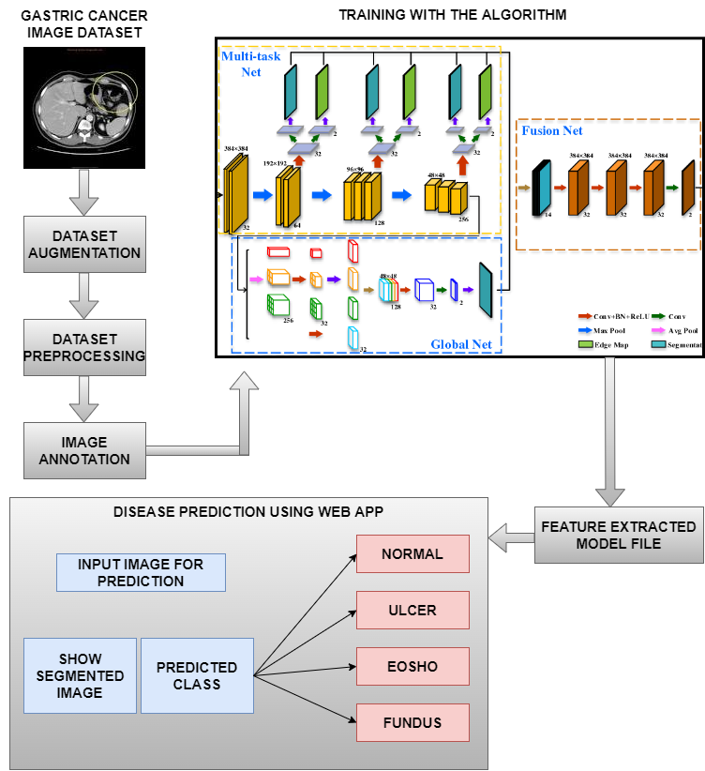

Slide 10
HARDWARE REQUIREMENTS
PC
RAM : 8 GB
Processor : i5
Hard disk : 1 TB

Slide 11
SOFTWARE REQUIREMENTS
Google Colab
Python
React js

Slide 12
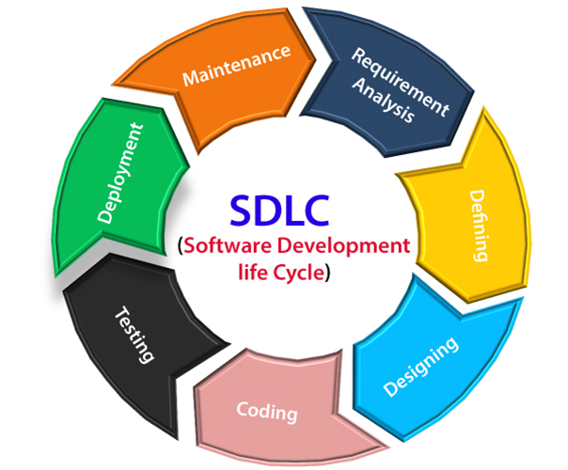
SDLC

Slide 13
TIMELINE

Slide 14
REFERENCE
[1] Shuai Ding , Member, IEEE, Shikang Hu, Xiaojian Li , Youtao Zhang , Member, IEEE, and Desheng Dash Wu,Senior Member, IEEE,(2021),“Leveraging Multimodal Semantic Fusion for Gastric Cancer Screening via Hierarchical Attention Mechanism”,IEEE Transactions on Systems, Man,and Cybernetics:Systems,Page 1 - 14
DOI: 10.1109/TSMC.2021.3096974
[2] Shaolong Shi , Student Member, IEEE, Yifan Chen , Senior Member, IEEE, and Xin Yao,Fellow, IEEE,(2020)”NGA-Inspired Nanorobots-Assisted Detection of Multifocal Cancer”, IEEE Transactions on Cybernetics, Page 1 - 11
DOI: 10.1109/TCYB.2020.3024868
[3] Efthymios P. Papageorgiou; Bernhard E. Boser; Mekhail Anwar,(2020),” Chip-Scale Angle-Selective Imager for In Vivo Microscopic Cancer Detection”, IEEE Transactions on Biomedical Circuits and Systems, Volume No 14, Page 91 – 103
DOI: 10.1109/TBCAS.2019.2959278

Slide 15
REFERENCE
[4] Jean-S´ebastien Boisvert, Julie Lafontaine, Audrey Glory, Sylvain Coulombe and Philip Wong,(2020),” Comparison of three radio-frequency discharge modes on the treatment of breast cancer cells in vitro”, IEEE Transactions on Radiation and Plasma Medical Sciences, Volume No 4, Page 644 - 654
DOI: 10.1109/TRPMS.2020.2994870
[5] Ai-Min Yang, Yang Han, Chen-Shuai Liu, Jian-Hui Wu, Dian-Bo Hua,(2020),” D-TSVR Recurrence Prediction Driven by Medical Big Data in Cancer”, IEEE Transactions on Industrial Informatics, Volume No 17, Page 3508 – 3517
DOI: 10.1109/TII.2020.3011675
[6] Seungwoo Song, Student Member, IEEE, Jukwan Na, MoonHyung Jang, Student Member, IEEE, Hyeyeon Lee, Student Member, IEEE,(2019),” A CMOS VEGF Sensor for Cancer Diagnosis Using a Peptide Aptamer-Based Functionalized Microneedle”,IEEE Transactions on Biomedical Circuits and Systems, Volume No 13, Page 1288 - 1299
DOI: 10.1109/TBCAS.2019.2954846

Slide 16
REFERENCE
[7] Chih-Hung Chan, Pau-Choo Chung, Chih-Yang Chen, Chein-Chen Lee, Man-Yee Chan, Tze-Ta Huang ,(2019),” Texture-Map Based Branch-Collaborative Network for Oral Cancer Detection“, IEEE Transactions on Biomedical Circuits and Systems, Volume No 13, Page 766 – 780
DOI: 10.1109/TBCAS.2019.2918244
[8] Bo Fu,Pei Liu, Jie Lin, Ling Deng, Kejia Hu, Hong Zheng,(2019),” Predicting Invasive Disease-Free Survival for Early Stage Breast Cancer Patients Using Follow-Up Clinical Data“,IEEE Transactions on Biomedical Engineering,Volume No 66, Page 2053 – 2064
DOI: 10.1109/TBME.2018.2882867
[9] Man-Sun Kim,Dongsan Kim, Jeong-Rae Kim, (2019),”Stage-Dependent Gene Expression Profiling in Colorectal Cancer “,IEEE Transactions on Computational Biology and Bioinformatics, Volume No 16, Page 1685 - 1692
DOI: 10.1109/TCBB.2018.2814043

Slide 17
REFERENCE
[10] SeongRyeol Moon, Curt Balch, Sungjin Park, Jinhyuk Lee, Jiyong Sung, and Seungyoon Nam,(2018),” Systematic Inspection of the Clinical Relevance of TP53 Missense Mutations in Gastric Cancer”, IEEE/ACM Transactions on Computational Biology and Bioinformatics, Volume No 16, Page 1693 – 1701
DOI: 10.1109/TCBB.2018.2814049

Slide 18


