Slide 1
DIAGNOSIS OF GASTRIC CANCER USING MIFNET ALGORITHM
BATCH A4
H.DHIVYADHARSHINI – 2018PECCS126
R.DIVYA DHARSHINI – 2018PECCS127
S.KEERTHANA – 2018PECCS149
PROJECT GUIDE: Dr.K.Sangeetha
PROJECT COORDINATOR: Dr.L.Jaba Sheela

Slide 2
SYSTEM ARCHITECTURE

Slide 3
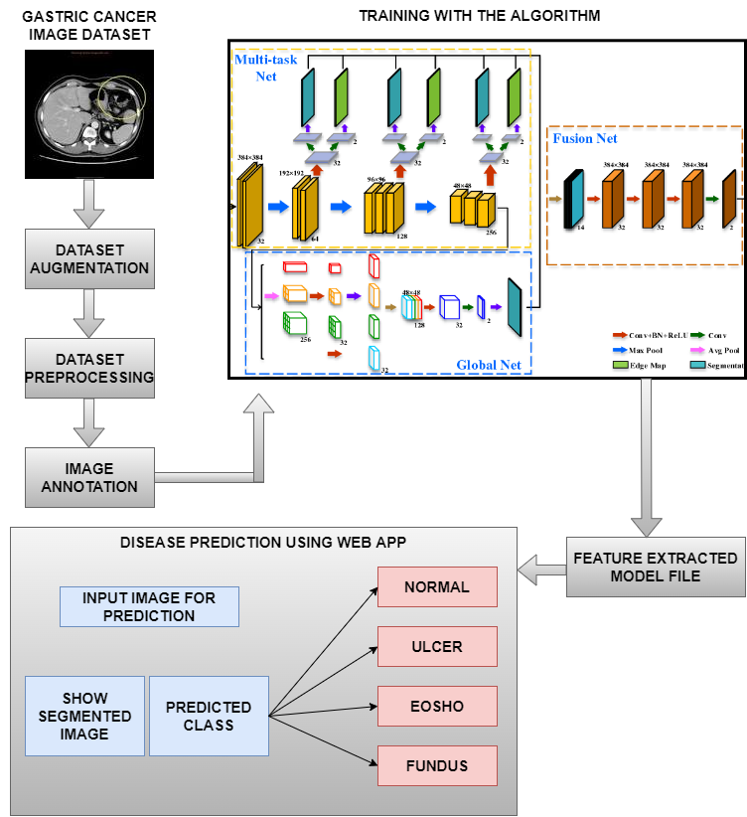

Slide 4
MODULES DESCRIPTION
Gastric Cancer Dataset Collection
Dataset Preprocessing
Annotating Images
MIFNET Algorithm training
Validation and Evaluation
Disease Prediction
Web application

Slide 5
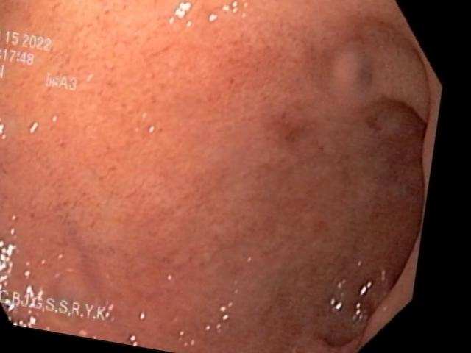
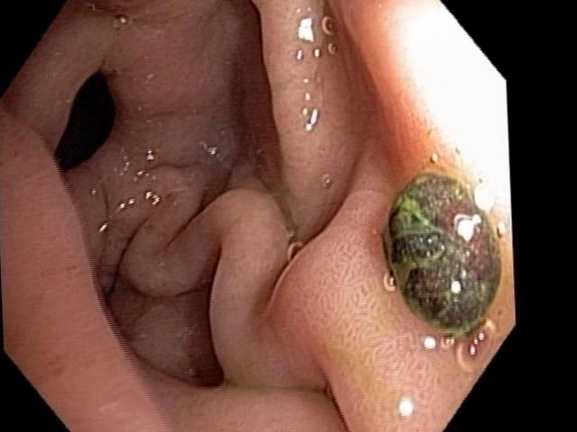
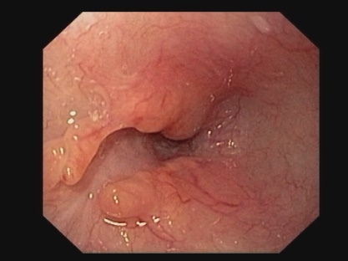
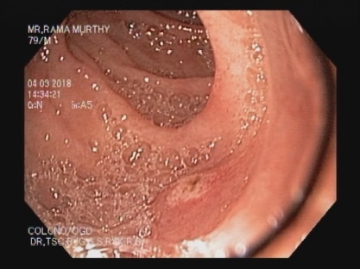
DATASET COLLECTION
FROM HOSPITAL
NORMAL WITHOUT CANCER
CANCER IN FUNDUS
CANCER IN EOSHOPHAGUS
ULCER IN STOMACH

Slide 6
GASTRIC CANCER DATASET COLLECTION
A dataset contains a lot of separate pieces of data but can be used to train an algorithm with the goal of finding predictable patterns inside the whole dataset.
For this project, datasets are collected from hospital.
The dataset contains images of cancer present in fundus, esophagus and ulcer present in the stomach.
It also contains images in without the presence of cancer.
Then the dataset is divided into two parts,
Training dataset – 75% used to train an algorithm to understand and learn.
Testing dataset – 25% used to evaluate how well an algorithm was trained.

Slide 7
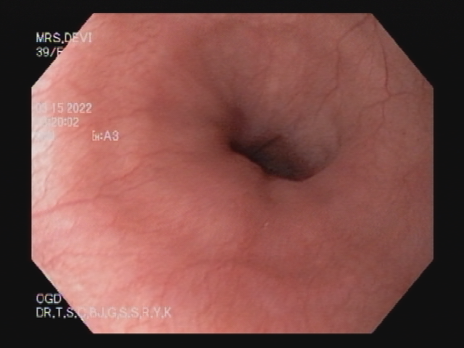
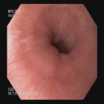
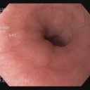
DATA PREPROCESSING
Simple pre-processing- Input
Random Size
Aspect aware pre-processing- Input
Edges are cut
Size is reduced
OUTPUT
128 * 128 preprocessed
OUTPUT
128 * 128 preprocessed

Slide 8
DATASET PREPROCESSING
A real-world data generally contains noises, missing values, and maybe in an unusable format which cannot be directly used for deep learning models.
The most common image data input parameters are the number of images, image height, image width, number of channels, and the number of levels per pixel.
Endoscopic images that differ in size are converted to images with dimensions of 128*128
Aspect aware ratio is done for all the images in which the edges of the images are cut to make the images in the understandable format.

Slide 9
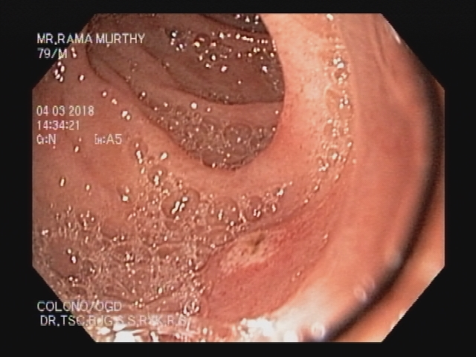

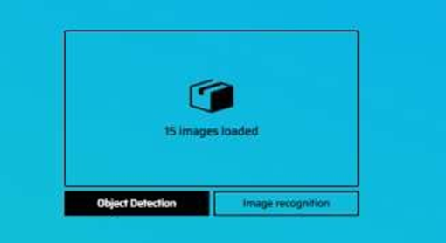
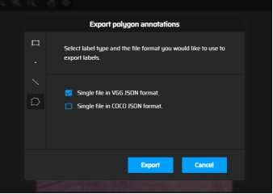
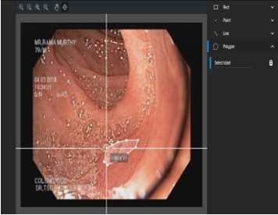
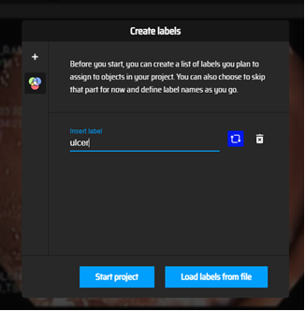
ANNOTATING IMAGES
INPUT IMAGE
ANNOTATION TOOL
OBJECT DETECTION
JSON FILE FORMAT
SEGMENT ROI
CREATE LABELS

Slide 10
ANNOTATING IMAGES
Image annotation is the process of labeling or classifying an image using text, annotation tools, or both.
The datasets are annotated using makesense.ai.
After selecting the images from the dataset, object detection is selected.
Label is created for each image.
Region of Interest(ROI) is marked (i.e.), the part in which cancer is present is segmented.
Finally, segmented data is produced as JSON file which is then given as the output for training.

Slide 11
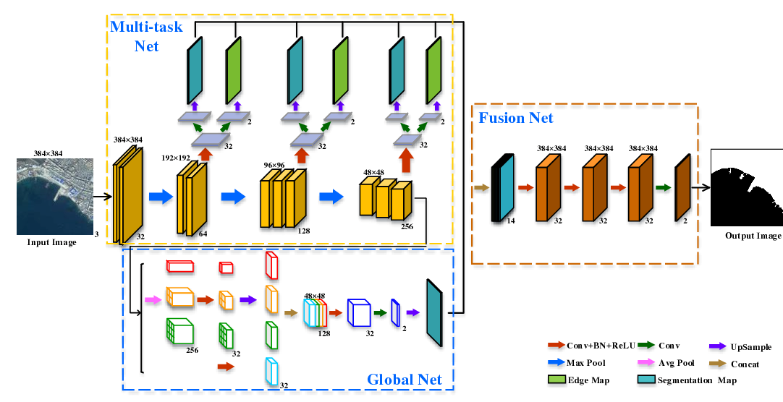
MIFNET ALGORITHM TRAINING PROCESS

Slide 12
MIFNET ALGORITHM TRAINING
After the collected dataset is passed and preprocessed, it will be fed for training with the Deep Learning algorithms.
The advanced algorithm such as MIFNET is used to diagnose the presence of cancer more accurately.
MIFNET is a combination of three different algorithm such as
Multi task Net
Fusion Net
Global Net
The combination of the algorithm gives accurate prediction of gastric cancer without any additional diagnosis.

Slide 13
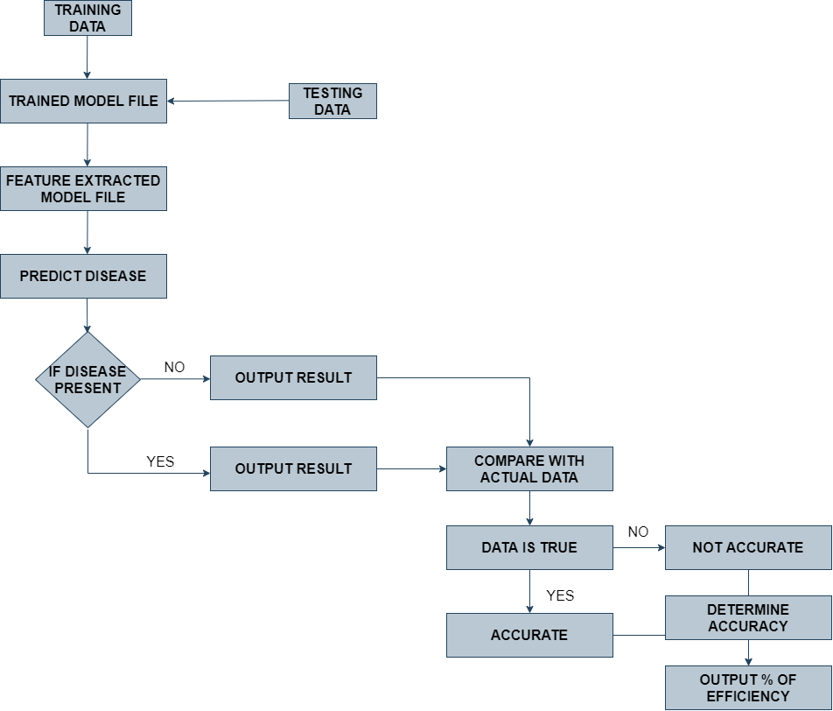
VALIDATION AND EVALUATION PROCESS

Slide 14
VALIDATION AND EVALUATION
After applying the MIFNET algorithm and training the data, validation is carried on.
75% of the dataset goes to the training set and 25% to the testing set.
After training data, the trained model file has been generated and the testing data is given to the trained model file.
As the features has been extracted as a model file, when an input image is given for the disease prediction process and it will predict the presence of disease.
If the disease is presents yes or no, the output result will be compared with actual data. If the data is true, it will be accurate and if the data is false, it will be not accurate.
At last, it will determine the presence of disease with higher accuracy.

Slide 15
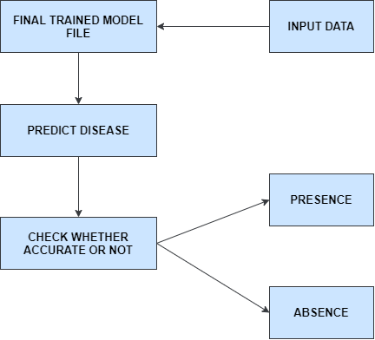
DISEASE PREDICTION PROCESS

Slide 16
DISEASE PREDICTION
The main objective is to predict the prediction efficiency that would be beneficial for the patients who are suffering from Gastric cancer and the percentage ratio will be reduced.
Generally in the first stage of the disease can be cured by the proper treatment. So it‘s important to identify the disease at the early stage for the betterment of the patients.
The main purpose of this research work is to find the best prediction model i.e. the best Deep Learning technique which will distinguishes the Gastric cancer patient from the healthy person.
After the validation and evaluation, the final trained model file has been generated.
When an input image is given, it will predict the disease and check whether the data is accurate or not. So, we can easily predict the presence of disease with higher accuracy.

Slide 17
WEB APPLICATION
In this project we have used Reactjs which is a javascript library for developing user interface.
React is a JavaScript library for building user interfaces. React is used to build single-page applications. React allows us to create reusable UI components.
Web application development is the creation of application programs that reside on remote servers and are delivered to the user’s device over the Internet.
A web application (web app) does not need to be downloaded and is instead accessed through a network. An end user can access a web application through a web browser such as Google Chrome, Safari, or Mozilla Firefox.
A majority of web applications can be written in JavaScript, Cascading Style Sheets (CSS), and HTML5.

Slide 18
SYSTEM DESIGN

Slide 19
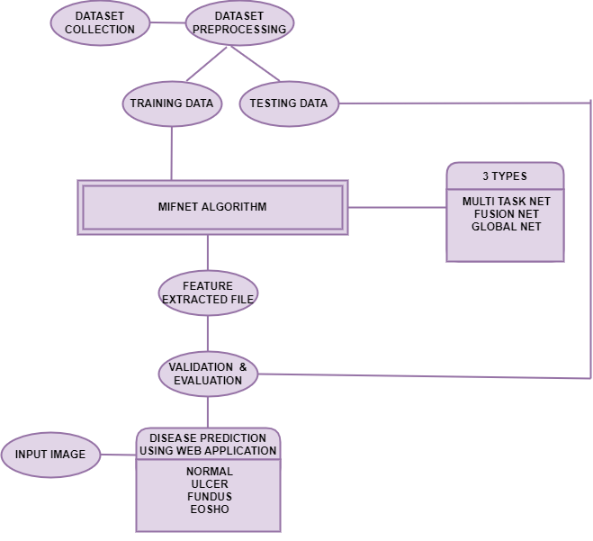
ER DIAGRAM

Slide 20
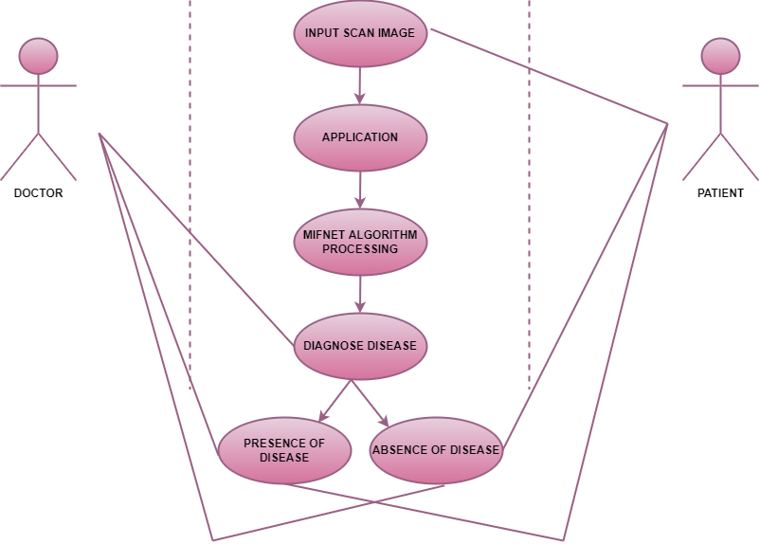
USECASE DIAGRAM

Slide 21
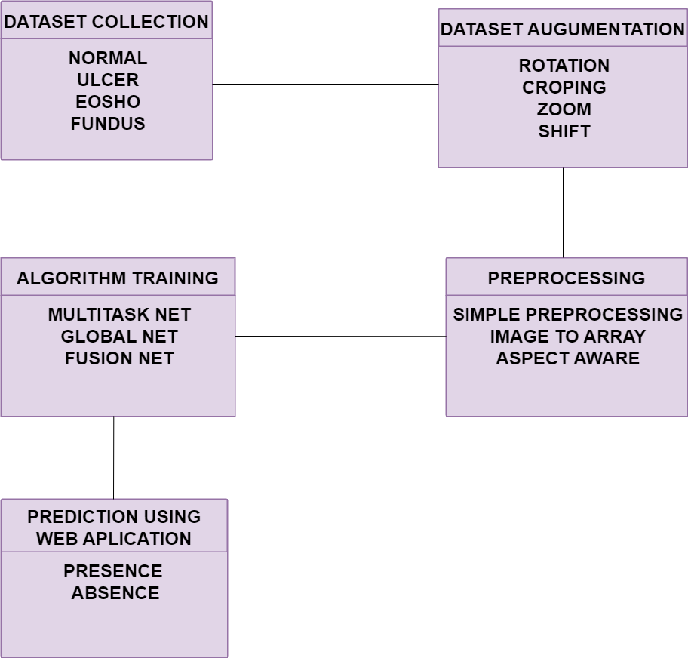
CLASS DIAGRAM

Slide 22
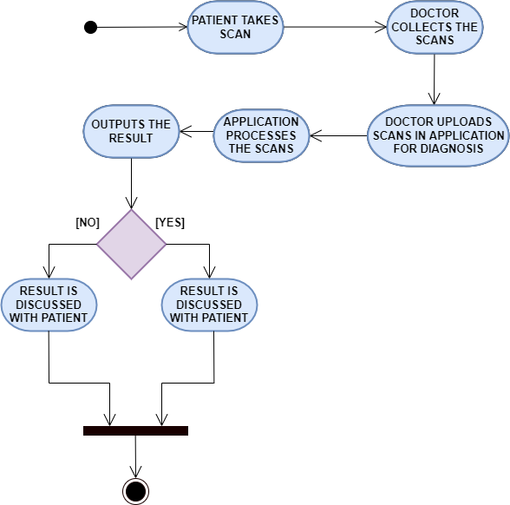
ACTIVITY DIAGRAM

Slide 23
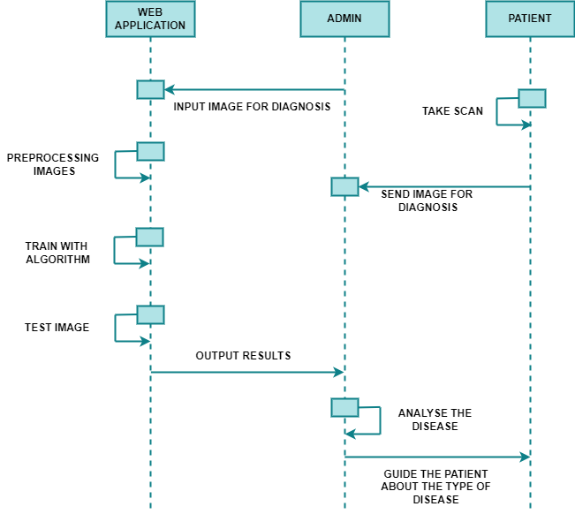
SEQUENCE DIAGRAM

Slide 24
DATA DICTIONARY
ENTITY | ATTRIBUTE | DATA TYPE | DESCRIPTION
pixel | image | numpy.array | Input image
dataset | class | string | dataset label
preprocess | size | int | image size
augmentation | angle | float | rotation range
annotation | annotated file | json | annotated cancer part in image
trained model | model | h5 | Saving model

Slide 25
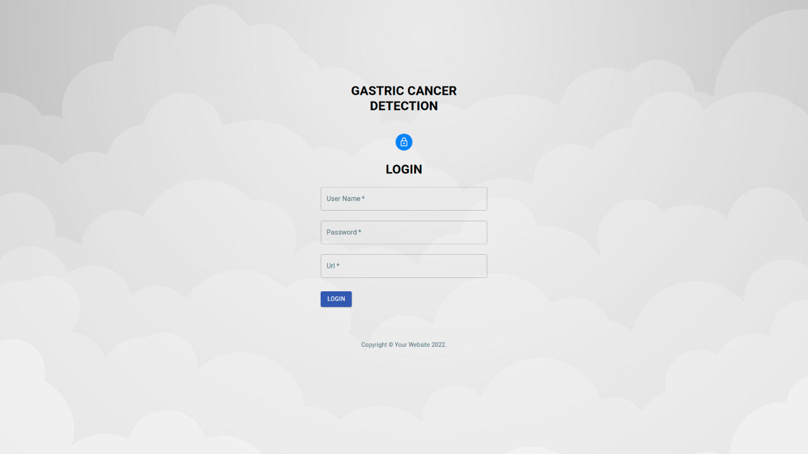
INPUT DESIGN

Slide 26
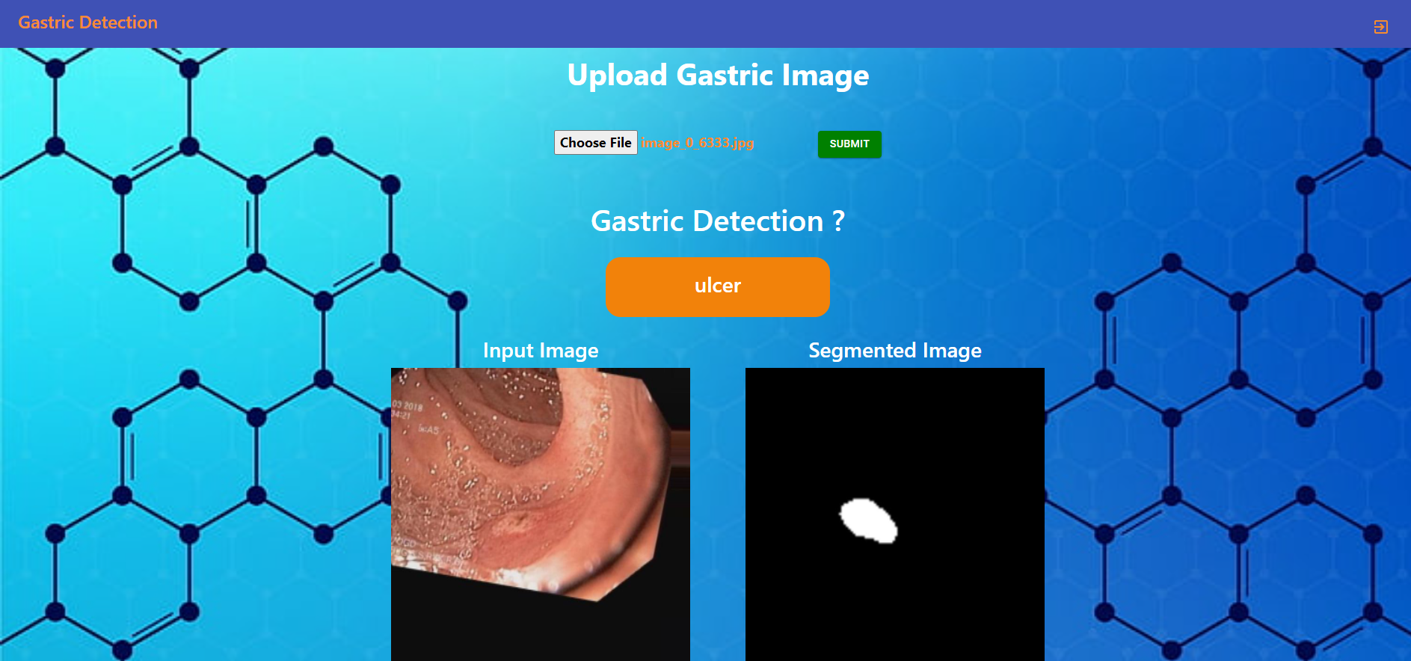
INPUT DESIGN

Slide 27
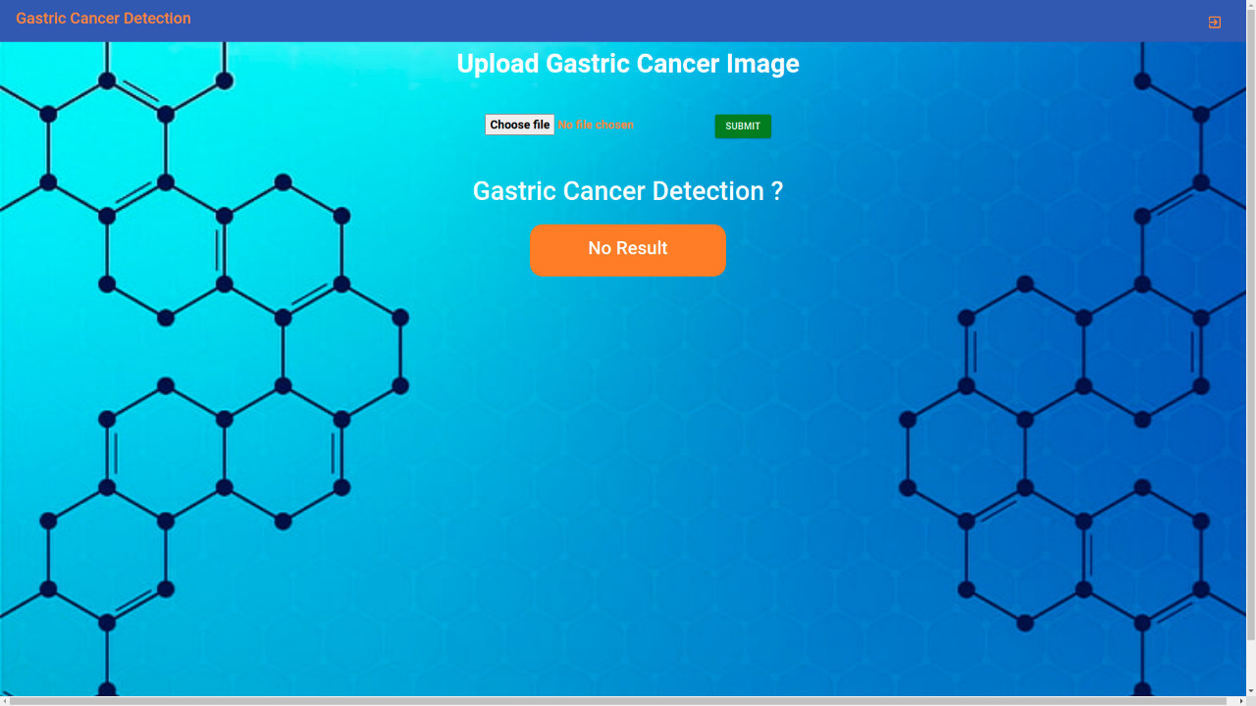
INPUT DESIGN

Slide 28
REFERENCES
[1] Shuai Ding , Member, IEEE, Shikang Hu, Xiaojian Li , Youtao Zhang , Member, IEEE, and Desheng Dash Wu,Senior Member, IEEE,(2021),“Leveraging Multimodal Semantic Fusion for Gastric Cancer Screening via Hierarchical Attention Mechanism”,IEEE Transactions on Systems, Man,and Cybernetics:Systems,Page 1 - 14
DOI: 10.1109/TSMC.2021.3096974
[2] Shaolong Shi , Student Member, IEEE, Yifan Chen , Senior Member, IEEE, and Xin Yao,Fellow, IEEE,(2020)”NGA-Inspired Nanorobots-Assisted Detection of Multifocal Cancer”, IEEE Transactions on Cybernetics, Page 1 - 11
DOI: 10.1109/TCYB.2020.3024868
[3] Efthymios P. Papageorgiou; Bernhard E. Boser; Mekhail Anwar,(2020),” Chip-Scale Angle-Selective Imager for In Vivo Microscopic Cancer Detection”, IEEE Transactions on Biomedical Circuits and Systems, Volume No 14, Page 91 – 103
DOI: 10.1109/TBCAS.2019.2959278

Slide 29
REFERENCES
[4] Jean-S´ebastien Boisvert, Julie Lafontaine, Audrey Glory, Sylvain Coulombe and Philip Wong,(2020),” Comparison of three radio-frequency discharge modes on the treatment of breast cancer cells in vitro”, IEEE Transactions on Radiation and Plasma Medical Sciences, Volume No 4, Page 644 - 654
DOI: 10.1109/TRPMS.2020.2994870
[5] Ai-Min Yang, Yang Han, Chen-Shuai Liu, Jian-Hui Wu, Dian-Bo Hua,(2020),” D-TSVR Recurrence Prediction Driven by Medical Big Data in Cancer”, IEEE Transactions on Industrial Informatics, Volume No 17, Page 3508 – 3517
DOI: 10.1109/TII.2020.3011675
[6] Seungwoo Song, Student Member, IEEE, Jukwan Na, MoonHyung Jang, Student Member, IEEE, Hyeyeon Lee, Student Member, IEEE,(2019),” A CMOS VEGF Sensor for Cancer Diagnosis Using a Peptide Aptamer-Based Functionalized Microneedle”,IEEE Transactions on Biomedical Circuits and Systems, Volume No 13, Page 1288 - 1299
DOI: 10.1109/TBCAS.2019.2954846

Slide 30
REFERENCES
[7] Chih-Hung Chan, Pau-Choo Chung, Chih-Yang Chen, Chein-Chen Lee, Man-Yee Chan, Tze-Ta Huang ,(2019),” Texture-Map Based Branch-Collaborative Network for Oral Cancer Detection“, IEEE Transactions on Biomedical Circuits and Systems, Volume No 13, Page 766 – 780
DOI: 10.1109/TBCAS.2019.2918244
[8] Bo Fu,Pei Liu, Jie Lin, Ling Deng, Kejia Hu, Hong Zheng,(2019),” Predicting Invasive Disease-Free Survival for Early Stage Breast Cancer Patients Using Follow-Up Clinical Data“,IEEE Transactions on Biomedical Engineering,Volume No 66, Page 2053 – 2064
DOI: 10.1109/TBME.2018.2882867
[9] Man-Sun Kim,Dongsan Kim, Jeong-Rae Kim, (2019),”Stage-Dependent Gene Expression Profiling in Colorectal Cancer “,IEEE Transactions on Computational Biology and Bioinformatics, Volume No 16, Page 1685 - 1692
DOI: 10.1109/TCBB.2018.2814043

Slide 31
REFERENCES
[10] SeongRyeol Moon, Curt Balch, Sungjin Park, Jinhyuk Lee, Jiyong Sung, and Seungyoon Nam,(2018),” Systematic Inspection of the Clinical Relevance of TP53 Missense Mutations in Gastric Cancer”, IEEE/ACM Transactions on Computational Biology and Bioinformatics, Volume No 16, Page 1693 – 1701
DOI: 10.1109/TCBB.2018.2814049

Slide 32


