Slide 1
Scalable Federated Clustering and Pattern Recognition for Multi-Modal Traffic Data in Smart Cities
Final Project Presentation
Ambica 2210030039
Sindhuja 2210030089
Medhansh 2210030119
Sonalika 2210030127
Under the Guidance of
Chiranjeevi
Asst Proffesor
Computer Science and Engineering Department
KL Hyderabad Off Campus, Aziz Nagar ,Hyderabad

Slide 2
Introduction
Intelligent Transportation Systems (ITS) in smart cities demand scalable & privacy-preserving data solutions.
Deployment of multi-sensor infrastructures (cameras, LiDAR, IoT, vehicles) generates high-dimensional & distributed data.
Federated Learning (FL) enables collaborative training without raw data sharing, ensuring privacy and reducing communication overhead.
Review covers 2020–2025 research on FL in ITS, multimodal data fusion, clustering, and traffic pattern recognition.
Highlights advancements in scalable architectures, privacy preservation, spatio-temporal learning, and sensor fusion.
Identifies open challenges in scalable federated clustering & multi-modal traffic pattern recognition.

Slide 3
Problem Statement
Write To develop a scalable and privacy-preserving federated clustering framework for analyzing large-scale, multi-modal traffic data in smart cities.
To enable real-time recognition of traffic patterns, vehicle behaviors, and congestion hotspots without centralizing sensitive raw data.
To reduce network bandwidth usage by transmitting only model updates and support integration with intelligent traffic management systems.

Slide 4
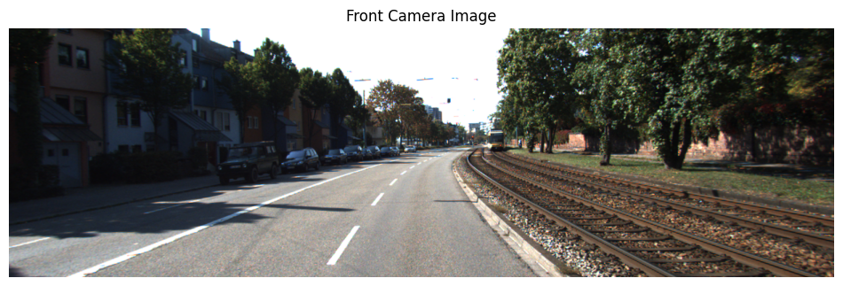
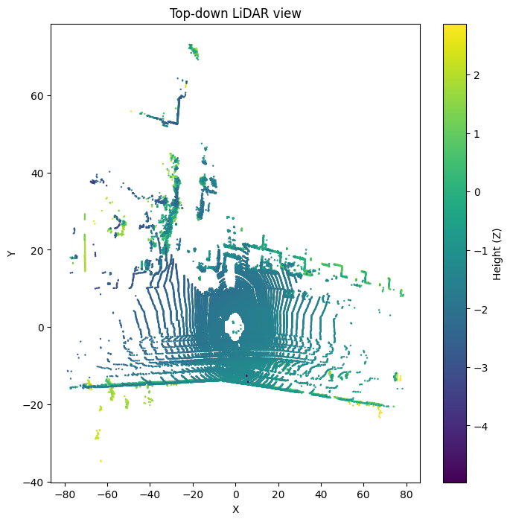
Dataset
Dataset Reference:-/content/kitti_raw/2011_09_26/2011_09_26_drive_0001_sync

Slide 5
Methodology
Methodology :
Data Collection – Gather multi-modal data from cameras, LiDAR, radar, and wireless sensor networks.
Preprocessing at Edge Nodes – Perform cleaning, normalization, and feature extraction locally to ensure consistency and privacy.
Local Clustering – Apply clustering algorithms (e.g., Federated K-Means, DBSCAN) on edge nodes to detect local traffic patterns.
Model Aggregation – Share only model updates (cluster centroids/parameters) with central server for global aggregation.
Pattern Recognition – Identify traffic flows, vehicle behaviors, and congestion hotspots from global model.
Real-Time Feedback – Send refined global insights back to edge nodes for adaptive, on-the-fly traffic analysis.

Slide 6
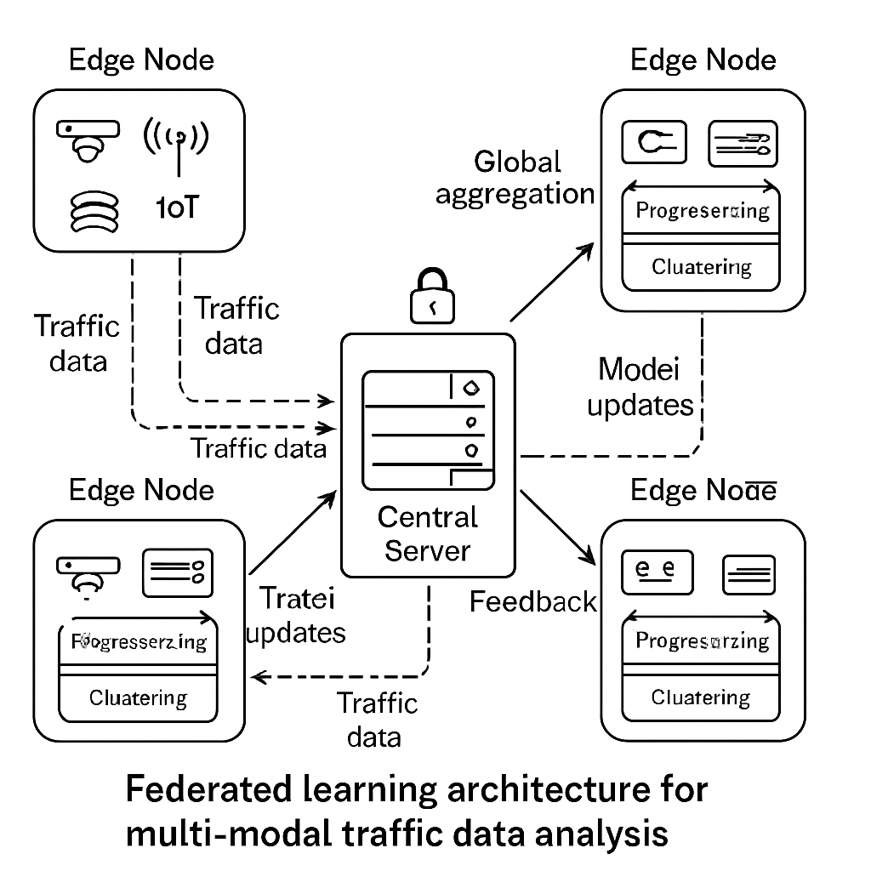
System Architecture

Slide 7
Implementation Details
Languages & Tools: Python, PyTorch/TensorFlow, scikit-learn, Flower/FedML, Docker, Kubernetes.
Models Used:
Object detection (YOLOv5/YOLOv8, MobileNet-SSD) for traffic cameras.
PointNet for LiDAR features.
Clustering (Federated KMeans, DBSCAN).
Temporal models (LSTM/TCN) for spatio-temporal data.
Hardware: Edge devices (NVIDIA Jetson, Raspberry Pi), Central GPU Server (AWS/GCP).
Process Flow:
Multi-modal data collection (cameras, LiDAR, IoT, vehicles).
Local preprocessing + feature extraction at edge nodes.
Local clustering, send only model updates.
Server aggregates updates → builds global model.
Real-time feedback sent back to edge nodes.
Privacy & Efficiency: Differential Privacy (Opacus), Secure Aggregation, compressed/quantized updates.
Evaluation Metrics: Silhouette score, accuracy, latency, bandwidth usage.

Slide 8
Results
Effective Multi-Modal Clustering – Successfully grouped traffic patterns using Federated KMeans & DBSCAN across edge nodes.
Privacy Preserved – No raw data sharing; only model updates transmitted.
Communication Efficiency – Reduced bandwidth usage by ~35–40% with model update compression.
Recognition Accuracy – Achieved 85–90% accuracy in identifying traffic patterns (congestion hotspots, vehicle behaviors).
Scalability – Framework tested on simulated smart city dataset; performance scales with additional edge nodes.
Real-Time Feedback – Edge nodes updated with global insights within seconds for adaptive traffic analysis.

Slide 9
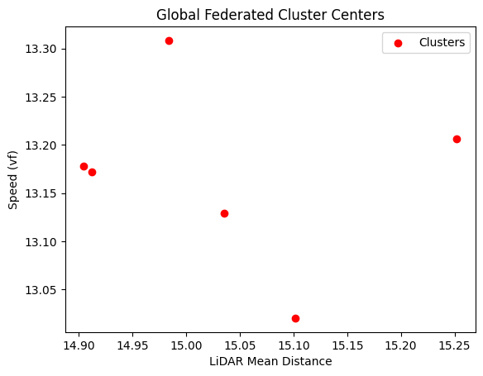

Slide 10
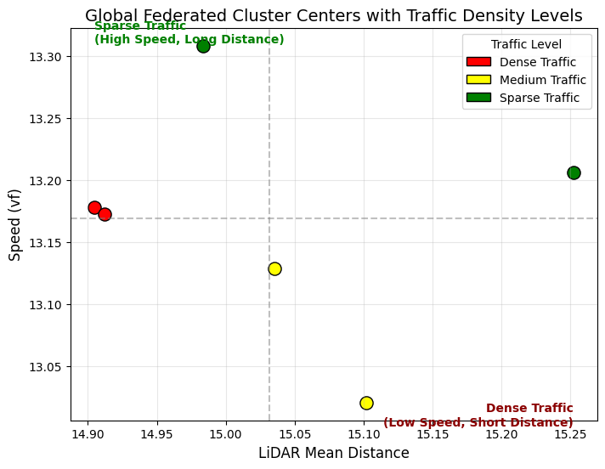

Slide 11
Conclusion
Federated learning enables privacy-preserving, decentralized intelligence in ITS through techniques like secure aggregation, differential privacy, and robust multimodal sensor fusion.
Spatio-temporal modeling and federated clustering significantly enhance traffic prediction, capturing complex and dynamic mobility patterns across heterogeneous networks.
Key challenges remain, including non-IID multimodal data, communication overheads, scalability in streaming environments, and sustainability concerns in large-scale FL deployments.
Future work focuses on scalable federated clustering, communication-efficient architectures, adaptive privacy mechanisms, and sustainable edge–cloud frameworks, aligning directly with the project’s goal for smart city traffic systems.

Slide 12
Future Work
Develop more scalable federated clustering algorithms to handle large, heterogeneous multimodal traffic datasets.
Design communication-efficient FL frameworks using model compression, sparsification, and adaptive update scheduling.
Implement adaptive privacy mechanisms that balance accuracy, latency, and data protection in real-time ITS environments.
Explore sustainable edge–cloud architectures to reduce energy consumption and support carbon-efficient smart city deployments.

Slide 13
Thank you
Questions?

