Slide 1
A comparative study of generative adversarial networks on domain name generator in botnet malware
Student: Chia-Ruei Lee
Advisor: Chia-Mu Yu
Po-Chun Huang

Slide 2
Contents
A. Introduction
1. Botnet
2. Domain Generation Algorithm
3. Literature Review
4. Purpose
B. Deep Learning
1. Neural Network (NN)
2. Deep Learning
CNN / RNN / RL
3. Auto-Encoder
4. Generative Adversarial Networks (GAN)
5. Wasserstein GAN (WGAN)
6. Improved Wasserstein GAN (WGAN-GP)

Slide 3
Contents
C. MATERIALS AND METHODS
1. Requirement
D. Result
1. Compare

Slide 4
Botnet
Introduction

Slide 5
Botnet
Command and Control Server
Bot
以往連接到C&C Server的方法：
特定IP
特定Domain

Slide 6

Botnet
用特定IP會被簡單抓到
Bot
用特定Domain
也會被簡單抓到
要怎麼做才有機會不被抓？

Slide 7
Domain Generation Algorithm (DGA)
Introduction

Slide 8


Domain Generation Algorithm
C&C server: DNS解析器 Bot
-- not working --
未發動攻擊時
DGA:
[a-d]{1,4}\.com
a.com

Slide 9
Domain Generation Algorithm
C&C server: DNS解析器 Bot
-- not working --
未發動攻擊時
DGA:
[a-d]{1,4}\.com
a.com
NXDOMAIN
(這個Domain不存在)

Slide 10
Domain Generation Algorithm
C&C server: DNS解析器 Bot
-- not working --
未發動攻擊時
DGA:
[a-d]{1,4}\.com
bb.com

Slide 11
Domain Generation Algorithm
C&C server: DNS解析器 Bot
-- not working --
未發動攻擊時
DGA:
[a-d]{1,4}\.com
bb.com
NXDOMAIN

Slide 12
Domain Generation Algorithm
C&C server: DNS解析器 Bot
-- not working --
未發動攻擊時
DGA:
[a-d]{1,4}\.com
ccc.com

Slide 13
Domain Generation Algorithm
C&C server: DNS解析器 Bot
-- not working --
未發動攻擊時
DGA:
[a-d]{1,4}\.com
ccc.com
NXDOMAIN

Slide 14
Domain Generation Algorithm
C&C server: DNS解析器 Bot
-- not working --
未發動攻擊時
DGA:
[a-d]{1,4}\.com
dddd.com

Slide 15
Domain Generation Algorithm
C&C server: DNS解析器 Bot
-- not working --
未發動攻擊時
DGA:
[a-d]{1,4}\.com
dddd.com
NXDOMAIN

Slide 16
Domain Generation Algorithm
C&C server: DNS解析器 Bot
140.138.240.240
發動攻擊時
DGA:
[a-d]{1,4}\.com
註冊 dddd.com
a.com

Slide 17
Domain Generation Algorithm
C&C server: DNS解析器 Bot
140.138.240.240
發動攻擊時
DGA:
[a-d]{1,4}\.com
註冊 dddd.com
a.com
NXDOMAIN
(這個Domain不存在)

Slide 18
Domain Generation Algorithm
C&C server: DNS解析器 Bot
140.138.240.240
發動攻擊時
DGA:
[a-d]{1,4}\.com
註冊 dddd.com
bb.com

Slide 19
Domain Generation Algorithm
C&C server: DNS解析器 Bot
140.138.240.240
發動攻擊時
DGA:
[a-d]{1,4}\.com
註冊 dddd.com
bb.com
NXDOMAIN

Slide 20
Domain Generation Algorithm
C&C server: DNS解析器 Bot
140.138.240.240
發動攻擊時
DGA:
[a-d]{1,4}\.com
註冊 dddd.com
ccc.com

Slide 21
Domain Generation Algorithm
C&C server: DNS解析器 Bot
140.138.240.240
發動攻擊時
DGA:
[a-d]{1,4}\.com
註冊 dddd.com
ccc.com
NXDOMAIN

Slide 22
Domain Generation Algorithm
C&C server: DNS解析器 Bot
140.138.240.240
發動攻擊時
DGA:
[a-d]{1,4}\.com
註冊 dddd.com
dddd.com

Slide 23
Domain Generation Algorithm
C&C server: DNS解析器 Bot
140.138.240.240
發動攻擊時
DGA:
[a-d]{1,4}\.com
註冊 dddd.com
dddd.com
IP:140.138.0.0

Slide 24
Domain Generation Algorithm
C&C server: DNS解析器 Bot
140.138.240.240
發動攻擊時
DGA:
[a-d]{1,4}\.com
註冊 dddd.com
dddd.com
IP:140.138.0.0
C&C 通道成功建立 開啟

Slide 25
Domain Generation Algorithm
隨手寫的式子：[a-d]{1,4}\.com
→ 就已經可以產生340種網域名稱了

Slide 26
Domain Generation Algorithm
現實中Botnet的DGA更加複雜
一天就可以產生成千上萬個網域名稱
→ 太多可疑對象，防禦方難以防禦
→ DNS供應商
→ 網路管理員
雖然有成千上萬的網域名稱，但是只有一個或少數幾個才會被真正註冊作為惡意伺服器
→ 攻擊方所付出的代價卻很低廉

Slide 27
Literature Review
Introduction

Slide 28
Literature Review
現有的許多論文

Slide 29
Purpose
Introduction

Slide 31
Neural Network
Deep Learning

Slide 33
Auto-Encoder
Deep Learning

Slide 35


Auto-Encoder
As close as possible
NN
Encoder
NN
Decoder
code
Randomly generate a vector as code
NN
Decoder
code
From Hung-yi Lee, “Generative Adversarial Network/Basic Idea/Machine Learning and having it deep and structured (2017,Spring)”
http://speech.ee.ntu.edu.tw/~tlkagk/courses_MLDS17.html

Slide 36



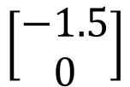
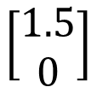
Auto-Encoder
2D
NN
Decoder
code
NN
Decoder
$$\left[\begin{aligned}1.5 \\ 0\end{aligned}\right]$$
-1.5
1.5
$$\left[\begin{aligned}−1.5 \\ 0\end{aligned}\right]$$
NN
Decoder
From Hung-yi Lee, “Generative Adversarial Network/Basic Idea/Machine Learning and having it deep and structured (2017,Spring)”
http://speech.ee.ntu.edu.tw/~tlkagk/courses_MLDS17.html

Slide 37
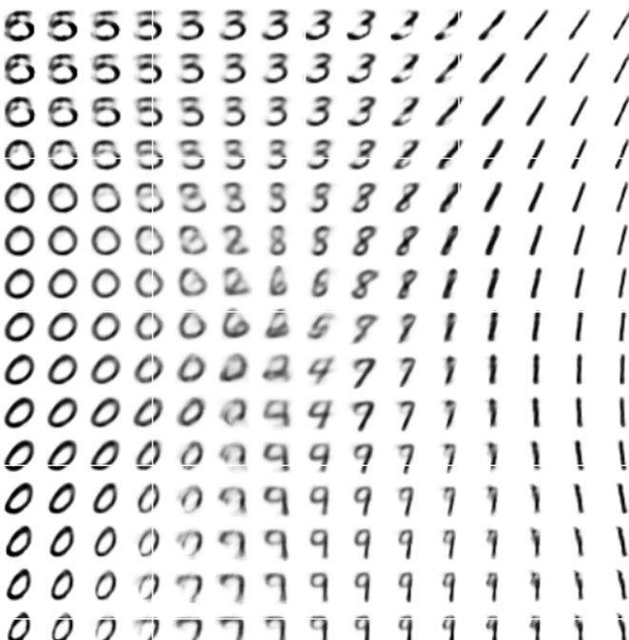
Auto-Encoder
From Hung-yi Lee, “Generative Adversarial Network/Basic Idea/Machine Learning and having it deep and structured (2017,Spring)”
http://speech.ee.ntu.edu.tw/~tlkagk/courses_MLDS17.html

Slide 38
Generative Adversarial Networks (GAN)
Deep Learning

Slide 40
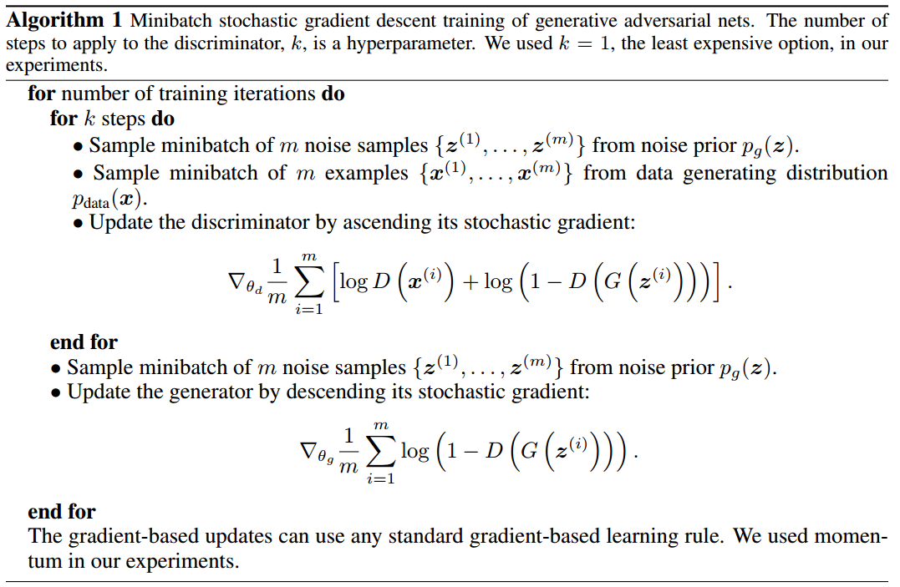
Algorithm
From “Generative Adversarial Networks”
https://arxiv.org/abs/1406.2661

Slide 41
Wasserstein GAN (WGAN)
Deep Learning

Slide 43
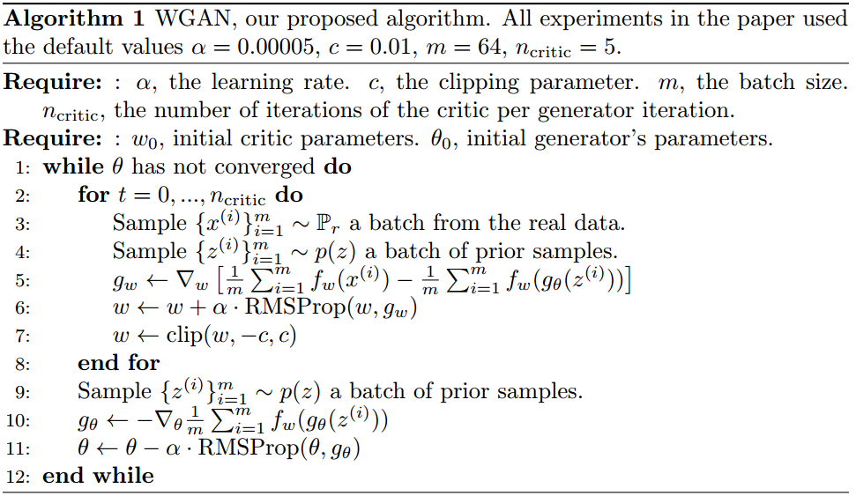
Algorithm
From “Wasserstein GAN”
https://arxiv.org/abs/1701.07875

Slide 44
Improved Wasserstein GAN (WGAN-GP)
Deep Learning

Slide 46
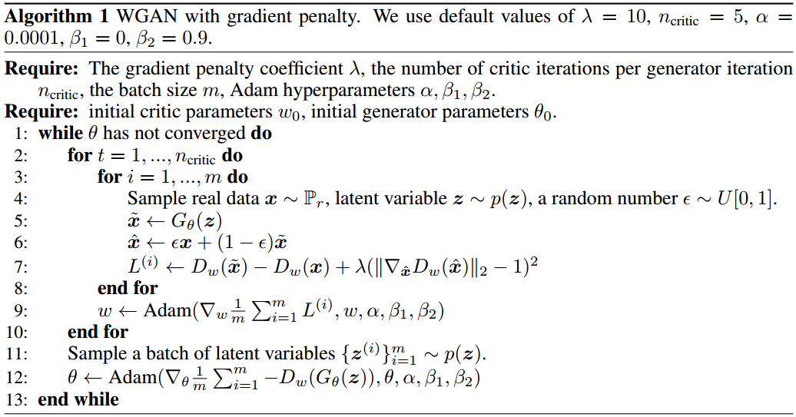
Algorithm
From “Improved Training of Wasserstein GANs”
https://arxiv.org/abs/1704.00028

Slide 47
Requirement
MATERIALS AND METHODS

Slide 49
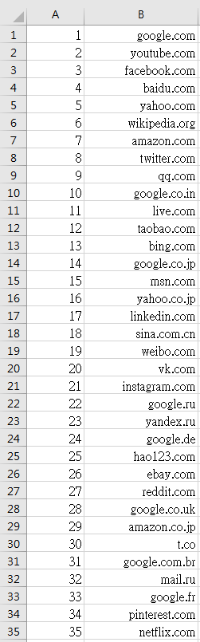
Requirement
Q: Where is my training data?
A: From Alexa Top 1-million sites.

Slide 50
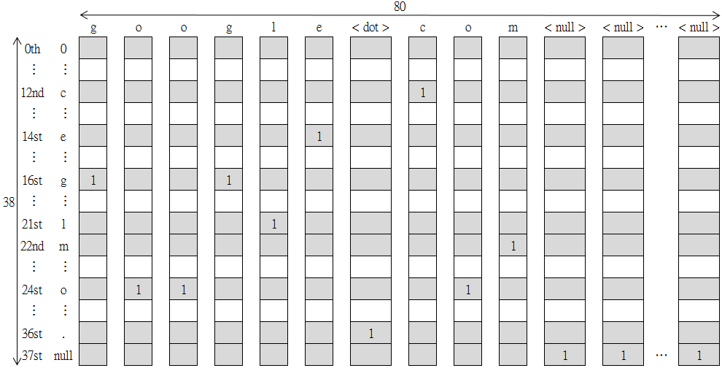
Requirement
Q: How to use this data?
A: I deal these domain names as 38x80 pictures.

Slide 51
Requirement
Because we don’t have the “code”. We have to train an Auto-encoder model.
As close as possible
NN
Encoder
NN
Decoder
code

