Slide 1


Slide 2






StreetPay
CROWDFUNDING TODAY

Slide 3
StreetPay
CROWDFUNDING TODAY
Internet based

Slide 4
StreetPay
Advantages
Personal connections
More interaction
Faster and easier

Slide 5
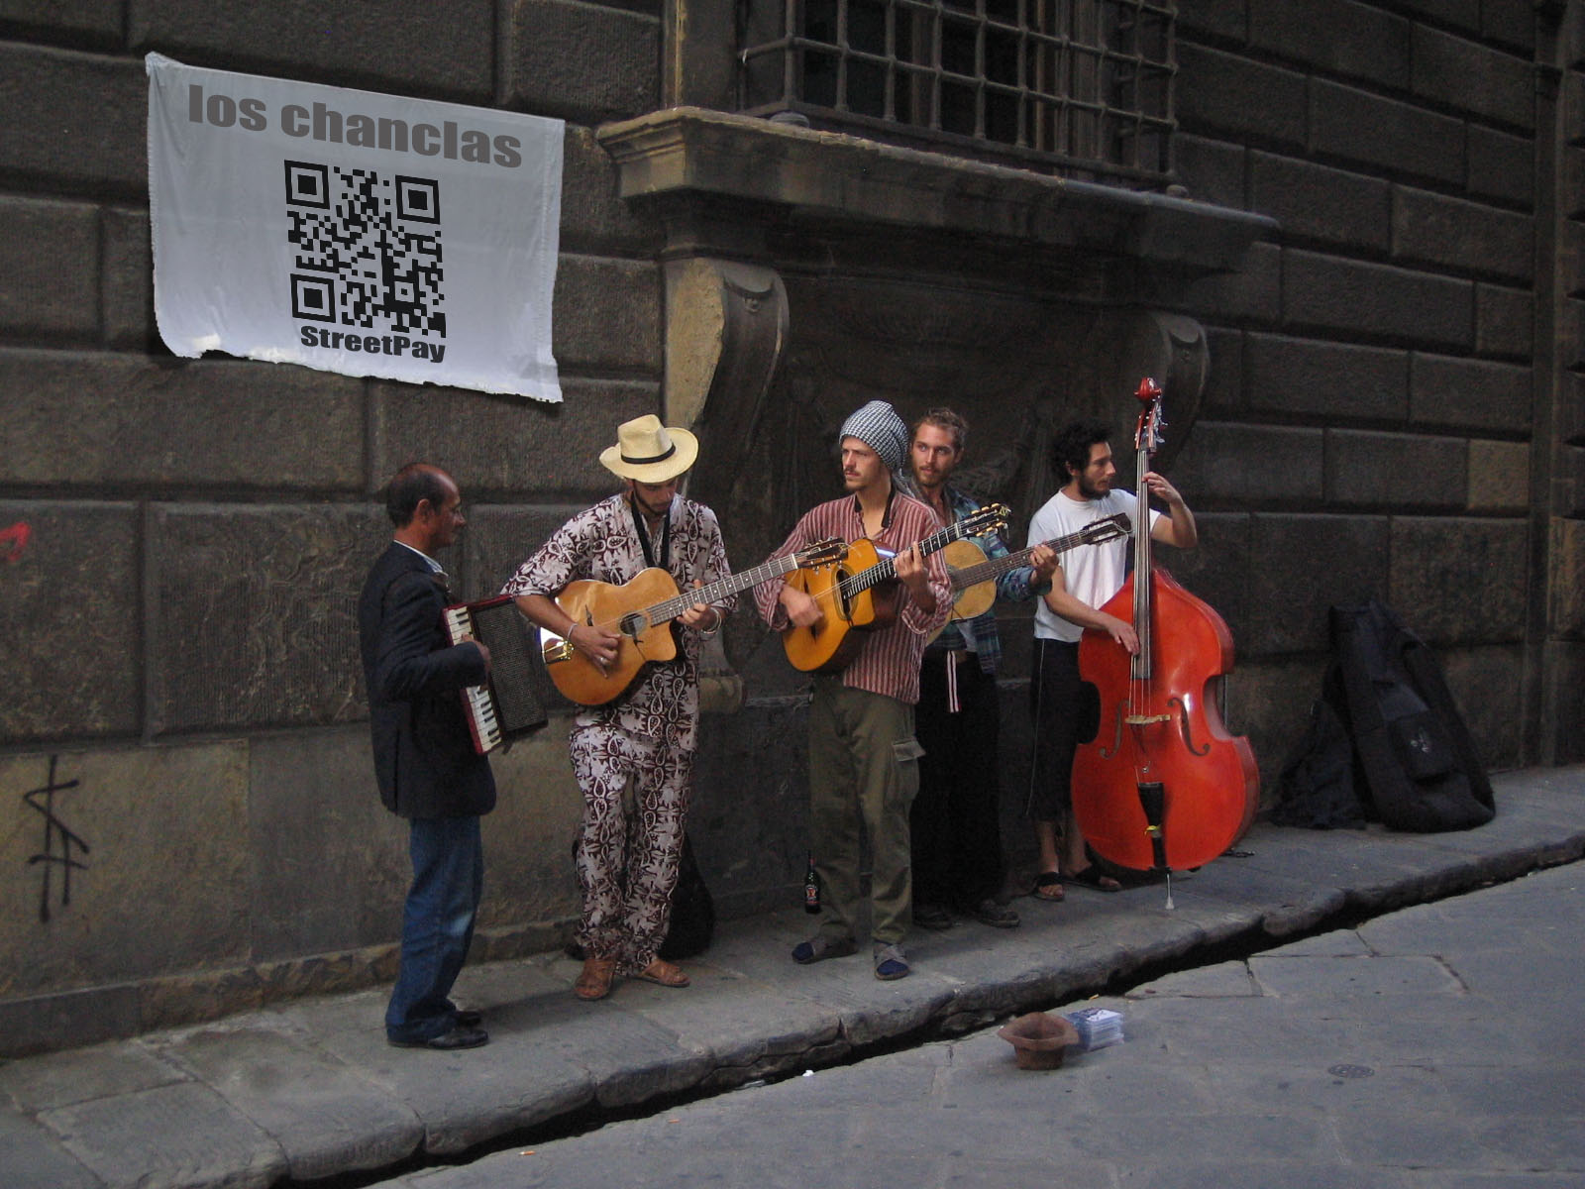

Slide 6


Slide 7
StreetPay
Business model
No sign up fee
Financed by commissions (1%)

Slide 8
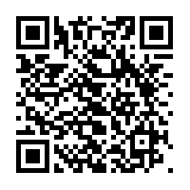
StreetPay
DEMO

Slide 9
StreetPay
Technology
Node.js (Heroku)
Lungo
C#
MongoDb (mongoLab)
Express.js
RESTful API

