Slide 1
Using Queuing Theory and Simulation in NHS Planning:
Applying the NHSRWaitinglist R Package
Chris Mainey
Head of Data Science
Birmingham, Black Country and Solihull ICB Cluster
c.mainey1@nhs.net

Slide 2


NHSRwaitinglist:
R programming language library
Free, Open-Source
Geared at NHS application
Easy application of principles in Prof Neil Walton’s tutorial paper and seminars:
Package website
Several releases so far
Published on ‘CRAN’
3,574 downloads from CRAN

Slide 3
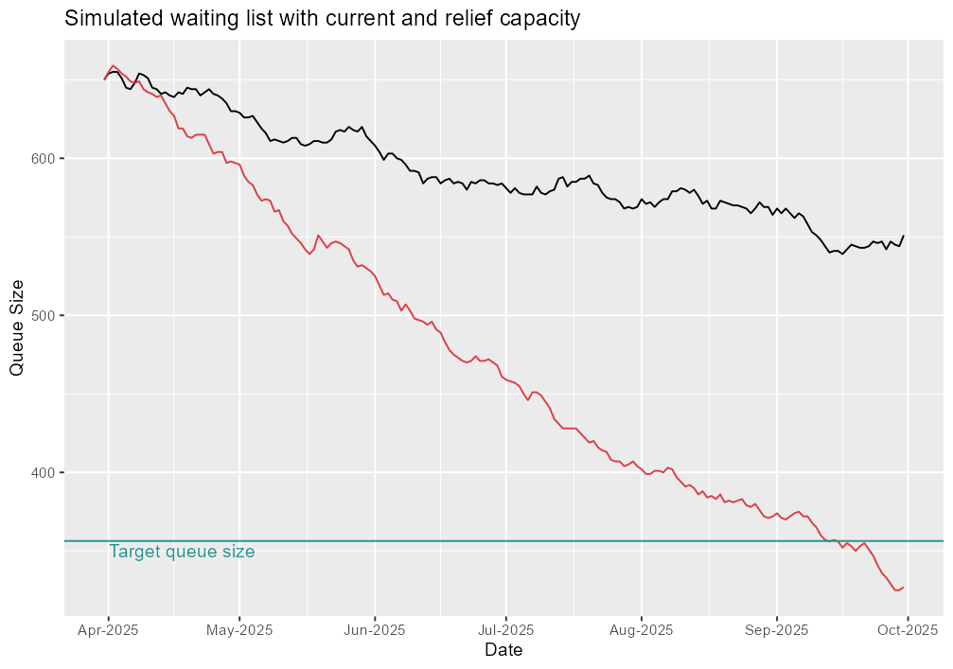
Example
Functions include:
  WL summary & calculations
  Queue load and
  Target queue, capacity calculations
  Relief capacity calculation
  Simple simulator for generating WL data…

Slide 4
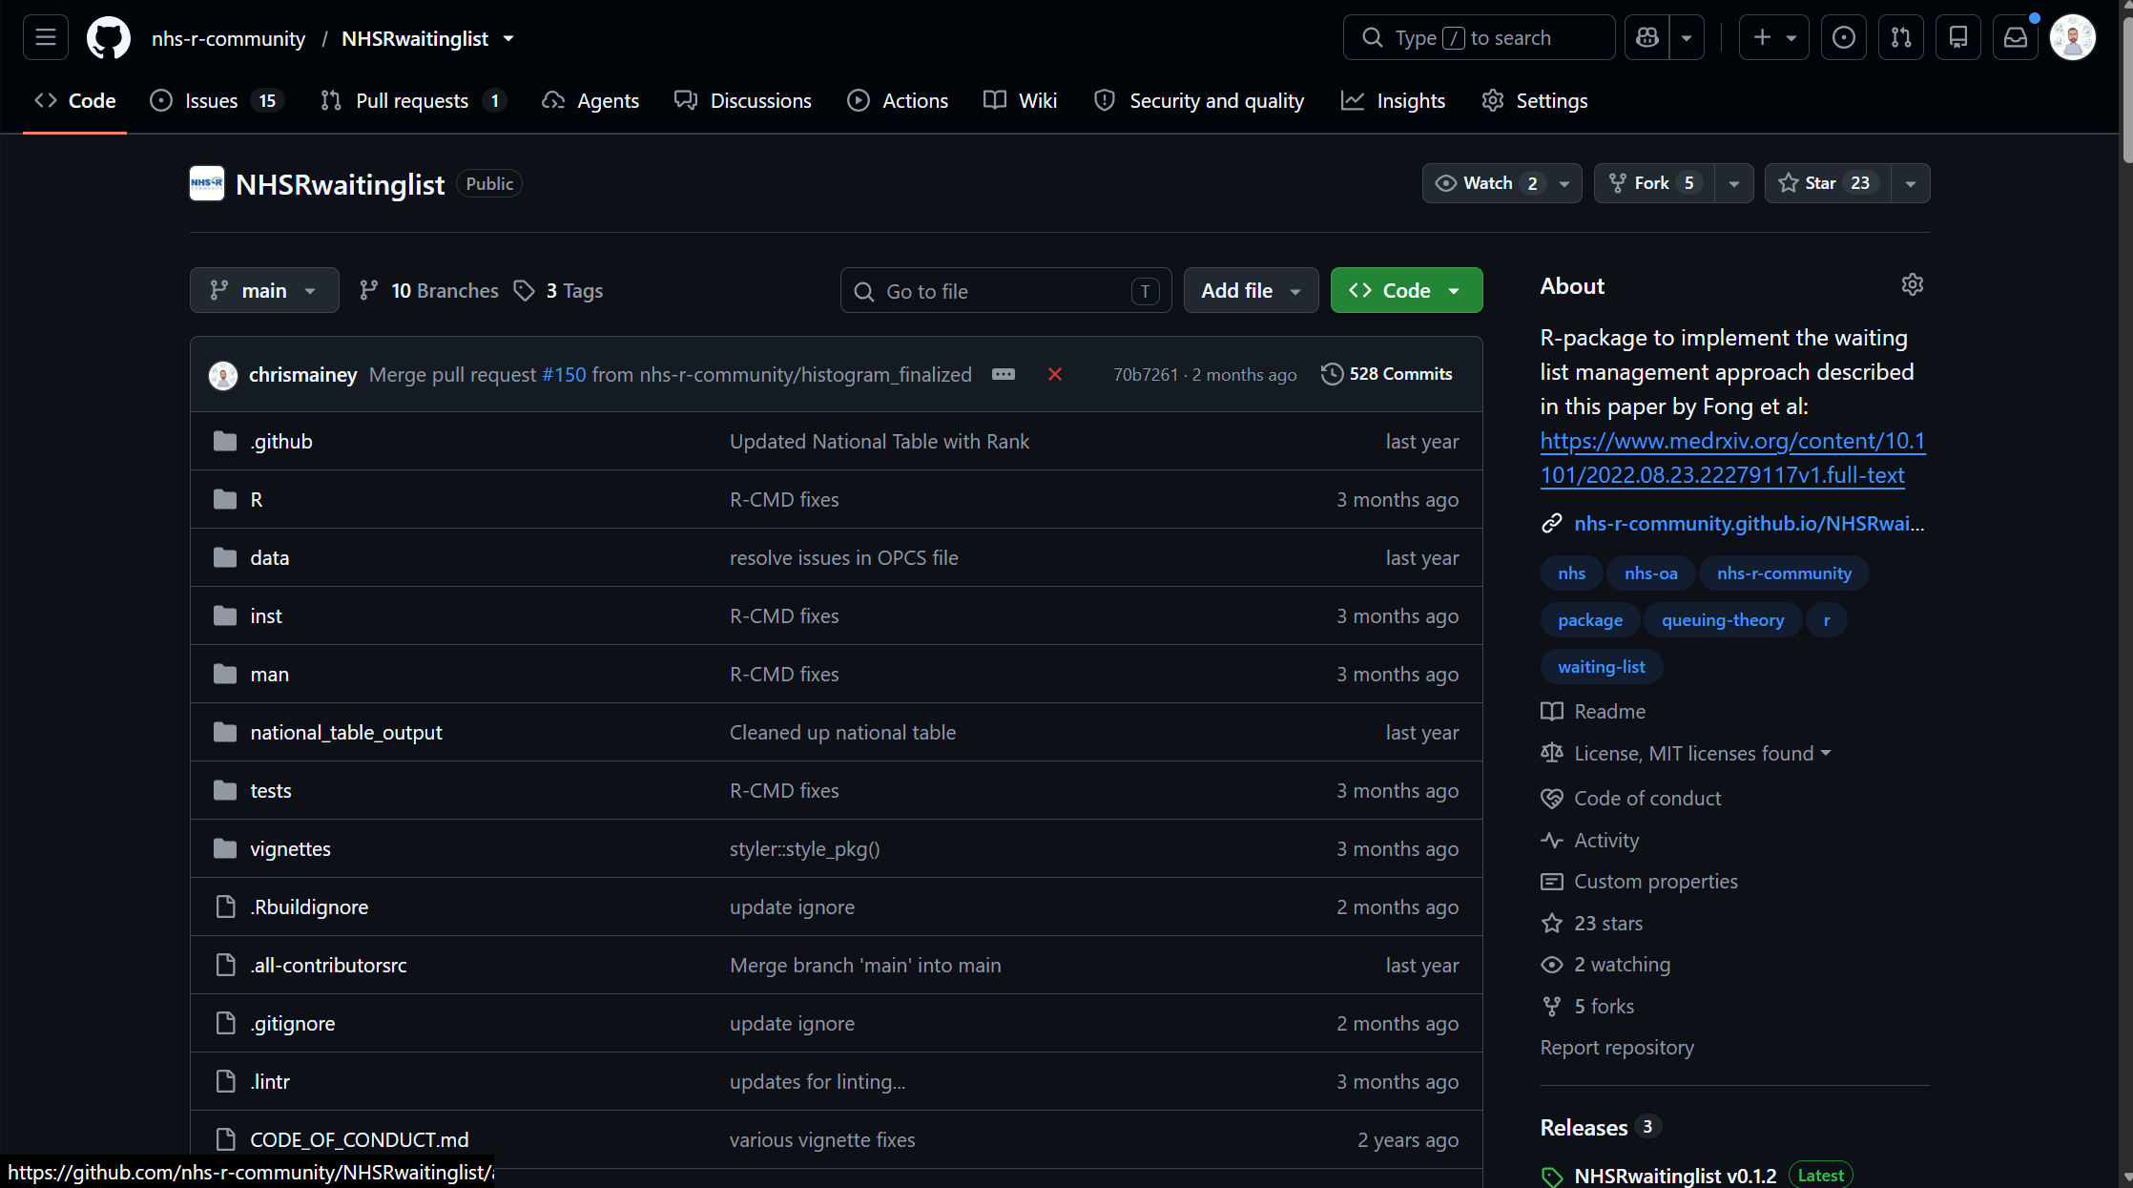

Get involved!
Free & Open-Source
Code on GitHub
Relies on ‘free time’ at present
Not just coders:
  people with questions
  opinions on design or application
  Bug reports / fixes

Slide 5
Application in BBCS ICB
How much elective activity should we commission?

Slide 6
Methods
Forecasting:
  “Naïve,” averaged or complex
  Uses past data point to predict future
Does not factor targets
Does not factor sustainable WL
Not driven by population change
Simulation
  “What if” analysis, using past patterns plus assumptions.
  Driven by distributions and can be stochastic (allowing uncertainty)
Requires explicit assumptions
Should be run as Monte Carlo

Slide 7
Model foundations (1)
Single compartment model:
  Consider joining and leaving pathway
  “M/M/1” queue:
  Arrivals are Poisson distributed
  Service time is exponentially distributed
  Over-simplification
Referrals / Arrivals
(Demand)
Removals / Activity (Capacity)
Waiting list
“…Essentially, all models are wrong, but some are useful…”
(paraphrase of Prof. George E.P. Box)

Slide 8
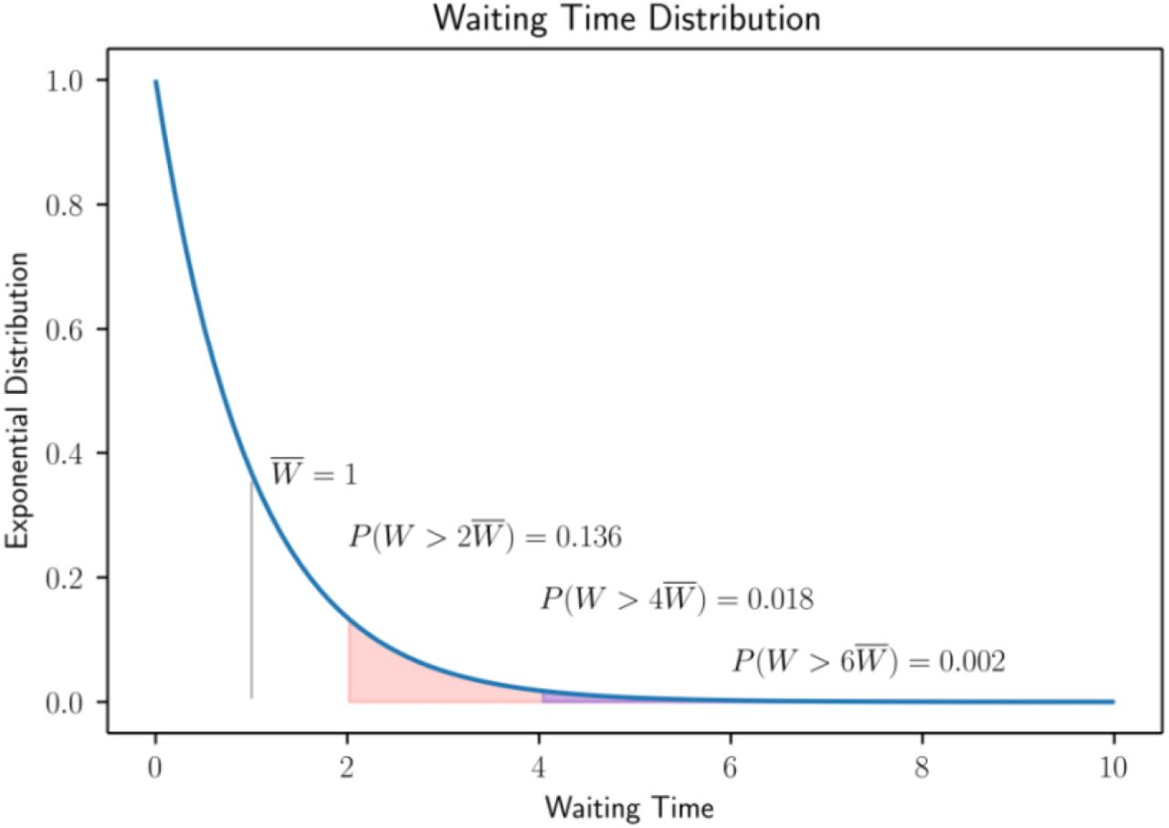
Distribution of waiting list
Average wait, and distribution linked.
Set probability, calculate average wait:
  ‘Factor’ = –ln(1-0.92) = 2.53
  Mean wait = Target / 2.53
  E.g. 18 / 2.53 = 7.13
Understanding Waiting Lists Pressures
Kevin Fong, et al. medRxiv https://doi.org/10.1101/2022.08.23.22279117

Slide 9

Three useful formulae:
If we know WL and demand, can work out average waiting time.
What is our target queue size for the demand and target wait?
What capacity do we need to get there in a specific time?
$$Target Queue Size=Demand × \frac{Target Wait}{′Factor′}$$
Understanding Waiting Lists Pressures
Kevin Fong, et al. medRxiv https://doi.org/10.1101/2022.08.23.22279117

Slide 10
Model foundations (2)
Take each provider’s ICB commissioned patients by TFC:
  Calculate queue size, average weekly demand and capacity
  Project forward with assumptions
  Calculate target queue size and relief capacity
  Run simulation modelling to verify and give uncertainty range
Take pathway projections for provider’s ICB commissioned patients, by TFC:
  Calculate average activity to close pathway by OP & IP
  Multiply pathway projections by average activity.
  Apply 2026/27 tariff at 2025/26 data and calculate variance

Slide 11
Waiting list simulation approach

Slide 12
Activity attribution approach
(ICB commissioned patients only)
From waiting list model
Calculate 25/26 closed RTT pathways by provider and specialty
Calculate RTT pathways closed to SUS activity ratios (where RTT related)
Apportion addition capacity requirement to providers base on pathway model *
Activity requirement calculated as recosted activity at 100 + plus additional capacity from pathway model
Summarise activity and cost variance
SUS 25/26 activity at POD by provider and specialty
25/26 SUS data is recosted at 26/27 tariff value
(latest value, but not including pay uplift)

Slide 13
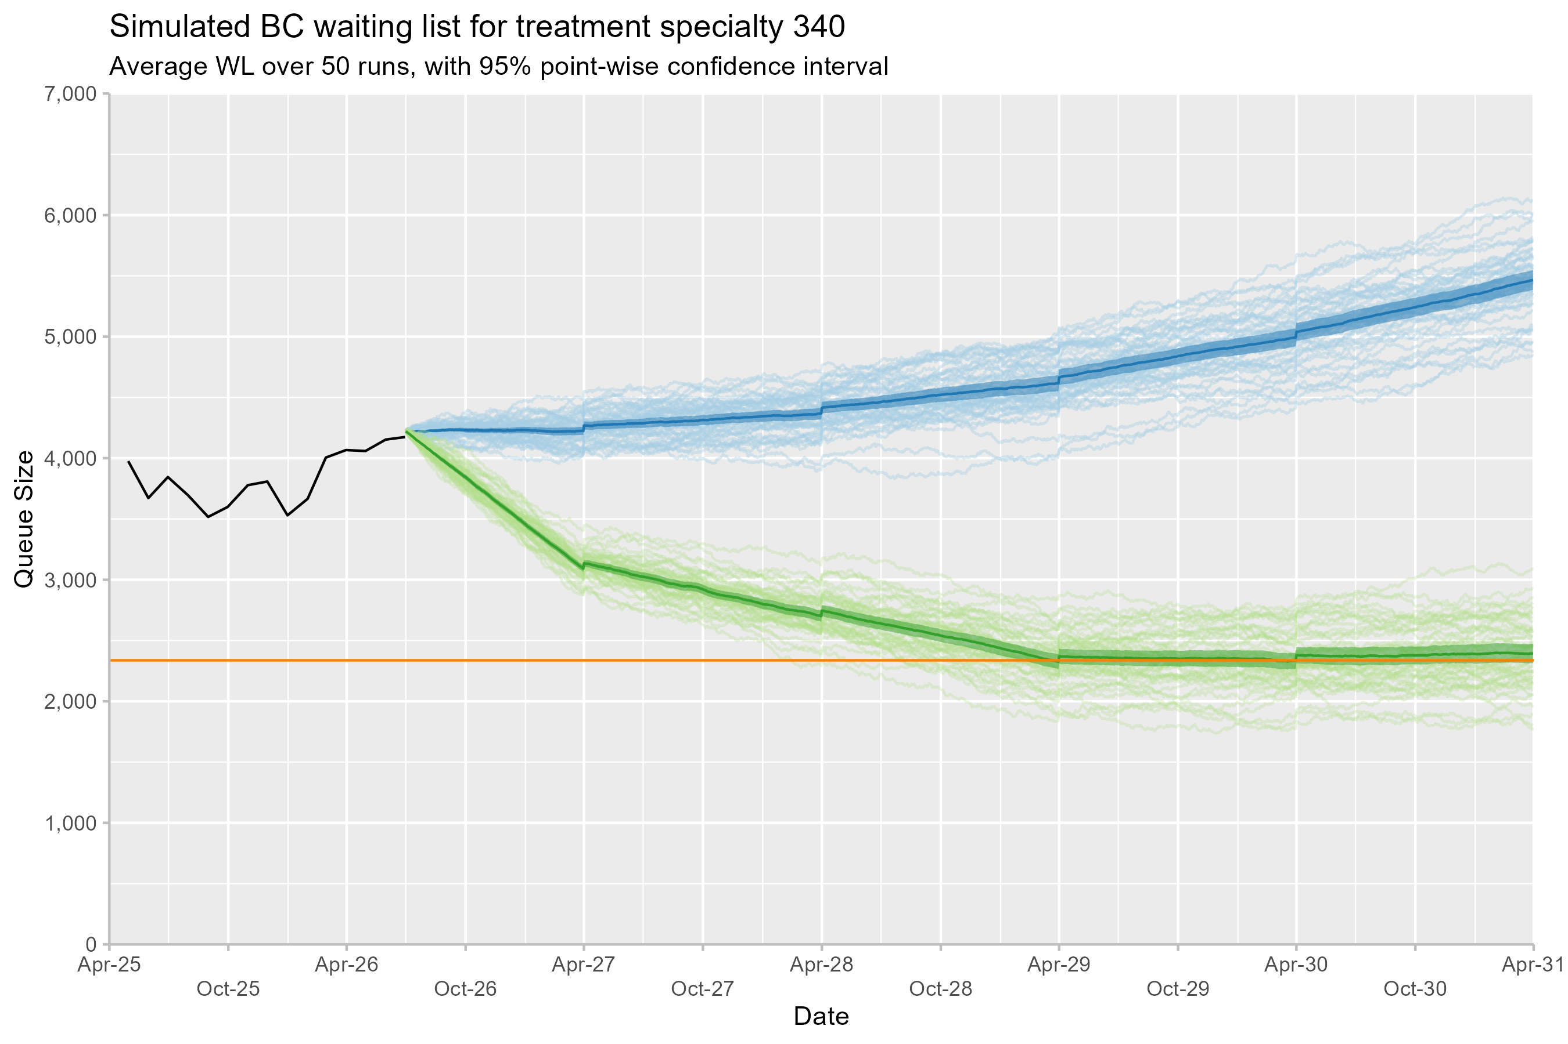
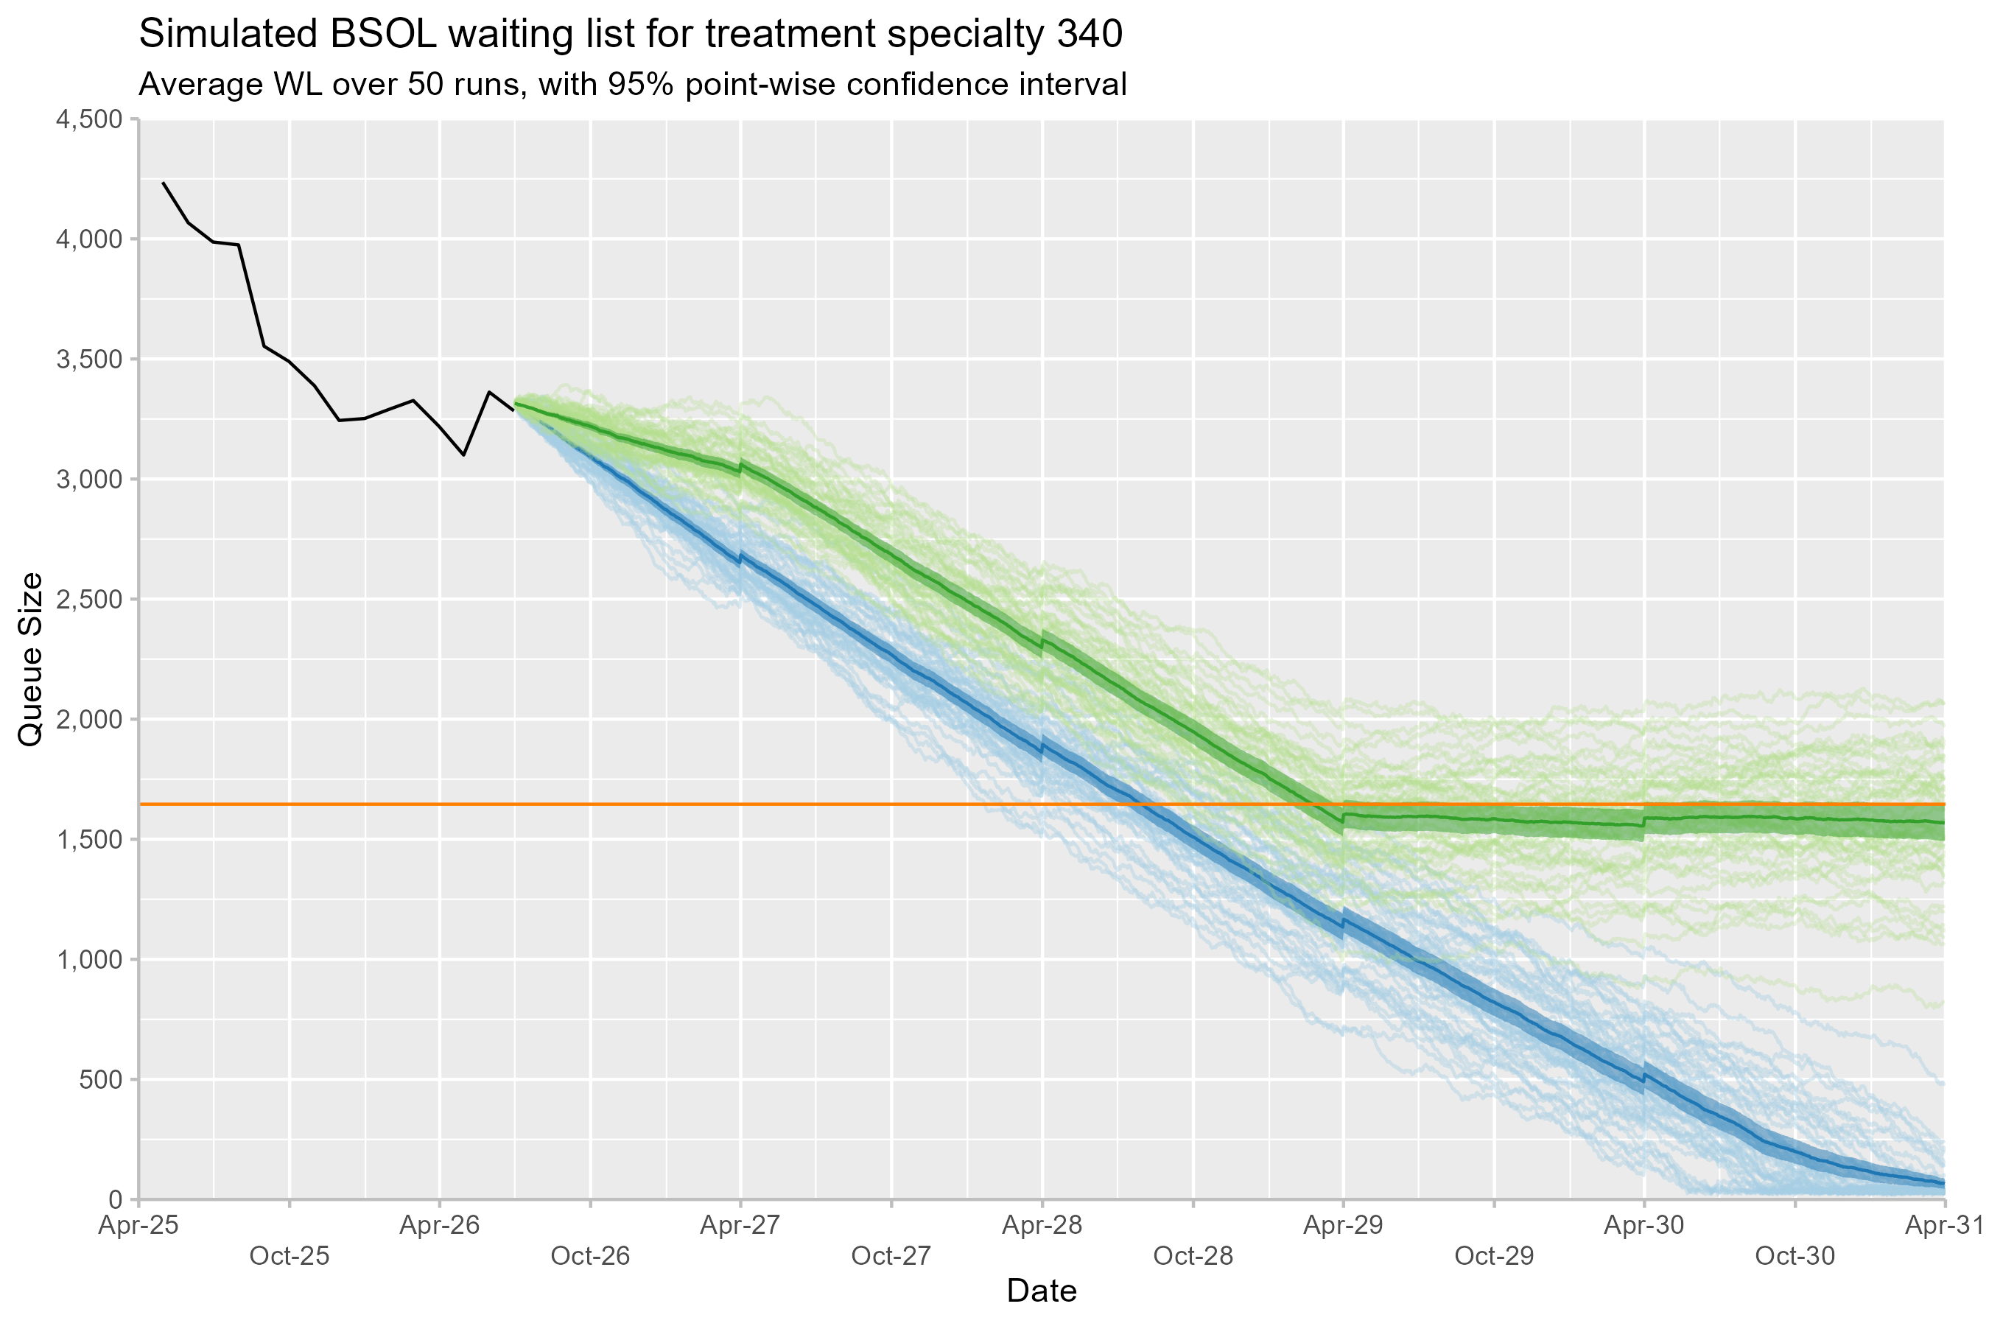
Example outputs: Respiratory
Orange lines: target waiting list size 2028/29, given forecast demand
Green and Blue lines: demographic + 1% non-demographic demand growth,
Blue lines: ‘do nothing’ – previous 12-month median capacity
Green lines: “relief capacity” – required capacity to demand

Slide 14
Uses so far:
Projections used for annual planning:
  Figure used to test and challenge NHSE, provider and local assumptions.
Methods used to calculate ISP activity requirements:
  Influenced capping and commissioning contracts
  Allowed inflation of lists in areas of oversupply
Impact modelling of referral management system across ICB.

Slide 15
Key learning points (1)
Modelling at different aggregations lead to different outcomes:
  ‘Pooling’ effects, combined with median capacity assumptions, and growth rates
  Similar to “Simpson’s Paradox”
Growth assumptions vary depending on situation
Additional local functions written:
  BBCS-PHI/BSOLwaitinglist: An R package to wrap various waiting list modelling elements together for reproducibility

Slide 16
Key learning points (2)
Statistical mechanics:
  Is point-wise confidence interval appropriate?
  M/M/1 is simplistic and for ICB use.
Our ICB is not equipped to deliver this type of modelling:
  Compute infrastructure is lacking
  Consumer curiosity is lacking
  Front-end development barrier
  Planning is incentive is to match NHSE, not produce local estimates

Slide 17
Reuse and sharing
Built on NHSRwaitinglist package and SUS data
Local modifications: GitHub
Modelling scripts / functions published – ISP
Technical bar or transparency?
Now needs work to “productionise”

Slide 18
Conclusions
Theoretically driven waiting list forecast
Activity assumptions made based on recent data
Data quality issues, but sufficient for planning
Based on assumptions, but what assumptions are ‘right?’
Open-source tools and code.
Get involved and help build it!

