Slide 1
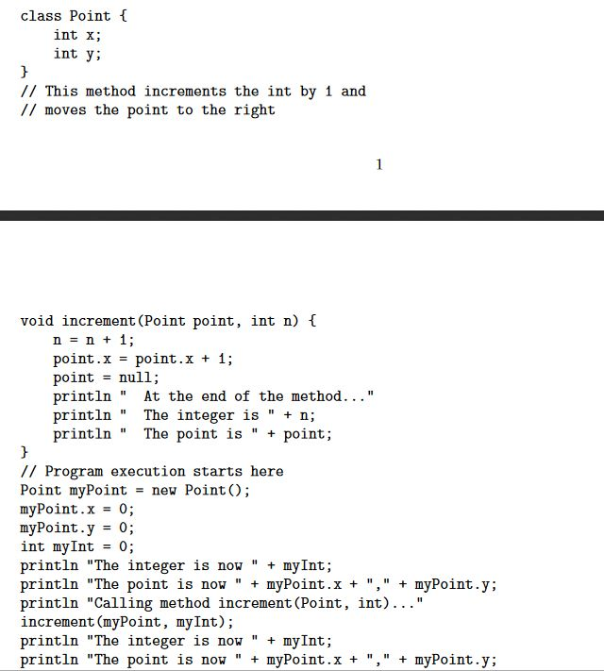
Heap
7
Stack
8
9
10
11
1
2
3
ERASED
=0
int
n
4
7
[+ 1 ]= 1
5
6
Point
point
12
= null
=0
6
9
int
x
increment
X
3
[+ 1 ]= 1
What compiler outputs:
The integer is now 0
The point is now 0,0
Calling method increment(Point, int)…
At the end of the method…
The integer is 1
The point is null
The integer is now 0
The point is now 1,0
4
int
myInt
8
=0
5
2
=0
int
y
3
10
1
Point
myPoint
12
ref
2

