Slide 1
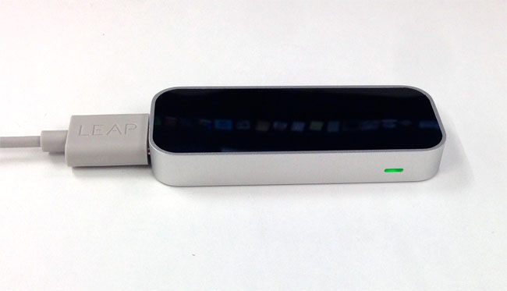

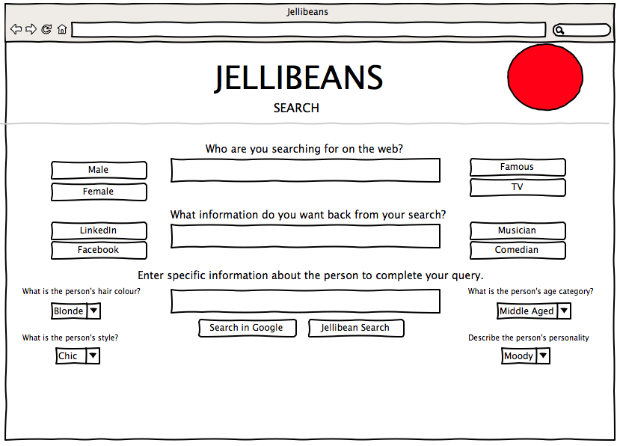


Presentation Tier: LEAP Motion Controller and Web Browser
Jellibean
Query formed
Using LEAP
Jellibean
Results
Returned
Logic Tier
WEB SERVER
Jellibean
Logic & commands.
Processes data
between tiers.
Search results retrieved
from Google API and sent back to logic tier for processing (external to Jellibeans)
nginx web server
Digitalocean.com
Data Tier
GOOGLE DATA STORE
DATA STORE
Information retrieved
from Database and sent back to logic tier for processing.

